Slide 1
Biogeochemistry
Susannah Burrows (deputy), Kate Calvin (lead)

Slide 2
The BGC Team
Mathew Maltrud, Xiaojuan Yang, Qing Zhu, Nicole Jeffery, Xiaoying Shi, Daniel Ricciuto, Shanlin Wang, Gautam Bisht, Jinyun Tang, Jon Wolfe, Bryce Harrop, Balwinder Singh, Philip Cameron-Smith, Hailong Wang, Chris Golaz, Forrest M. Hoffman, William Riley, Peter Thornton, Noel Keen

Slide 3
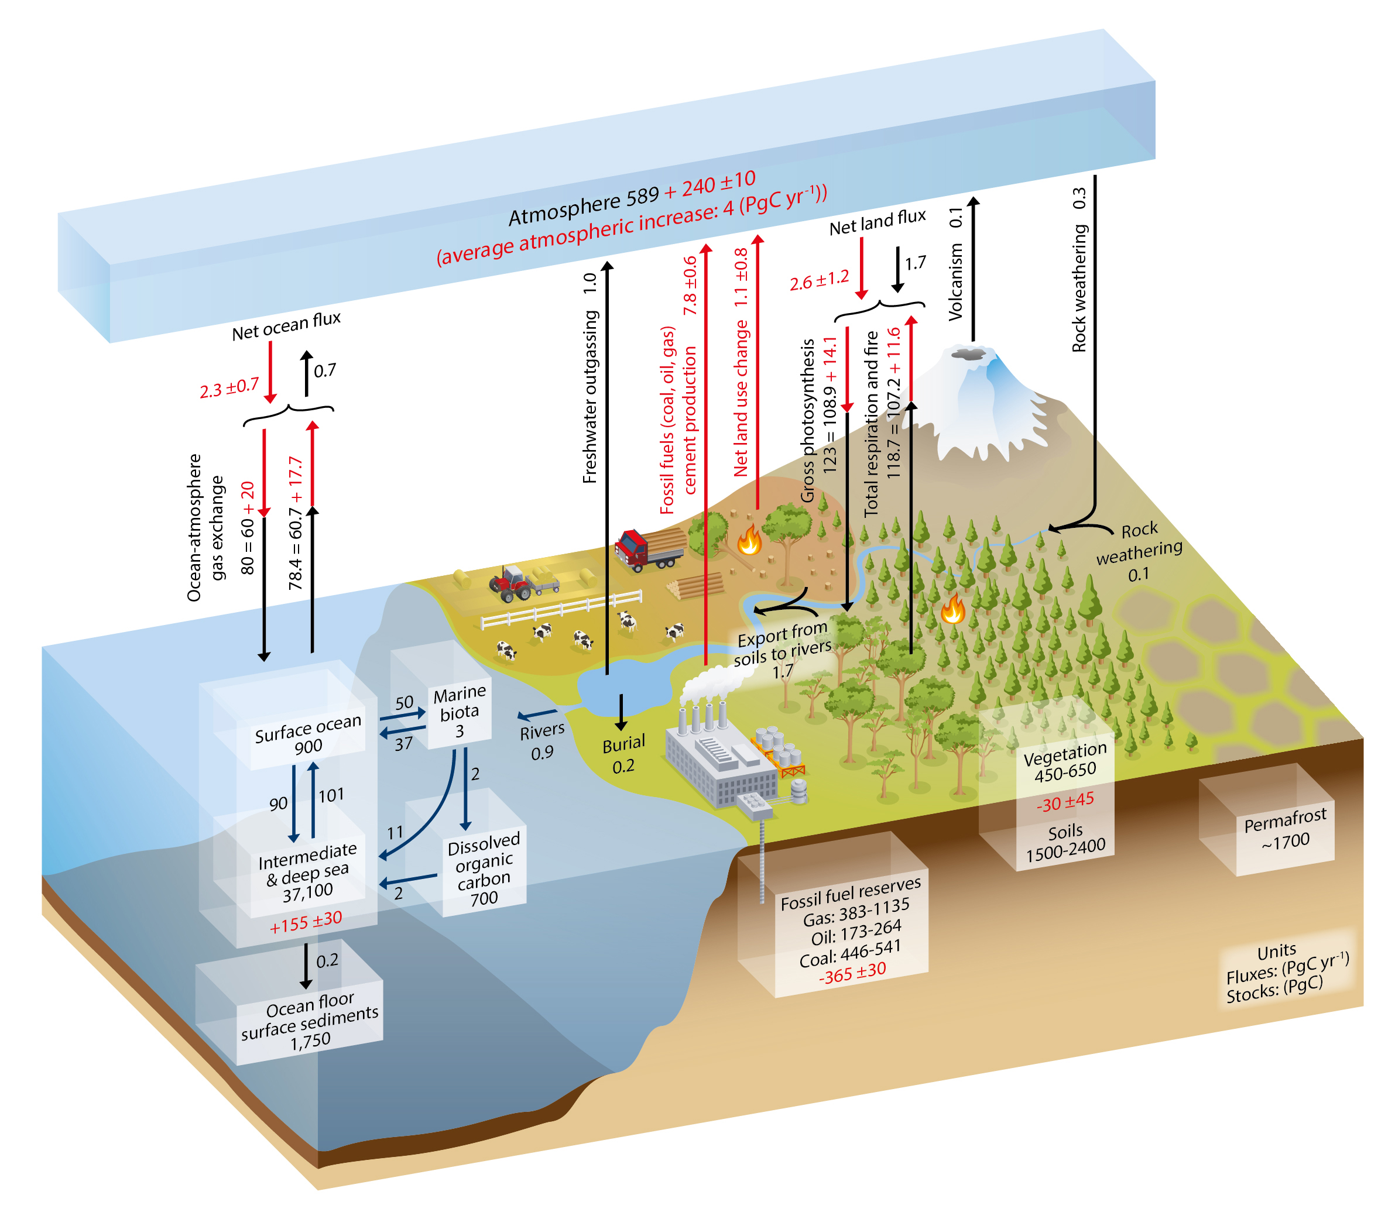
The Global Carbon Cycle
Source: IPCC AR5 WG1 Ch6

Slide 4
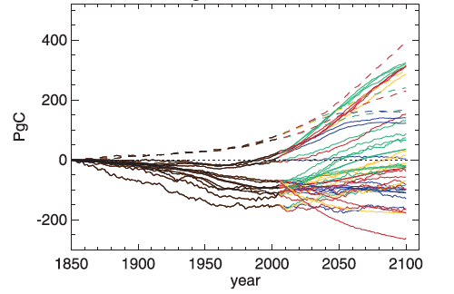
Motivation: There is large uncertainty in future changes in terrestrial and ocean carbon.
Changes in carbon vary dramatically across models in CMIP5.
Land models that included nitrogen limitations tended to have weaker terrestrial carbon uptake.
These results suggest that model structure and nutrient limits matter.
Change in Vegetation Carbon
Source: Jones et al. (2013)

Slide 5
Simulation Plan
V1 Science Question: What are the effects of nitrogen and phosphorous on climate-biogeochemistry interactions, and how sensitive are these interactions to model structural uncertainty?

Slide 6
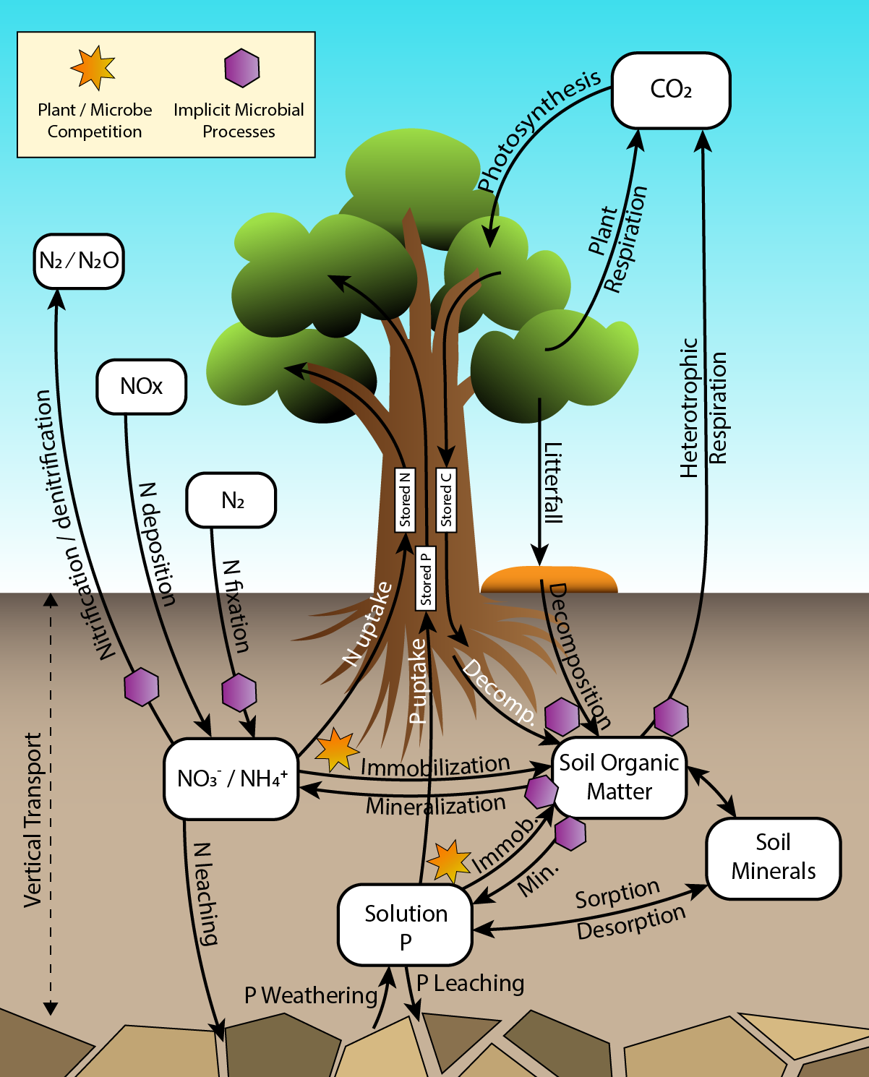
The v1 BGC model
ELM v1 CNP dynamics in vegetation and soil
Terrestrial:
  Two approaches to soil biogeochemistry (ECA and CTC), both including N and P limits on C uptake
Ocean/ice:
  Based on the Biogeochemical Elemental Cycling model (BEC), including N, P, Si, Fe
  Includes ocean-ice biogeochemical interactions

Slide 7
Simulation Plan
CTC-CNP
CNTL: Pre-Industrial Control Simulation
BCRC: Biogeochemical CO₂ Constant, Radiative CO₂ Constant
BDRC: Biogeochemical CO₂ Diagnostic, Radiative CO₂ Constant
BDRD: Biogeochemical CO₂ Diagnostic, Radiative CO₂ Diagnostic
ECA-CNP
CNTL: Pre-Industrial Control Simulation
BCRC: Biogeochemical CO₂ Constant, Radiative CO₂ Constant
BDRC: Biogeochemical CO₂ Diagnostic, Radiative CO₂ Constant
BDRD: Biogeochemical CO₂ Diagnostic, Radiative CO₂ Diagnostic
CTC-CN
CNTL: Pre-Industrial Control Simulation
BCRC: Biogeochemical CO₂ Constant, Radiative CO₂ Constant
BDRC: Biogeochemical CO₂ Diagnostic, Radiative CO₂ Constant
BDRD: Biogeochemical CO₂ Diagnostic, Radiative CO₂ Diagnostic
EF CTC-CNP
CNTL: Pre-Industrial Control Simulation
BPRP: Biogeochemical CO₂ Prognostic, Radiative CO₂ Prognostic
Additional sensitivities:
BCRD
8.5 extension
3.4 overshoot
1% CO₂
Ndep

Slide 8
CBGC-CTC

Slide 9
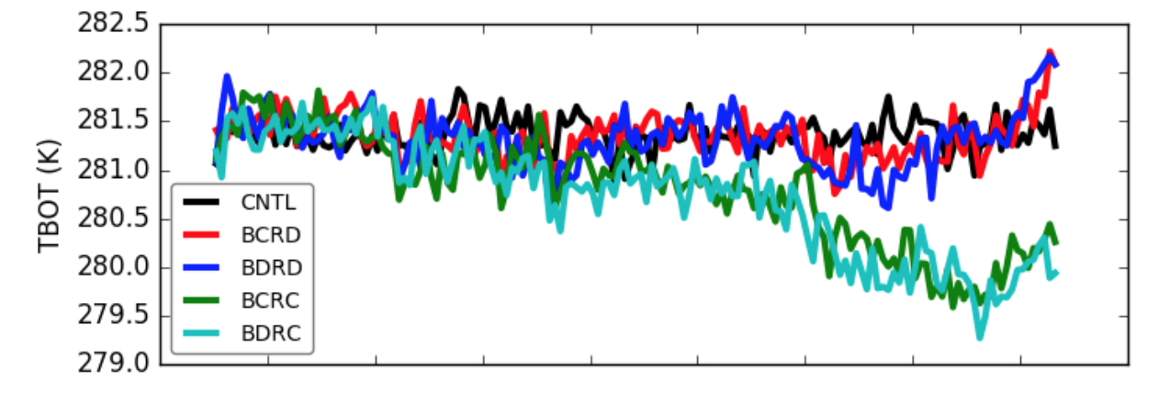
Radiative influence of transient CO₂ concentration dominates for surface temperature
RD
RC

Slide 10
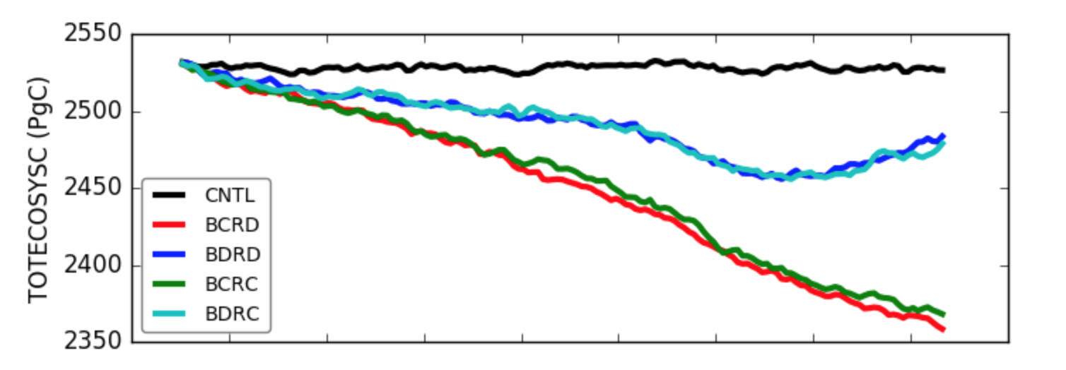
Biogeochemical influence of transient CO₂ concentration dominates for total ecosystem carbon
BD
BC
Notes:
The difference between BCRx and BDRx is due to CO2 fertilization effect

Slide 11
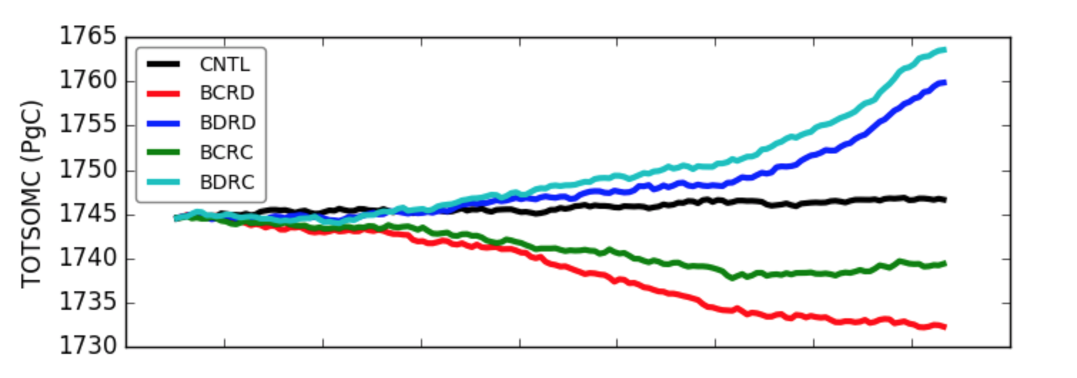
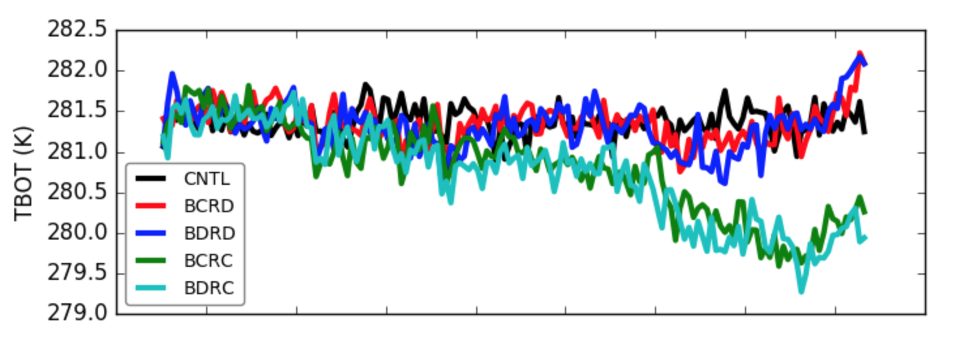
Radiative influence and biogeochemical influence of transient CO₂ for soil organic carbon
BDRC
BDRD
BCRC
BCRD
Notes:
Soil carbon turnover depends on temperature – warmer temperature leads to more decomposition and loss of carbon. So although CO2 fertilization effect leads to more growth and more soil carbon, rising temperature would lead to a loss of soil carbon in BxRD

Slide 12
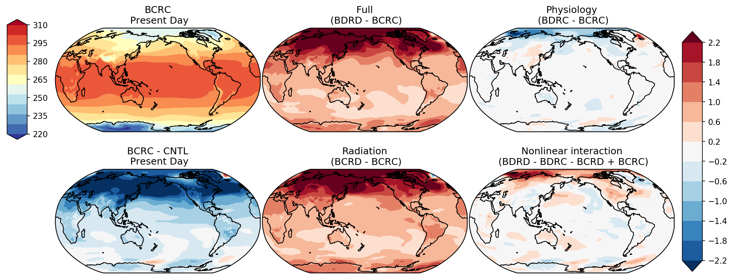
Preliminary Results: Temperature
Notes:
Points of interest:
- BCRC looks physically plausible, so nothing went “off the rails”
- BCRC – CNTL shows the huge hemispherically asymmetric impact of aerosols (LULCC wrapped up in there too)
- Full effect of carbon shows strong arctic amplification and intensification of the hydrological cycle
- Radiation dominates the warming effect
- Physiology temperature effects strongest at high latitudes and Australia (no idea why there)
- Nonlinear temperature effects highest over N. America, mid-latitude Pacific, N. Central Asia, and Arctic
- Strong nonlinearities across the tropics for precipitation
- Amazon precipitation change dominated by nonlinear interaction
There’s also a weird blip in the N. Atlantic temperature difference between BCRC and CNTL. I am not sure what’s happening there.

Slide 13
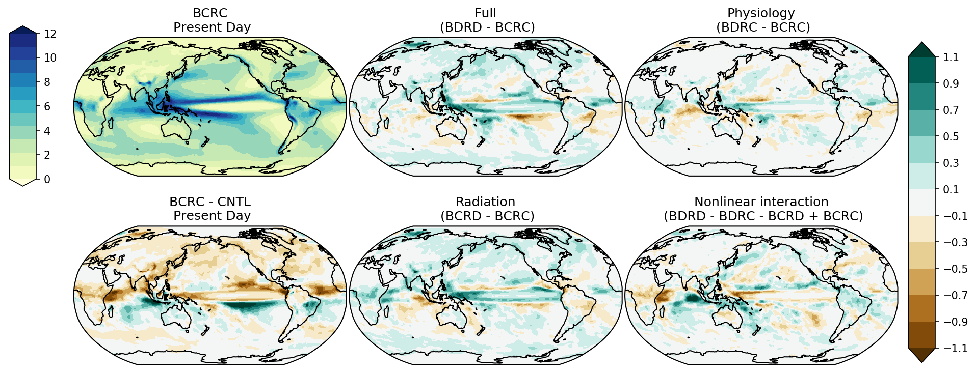
Preliminary Results: precipitation
Notes:
Points of interest:
- BCRC looks physically plausible, so nothing went “off the rails”
- BCRC – CNTL shows the huge hemispherically asymmetric impact of aerosols (LULCC wrapped up in there too)
- Full effect of carbon shows strong arctic amplification and intensification of the hydrological cycle
- Radiation dominates the warming effect
- Physiology temperature effects strongest at high latitudes and Australia (no idea why there)
- Nonlinear temperature effects highest over N. America, mid-latitude Pacific, N. Central Asia, and Arctic
- Strong nonlinearities across the tropics for precipitation
- Amazon precipitation change dominated by nonlinear interaction
There’s also a weird blip in the N. Atlantic temperature difference between BCRC and CNTL. I am not sure what’s happening there.

Slide 14
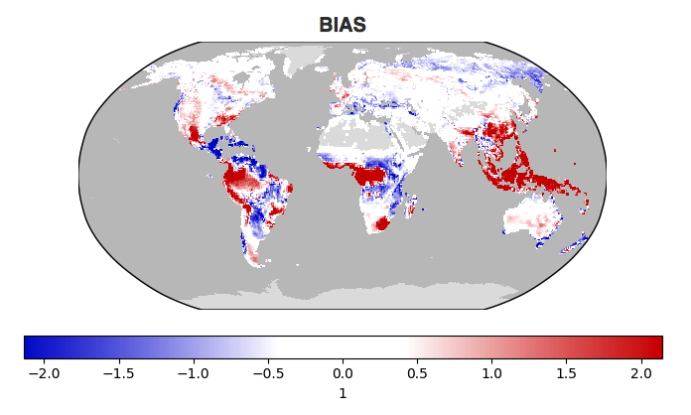
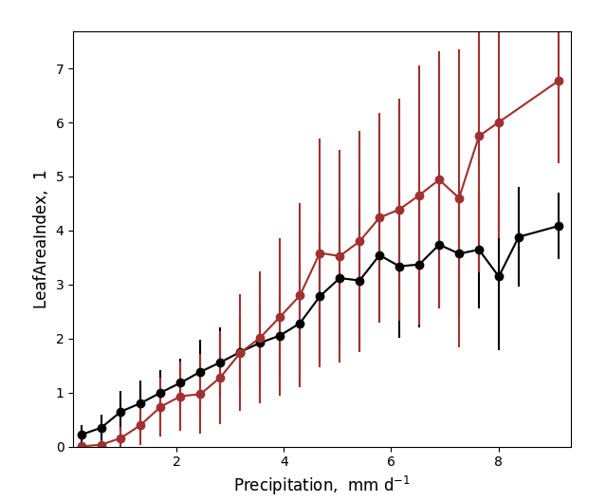
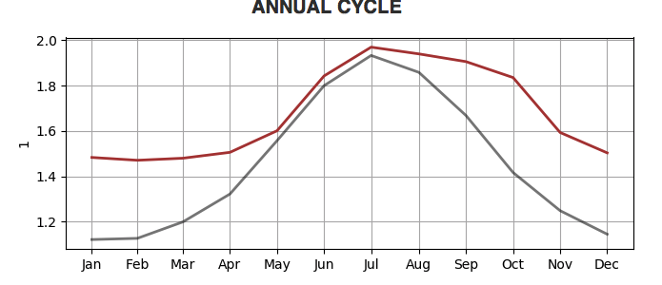
Leaf area index (BDRD)
Notes:
Overall good- LAI high bias in the tropics
But noting that observational LAI is based on MODIS, which has a known low bias in the tropical region

Slide 15
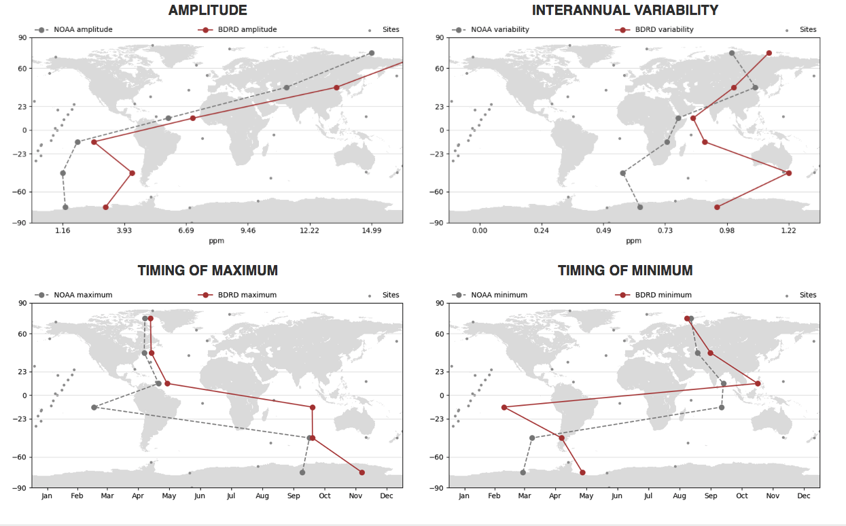



CO₂ concentrations (Transported CO₂ fluxes)
Notes:
ILAMB takes the model simulated NEE and use an impulse response function to calculate CO2 concentration at NOAA flask sites and then compare that with observed(NOAA flask data)
CBGC is concentration driven for v1 – this provides an estimate on how land carbon flux might affect atmospheric CO2 concentration.
Amplitude(seasonal cycle): pretty well in the northern hemisphere, but too large compared with observation in Southern hemisphere
Interannual variability: similar to amplitude
Timing of maximum: again good in the northern hemisphere but missed mostly in southern hemisphere, especially tropical region due to complex seasonal dynamics
Comparisons from selected four sites: BRW(high latitude) AZR( middle of Atlantic Ocean) SMO (Tropical pacific) SPO (south pole)
Too much amplitude going south : too much seasonality and interannual variability in the Tropics - too much response to drought or other drivers or uncertainties in the transport process

Slide 16
Annual Sea Ice Primary Production Per Area
Mostly climate effects
Arctic
Southern Ocean

Slide 17
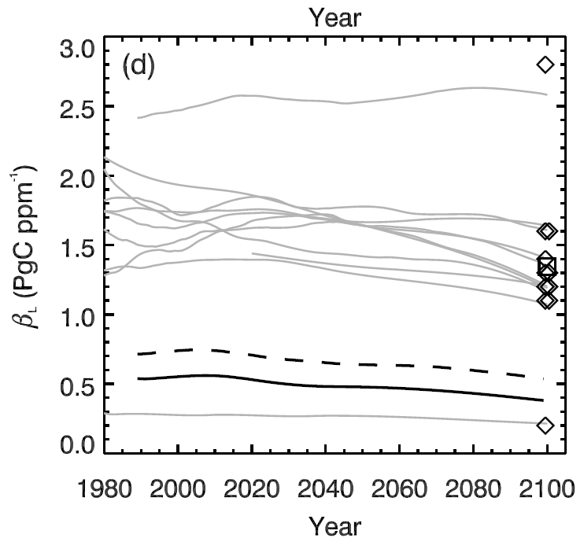
E3SM land CO₂ – climate feedbacks are comparatively weak (~expected)
Beta (Response of CO₂ uptake to CO₂ concentration, PgC/ppmv)
E3SM v1 BGC estimate
Differences:
Different physical climate
Different land model
  Physics and BGC
Active P cycle
E3SM is using dynamic LULCC
Plotted on data from Thornton et al. 2009

Slide 18
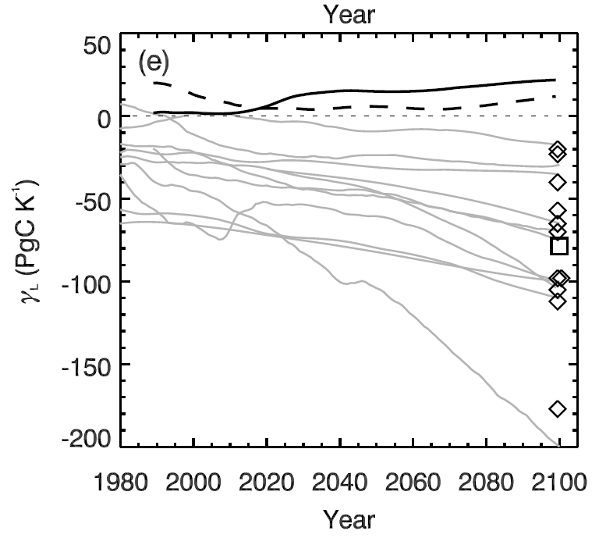
E3SM land CO₂ – climate feedbacks are comparatively weak (~expected)
Gamma (Response of CO₂ uptake to temperature, PgC/K)
Differences:
Different physical climate
Different land model
  Physics and BGC
Active P cycle
E3SM is using dynamic LULCC
E3SM v1 BGC estimate
Plotted on data from Thornton et al. 2009

Slide 19
Next steps: CBGC-ECA, prognostic CO₂

Slide 20
ECA spinup (Net Biological Productivity)
ECA historical simulations are now in production

Slide 21
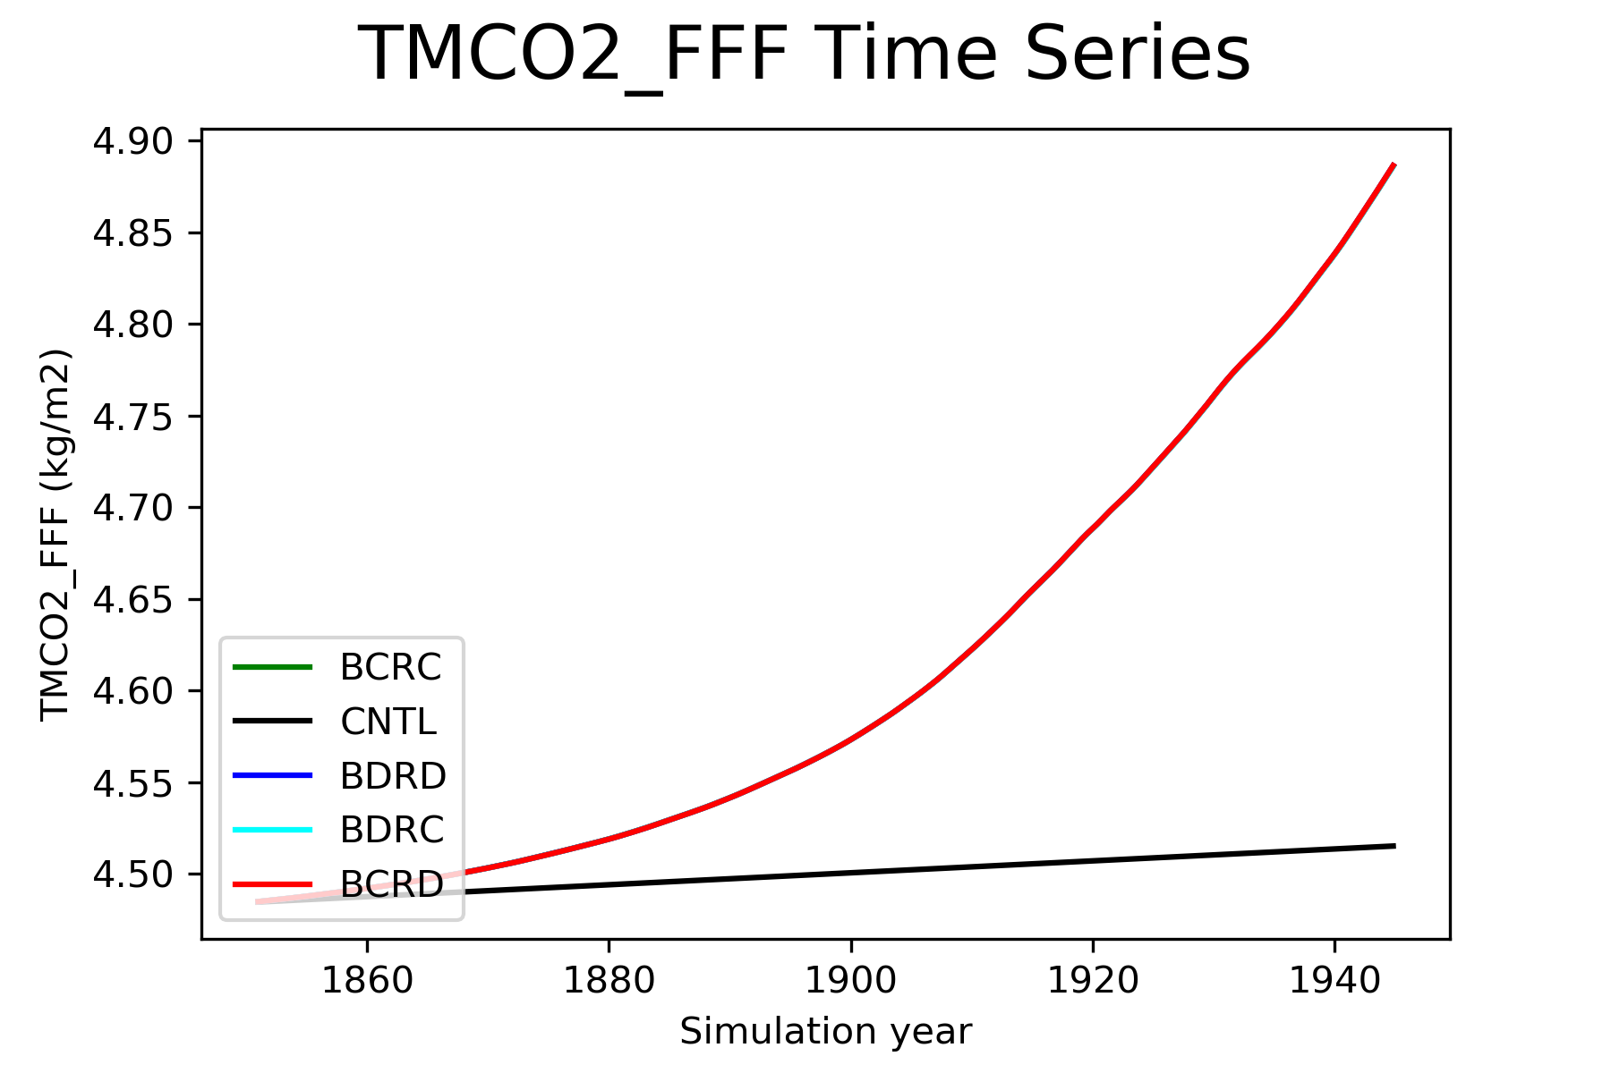
Prognostic CO2 test revealed tracer mass conservation problem

Slide 22
Planned Papers
Overview of E3SM v1 BGC (Burrows)
Overview of MPAS-O BGC (Jeffrey)
Implications of P on the carbon cycle (Thornton)
Effects of structural uncertainty on BGC (Bond-Lamberty)
Nutrient limitations on the carbon cycle (Zhu)
Plant, soil responses in the BGC simulations (Riley)
Atmospheric effects of BGC simulations (Harrop)

Slide 23
Next steps
Complete and analyze simulations
Complete papers documenting the model and the simulations
Submit to ESGF for use in C4MIP and CMIP6

Slide 24
The BGC Team
Mathew Maltrud, Xiaojuan Yang, Qing Zhu, Nicole Jeffery, Xiaoying Shi, Daniel Ricciuto, Shanlin Wang, Gautam Bisht, Jinyun Tang, Jon Wolfe, Bryce Harrop, Balwinder Singh, Philip Cameron-Smith, Hailong Wang, Chris Golaz, Forrest M. Hoffman, William Riley, Peter Thornton, Noel Keen

Slide 25
Thank you!

