Slide 1
Preliminary analysis of V1 coupled BGC experiments (CTC+Ocean BGC): Carbon-Climate feedbacks during historical period
Peter Thornton, Xiaoying Shi, Xiaojuan Yang, Dan Ricciuto, Mat Maltrud, Nicole Jeffery, Lee Brent, Susannah Burrows, and the E3SM v1 BGC team

Slide 2
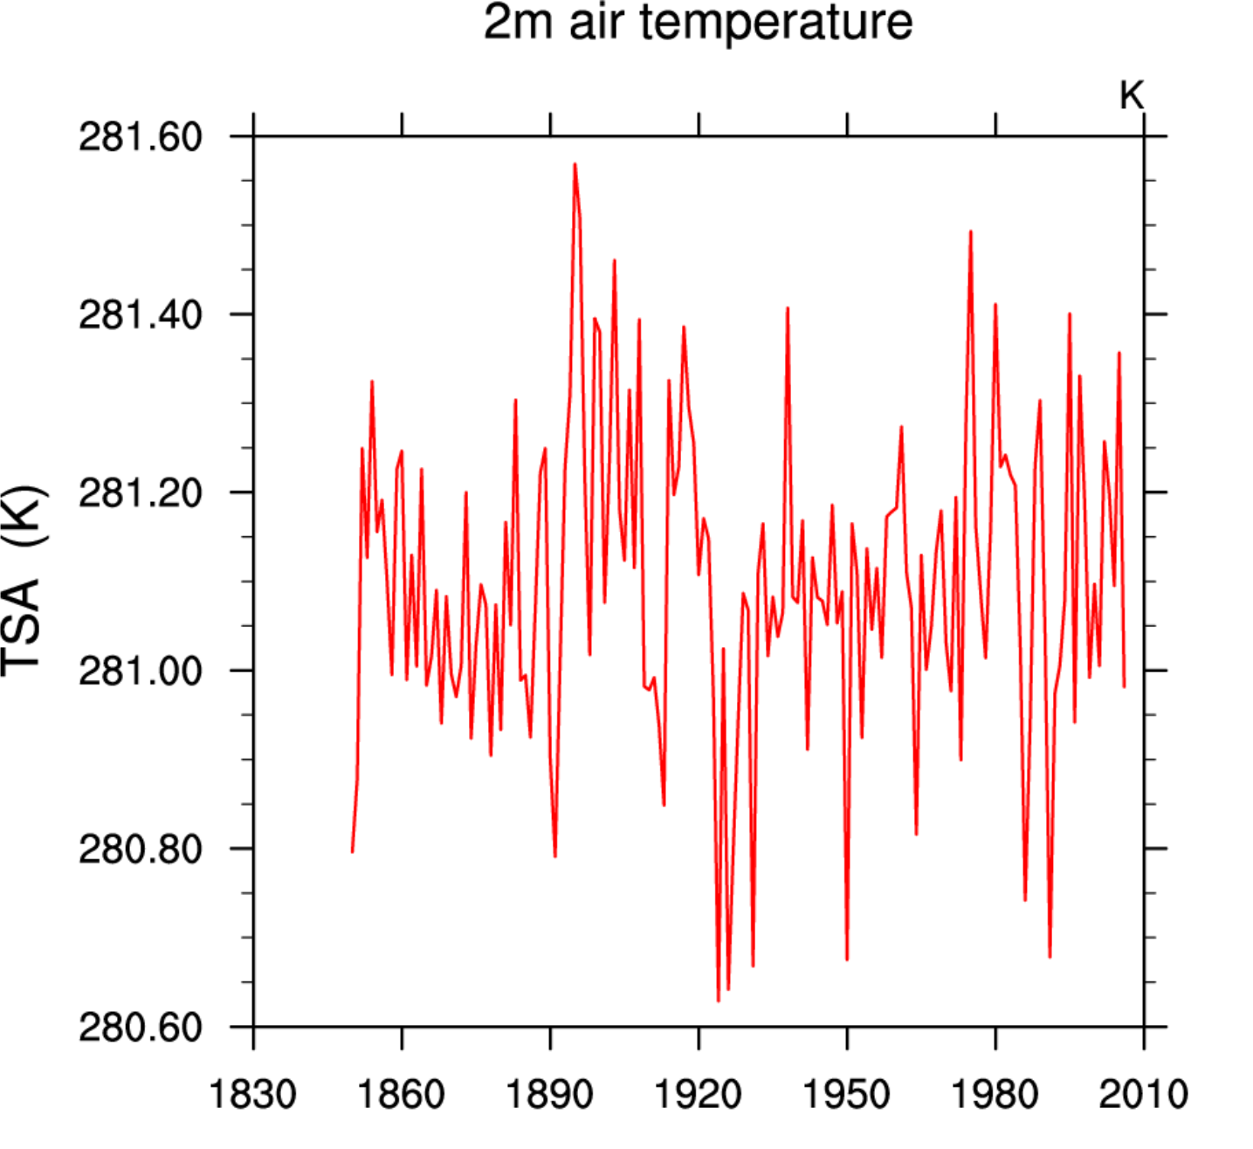
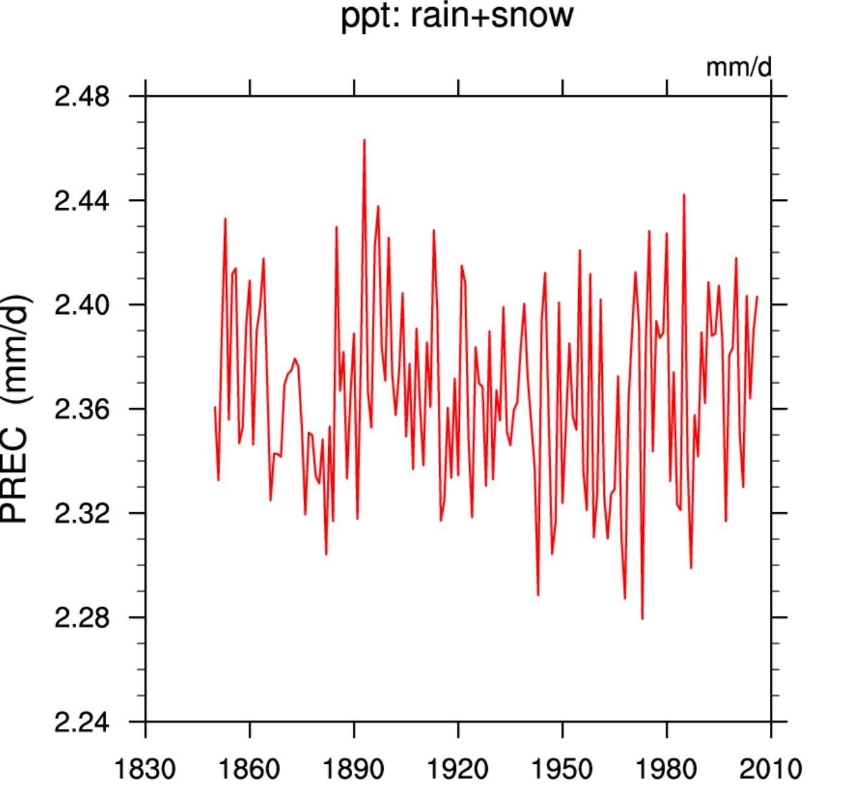
The control simulation is stable: Physics

Slide 3
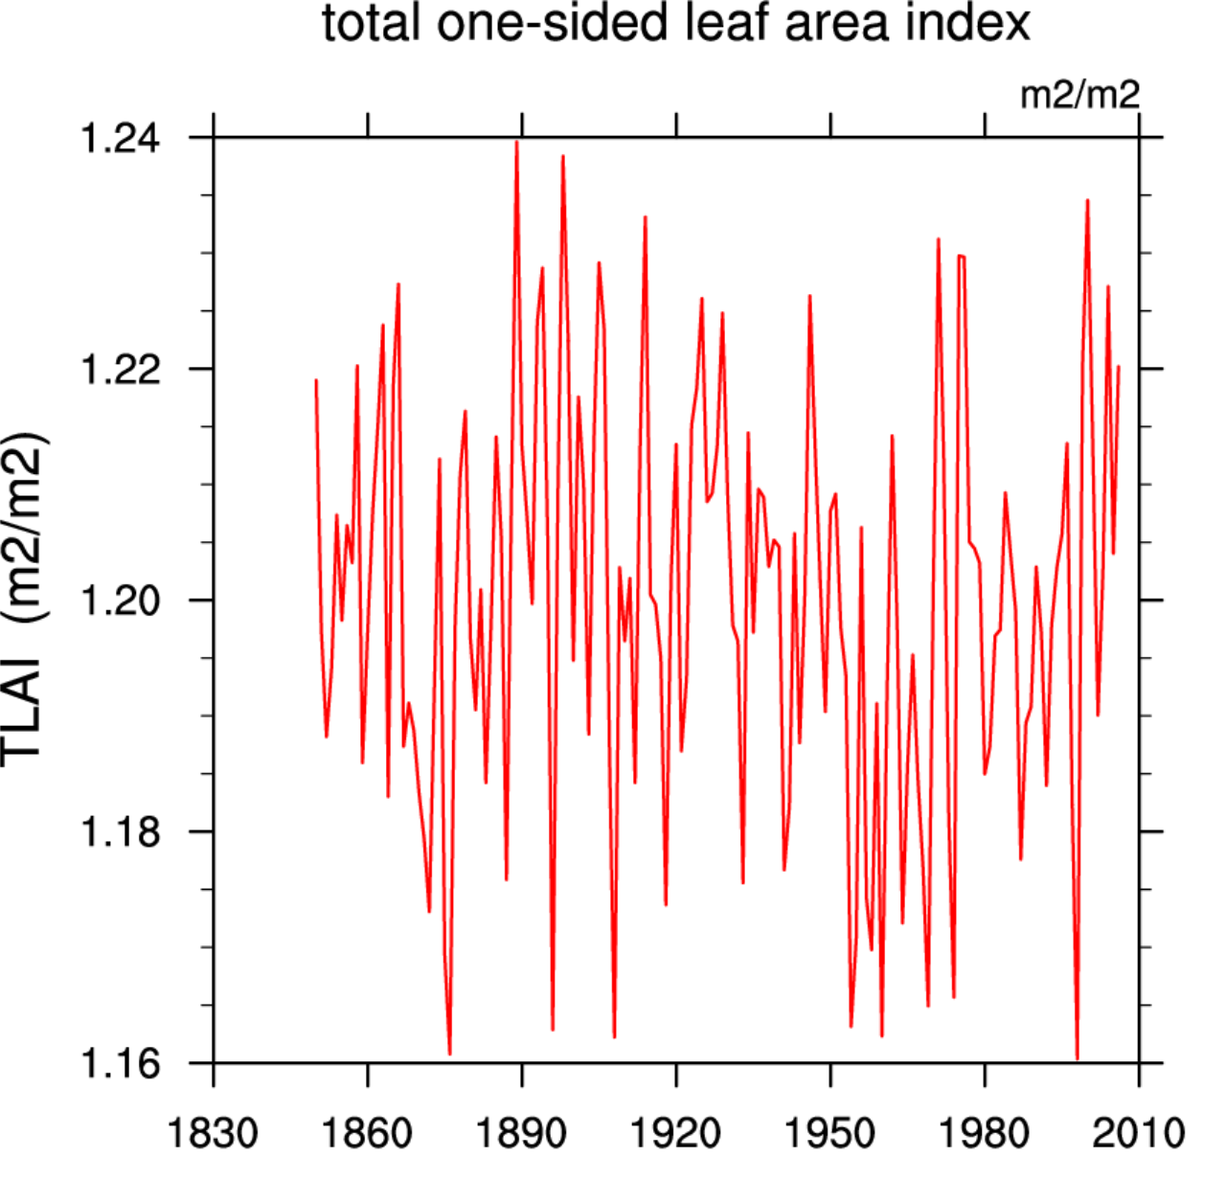
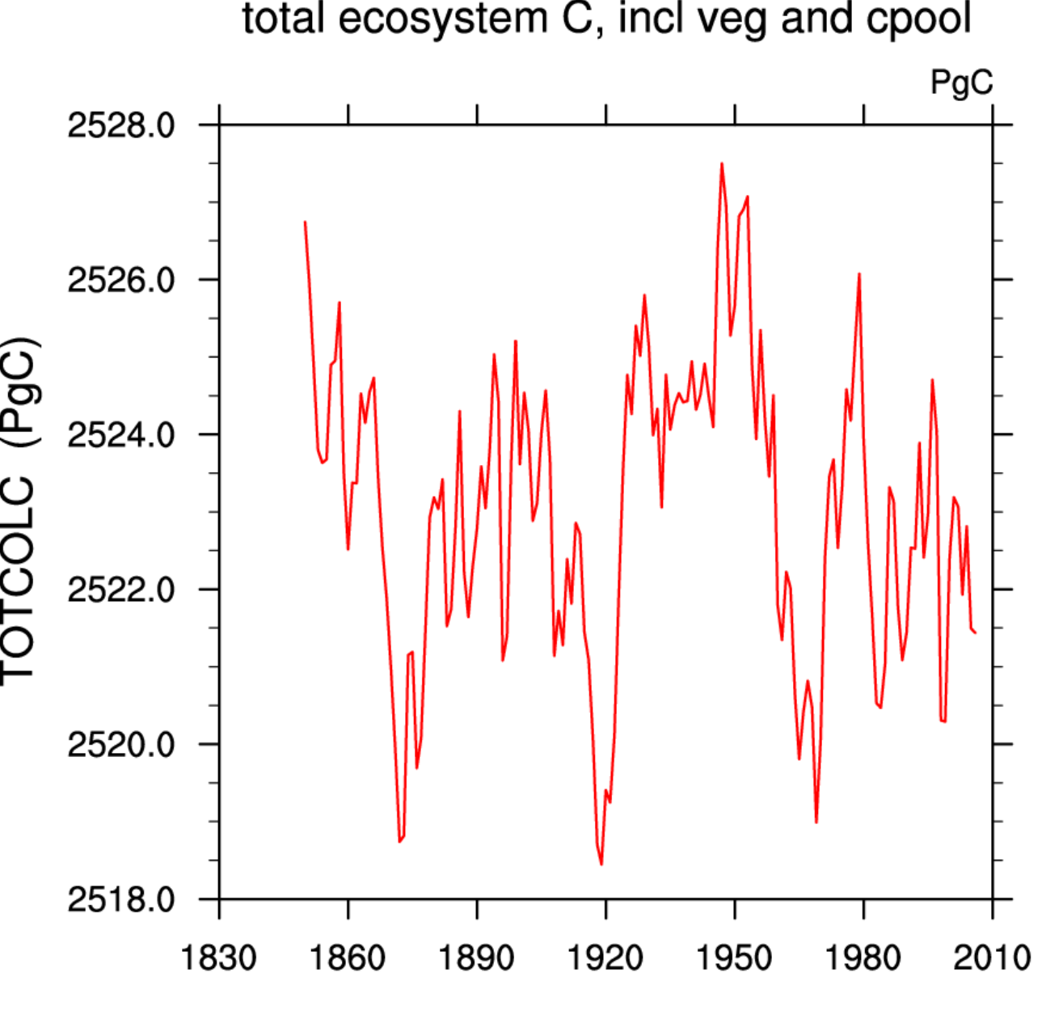
The control simulation is stable: Land ecosystem
30-year mean NEE = +0.079 PgC/yr (1977-2006)

Slide 4
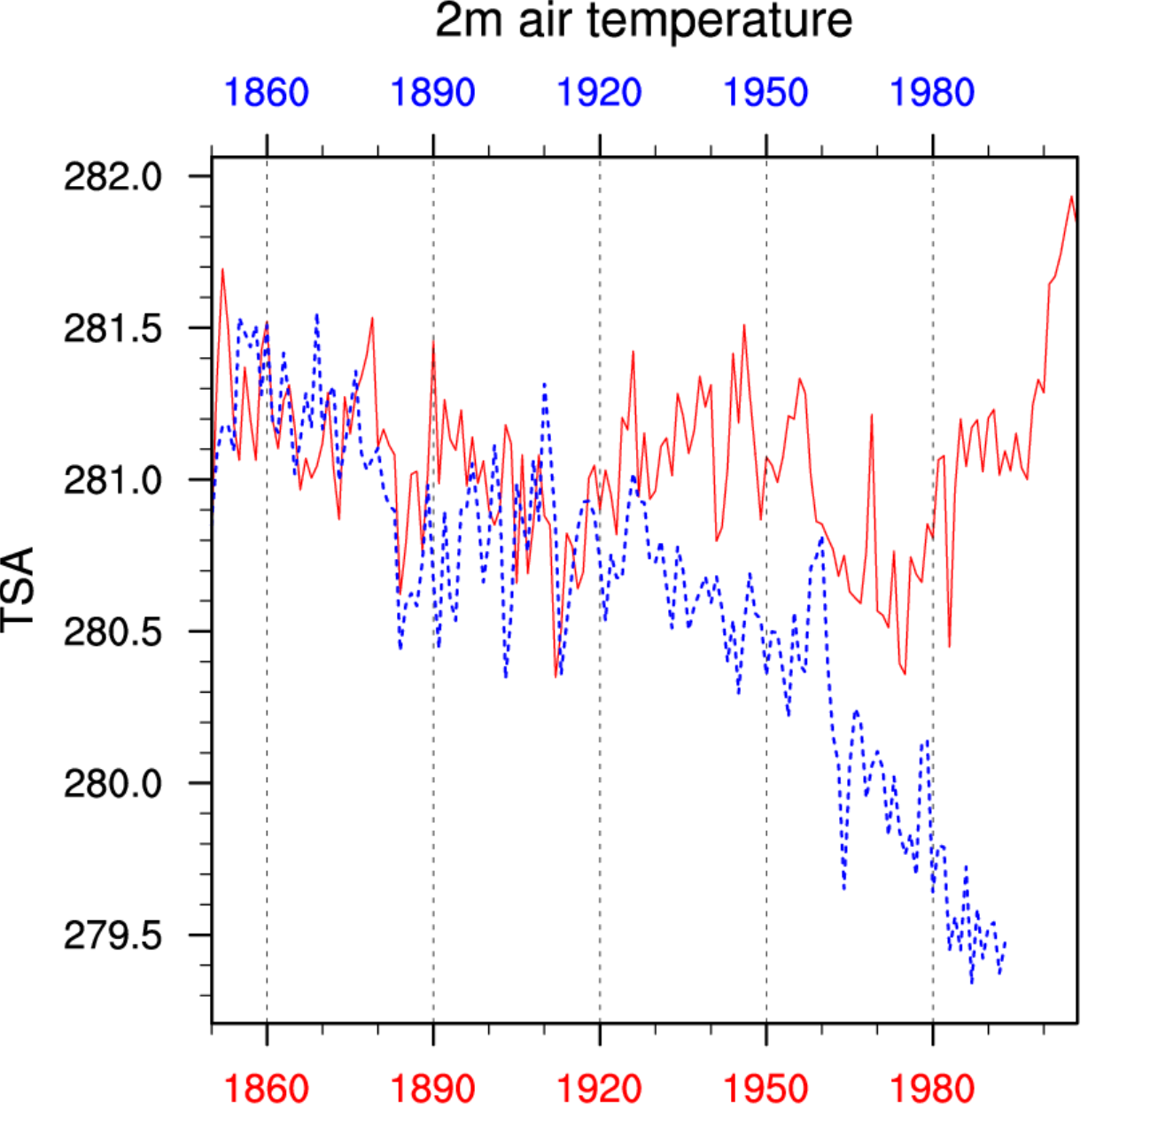
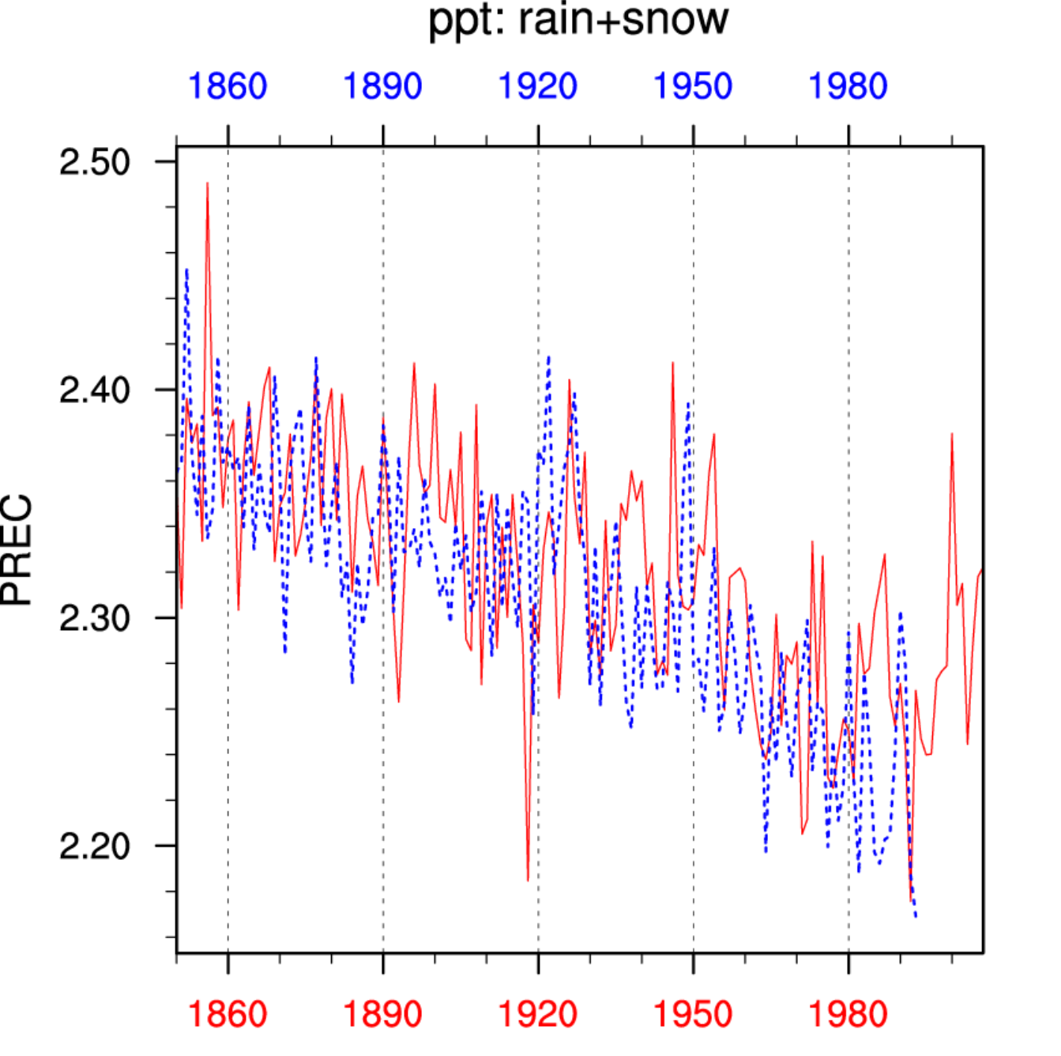
The constant GHG-forcing run (BCRC) is cooling and drying (aerosols, LULCC, and other forcings)
Focus on the blue lines…

Slide 5
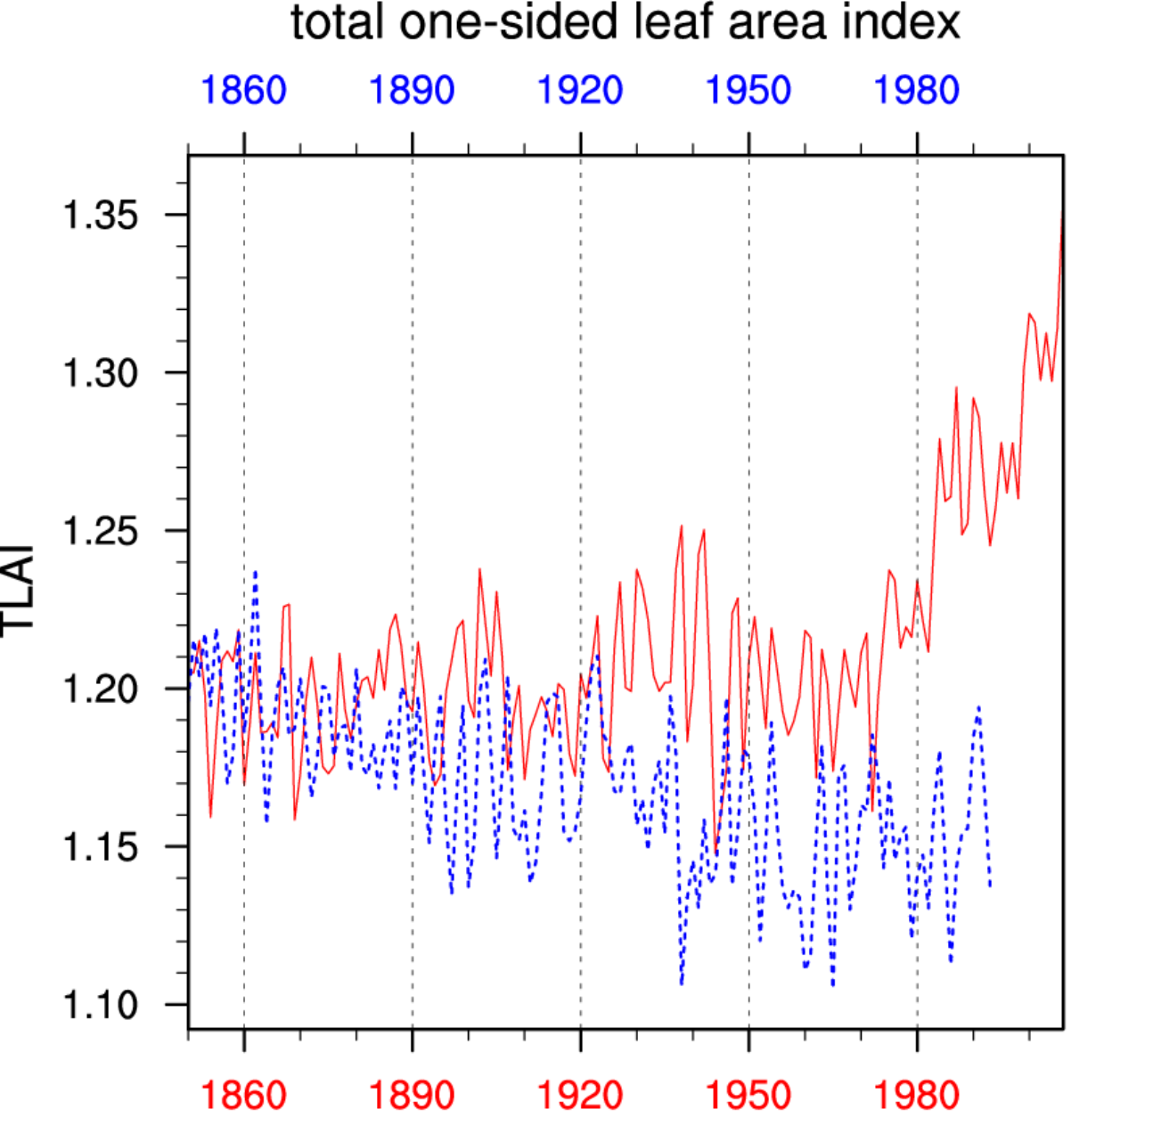
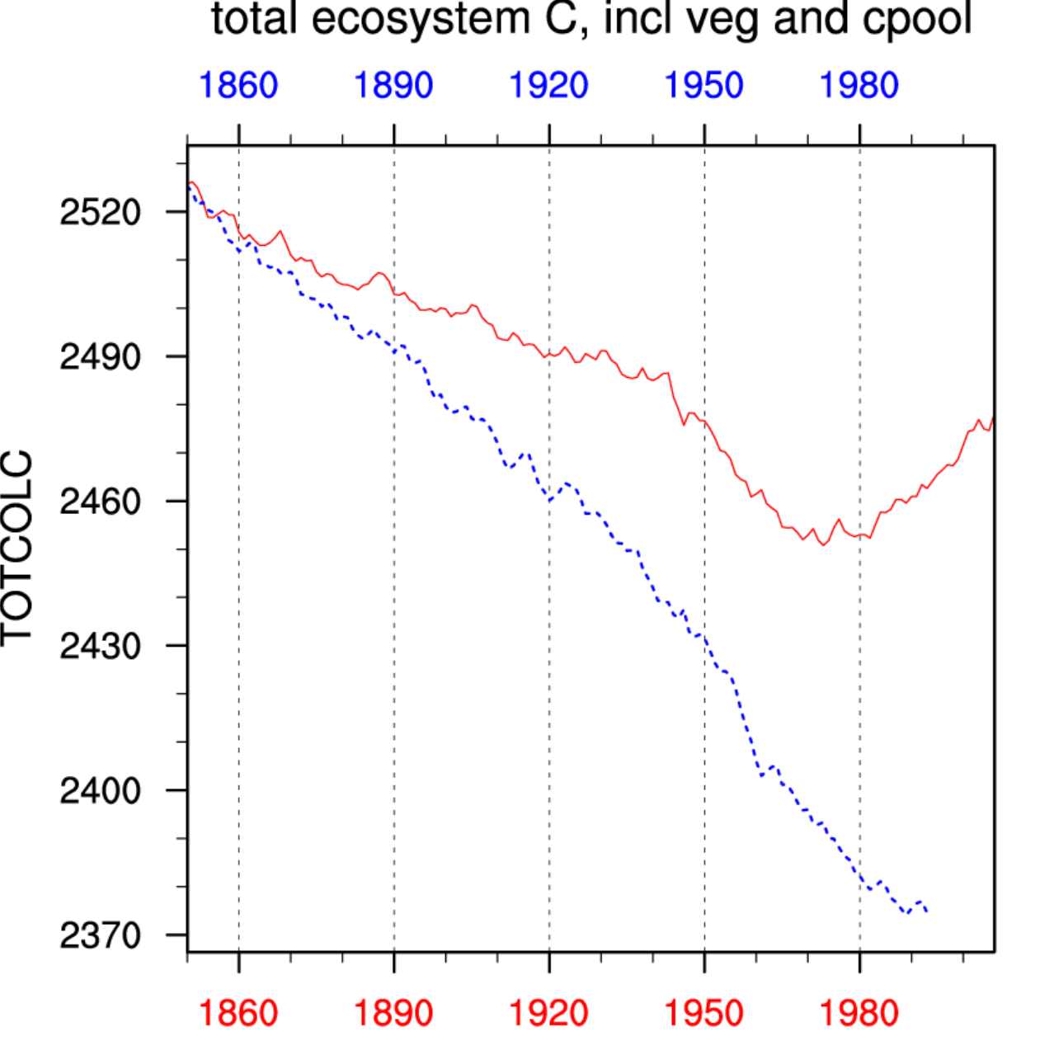
The constant GHG-forcing run (BCRC) has a slowly shrinking land ecosystem…
Focus on the blue lines…

Slide 6
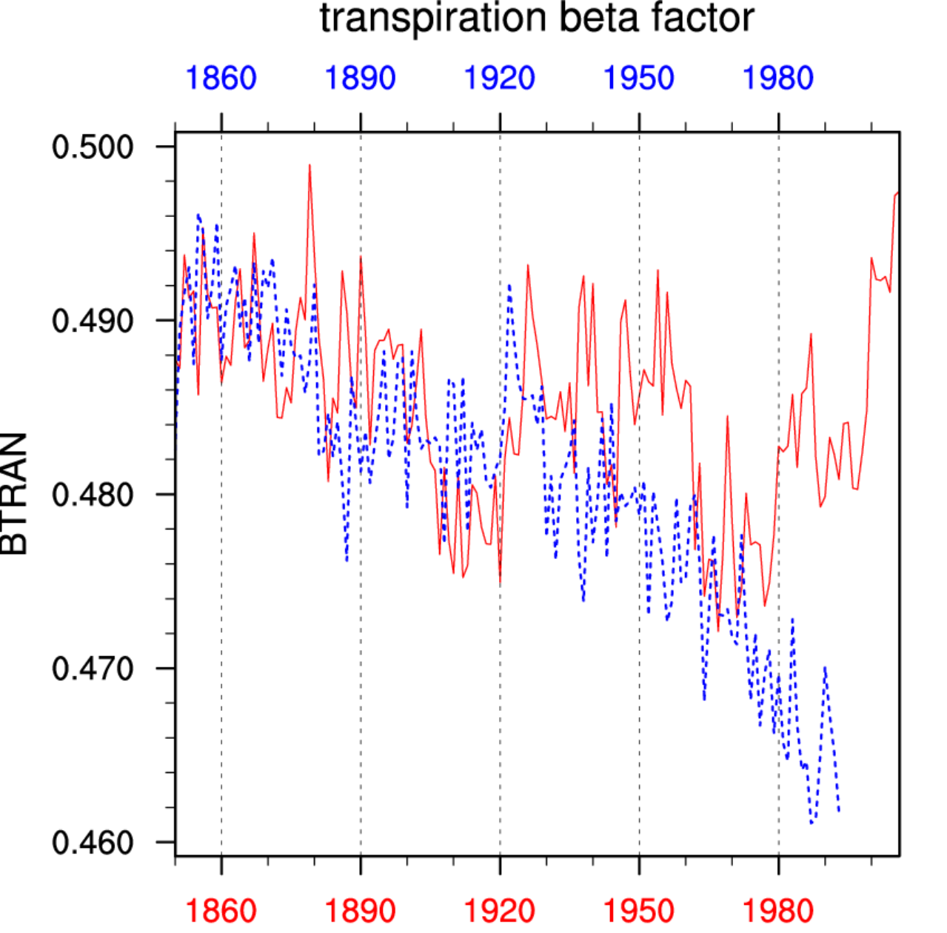
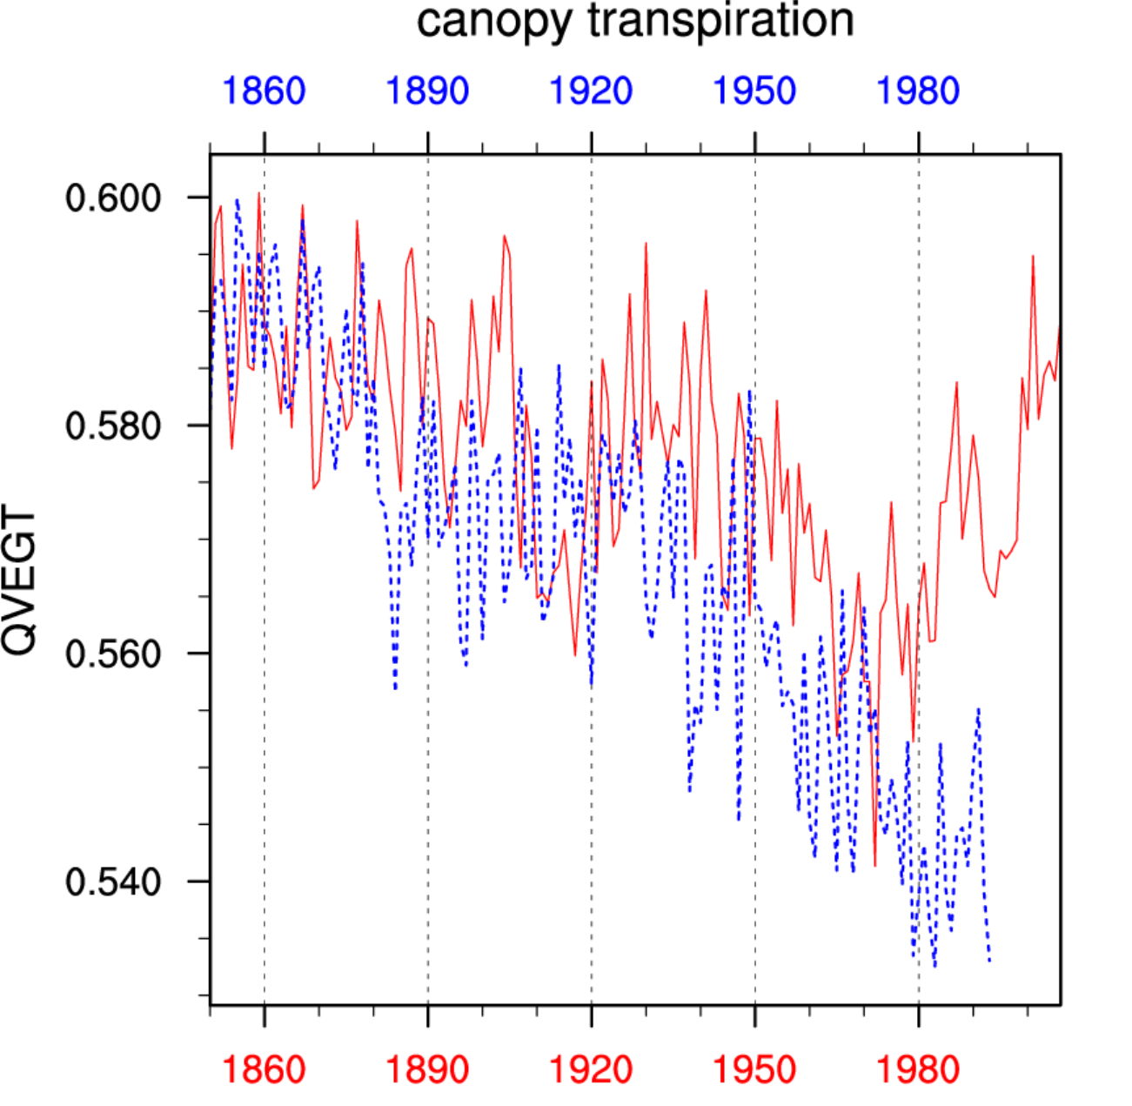
…due to LULCC, and also drying
Focus on the blue lines…

Slide 7
Transient GHG simulations are warming and accumulating carbon… relative to constant GHG
Focus on the blue lines…

Slide 8
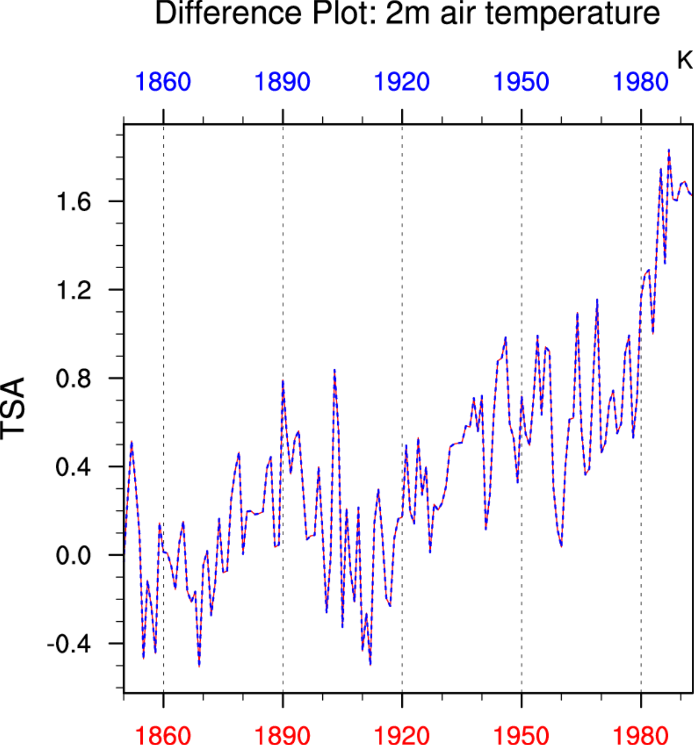
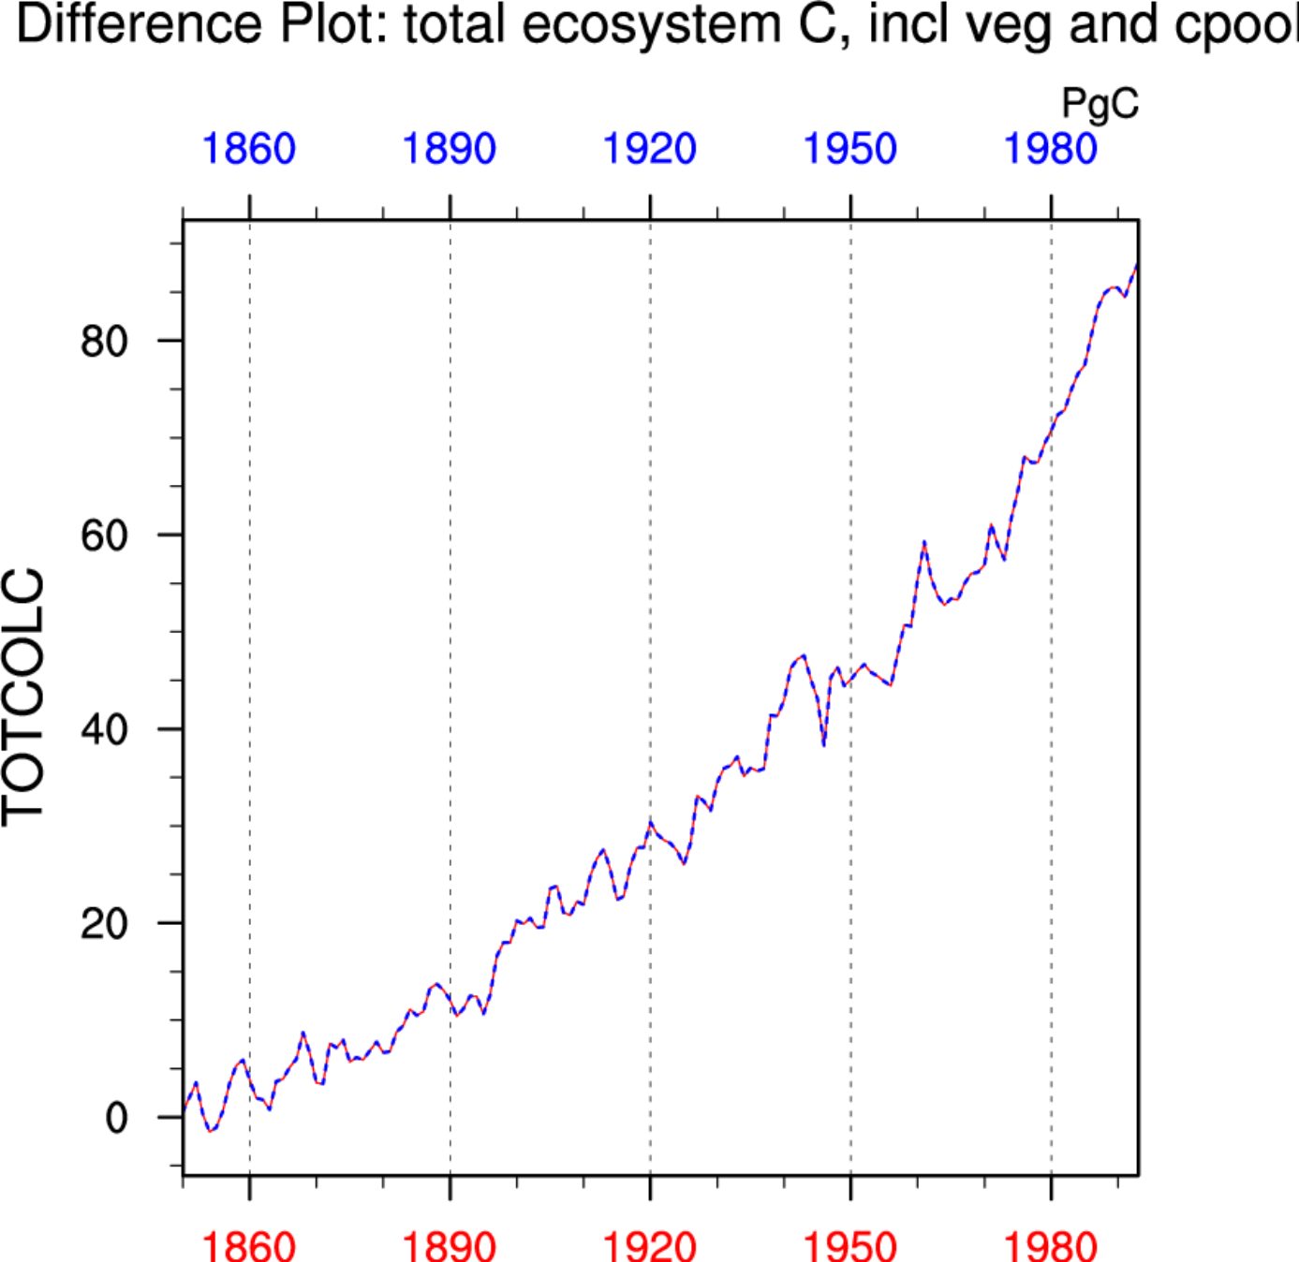
Transient GHG simulations are warming and accumulating carbon… relative to constant GHG
Focus on the blue lines…

Slide 9
Climate-carbon cycle feedback analysis
Following Friedlingstein et al. 2006:
Gain ≈ -α (γ_{L} + γ_{O}) / (1 + β_{L} + β_{O})
α = transient climate sensitivity to CO₂
β = (land or ocean) carbon storage sensitivity to CO₂
γ = (land or ocean) carbon storage sensitivity to climate
(K ppm⁻¹)
(PgC ppm⁻¹)
(PgC K⁻¹)

Slide 10
Major climate-carbon and climate-ecosystem feedbacks
Ocean system
β_{O}
γ_{O}
Fossil Fuel Emissions
Atm CO₂
Climate
(T, P, q, rad)
α
γ_{L}
β_{L}
Land system

Slide 11
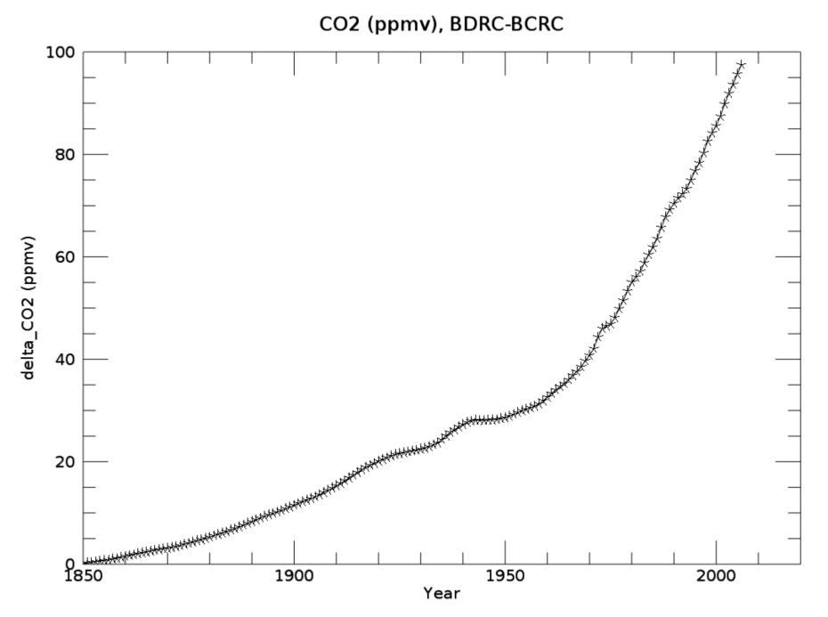
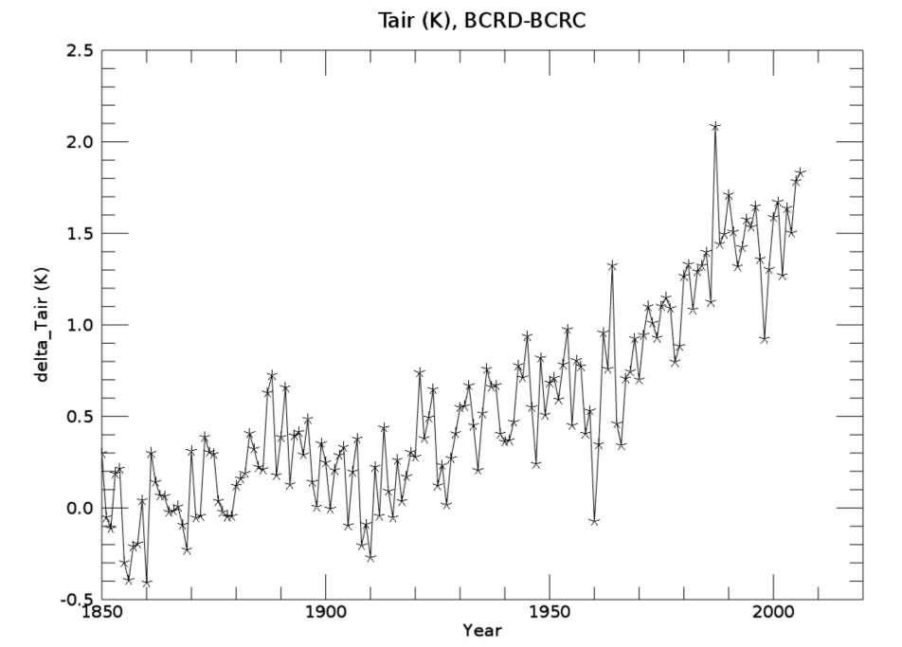

Slide 12
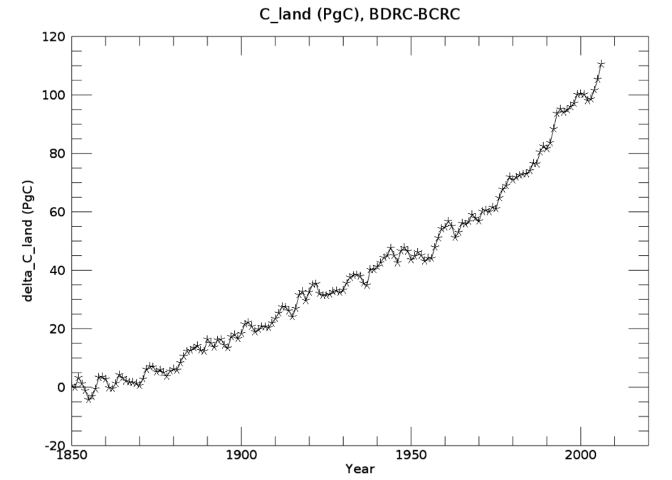
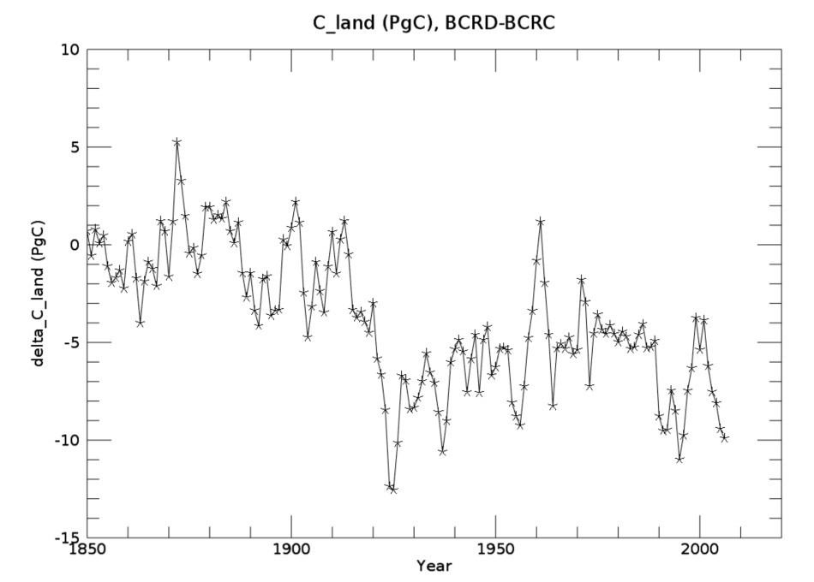

Slide 13
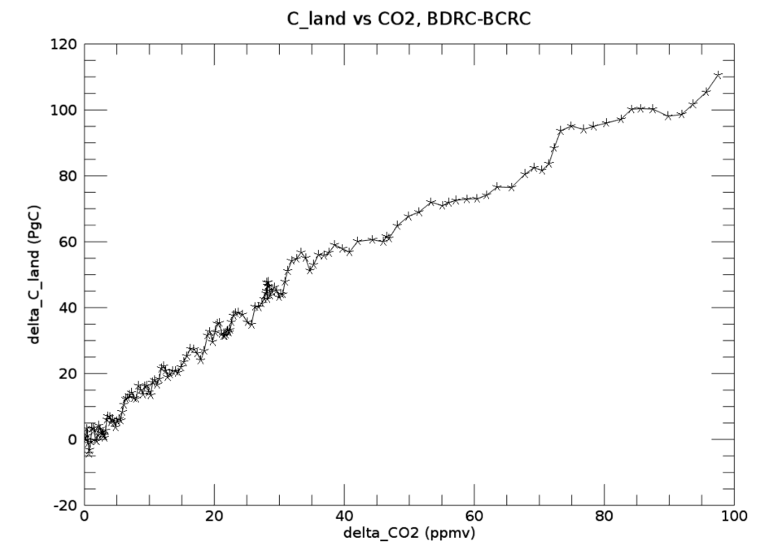
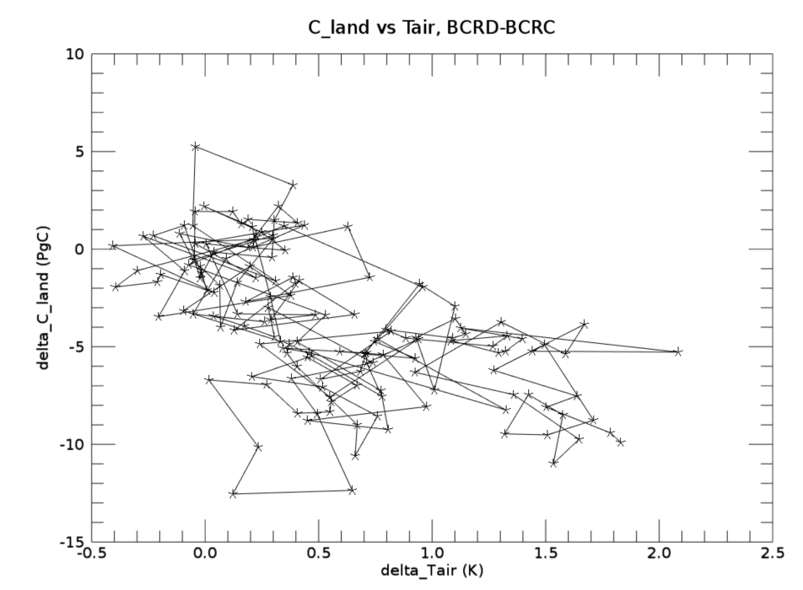

Slide 14
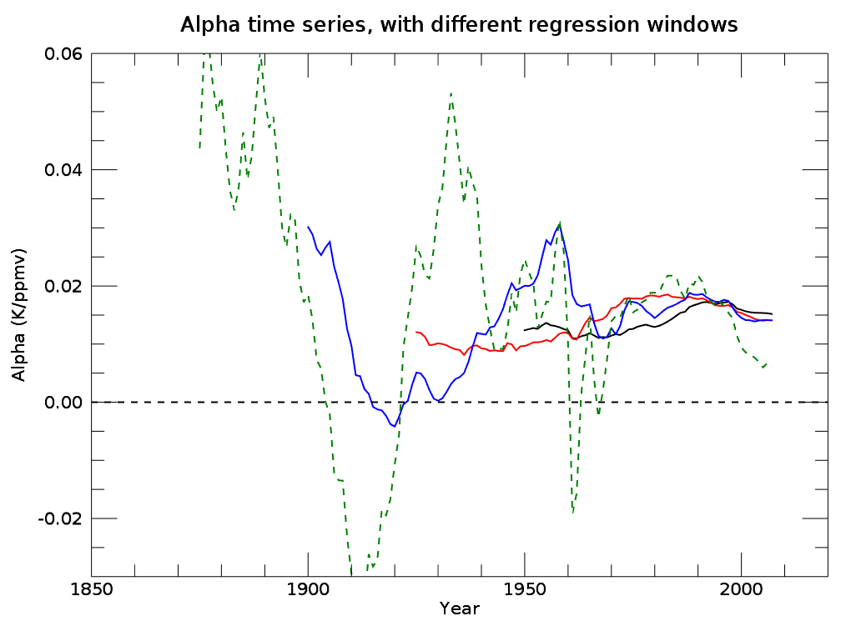
100 yr
75 yr
50 yr
25 yr

Slide 15
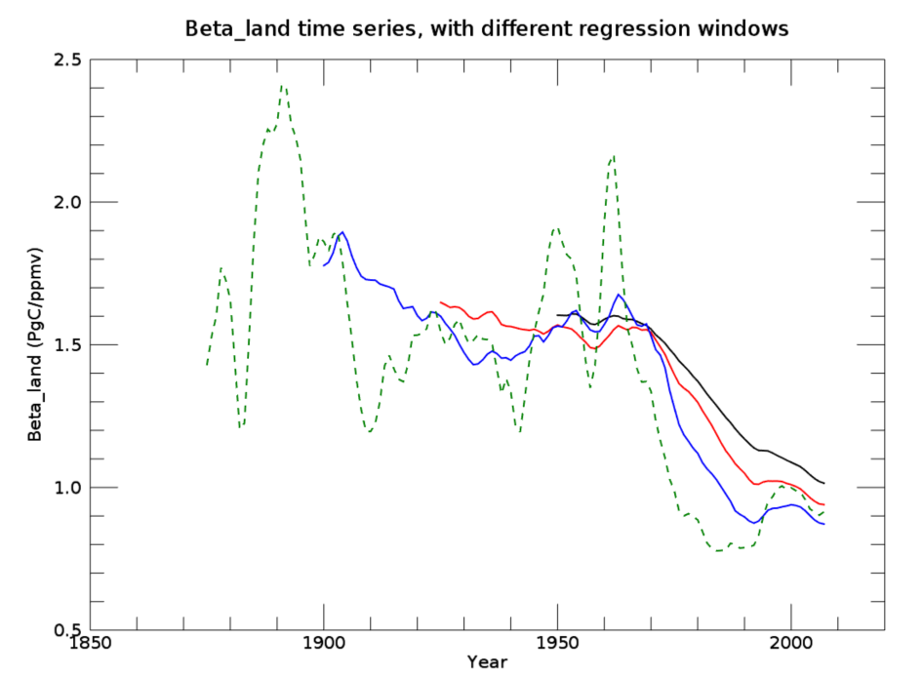
100 yr
75 yr
50 yr
25 yr

Slide 16
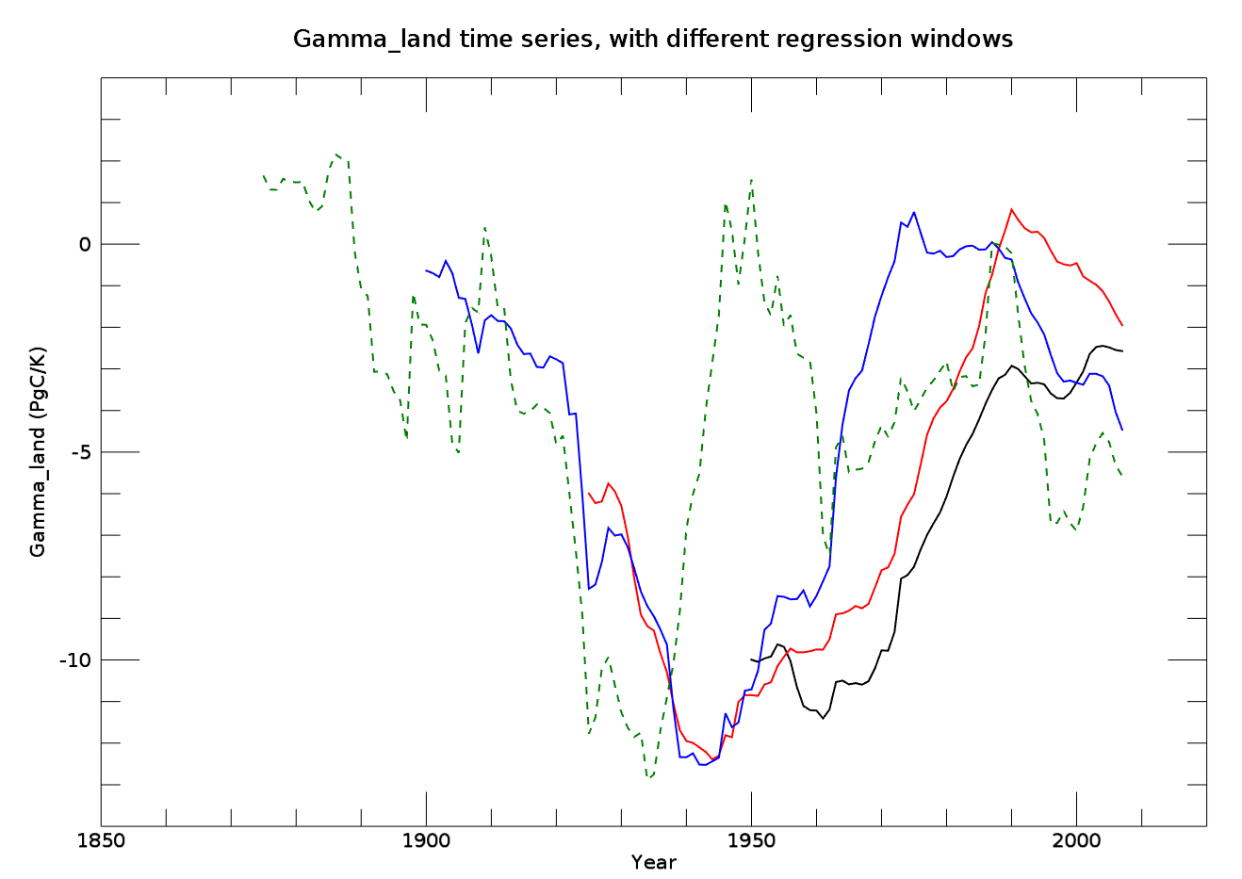
100 yr
75 yr
50 yr
25 yr

Slide 17
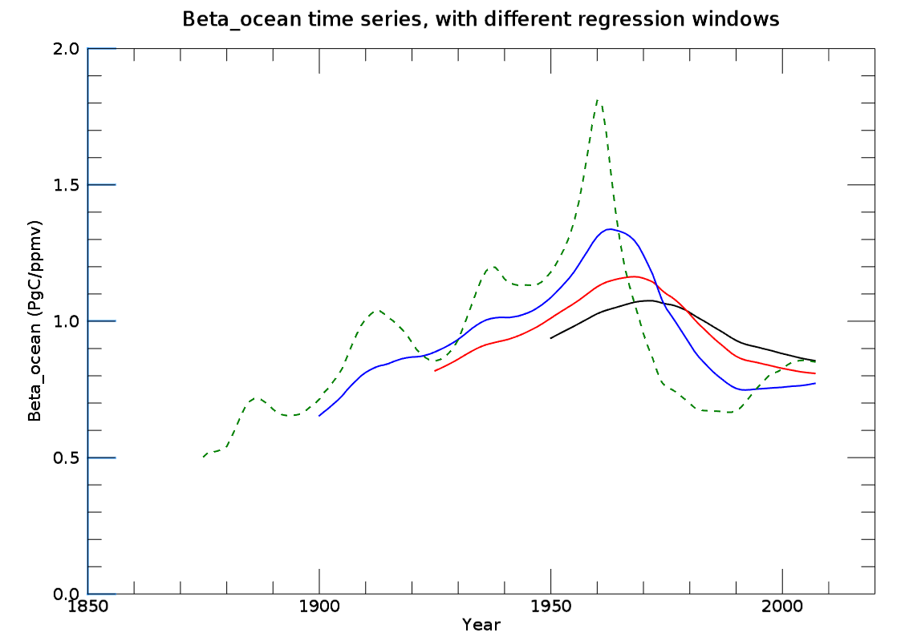
100 yr
75 yr
50 yr
25 yr

Slide 18
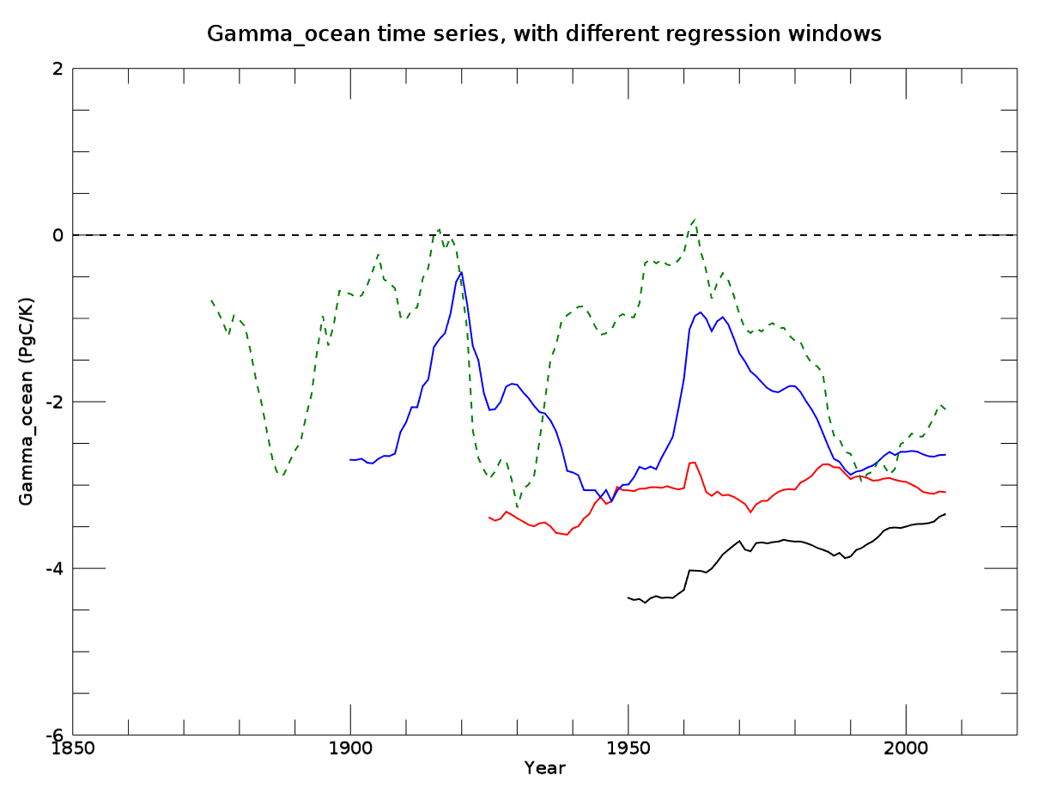
100 yr
75 yr
50 yr
25 yr

Slide 19
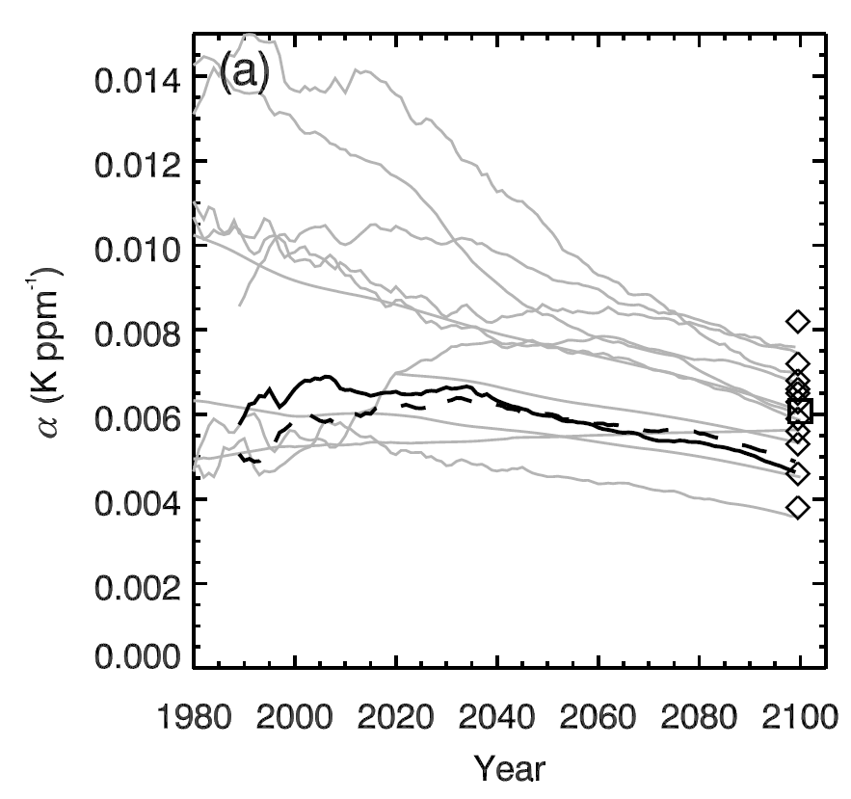
E3SM v1 BGC estimate
Alpha: transient climate sensitivity to CO₂
Differences:
Different physical climate
Different land model
Physics and BGC
Active P cycle
E3SM is using dynamic LULCC
Plotted on data from Thornton et al. 2009

Slide 20
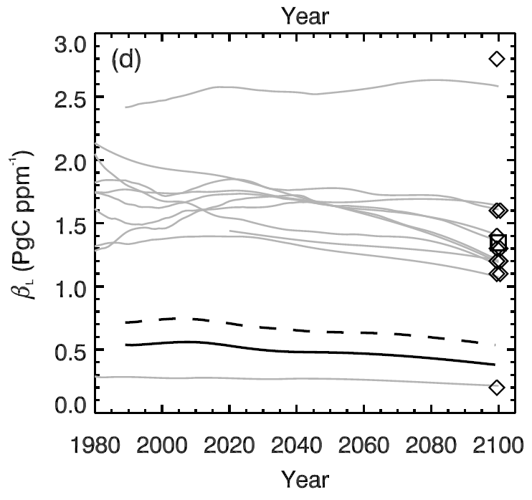
E3SM v1 BGC estimate
Beta_land: land carbon sensitivity to CO₂
Notes
Like CESM1, E3SM v1 CTC has a lower CO₂ fertilization effect than many other land models
Consistent with nutrient constraint hypothesis, and with other models that include nutrient limitations
Plotted on data from Thornton et al. 2009

Slide 21
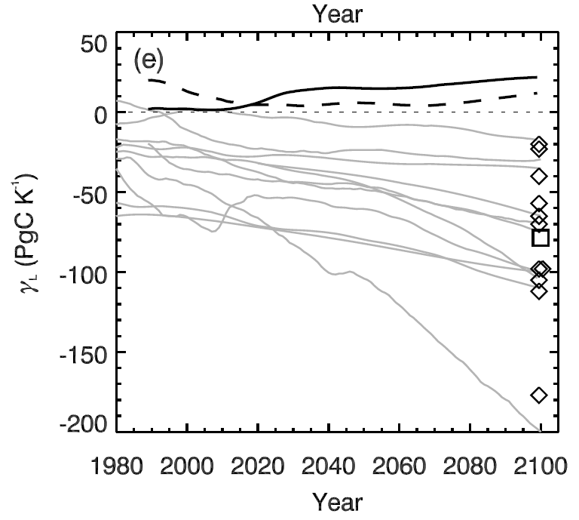
E3SM v1 BGC estimate
Gamma_land: land carbon sensitivity to T_{air}
Notes
Like CESM1, E3SM v1 has a near-neutral land carbon sensitivity to rising temperature
Mainly a function of nutrient dynamics:
Warming makes more nutrients available, mitigating losses due to increased respiration
Plotted on data from Thornton et al. 2009

Slide 22
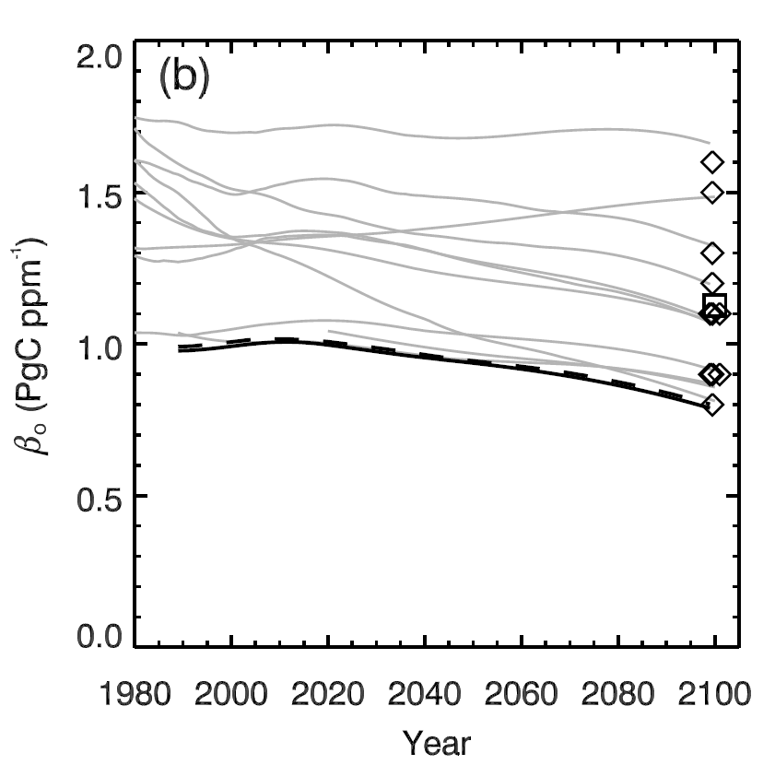
E3SM v1 BGC estimate
Beta_ocean: ocean carbon sensitivity to CO₂
Notes
E3SM v1 has a lower sensitivity of ocean carbon uptake to rising CO2 than CESM1, which itself was at the low end of the CMIP5 models
Plotted on data from Thornton et al. 2009

Slide 23
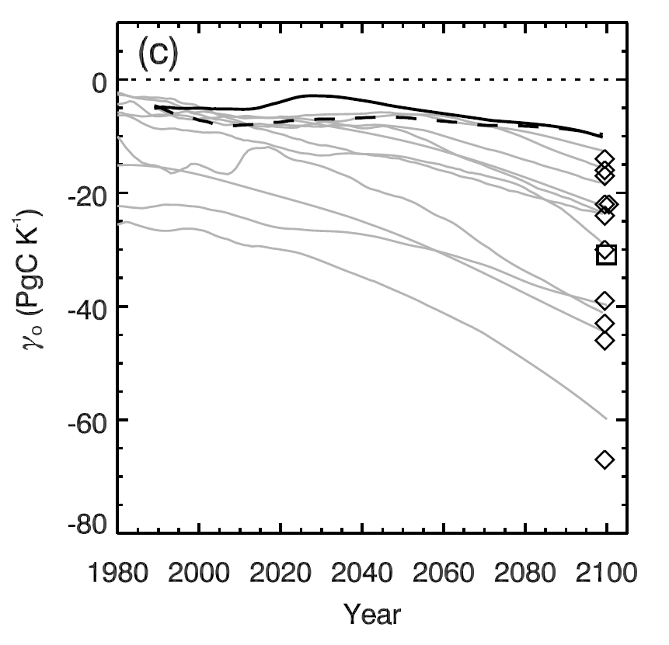
E3SM v1 BGC estimate
Gamma_ocean: ocean carbon sensitivity to T_{air}
Notes
Like CESM1, E3SM v1 has a near-neutral ocean carbon sensitivity to rising temperature
Plotted on data from Thornton et al. 2009

