Slide 1
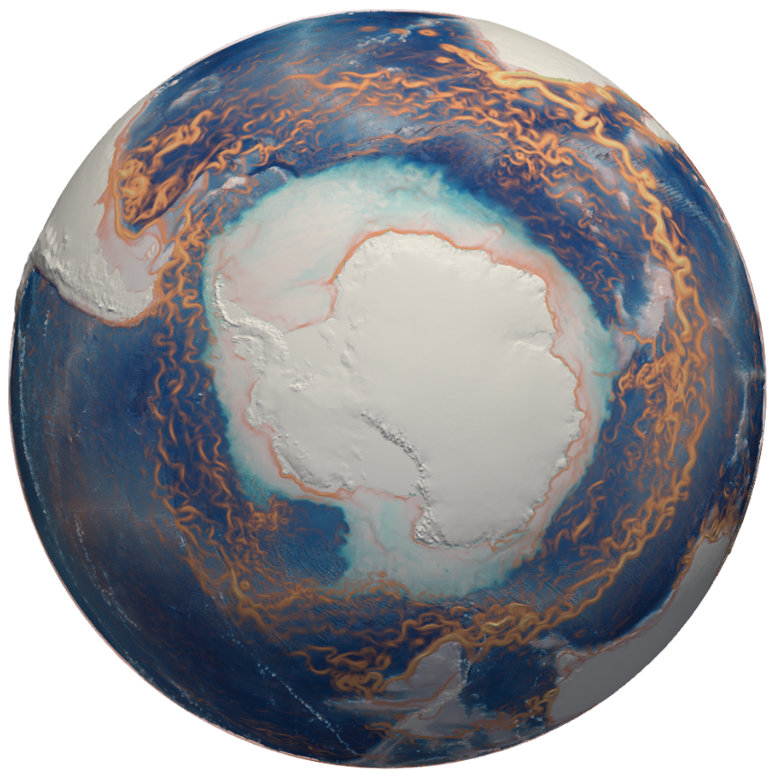
Cryosphere Simulation Campaign
S. Price, W. Lin, M. Petersen
(and the Cryosphere team)

Slide 2
Outline
Review
Simulation Campaign Status
Development
Simulation Analysis
Summary

Slide 3
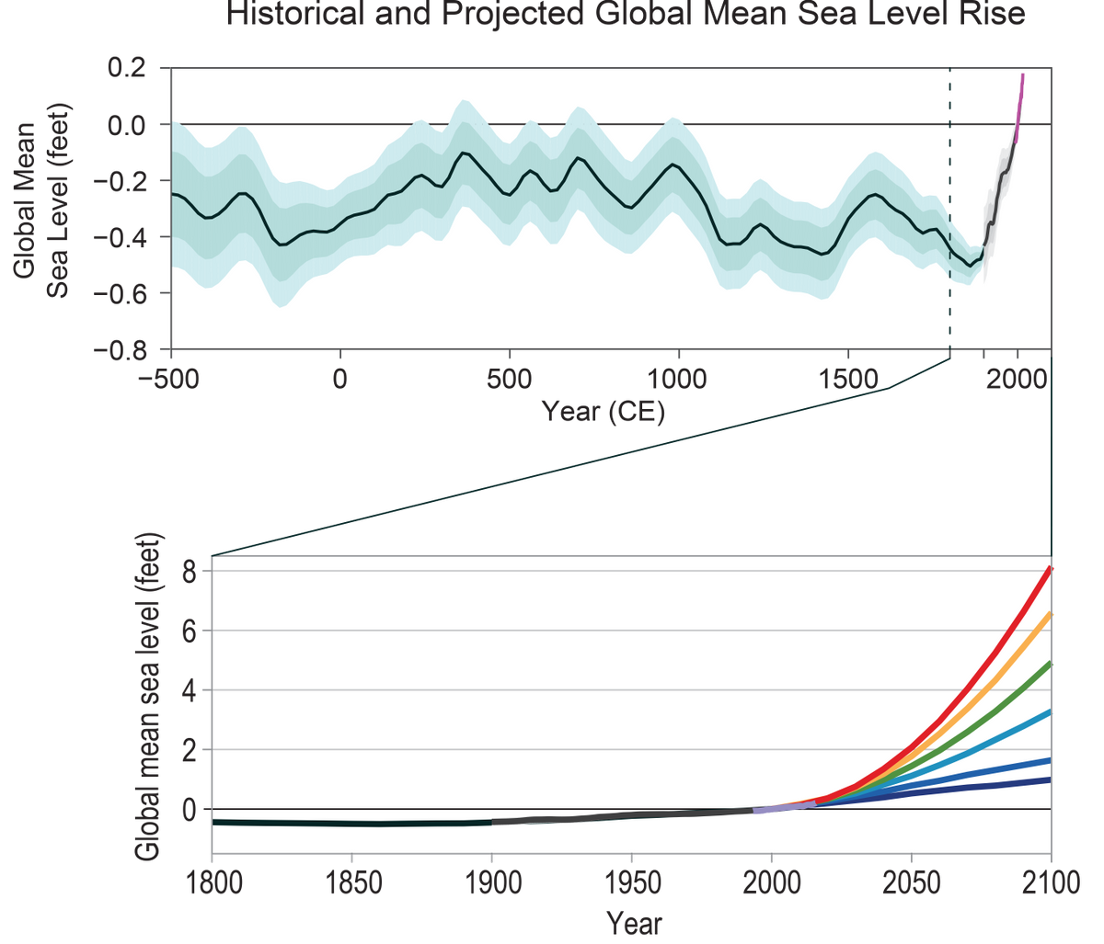
Motivation
“Global average sea levels are expected to continue to rise—by at least several inches in the next 15 years and by 1–4 feet by 2100. A rise of as much as 8 feet by 2100 cannot be ruled out. Sea level rise will be higher than the global average on the East and Gulf Coasts of the United States.”
USGCRP, 2017: Climate Science Special Report: Fourth National Climate Assessment, Volume I

Slide 4
V1 Cryosphere Science Question
SCIENTIFIC QUESTION: What are the impacts of ocean-ice shelf interactions on melting of the Antarctic Ice Sheet, the global climate, and sea level rise?
Most ESMs: no ice shelves and no
explicit ocean-ice shelf melt processes
E3SM V1: ice shelves included and ocean-
ice shelf melt processes simulated
marine ice sheet
ice shelf
high-salinity
shelf water
marine ice sheet
tidal
ocean
plume
ocean
Antarctica
CDW
Antarctica

Slide 5
V1 Cryosphere Science Question
SCIENTIFIC QUESTION: What are the impacts of ocean-ice shelf interactions on melting of the Antarctic Ice Sheet, the global climate, and sea level rise?
Most ESMs: no ice shelves and no
explicit ocean-ice shelf melt processes
E3SM V1: ice shelves included and ocean-
ice shelf melt processes simulated
SPECIFIC QUESTIONS:
What role do ice shelves play in the global climate system and, more precisely, what is their role in setting the climate of the Southern Ocean?
What factors control, either directly or indirectly, the melt rates around the Antarctic ice sheet?
What are the (climate) indicators for likelihood of Ant-arctic ice sheet collapse and abrupt sea-level rise?
marine ice sheet
ice shelf
high-salinity
shelf water
marine ice sheet
tidal
ocean
plume
ocean
Antarctica
CDW
Antarctica

Slide 6
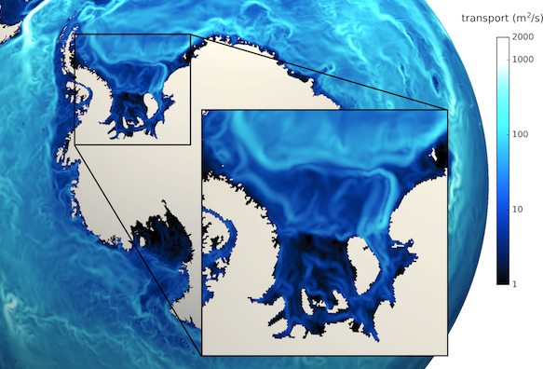
V1 Cryosphere Simulation Campaign
Low (EC60to30km), med. (RRS30to10km), and high res. (RRS18to6km) configurations with & without ice shelves
CORE-IAF forcing (multiple cycles)
coupled, pre-industrial & historical
4xCO₂
CORE-IAF global high and S. Ocean-enhanced high resolution
Goals:
demonstrate ice shelves do no harm w.r.t. global simulation metrics
demonstrate (i) sub-ice shelf melt & (ii) melt-relevant, ice-sheet-proximal ocean characteristics are plausible (relative to obs.)
Understand sensitivity to (i) resolution & (ii) forcing
ocean transport in global, med. Resolution E3SM simulation
Notes:
** make some mention here of new (this week!) diagnostics we’ve put in place (SOSE velocities and mixed layer depths in addition to SOSE T,S) … but have not yet looked at in detail for these same simulations

Slide 7
V1 Cryosphere Simulation Campaign
Low (EC60to30km), med. (RRS30to10km), and high res. (RRS18to6km) configurations with & without ice shelves
✓
CORE-IAF forcing (multiple cycles)
coupled, pre-industrial & historical
4xCO₂
CORE-IAF global high and S. Ocean-enhanced high resolution
✓
Goals:
demonstrate ice shelves do no harm w.r.t. global simulation metrics
demonstrate (i) sub-ice shelf melt & (ii) melt-relevant, ice-sheet-proximal ocean characteristics are plausible (relative to obs.)
Understand sensitivity to (i) resolution & (ii) forcing
ocean transport in global, med. Resolution E3SM simulation
✓
✓
✓
Notes:
** make some mention here of new (this week!) diagnostics we’ve put in place (SOSE velocities and mixed layer depths in addition to SOSE T,S) … but have not yet looked at in detail for these same simulations

Slide 8
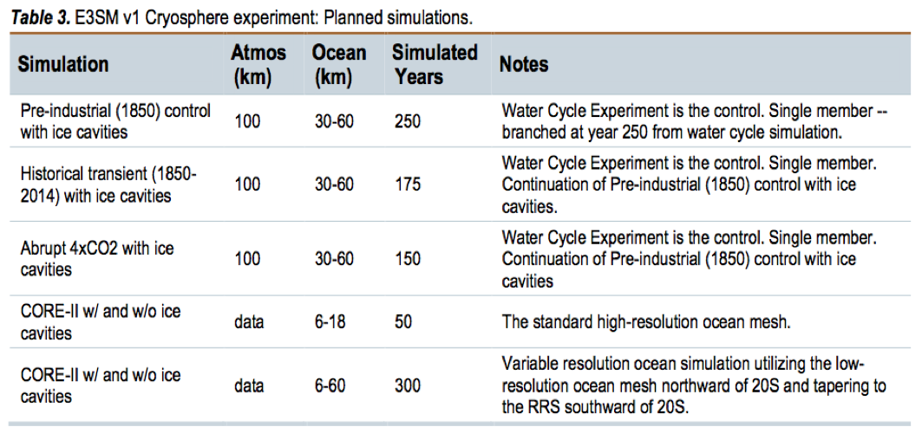
Simulation Campaign: Status
105 M cpu hrs under ALCC for ’18-’19 (approx. on track to use)
106 M cpu hrs proposed under ALCC (‘19-’20)
10 new out-of-the-box compsets supporting ice sheet-ocean
new tag (v1.2) for v1 Cryosphere Simulation Campaign
Notes:
Icebergs – clearly distinguish between data iceberg work (now) and dynamic / active icberg model (v2)
This PR brings in data iceberg capabilities to E3SM through the mpas-seaice model. It brings in a new MPAS source submodule that includes the necessary changes to mpas-seaice -- where the data is read-in and managed -- as well as mpas-ocean where the data is used. New coupler fields are created and passed between mpas-seaice and mpas-ocean via the coupler, and there are several new compsets added:
GMPAS-DIB-NYF
GMPAS-NYF-ISMF
GMPAS-DIB-NYF-ISMF
GMPAS-DIB-IAF
GMPAS-IAF-ISMF
GMPAS-DIB-IAF-ISMF
A_WCYCL1850-DIB
A_WCYCL1850-DIB-ISMF
A_WCYCL1850-DIB_CMIP6
A_WCYCL1850-DIB-ISMF_CMIP6
The naming convention applied to the compsets is that "DIB" includes DataIceBergs and "ISMF" indicates IceSheet Melt Fluxes. In support of the new G-compsets, there are new extensions to drof to remove different percentages of runoff from Antarctica via new data files. That "runoff" is replaced by the data icebergs and their eventual melting.

Slide 9
Simulation Campaign: Status
105 M cpu hrs under ALCC for ’18-’19 (approx. on track to use)
106 M cpu hrs proposed under ALCC (‘19-’20)
10 new out-of-the-box compsets supporting ice sheet-ocean
new tag (v1.2) for v1 Cryosphere Simulation Campaign
We are
still here
We should
be here
We may skip this
Working on this
Notes:
Icebergs – clearly distinguish between data iceberg work (now) and dynamic / active icberg model (v2)
This PR brings in data iceberg capabilities to E3SM through the mpas-seaice model. It brings in a new MPAS source submodule that includes the necessary changes to mpas-seaice -- where the data is read-in and managed -- as well as mpas-ocean where the data is used. New coupler fields are created and passed between mpas-seaice and mpas-ocean via the coupler, and there are several new compsets added:
GMPAS-DIB-NYF
GMPAS-NYF-ISMF
GMPAS-DIB-NYF-ISMF
GMPAS-DIB-IAF
GMPAS-IAF-ISMF
GMPAS-DIB-IAF-ISMF
A_WCYCL1850-DIB
A_WCYCL1850-DIB-ISMF
A_WCYCL1850-DIB_CMIP6
A_WCYCL1850-DIB-ISMF_CMIP6
The naming convention applied to the compsets is that "DIB" includes DataIceBergs and "ISMF" indicates IceSheet Melt Fluxes. In support of the new G-compsets, there are new extensions to drof to remove different percentages of runoff from Antarctica via new data files. That "runoff" is replaced by the data icebergs and their eventual melting.

Slide 10
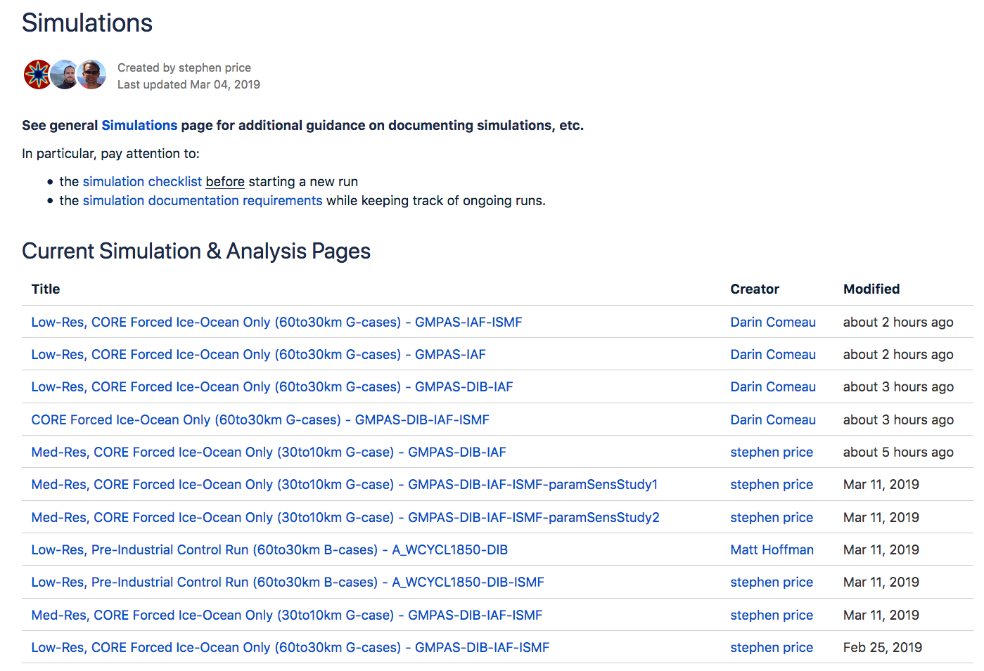
Simulation Campaign: Status
March 13, 2019
Notes:
Icebergs – clearly distinguish between data iceberg work (now) and dynamic / active icberg model (v2)
This PR brings in data iceberg capabilities to E3SM through the mpas-seaice model. It brings in a new MPAS source submodule that includes the necessary changes to mpas-seaice -- where the data is read-in and managed -- as well as mpas-ocean where the data is used. New coupler fields are created and passed between mpas-seaice and mpas-ocean via the coupler, and there are several new compsets added:
GMPAS-DIB-NYF
GMPAS-NYF-ISMF
GMPAS-DIB-NYF-ISMF
GMPAS-DIB-IAF
GMPAS-IAF-ISMF
GMPAS-DIB-IAF-ISMF
A_WCYCL1850-DIB
A_WCYCL1850-DIB-ISMF
A_WCYCL1850-DIB_CMIP6
A_WCYCL1850-DIB-ISMF_CMIP6
The naming convention applied to the compsets is that "DIB" includes DataIceBergs and "ISMF" indicates IceSheet Melt Fluxes. In support of the new G-compsets, there are new extensions to drof to remove different percentages of runoff from Antarctica via new data files. That "runoff" is replaced by the data icebergs and their eventual melting.

Slide 11
Simulation Campaign: Status
March 13, 2019
Notes:
Icebergs – clearly distinguish between data iceberg work (now) and dynamic / active icberg model (v2)
This PR brings in data iceberg capabilities to E3SM through the mpas-seaice model. It brings in a new MPAS source submodule that includes the necessary changes to mpas-seaice -- where the data is read-in and managed -- as well as mpas-ocean where the data is used. New coupler fields are created and passed between mpas-seaice and mpas-ocean via the coupler, and there are several new compsets added:
GMPAS-DIB-NYF
GMPAS-NYF-ISMF
GMPAS-DIB-NYF-ISMF
GMPAS-DIB-IAF
GMPAS-IAF-ISMF
GMPAS-DIB-IAF-ISMF
A_WCYCL1850-DIB
A_WCYCL1850-DIB-ISMF
A_WCYCL1850-DIB_CMIP6
A_WCYCL1850-DIB-ISMF_CMIP6
The naming convention applied to the compsets is that "DIB" includes DataIceBergs and "ISMF" indicates IceSheet Melt Fluxes. In support of the new G-compsets, there are new extensions to drof to remove different percentages of runoff from Antarctica via new data files. That "runoff" is replaced by the data icebergs and their eventual melting.

Slide 12
Simulation Campaign: Status
60to30km G cases (GMPAS-IAF): impacts of iceberg / runoff approx
  with cavities, ISMF ** off, standard runoff: 12 yrs
  with cavities, ISMF on, standard runoff: 25 yrs
  with cavities, ISMF off, improved runoff, data icebergs: 71 yrs
  with cavities, ISMF on, improved runoff, data icebergs : 70 yrs
60to30km B cases (A_WCYCL1850): fully coupled PI control
  with cavities, ISMF off, improved runoff, data icebergs: ~100 yrs
  with cavities, ISMF on, improved runoff, data icebergs : ~100 yrs
30to10km G cases (GMPAS-IAF): impacts of high(er) resolution
  with cavities, ISMF off (control): 5 yrs
  with cavities, ISMF on: 2 yrs
  with cavities, ISMF on, BL flux params. 1: 2 yrs
  with cavities, ISMF on, BL flux params. 2: 2 yrs
** ISMF = ice shelf melt flux
Notes:
Icebergs – clearly distinguish between data iceberg work (now) and dynamic / active icberg model (v2)
This PR brings in data iceberg capabilities to E3SM through the mpas-seaice model. It brings in a new MPAS source submodule that includes the necessary changes to mpas-seaice -- where the data is read-in and managed -- as well as mpas-ocean where the data is used. New coupler fields are created and passed between mpas-seaice and mpas-ocean via the coupler, and there are several new compsets added:
GMPAS-DIB-NYF
GMPAS-NYF-ISMF
GMPAS-DIB-NYF-ISMF
GMPAS-DIB-IAF
GMPAS-IAF-ISMF
GMPAS-DIB-IAF-ISMF
A_WCYCL1850-DIB
A_WCYCL1850-DIB-ISMF
A_WCYCL1850-DIB_CMIP6
A_WCYCL1850-DIB-ISMF_CMIP6
The naming convention applied to the compsets is that "DIB" includes DataIceBergs and "ISMF" indicates IceSheet Melt Fluxes. In support of the new G-compsets, there are new extensions to drof to remove different percentages of runoff from Antarctica via new data files. That "runoff" is replaced by the data icebergs and their eventual melting.

Slide 13
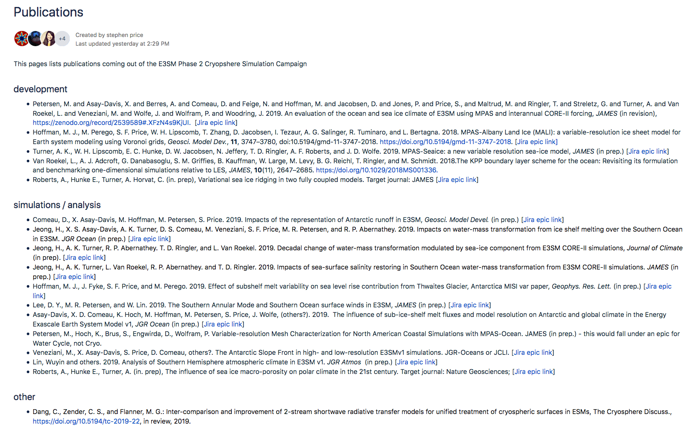
Publications

Slide 14
V2 Development
support for simulations with ice shelves (new compsets, cryosphere sim. campaign tag)
improved snow-on-sea ice model
support for icebergs *
RRM, S. Ocean enhanced mesh *
RRM, atmos. (over) S. Ocean mesh *
var. res. GM; along-isopycnal (Redi) mixing *
** More discussion on this topic in breakout this afternoon ***

Slide 15
Improved Snow-on-Sea Ice Model
Annual ice thickness with dynamic snow grain (3 layers) minus control (standard MPAS-seaice, 1 snow layer)
5 year, stand alone, CORE2 forced MPAS-Seaice
All snow mods use 3 layers
All appear to increase volume
wind redistribution effects are small (in these runs) and likely decrease volume
Sea ice is most sensitive to dynamic snow grain radius.
Snow grain aging is likely too weak in current run or fresh snow grain size too small.
Notes:
Increase snow layers from 1 to 3
Add wind redistribution of snow fall
3 options
All contribute to loss of snow to leads
Option “30%percentsw” also leads to snow packing and changes in shortwave absorption
Track both ice and water content of snow layers
Rainwater may be stored in the snow
Excess liquid water drains to melt-ponds
Currently no changes in ice-ocean fresh water fluxes
Dynamic Snow Grain Radius
Temperature gradient and meltwater Aging
Albedo is effected. *Several parameters still need tuning*

Slide 16
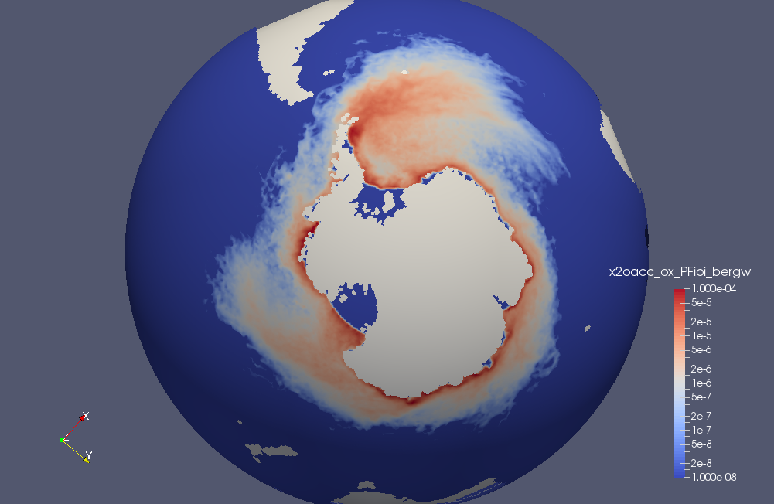
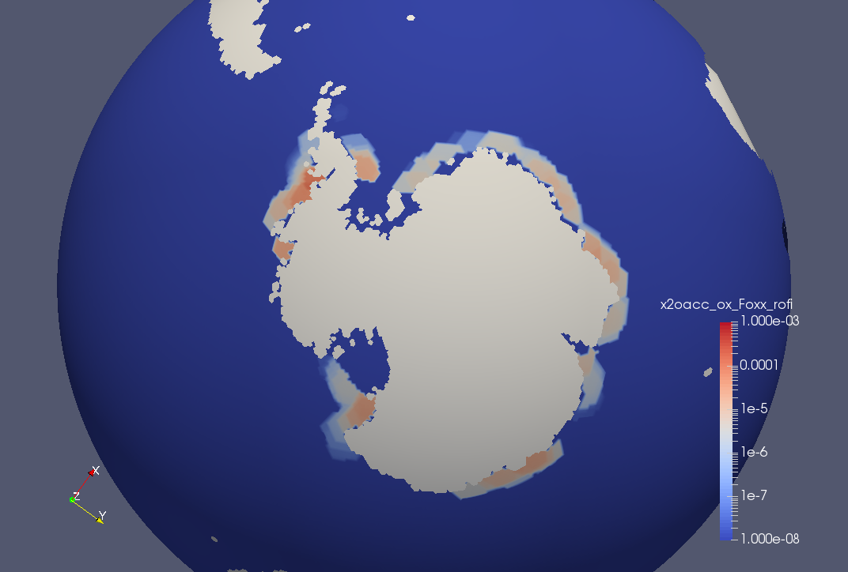
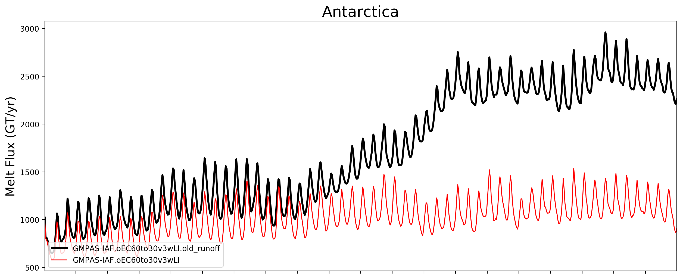
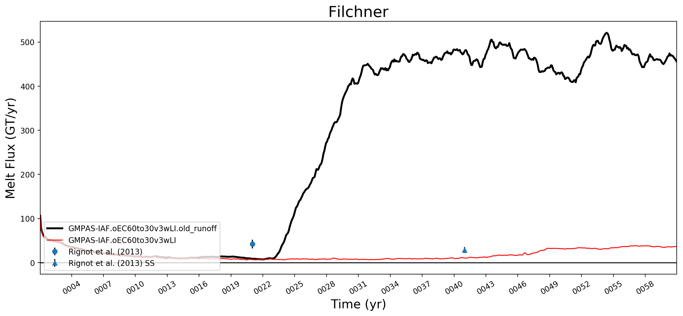
Improved Freshwater Flux via Icebergs
original forcing
improved forcing
Snapshots of solid ice runoff with data icebergs (left) and snowcapping scheme (right).
Addition of data icebergs (DIB) to replace data and snowcapping based solid runoff limits hyperactive circulation and melting under Antarctic ice shelves:
~3x reduction in overall Antarctic melt
>10x reduction beneath Filchner-Ronne
This demonstrates that modeled sub-ice shelf melt rates are highly sensitive to both fresh-water flux and regional ocean conditions.
Comeau, D. et al., 2019: Impacts of the representation of Antarctic runoff in E3SM, Geosci. Model Devel. (in prep.)
Notes:
This example sets us up for discussing warm ocean biases (next)

Slide 17
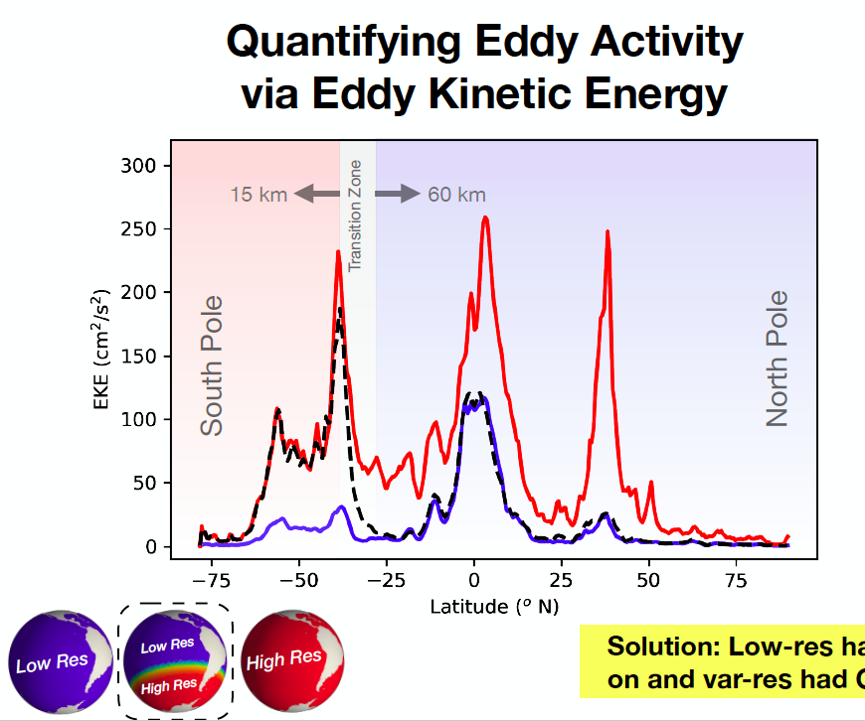
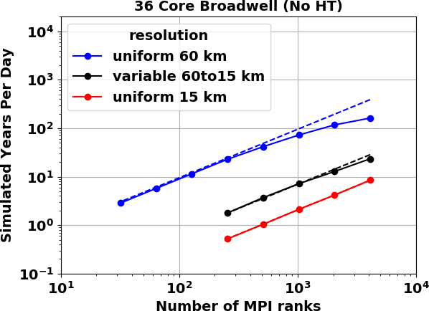
Enhanced Resolution S. Ocean Mesh
(Figures courtesy K. Rosa, LANL)

Slide 18
Beyond V2 Development
New sea ice ridging scheme
Sea ice altimetry emulator
Land ice / ocean coupling

Slide 19
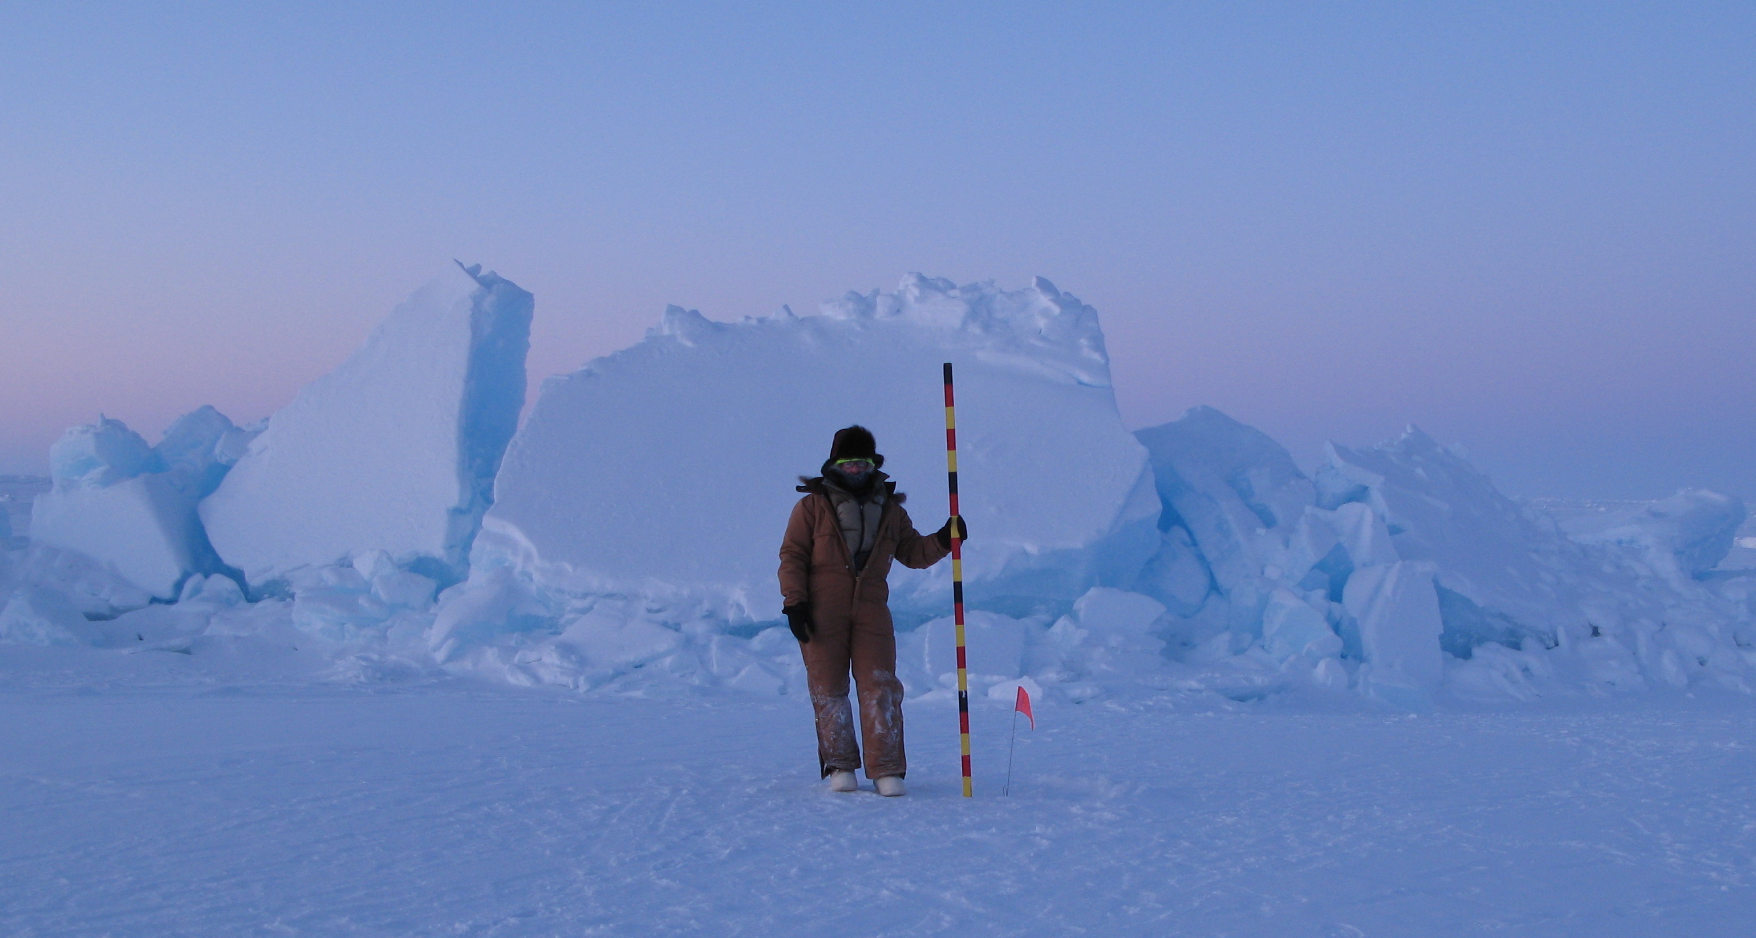
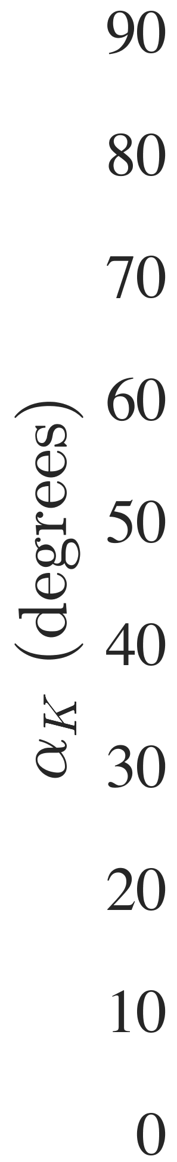
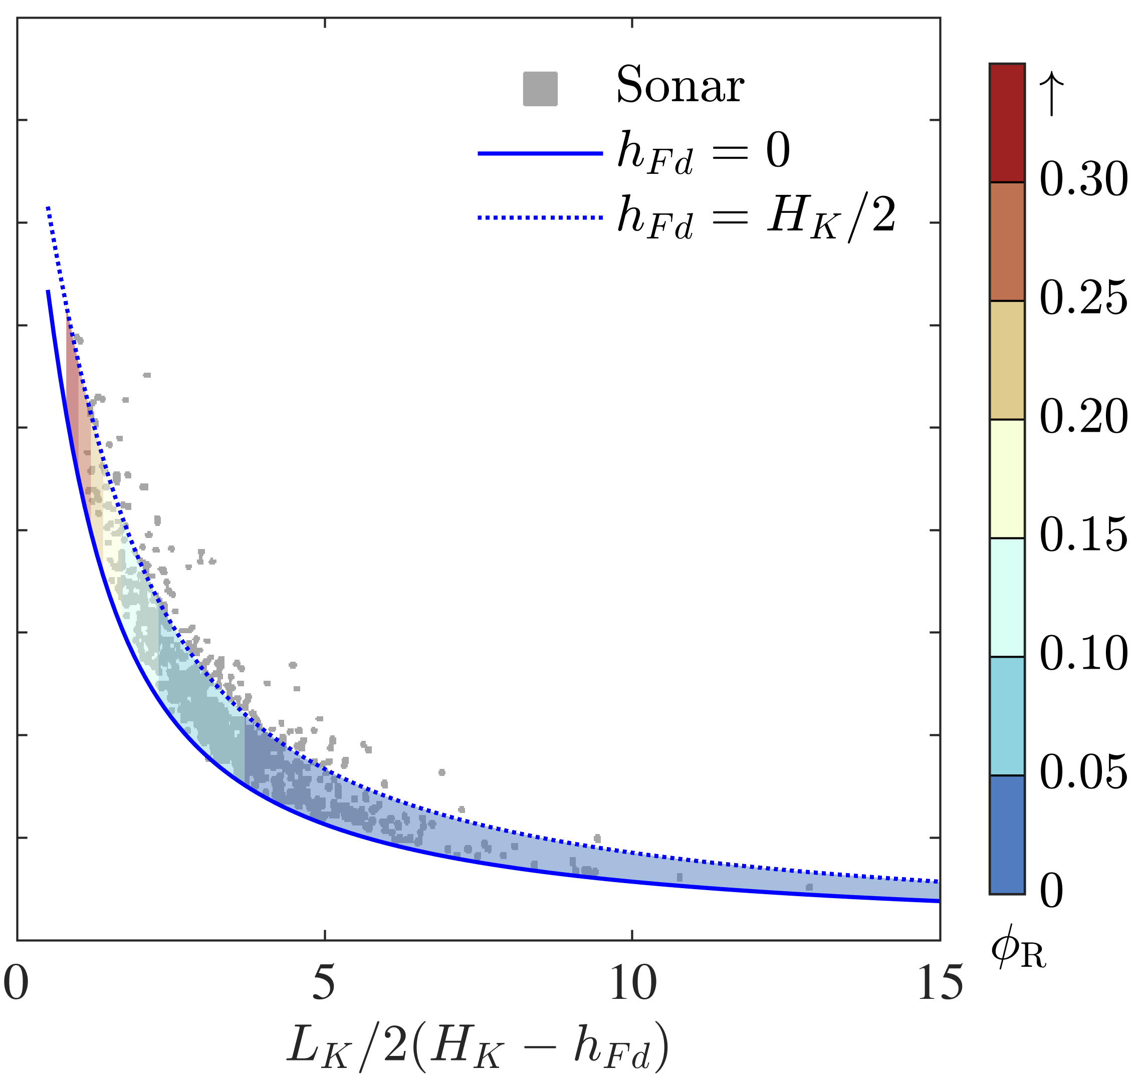
Improved Sea Ice Ridging Scheme
Fixing the problem of sea ice thickness redistribution and compressive strength,
with applications to form drag and land-fast ice
(Andrew Roberts, Adrian Turner, Elizabeth Hunke)
∇_{R} ∙ đ = 0
Derivation of key, missing field in sea ice models, the Dilation Field, đ, which is necessary for representing deformed sea ice in models, and requires ice thickness to be represented as a bi-variate distribution g(h, 𝟇), including macro-porosity, 𝟇, and representing spectrums of the strain 𝞊 and angle of repose 𝝰 of ridges.
Roberts, A. F. et al., 2019: A Variational Method for Sea Ice Ridging in Earth System Models, J. Adv. Model. Earth Sy., doi:10.1029/2018MS001395.
Roberts, A. F. et al., 2019: Variational sea ice ridging in two fully coupled models, JAMES (in prep.)
Notes:
A tick in the top lines represents instant pass of a submitted pull request after quality control. Quality Control in CICE exploits the high autocorrelation in sea ice thickness that is common across a range of sea ice models with very different configurations. The quality control method is computationally efficient, and is able to interrogate a large range of model configurations overnight. Results from this work has implications for the general detection of statistically-significant thickness changes in sea ice models, including building the satellite emulator discussed in a later slide.

Slide 20
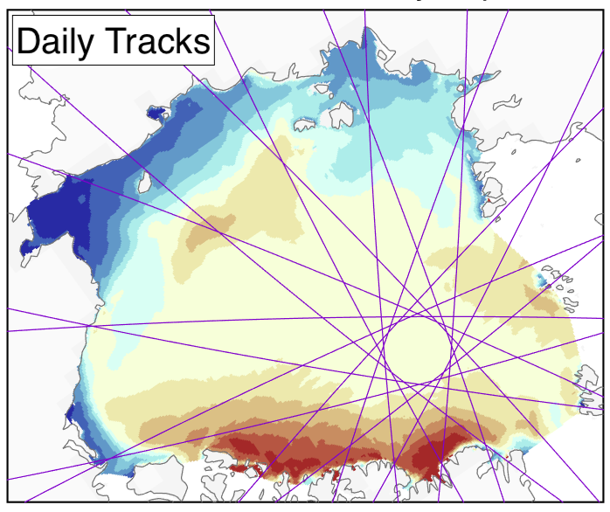
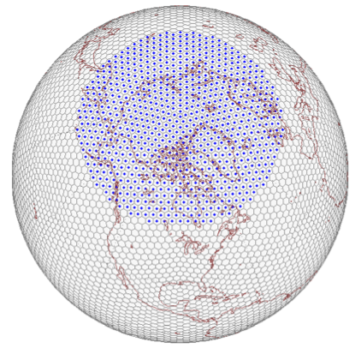
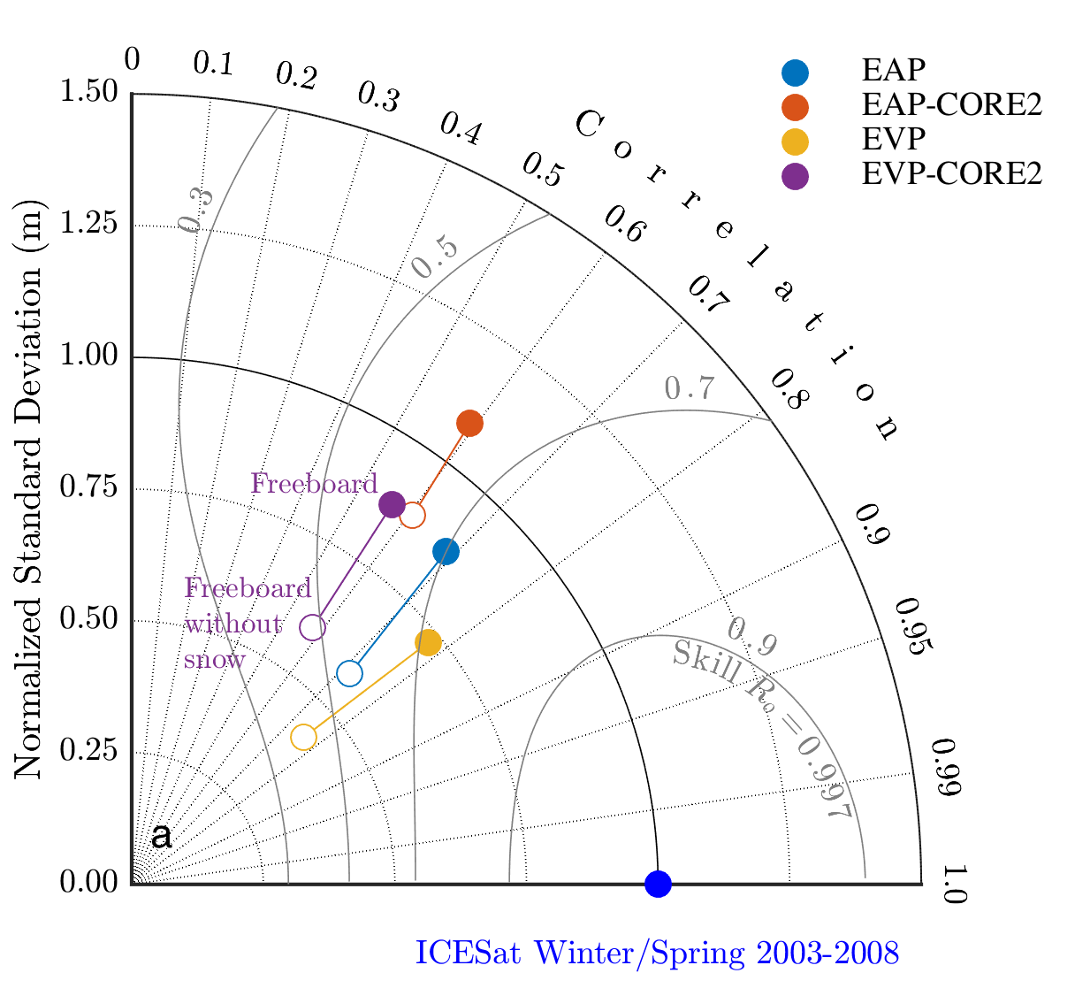
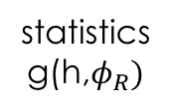
Sea Ice Satellite Emulator in E3SM
‘Flying’ an altimetric satellite through the model for more accurate and efficient assessment
(Andrew Roberts, Adrian Turner, Elizabeth Hunke)
Preprocessing
Runtime evaluation
grid
mapping
statistics
g(h,$φ_{R})$
Flight Path Through Model
ATL07
End result is a set of skill and bias scores from all simulations obtained in run-time, providing accurate, on-the-fly model analysis, including of ensemble spread, sea ice mass, and snow cover with confidence bounds.
Along-track freeboard from ICESat-2
Roberts, A., et al., 2019: … ?
Notes:
The satellite emulator results in an objective measure of sea ice mass, and allows evaluation of different model physics in CICE. This work is being applied in different incarnations in DEMSI, E3SM and RASM.
This is for the first satellite emulator paper to properly quantify ice and snow mass in the Arctic and Antarctic, and also to conduct a drift and deformation analysis on the model to investigate the thin ice bias in the Arctic Ocean. We are outputting hourly instantaneous sea ice (in recent re-do runs of DECK w/ high-freq output) to enable rigorous signal processing and comparison with freeboard tracks from ICESat.

Slide 21
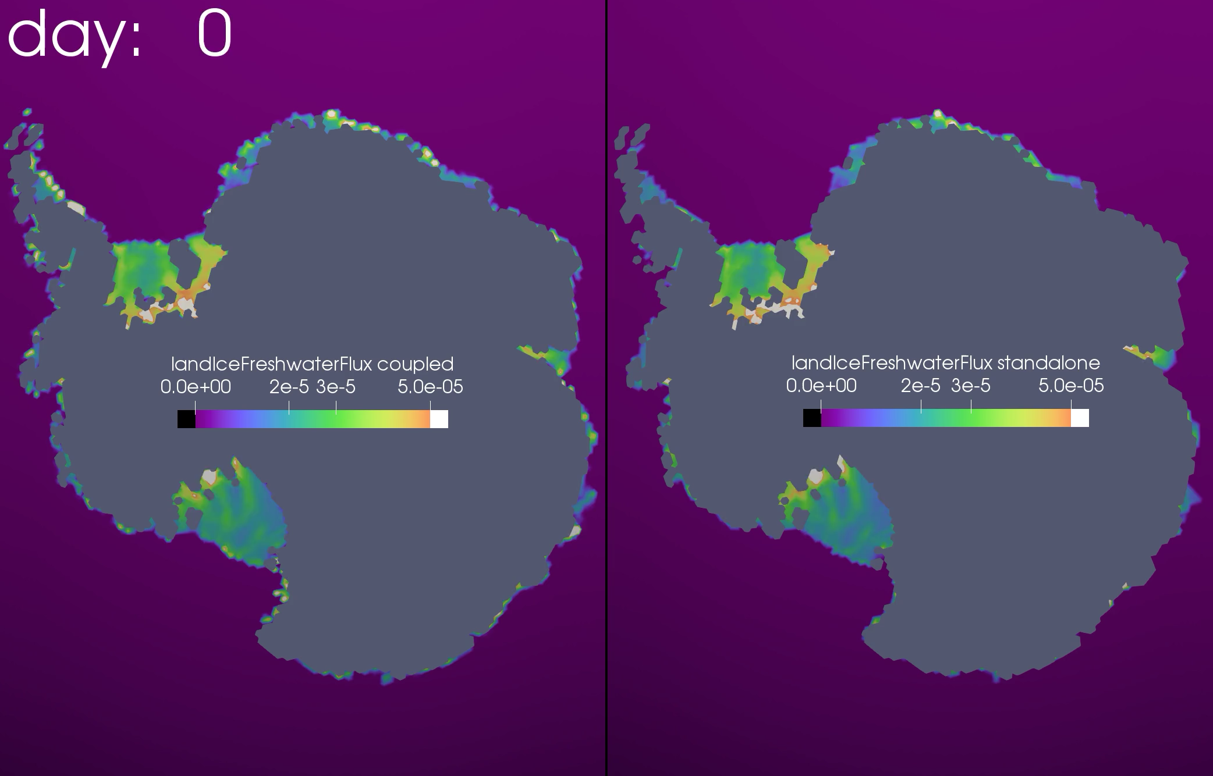
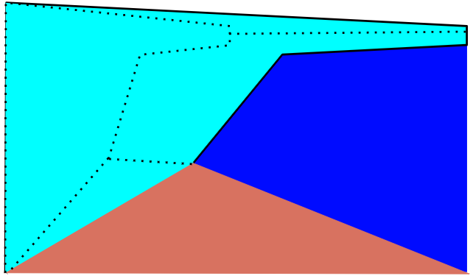
Antarctic Ice Sheet / Ocean Coupling*
Sub-ice-shelf melt fluxes
Currently calculated in MPAS-O
PR (#2726) to move calculation to coupler
  On OCN coupling interval, GLC grid
First step to active ice sheets
  Ice shelf geometry and temperature come from MALI (currently run in “static” mode)
Status:
  Implementation working and validated
  Awaiting PR code review
Subshelf Melt Flux
Calculated in E3SM CPL
Calculated in MPAS-O
Dynamic component footprints
Required for dynamic ice shelf calving front
Status: working on initial implementation and testing
* In collaboration with SciDAC ProSPect project

Slide 22
Simulation Analysis
Antarctic sub-ice shelf melt rates
B-case with ice shelf melt fluxes: impacts on global simulation quality
S. Hemisphere atmos. analysis (DECK)
SAM and ocean wind stress (DECK)
Antarctic Slope Front
Importance of improved S. Ocean freshwater flux
S. Ocean warm bias
Analysis of S. Ocean water mass transformation

Slide 23
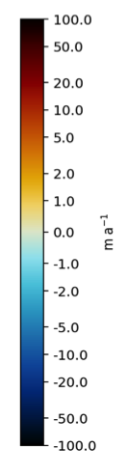
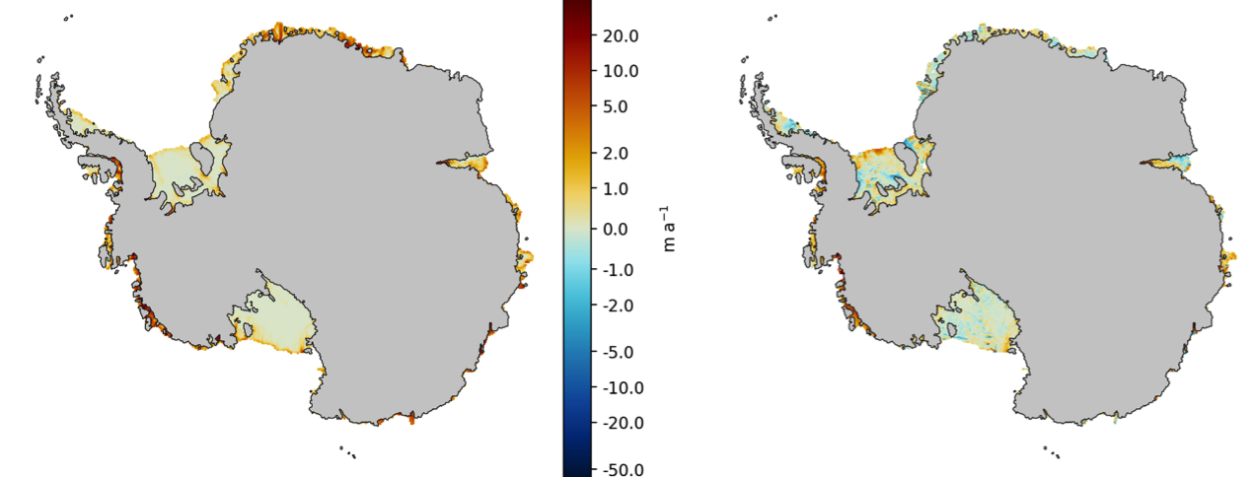
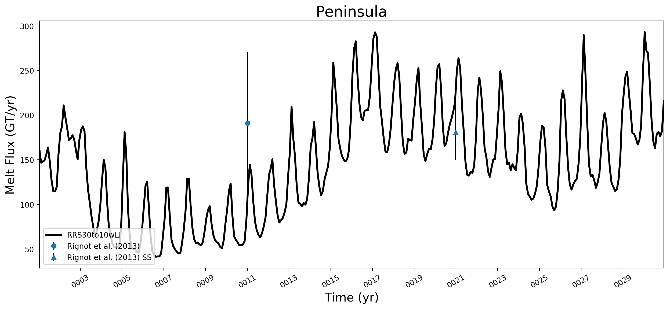
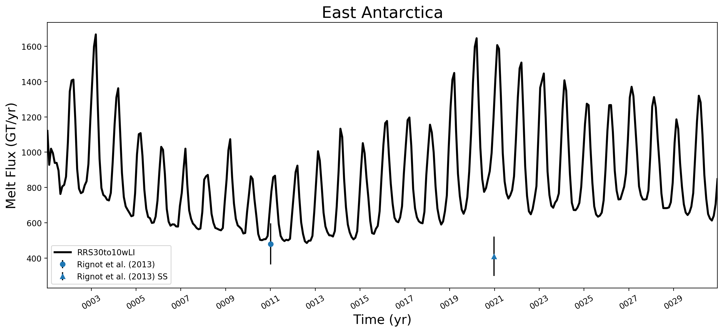
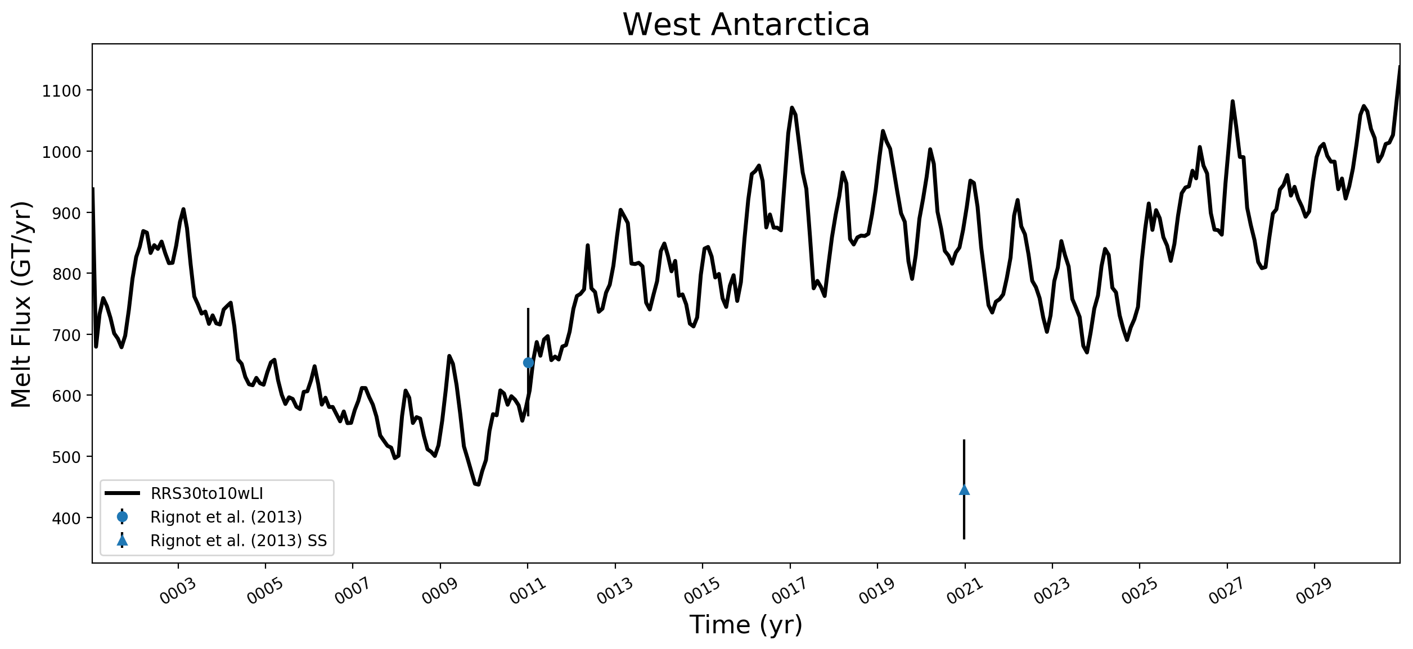
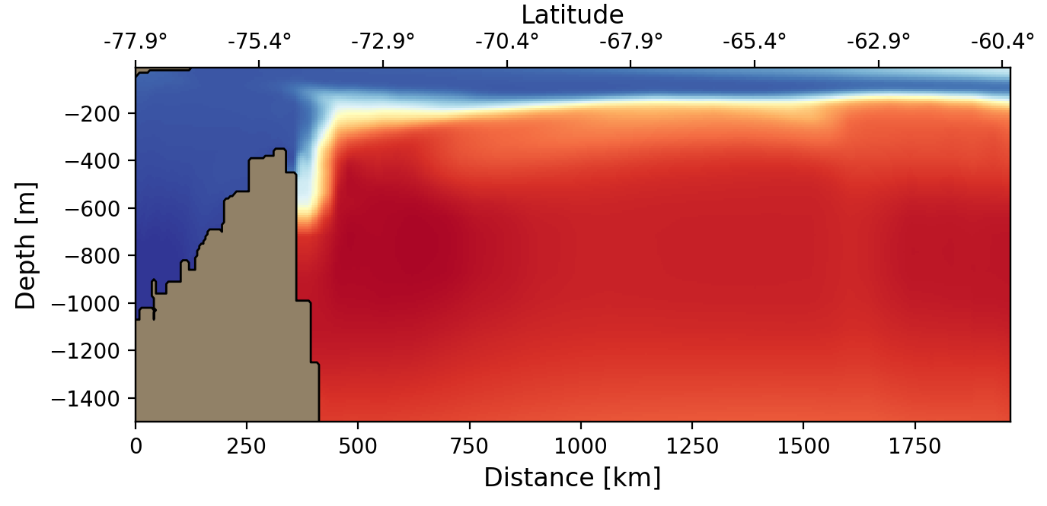
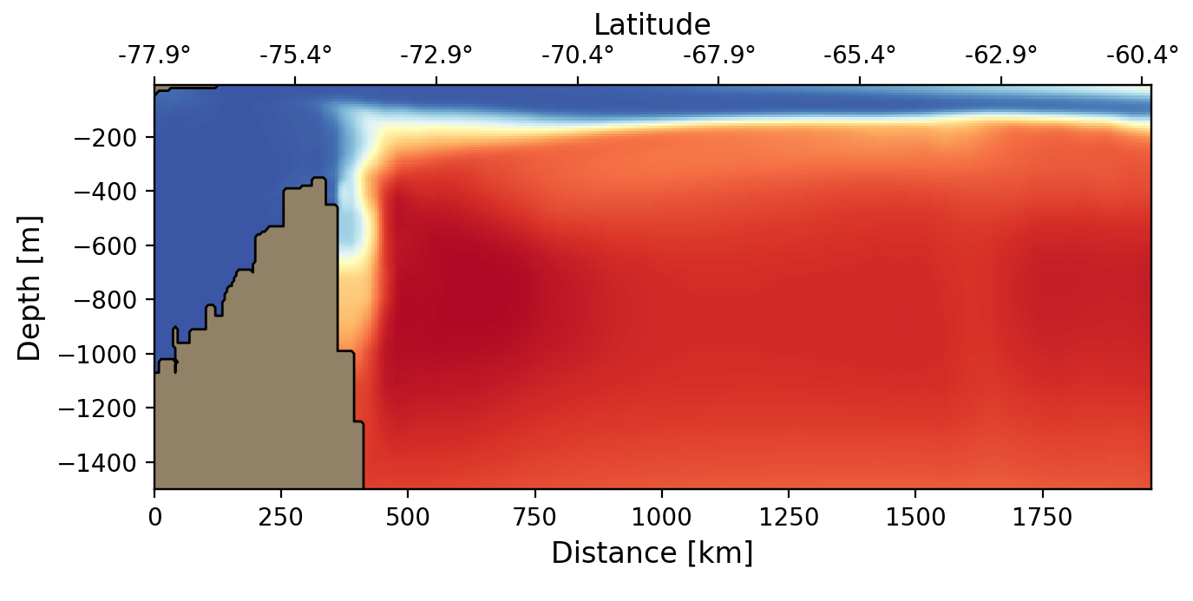
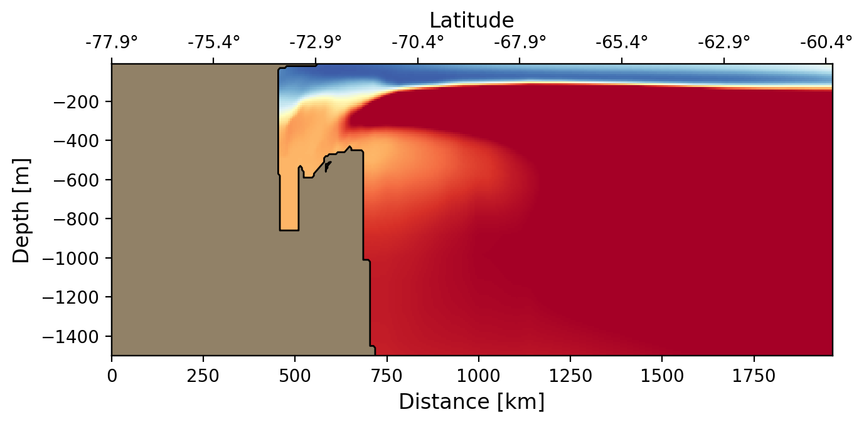
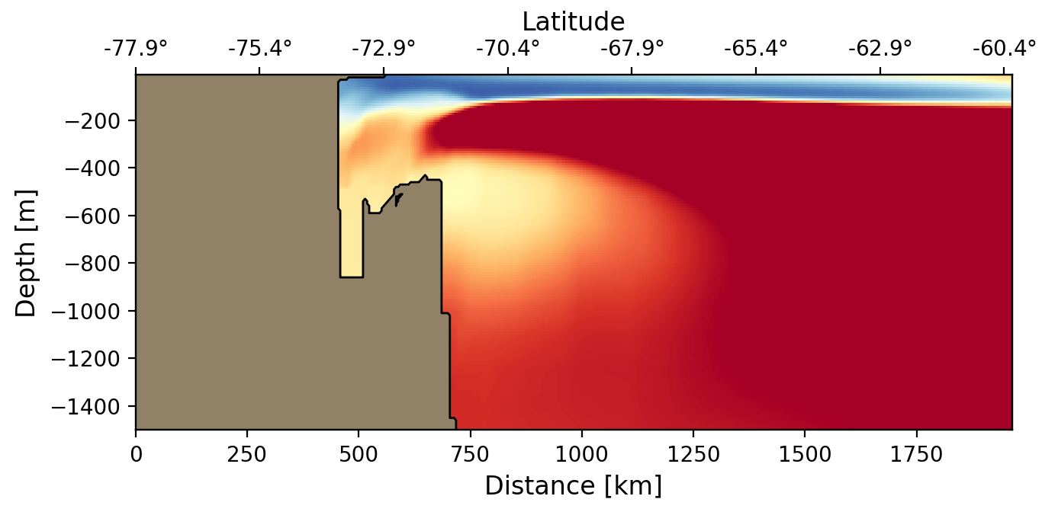
Ice Shelf Melt Rates: Model vs. Observations
Model
(med-res, CORE)
observations
(Rignot et al., 2012)
East Antarctica
Antarctic Peninsula
observations (Rignot et al., 2013)
Asay-Davis, X. et al., 2019: The influence of sub-ice-shelf melt fluxes and model resolution on Antarctic and global climate in the Exascale Earth System Model v1, JGR Ocean (in prep.)
observations + SS
low-res = EC60to30km
med-res = RRS30to10km
West Antarctica
Notes:
This is the broad brush summary of our effort – we care about the melt rates being delivered to ice shelves, we are doing approx. ok there already (With caveats discussed below)

Slide 24
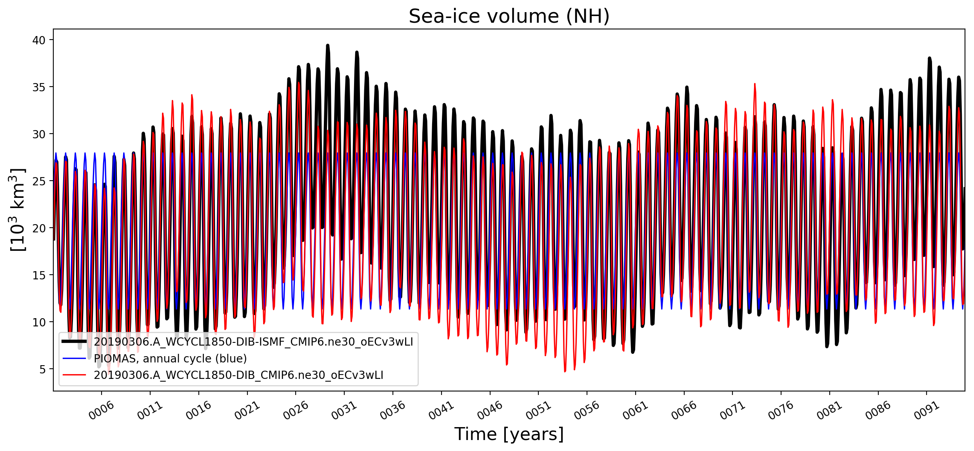
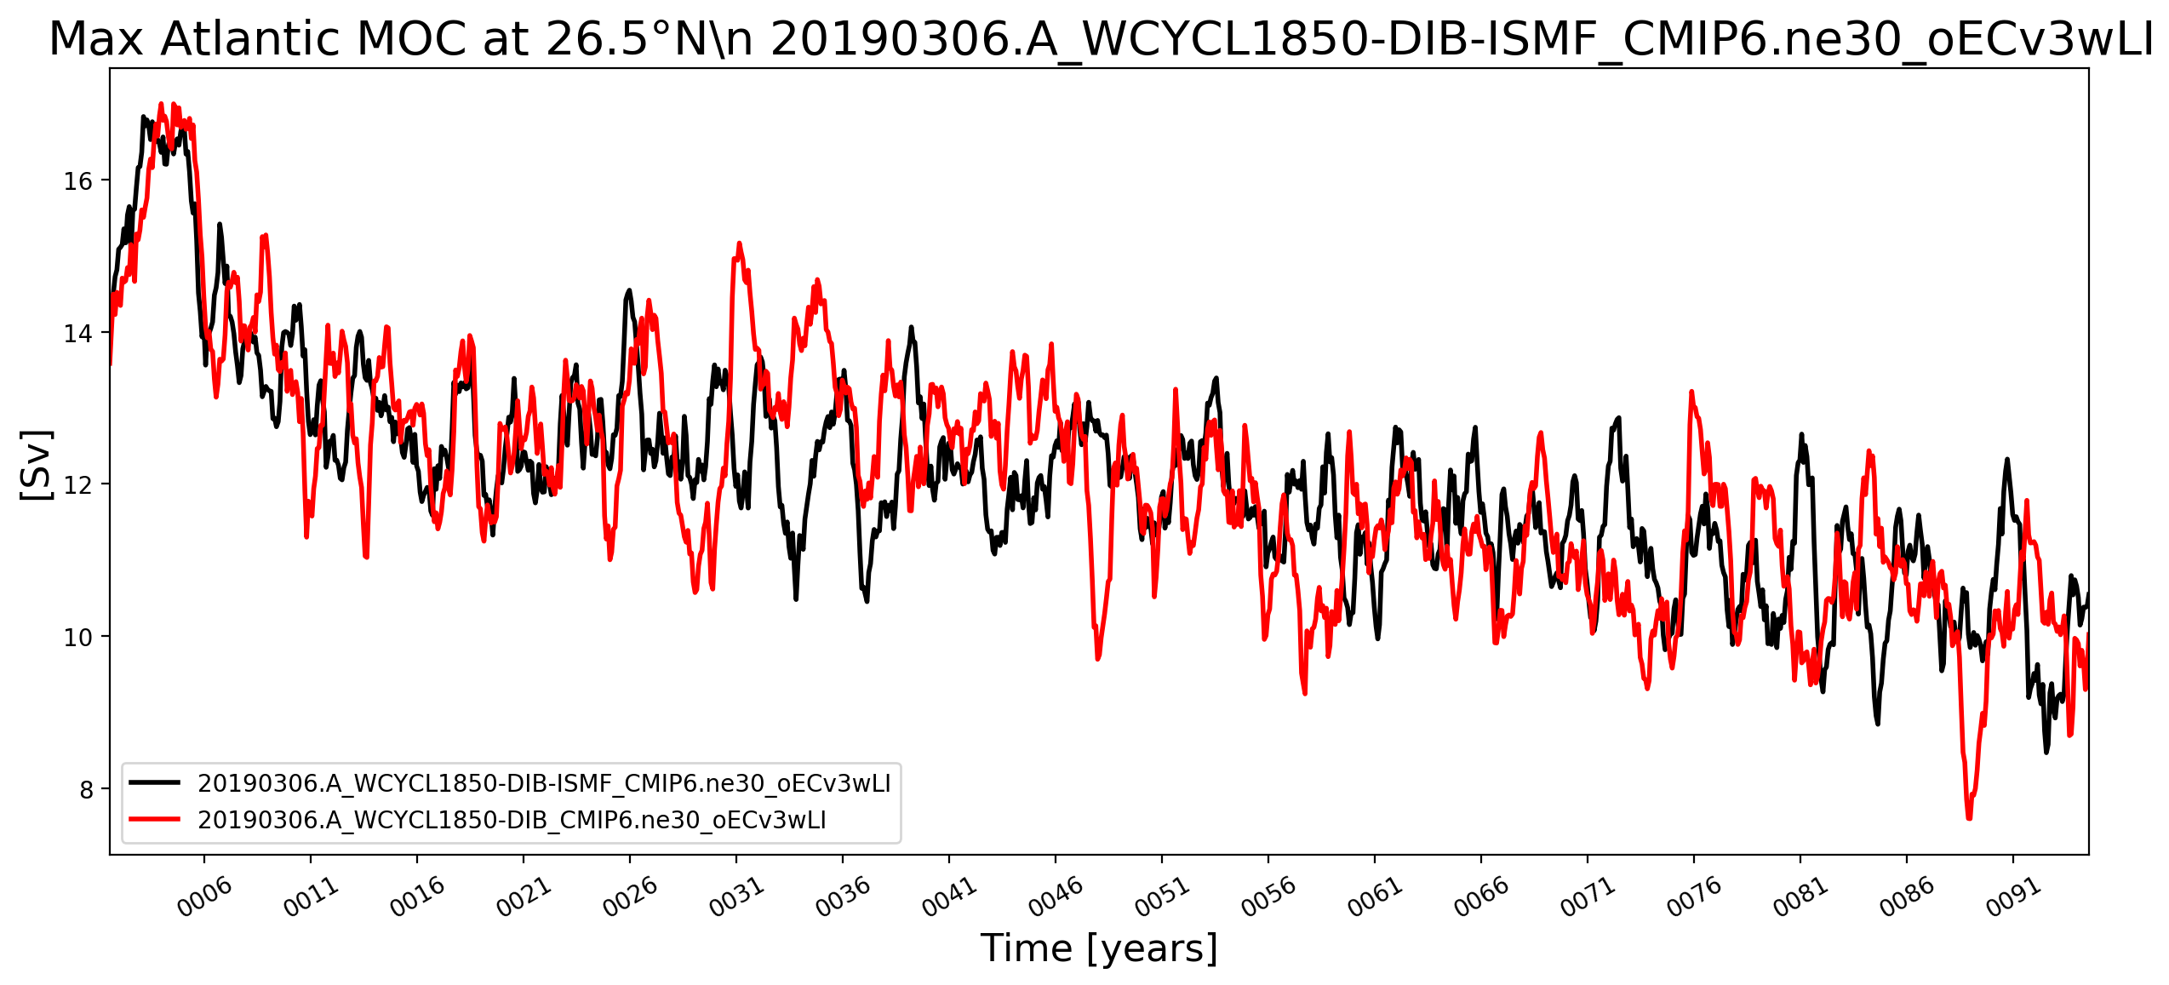
Low-res 1850 B-Case: Impact of ISMF
NH Sea Ice Volume
W.r.t. “do no harm” metric:
ISMF appear to introduce global variability on the order of an en-semble member
Longer integrations will be necessary to confirm this
MOC
ISMF
Control

Slide 25
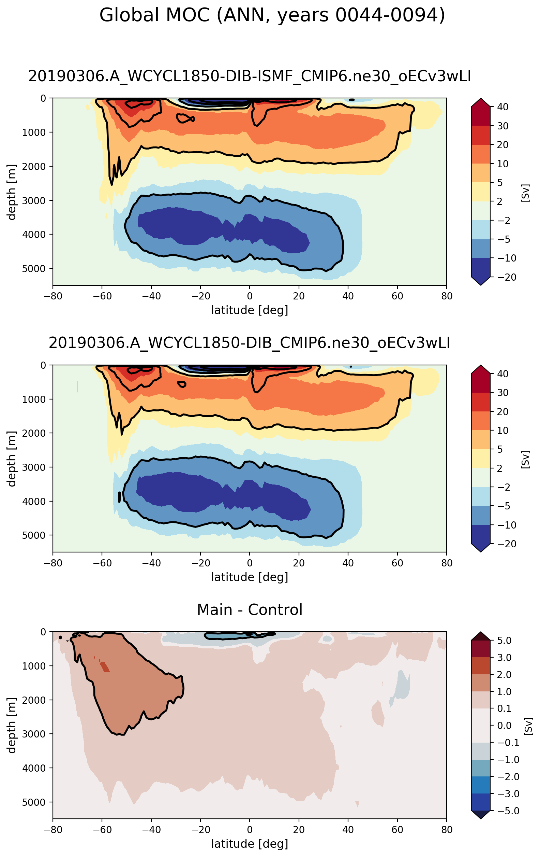
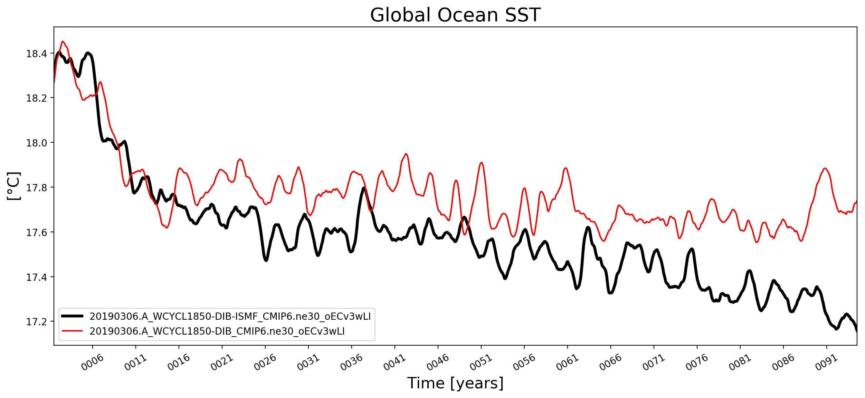
Low-res 1850 B-Case: Impact of ISMF
On the other hand …
Important regional differences in MOC
SSTs overall are ~0.1 - 0.4 C cooler
This difference is consistent with expectations (additional heat sink) and other recent work (Bronselaer et al., Nature, 564, 2018)
ISMF
Control
ISMF - Control
ISMF - Control

Slide 26
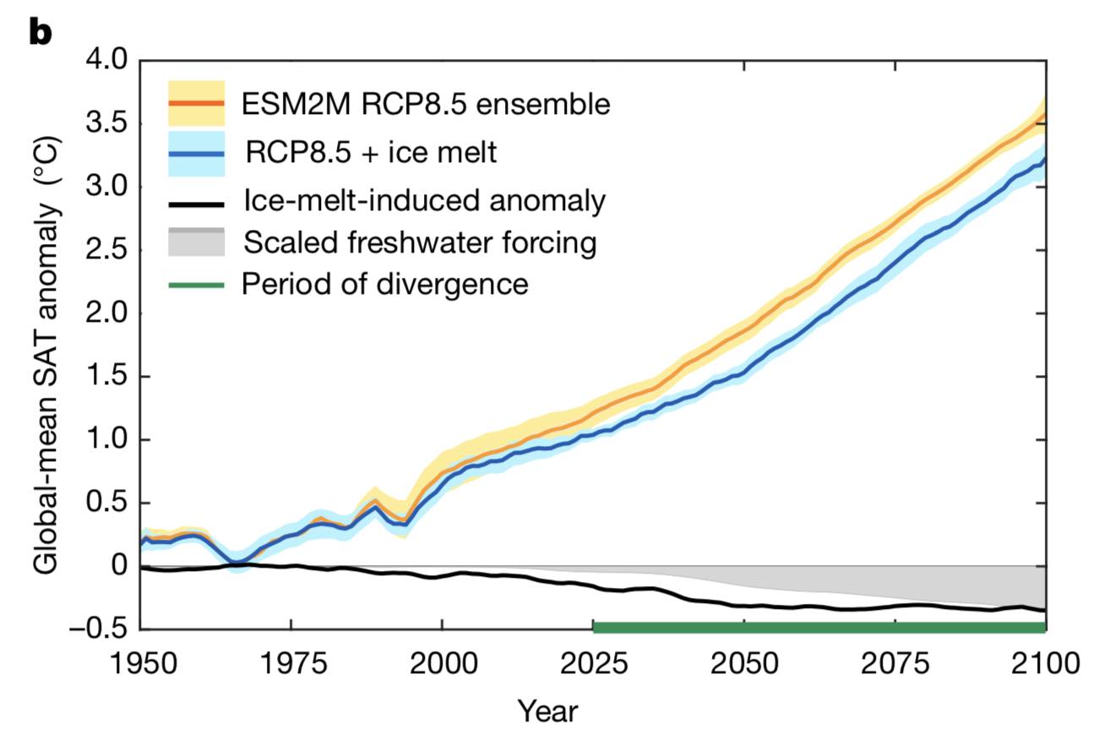
Low-res 1850 B-Case: Impact of ISMF
Bronselaer et al., Nature, 564, 2018
ISMF
Control
ISMF - Control

Slide 27
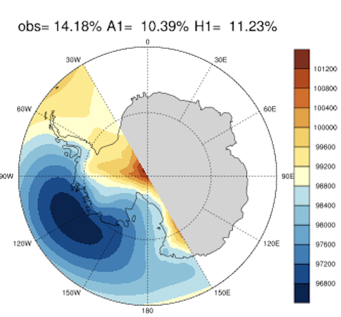
Antarctica & S. Ocean Atmos. Analysis
W
DECK v1 AMIP and Historical Ensembles
Objectives:
assess E3SM v1 performance on simulating surface energy and mass fluxes
characterize biases from cloud to synoptic and planetary scales
process-oriented investigation and tuning for bias improvement
Synoptic Regimes Net Heating Net Radiation Net CRE Cloud IWP biases
E3SM reproduces leading synoptic regimes at reason-able frequencies
Ensemble AMIP and coupled simulations capture the general pattern of surface mass balance and net heat fluxes
Substantial biases exist, attributable to discrepancies in large-scale environment, turbulent fluxes and cloud properties
Lin, W. et al., 2019: Analysis of Southern Hemisphere atmospheric climate in E3SM v1. JGR Atmos (in prep.)
Notes:
Figures as illustration only to show the scope of the analysis. Synoptic regimes for JJA, The rest are biases (model – obs) surface heating, cloud effect and cloud forcings for ANN AMIP ensemble. Biases are organized, and contrast between the continent and the surrounding oceans standing out.

Slide 28
S. Hemis. Climate Variability (DECK)
SAM index
SH surface zonal wind stress
Annual mean SAM index (gray bars) and 5-yr running means (lines) defined as the corresponding time series of the 1st EOF mode. Annual-mean trends (circles) are shown at the right panel (circles). Shaded areas and error bars are the 95% confidence intervals about the E3SM-HIST (top) and E3SM-AMIP (bottom) ensemble means.
Climatological position (top) and strength (bottom) of the Southern Ocean annual mean surface wind stress versus latitude (lines) and their zonal mean (circles). Shaded areas and error bars represent the 95% confidence intervals about the E3SM-HIST (red) and E3SM-AMIP (blue) ensemble means
Li, D.Y. et al., 2019: The Southern Annular Mode and Southern Ocean surface winds in E3SM, JAMES (in prep.)

Slide 29
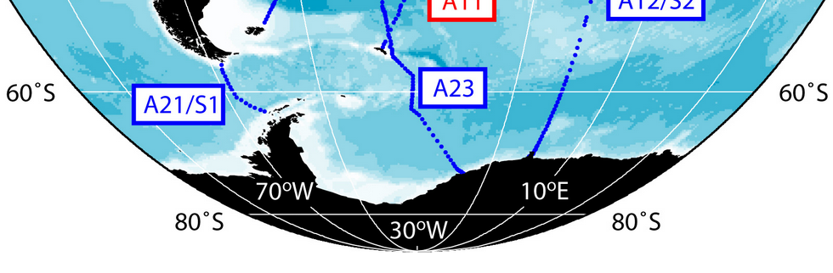
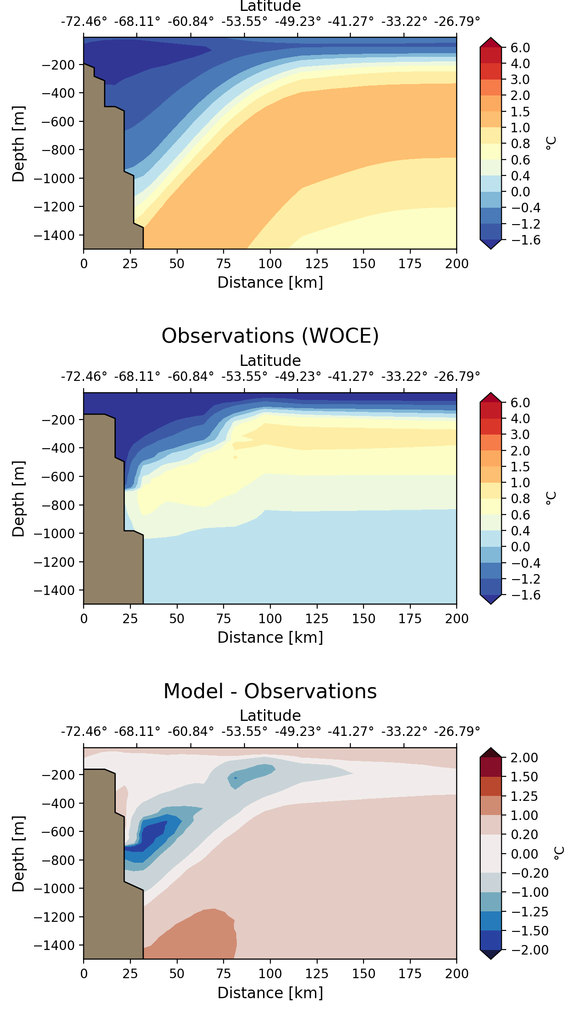
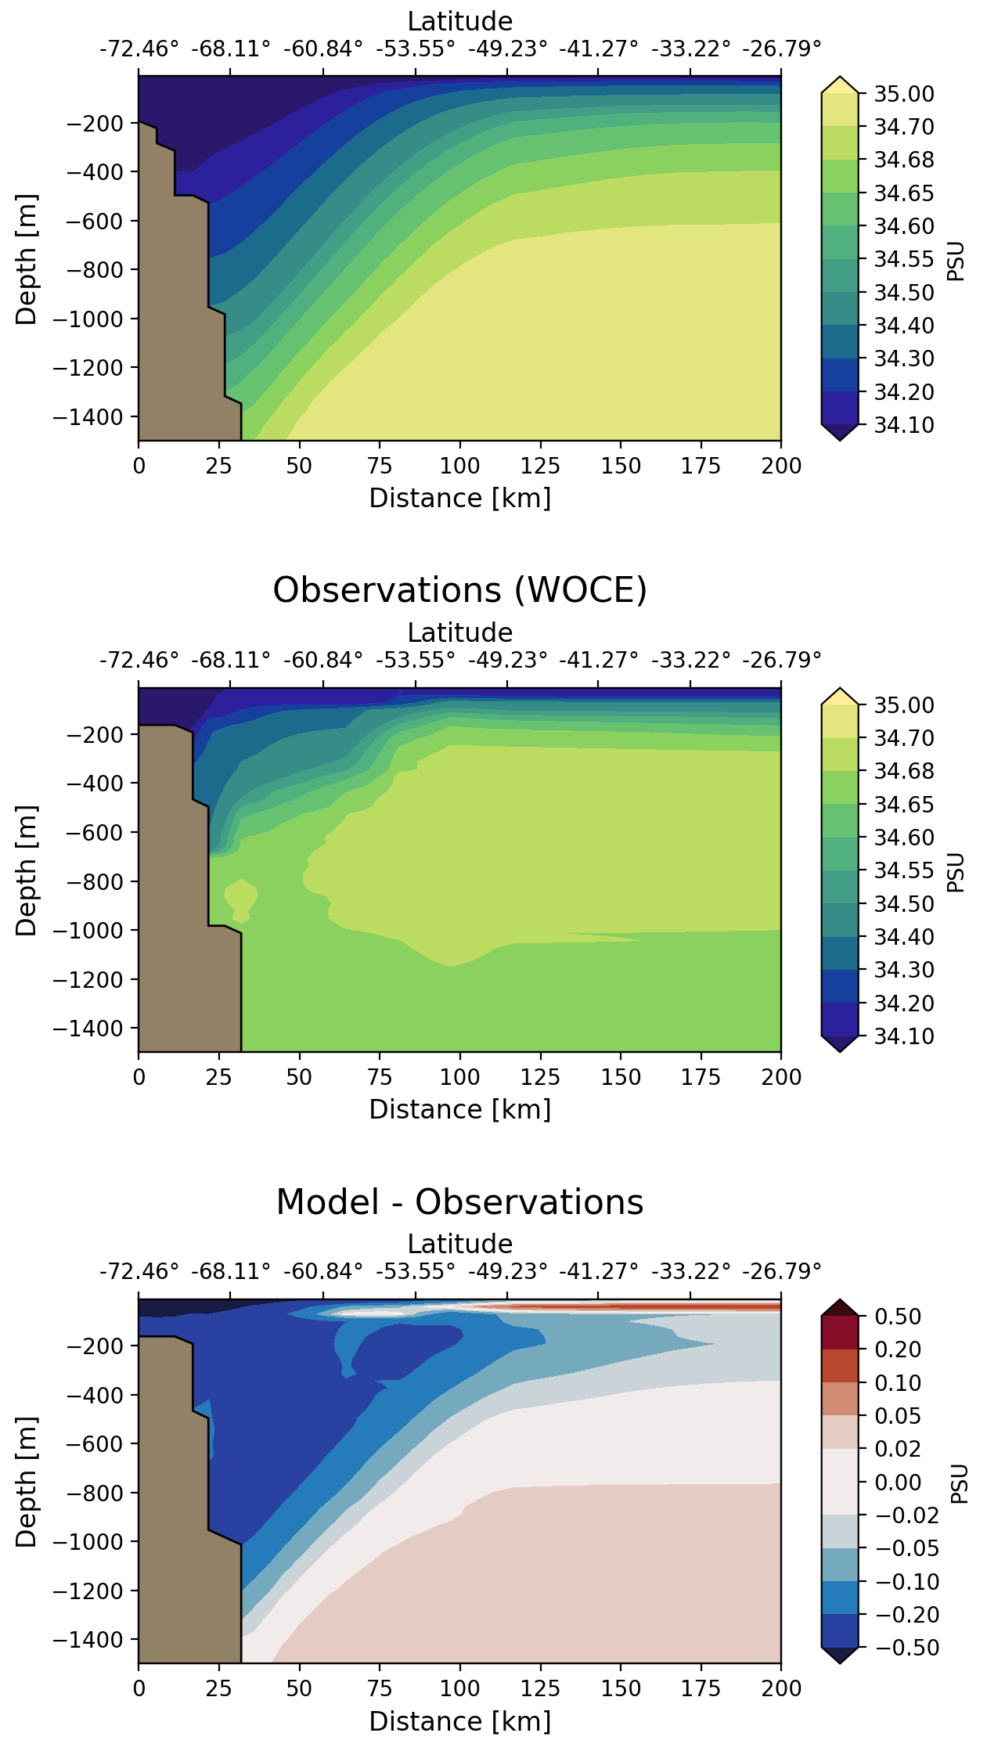
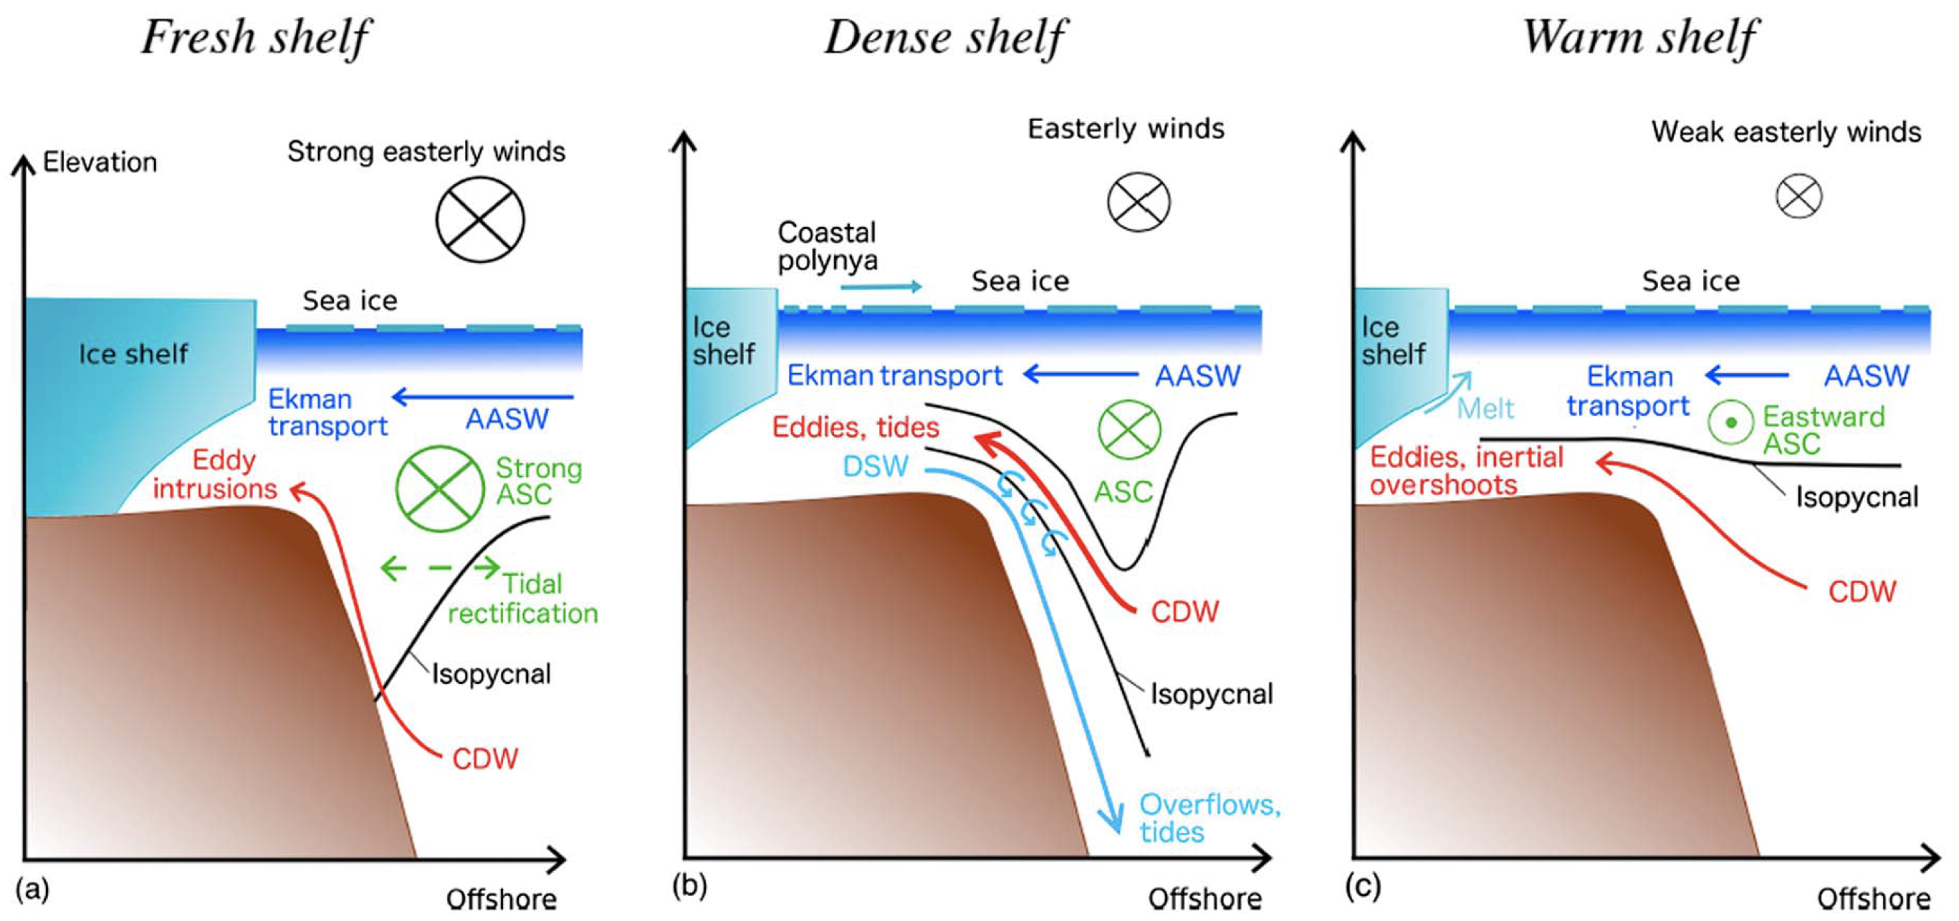
Antarctic Slope Front (ASF) in E3SM
The ASF, found around Antarctica where the continental slope meets the shelf break, is an important regulator of cross-shelf transport
Example of fresh shelf
E3SMv1 HR simulation
Annual climatologies over years 16-55
WOCE transect A23 (Weddell Sea)
Its intensity varies, resulting in three broad regimes: the fresh shelf (strong ASF), the dense shelf (weak ASF), and the warm shelf (no ASF)
In E3SM: ASF is too weak at low-res and too strong at hi-res; dense water for-mation is under-represented for both
Temperature
Model
Salinity
Model
from Thompson et al 2018
Veneziani, M. et al., 2019: The Antarctic Slope Front in high- and low-resolution E3SMv1 simulations, JGR-Oceans (in prep.)
Notes:
> - ASF is weak and under-resolved in all low-res. simulations, with consequent biases for fresh, warm, and dense shelves
I’d say it’s very weak (at best).
>
> - ASF is better represented at high-res: relatively too strong for fresh and warm shelves, dense water formation absent, likely due to … [lack of ventilation? stratification too strong? weak vert. mixing? Other?]
I’d say it’s ‘reasonably well represented for fresh shelves, relatively too strong for warm and dense shelves, likely due to shelf water biases whose origin needs to be investigated further (fresh water biases and possibly impact of winds).’
I would not say that 'dense water formation is absent', as we really don’t know that for sure. And in some cases I’m pretty sure we do have dense water formation (maybe not as much).

Slide 30
Improved S. Hemis. Freshwater Flux
original forcing
improved forcing
Snapshots of solid ice runoff with data icebergs (left) and snowcapping scheme (right).
Addition of data icebergs (DIB) to replace data and snowcapping based solid runoff limits hyperactive circulation and melting under Antarctic ice shelves:
~3x reduction in overall Antarctic melt
>10x reduction beneath Filchner-Ronne
This demonstrates that modeled sub-ice shelf melt rates are highly sensitive to both fresh-water flux and regional ocean conditions.
Comeau, D. et al., 2019: Impacts of the representation of Antarctic runoff in E3SM, Geosci. Model Devel. (in prep.)
Notes:
This example sets us up for discussing warm ocean biases (next)

Slide 31
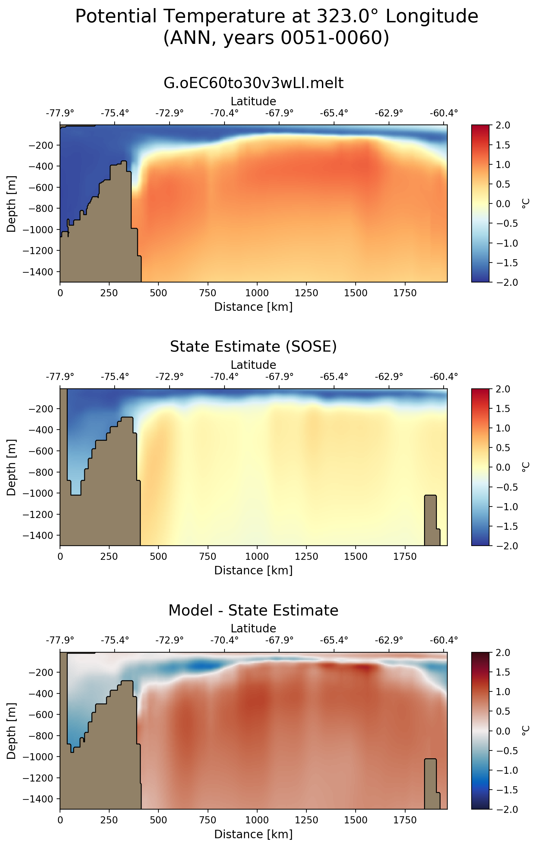
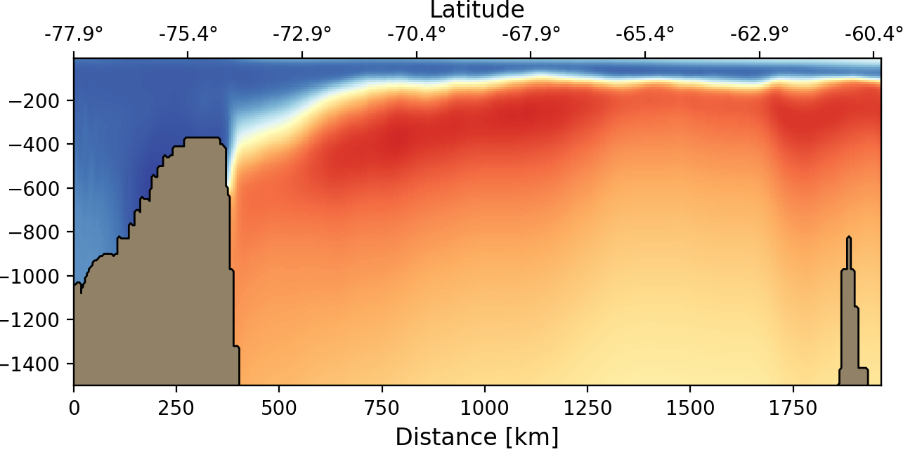
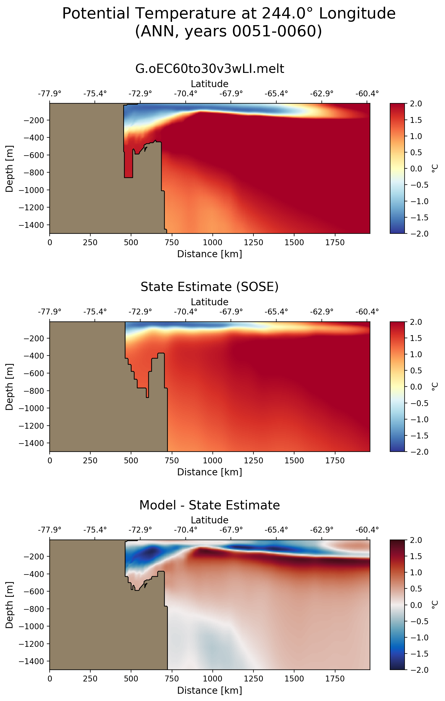
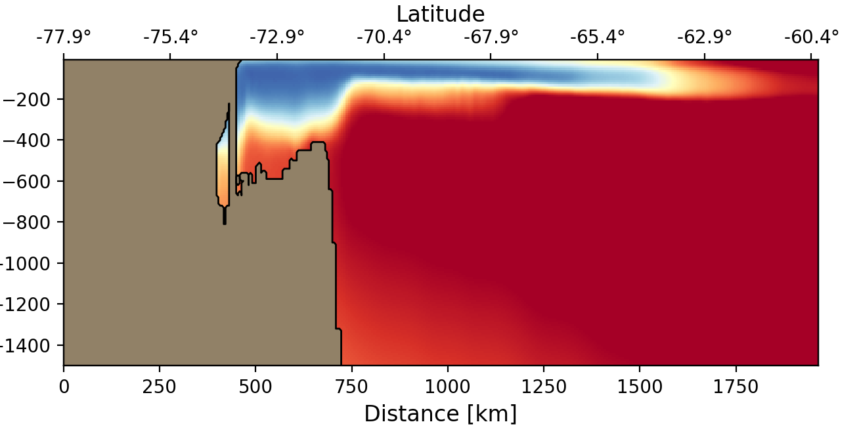
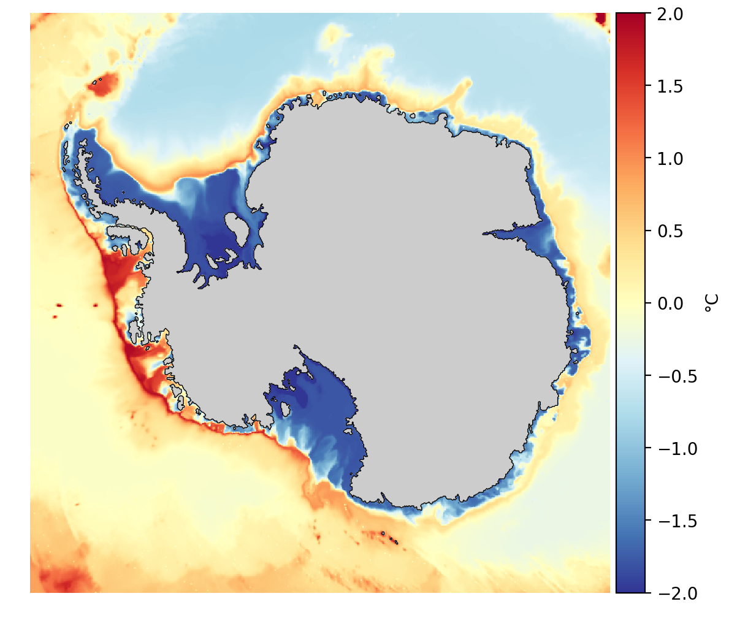
Ice Shelf Melt Rates: Ocean Warm Biases
Ocean Temperature from CORE-forced (G) simulations
Low Res.
Med. Res.
SOSE
Weddell Sea
Amundsen Sea
Weddell
Sea
Ocean temperatures and model resolution:
relatively too warm at depth
relatively too cold at the surface
not dependent on low- vs. med- res.
Amundsen
Sea
Asay-Davis, X. et al., 2019: The influence of sub-ice-shelf melt fluxes and model resolution on Antarctic and global climate in the Exascale Earth System Model v1, JGR Ocean (in prep.)
Notes:
T,S biases similar in sign / magnitude at low- and med-res
Top: Potential temperature sections from years 51-60 in the Weddell and Amundsen seas taken from 30-km (left) and 10-km (right) simulations with prescribed atmospheric forcing (low and mid res G). Temperature biases are at least as pronounced at mid resolution.
Left: Seafloor temperature from Mid Res G simulation with melt fluxes. Transect locations from Figs. 4-6 are shown.The Amundsen and Weddell Seas are regions of particular interest for present and future ice-shelf melting.

Slide 32
S. Ocean Water Mass Transformation
ISMF: more sea-ice freezing (red) and melting (blue)
ISMF: thicker sea-ice (left) and less melting (right) near Antarctica, thinner sea ice and more melting off shore from Antarctica
ISMF: surface freshening, increased stratification, depressed isopycnals
The addition of ISMF changes Southern Ocean stratification, convection, and overturning both directly and through its impacts on the rates and locations of of sea ice formation and melting
Jeong, H., et al., 2019: Impacts on water-mass transformation from ice shelf melting over the Southern Ocean in E3SM. JGR Ocean (in prep.)
Jeong, H., et al., 2019: Decadal change of water-mass transformation modulated by sea-ice component from E3SM CORE-II simulations, Journal of Climate (in prep).
Jeong, H., et al., 2019: Impacts of sea-surface salinity restoring in Southern Ocean water-mass transformation from E3SM CORE-II simulations. JAMES (in prep.)
Notes:
This is one way we are working to better understand where the biases come from

Slide 33
Summary
Simulation campaign is ~0.5-1 quarter behind
Largely from “stop-work” to fix model short-comings (S. Ocean freshwater flux from Ant.) that caused significant, negative impacts on simulation quality
Fixes = new model devel. = E3SM-unique capability to be part of v2 (including significant new support for cryo. sim. configs)
We are largely on track to complete Q1 simulations by end of Q2
Other new development for v2 will be fairly limited (but >0)
Significant v1 biases could limit our ability to reach v1 science goals
Progress being made on characterizing & understanding these biases

