Slide 1
Thoughts about adopting some CMDV-MCS work for NGD in cloud and convection
Jiwen Fan, PNNL
A new PDF vertical overlap treatment for CLUBB-SILHS
Implement P3 that allows for convective microphysics into ZM cumulus scheme
Evaluation approaches for comparing with high-resolution observations in MCS, cloud, and precipitation
The MCS tracking approach at ¼ degree (25 km)
Comparison with GPM and NEXRAD
RRM ¼ CONUS grid testbed
4. Newly developed observational datasets

Slide 2

1. A new PDF vertical overlap treatment for CLUBB-SILHS
Developed a new parameterizations for correlation of distributions of microphysical variables at different levels
Problems:
PDF correlations between
levels depend on layer
separation, but correlation
length scale z₀ is
the SAME FOR ALL variables
$$σ_{φ}\sim \overline{φ}$$
Correlation
Began working with the E3SM code to implement the new overlap treatment
Linear and power-law functions (correlation coefficient ~0.8)
Ovchinnikov, M., S. Giangrande, V. E. Larson, A. Protat, and C. R. Williams, 2019: Dependence of vertical alignment of cloud and precipitation properties on their effective fall speeds, JGR, doi:10.1029/2018JD029346.

Slide 3
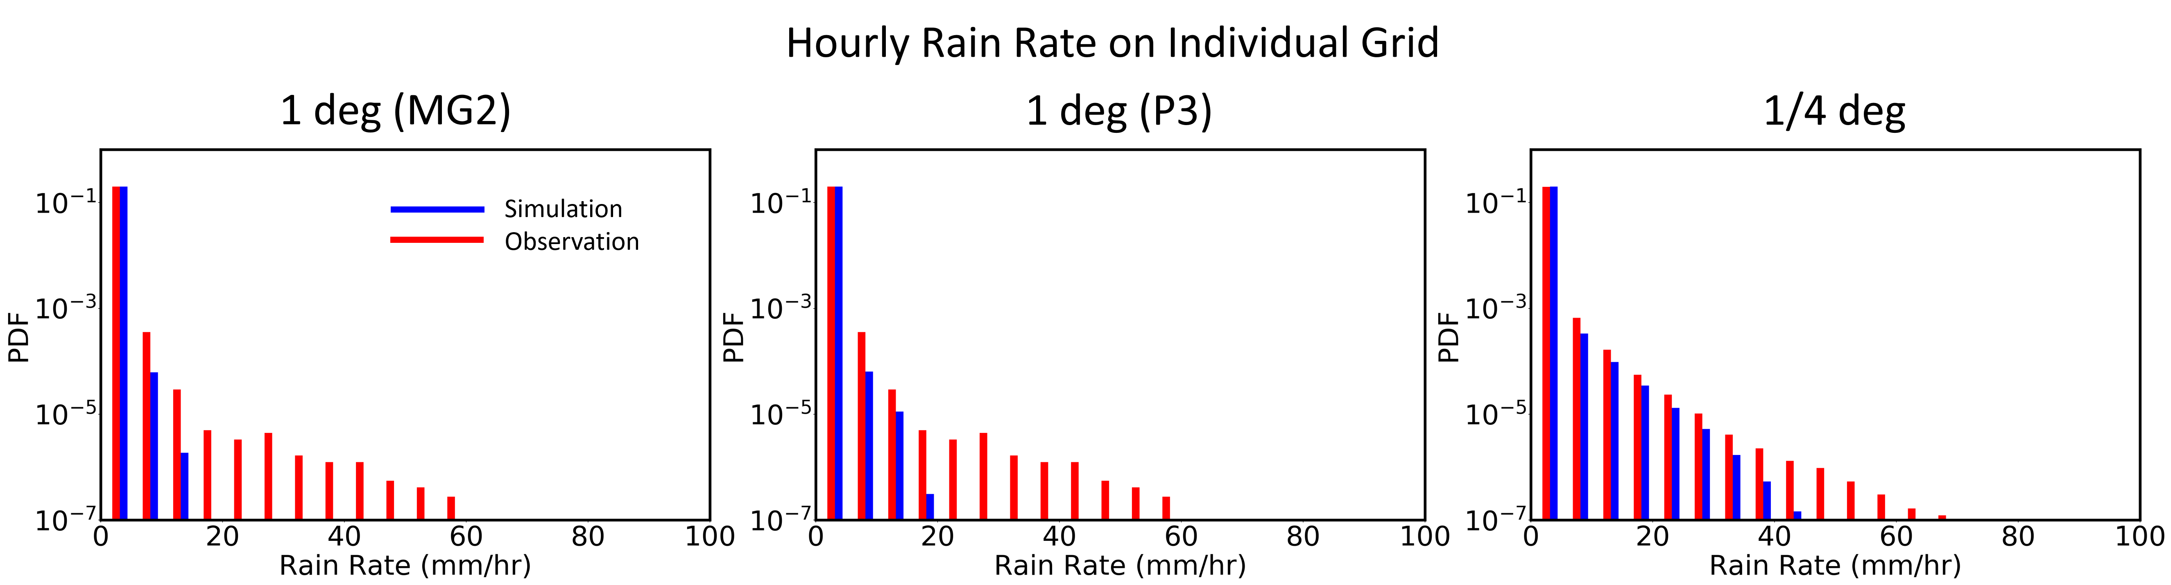
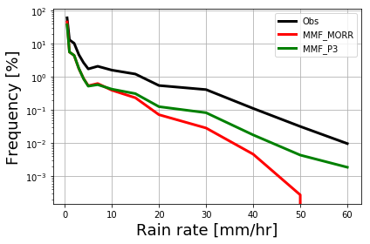
2. Implement P3 into ZM cumulus scheme
E3SM-P3 at 1 degree
MG2
P3
Rain rate PDF (CONUS; Apr-Aug, 2011)
MMF-P3 (2 deg host grid and 4-km CRM)
Rain rate PDF (SGP area; May 2011)

Slide 4
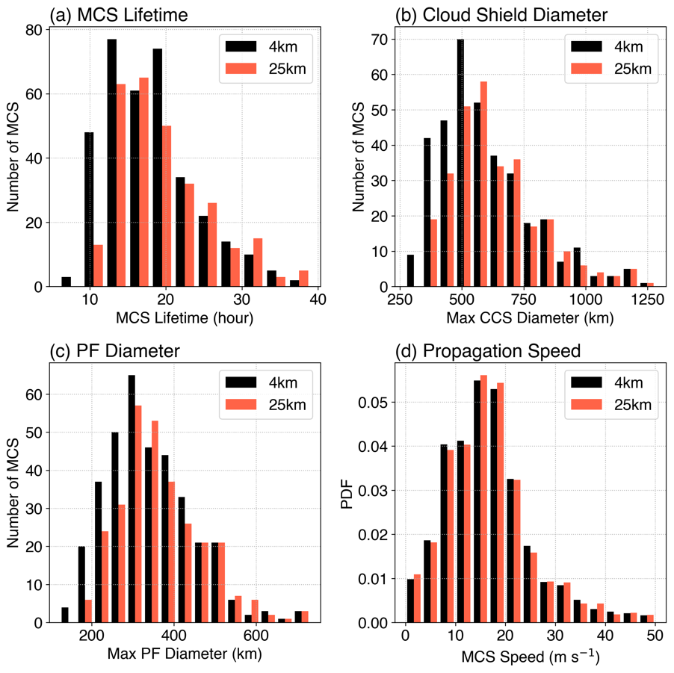
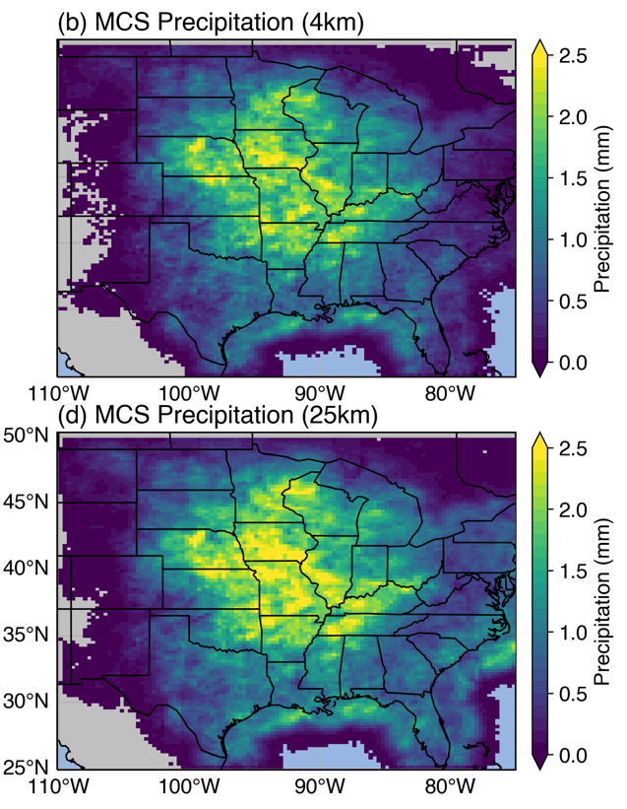

3. Evaluation approaches for comparing with high-resolution observations
The MCS tracking algorithm at ¼ degree (25 km)
FLEXTRKR (Feng et al. 2018): uses infrared brightness temperature (OLR) and precipitation only, both are commonly provided in global model outputs
The method is able to track MCSs identified by 4-km resolution satellite and radar data, and the MCS statistics agree well between the two sets of tracking
4-km Tracking
25-km Tracking
Mean MCS precipitation during warm seasons
MCS statistics comparison between two sets of trackings

Slide 5
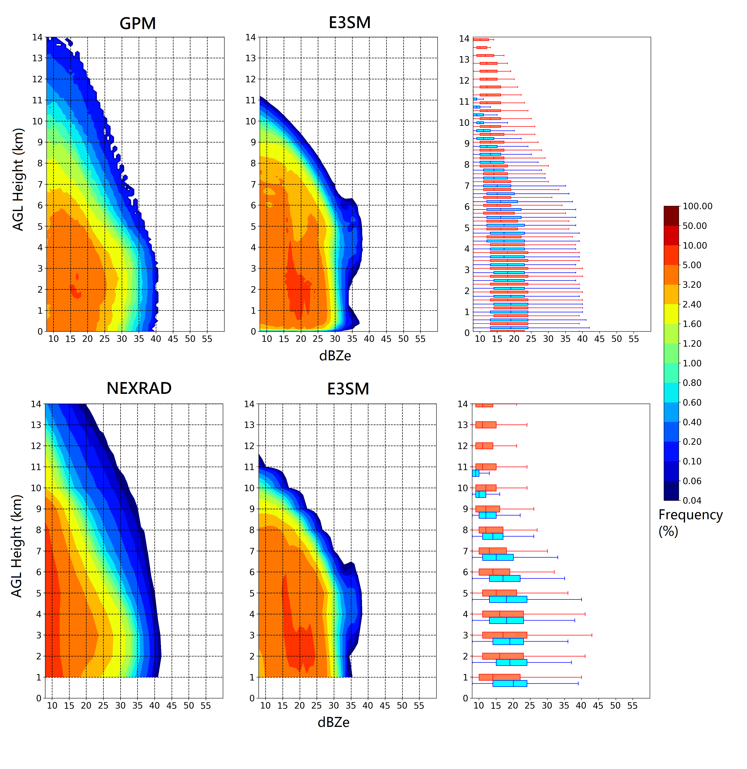
Uses of GPM and NEXRAD for evaluation
Evaluated E3SM 1-deg for warm seasons in 2014-2016 with GPM and NEXRAD measurements (example processing: vertical smoothing, sub-column sampling, and update COSP radar simulator)

Slide 6
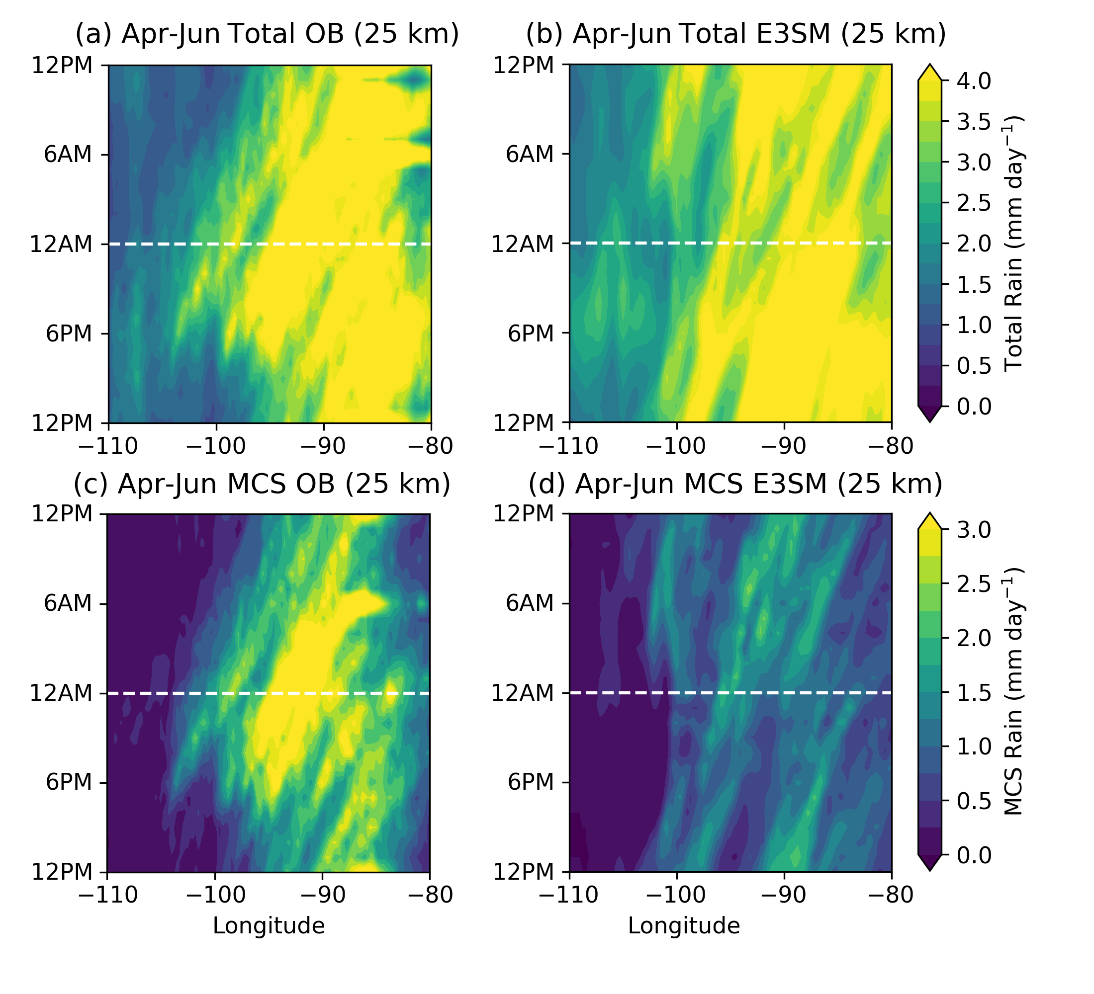
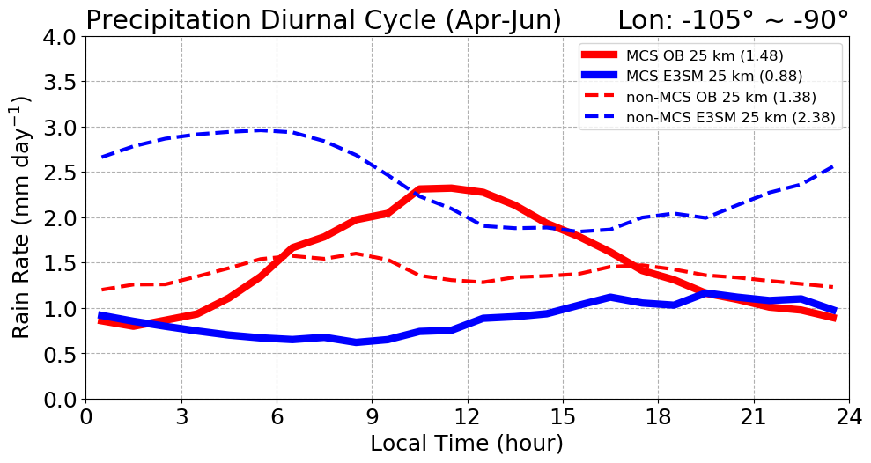
RRM ¼ CONUS grid testbed
Rain rate PDF (CONUS; Apr-Aug, 2011)
Total and MCS rain rates during spring 2011 (Apr-Jun)
OBS
RRM 1/4
1-deg
All
RRM 1/4
MCS
RRM ¼-deg improves rain rate PDF significantly.
RRM ¼-deg still greatly underestimates the MCS precipitation in spring, and fails to correctly simulate the diurnal pattern.
RRM ¼-deg overestimates non-MCS precipitation, but the phase of the diurnal is similar to OBS.
Diurnal variation over the SGP region

Slide 7
4. Newly developed observational datasets for cloud and precipitation
Processed ARM/NASA disdrometer data during MC3E (Joe)
High-resolution precipitation rate (every a few minutes) and hydrometeor(Joe) identifications from ARM polarimetric radar retrieved data
Vertical velocity retrieval from RWP (at least 5 yrs) and scanning radar (Die, Scott)
13 years of 3-D MCS database from NEXRAD east of the Rocky Mountains (Zhe)
Global MCS database from GPM measurements (Jingyu, Jiwen, Bob).
Processed 1-yr of IWP/IWC retrievals from NEXRAD over the CONUS (Jingjing, Xiquan)
All these data have been used in our E3SM or WRF evaluations under CMDV-MCS.

