Slide 1
North American Grid:
Feedback sought from
YOU
to finalize shape

Slide 2
North American Grid:
Insights from CONUS

Slide 3
North American Grid:
Insights from CONUS
Higher resolution topography impacts climate and convective systems

Slide 4
North American Grid: Insights from CONUS
Process-based studies of convective storms and diurnal cycle of precipitation:
  Minghaui Zhang, Xue Zheng and Shaocheng Xie (LLNL), Wuyin Lin (BNL): Using ARM data and 3DVAR Analysis to Understand Precipitation and Large-Scale Circulation Bias in E3SM Simulations during MC3E
  Zhe Feng, Guangxing Lin, Jiwen Fan (PNNL) for seasonal MCS triggering and propagation
Climate-related studies of CONUS region
  Qi Tang and coauthors for Regionally refined capability in E3SM Atmosphere Model Version 1 (EAMv1) and applications for high-resolution modelling
Tang et al (submitted)

Slide 5
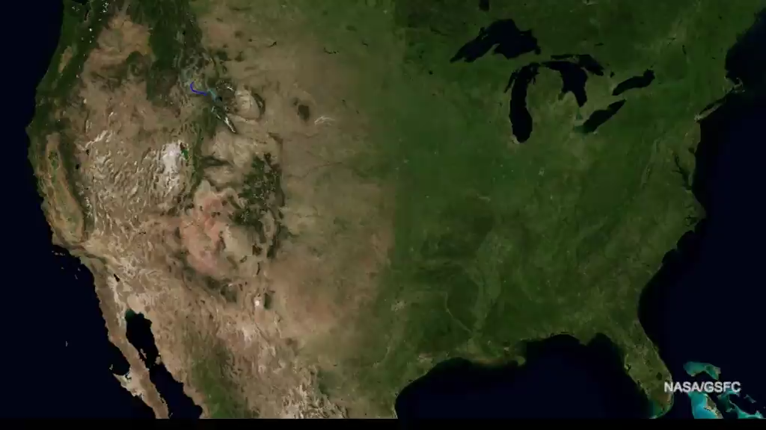
North American Grid:
Motivating Factors
Captures contribution of North American rivers to water cycle of United States

Slide 6
North American Grid:
Motivating Factors
Gain upstream Storm Tracks for Landfalling Tropical Cyclones
  Gulf of Mexico
  Western North Atlantic
  Benefits moisture transport to central and eastern US (important for warm season precipitation east of Rockies
North American Monsoon including Gulf of California & Sierra Madre
Hypothesis: Increased resolution over Canadian Rockies will steer polar jet stream and impact precipitation in Northeastern U.S.

Slide 7
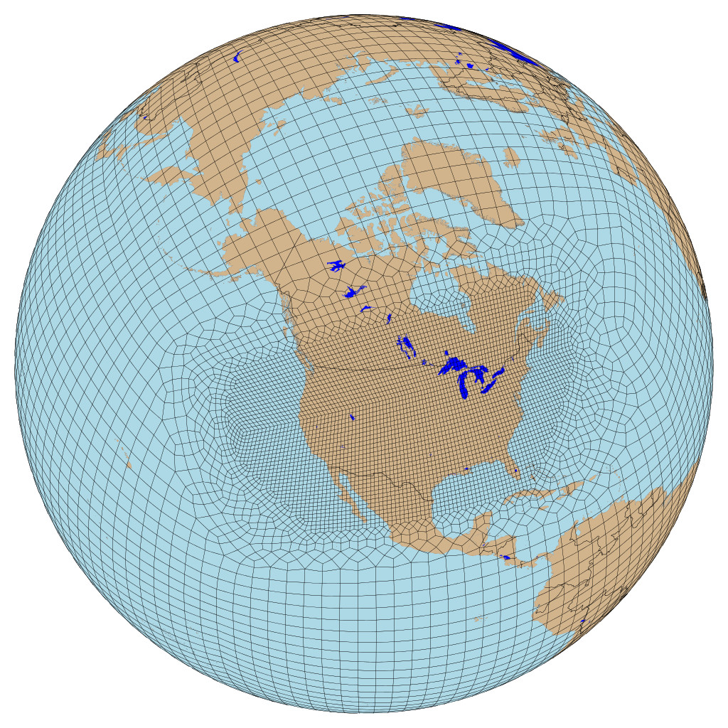
Proposed North America grid
Encompasses CONUS domain
Can be used to further study topography, fresh water flow, and high latitude processes on continental climate
Total number of elements: ~14,000
  Elements in 1-degree: 5,400
  Elements in 1/4-degree: 86,400
  Elements in CONUS: 9,905

Slide 8
What biases might be improved by moving the high resolution region North? (Wuyin Lin)
DECKv1b_HIST_ENS - Low Res
B1950hi_noCNT_Y26to55-obs - HiRes

Slide 9
What biases might be improved by moving the high resolution region North? (Wuyin Lin)
DECKv1b_HIST_ENS - Low Res
B1950hi_noCNT_Y26to55-obs - HiRes

Slide 10
What biases might be improved by moving the high resolution region North? (Wuyin Lin)
DECKv1b_HIST_ENS - Low Res
B1950hi_noCNT_Y26to55-obs - HiRes

Slide 11
What biases might be improved by moving the high resolution region North? (Wuyin Lin)
DECKv1b_HIST_ENS - Low Res
B1950hi_noCNT_Y26to55-obs - HiRes

Slide 12
What biases might be improved by moving the high resolution region North? (Wuyin Lin)
DECKv1b_HIST_ENS - Low Res
B1950hi_noCNT_Y26to55-obs - HiRes

Slide 13
What biases might be improved by moving the high resolution region North? (Wuyin Lin)
DECKv1b_HIST_ENS - Low Res
B1950hi_noCNT_Y26to55-obs - HiRes

Slide 14
North American Grid:
Overview of Grid Design
https://acme-climate.atlassian.net/wiki/spaces/ATM/pages/831620987/Regionally+Refined+North+American+Grid

