Slide 1
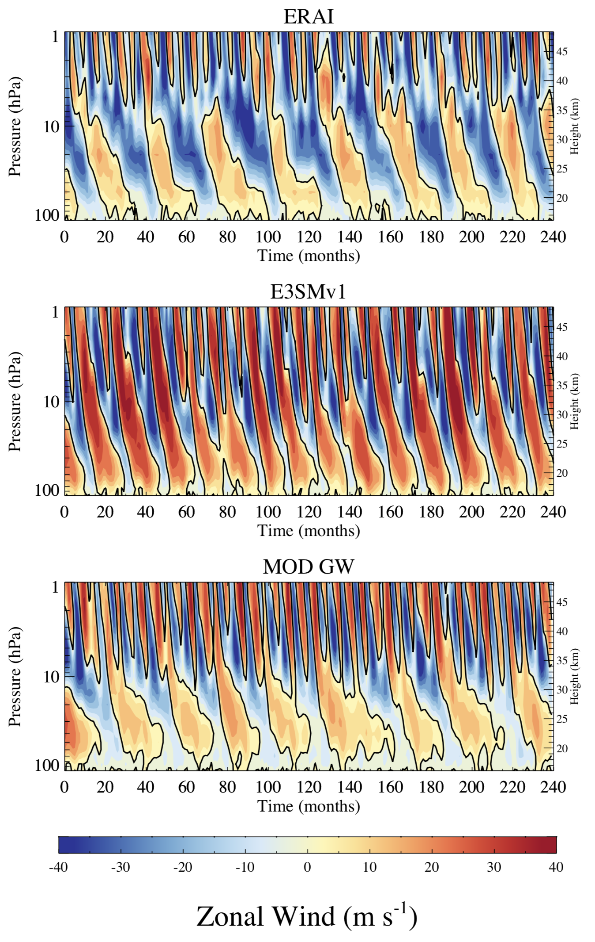
Improved QBO with GW changes:
Convective GW source was tuned to obtain a more realistic QBO
Two parameter changes: CF: Conversion Factor of ZM heating rate to convective cell heating rate (20 -> 12.5) Efficiency of convective GWs (0.4 -> 0.35)
QBO period now ~ 26 months (E3SMv1: 18 months)
Tested now in AMIP and Coupled 30 yr runs
Ready for implementation
J. Richter, C. Chen, Q. Tang, S. Xie, P. Rasch

Slide 2
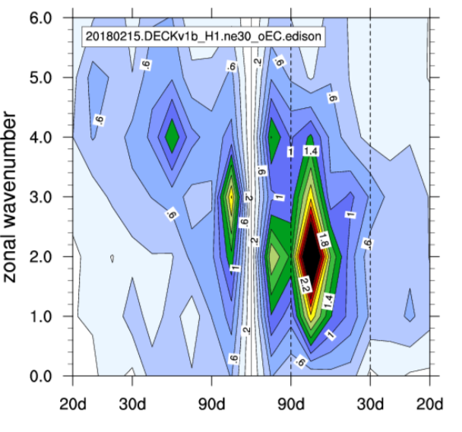
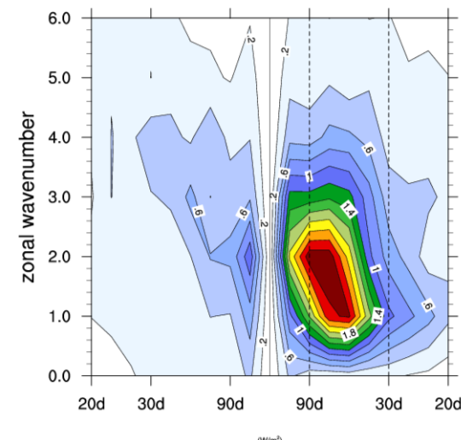
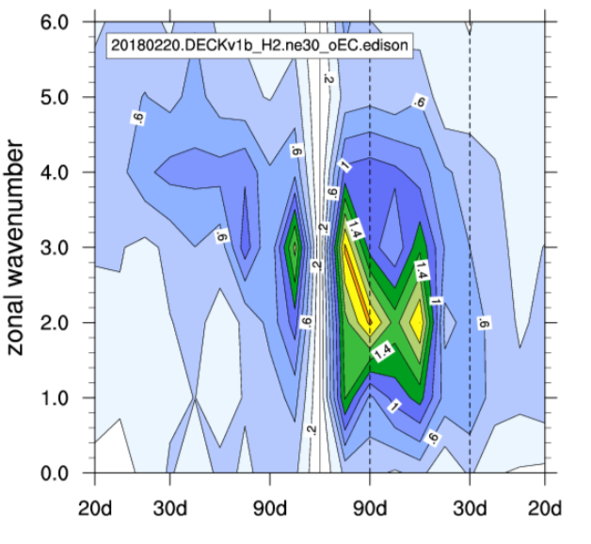
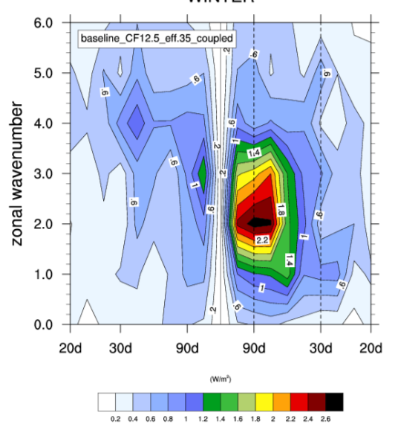
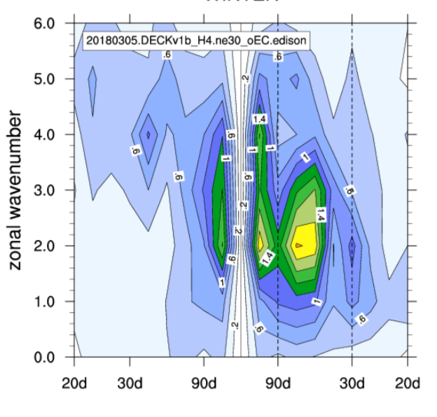
Improved QBO with GW changes:
Possible MJO Improvement Winter OLR Spectra
DJF U Mean
OBS
E3SMv1 Ens 1
DJF PSL Mean
E3SMv1 Ens 2
MOD GW
DJF PSL Stddev
E3SMv1 Ens 2
J. Richter, C. Chen, Q. Tang, S. Xie, P. Rasch

