Slide 1
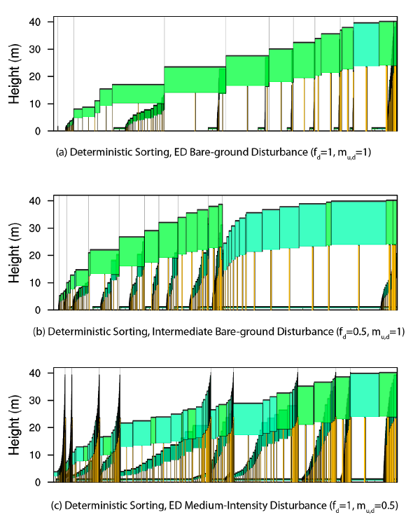
ELM-FATES – Updates, progress, and cool things with demographic modeling
Jennifer Holm,
Ryan Knox, Charlie Koven, Rosie Fisher, Greg Lemieux, many many more.
E3SM All Hands Meeting Fall 2019
Arlington, VA

Slide 2
FATES in E3SMv2 ----
New (and some to be developed) Features
  Co-existence of multiple competing PFTs spanning a trait space
    Done by sensitivity to plant traits; and sensitivity to disturbance level and height-based light competition
  Plant hydraulics
    Testing and parameterization of hydraulic traits for all PFTs
    Exploring vegetation and carbon effects from varying levels of saturated soils
  Nutrient competition
    Finalize testing nitrogen & phosphorus cycling use arbitrary input values (smoke-test), then couple with both belowground ELM BGC code
  Land-Use Land Cover Change
    Creation of secondary forest patches, and time-since anthropogenic disturbance
    Previously only primary forest patches
    Need to set up land-use driver dataset to pass into FATES. First will be harvest dataset.
    Create transition matrix in FATES to allow for changes to different land-use types; at the patch scale
  Global PFT parameterization and UQ (boreal forests underway)
  Higher resolution wind disturbance (NGEE-Tropics only)

Slide 3
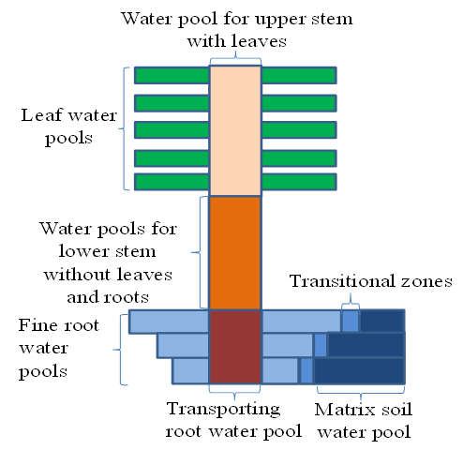
Dynamic plant hydraulics and modeling plant available water
Objective: Improve model representation of water extraction at various depths in ELM-FATES.
Tracks water transport through new recruits, growth, and mortality of plants.
Improve plant mortality during water stress, droughts via hydraulic failure.
Vertical dynamics of plant water pools and conductivity.
FATES PFTs will be based on root morphological traits and dynamic rooting distributions.
Stomatal conductance
Water pools for lower stem & Stem xylem
Simplified FATES hydraulics schematic, Xu et al. in prep.
Notes:
This model capability: a) track water transport in plant and thus more mechanistic representation of water stress on plant growth (e.g., gs) and mortality (e.g., hydraulic failure); a) capable of representing hydraulic trait diversity in the model to test the hydraulic trait control on forest response to droughts

Slide 4
ELM’s configurations of soil hydrology, plant hydraulics, and vegetation structure/dynamics
Help from Gautam Bisht, Ruby Leung, Yilian Fang

Slide 5
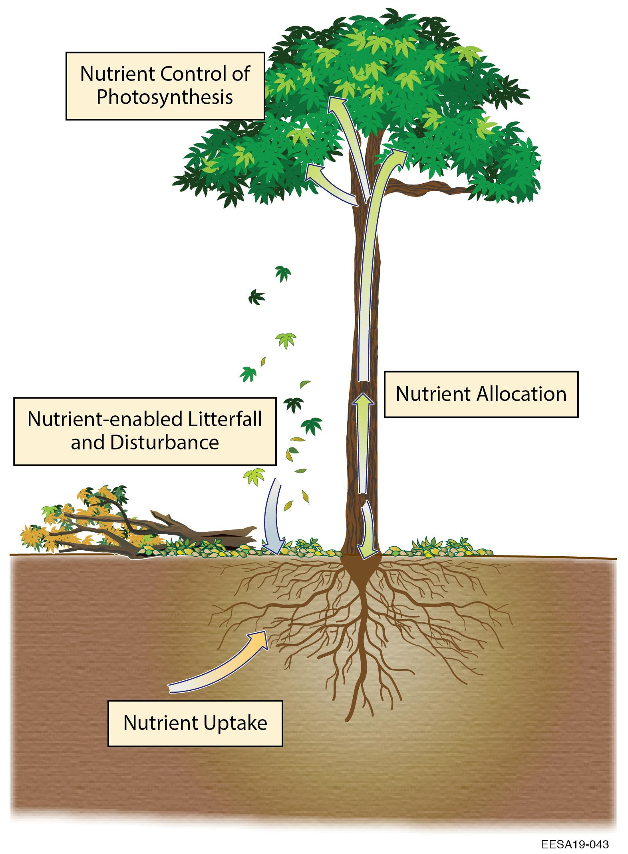
Nutrient-Enabled ELM-FATES
Developed to be a stand-alone flexible module to efficiently test ✓alternative representations of:
Allometry-aware allocation of C-N-P (PARTEH).
Add fluxes litter, plants to ELM’s soil BGC.
Plant nutrient acquisition coupled with both ELM’s ECA and RD BGC models.
  Current phase = testing reactive transport of C-N-P with simplified boundary conditions.
Leaf-level nutrient function and controls (e.g. photosynthesis).
Soil nutrient adsorption/competition (NGEE-Tropics).
4
✓
✓
1
2
5
3
Phosphorus sorption
See Knox et al. poster
Notes:
Approach to WP2.3 is on multiple fronts
-Central effort will be to develop a robust, nutrient-enabled FATES coupled to ELM-soil BGC routines
- Developing representation of nutrient cycles in ELM-FATES using flexible model structure allowin…
- One key aspect: allometry-aware allocation
- Also, because C allocation is intimately tied to nutrient acquisition, these links will be an explicit aspect of nut model development
- Another dev’t builds on advances in soil BGC & emerging understanding of soil mineral adsorption of P as constraint on P avail
- To establish the empirica basis for allocation/allometry, will collab with GEM across nut gradients

Slide 6
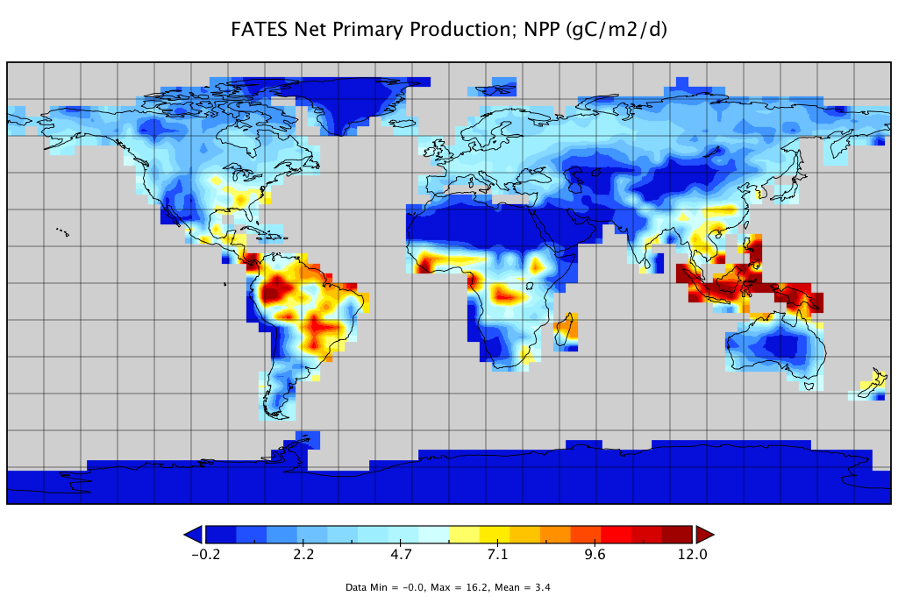
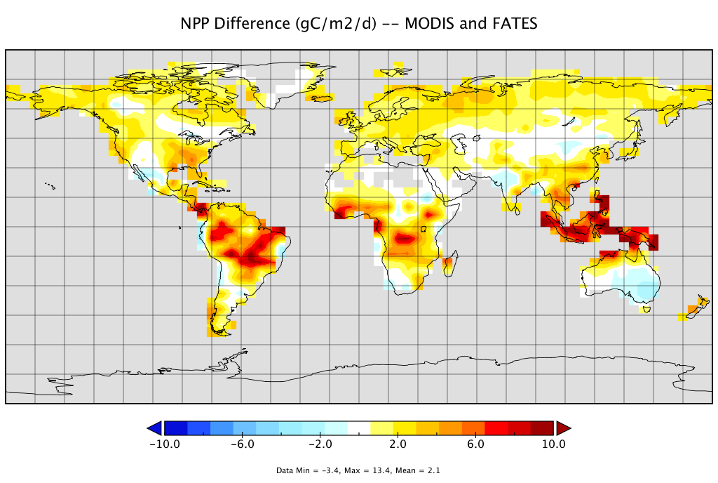
Net Primary Productivity ELM-FATES (gC m⁻² d⁻¹)
Global ELM-FATES Simulations with plant demography and dynamic trait-based competition.
Coarse global simulations for initial testing.
13 PFTs
Mean 3.4 (gC /m2/d)
High NPP bias in FATES compared to MODIS
Mean +2.1 (gC /m2/d)

Slide 7
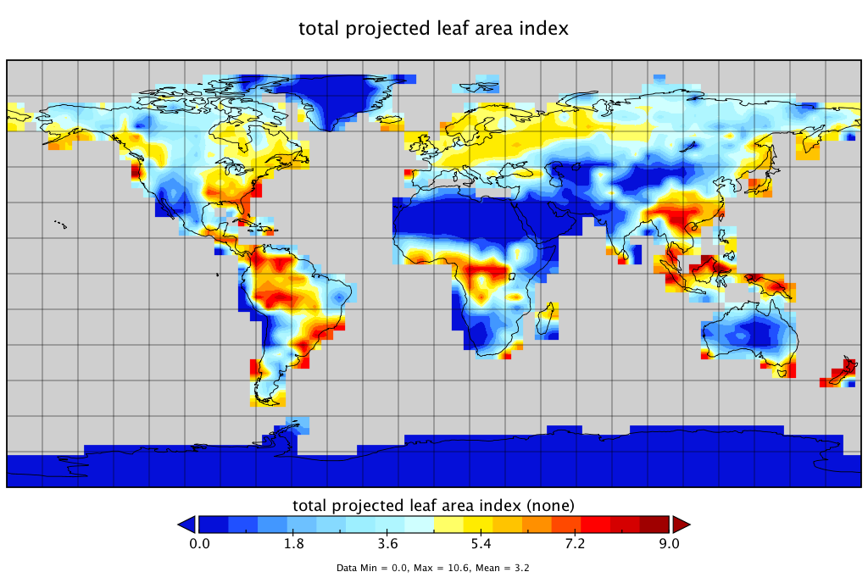
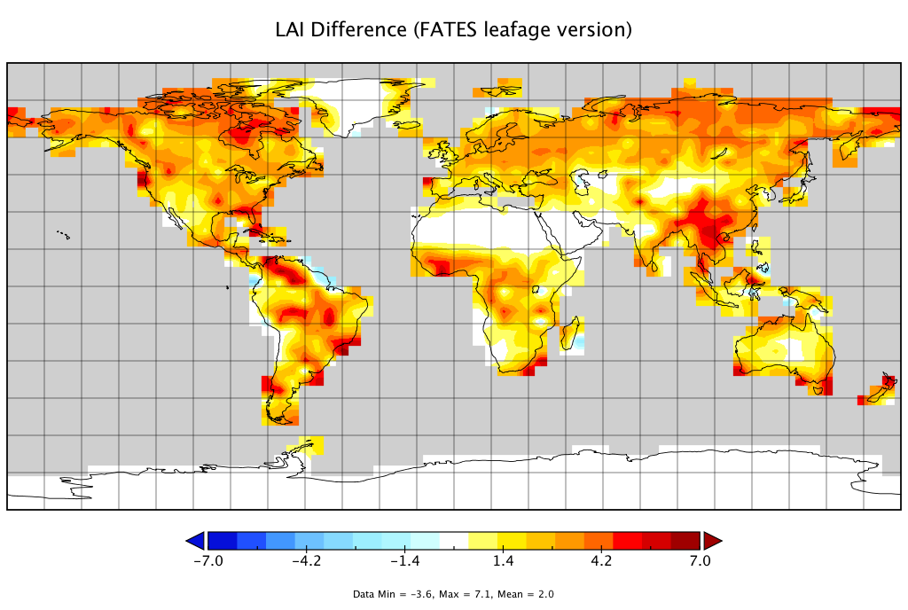
Leaf Area Index ELM-FATES
Global Mean 3.2
Also high LAI bias in FATES compared to MODIS

Slide 8
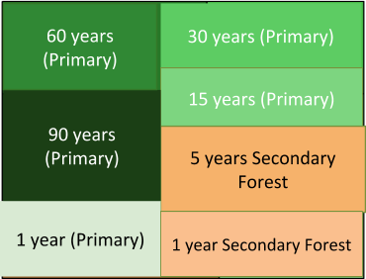
First steps of LULCC capabilities in ELM-FATES
FATES has secondary forest patches, which track their own area, biomass, time-since-anthropogenic disturbance, and time-since-natural disturbance (it can have both)
Uses an existing logging module to generate the anthropogenic disturbance that creates a secondary forest
Only primary patches can fuse together
Only secondary patches can fuse together

Slide 9
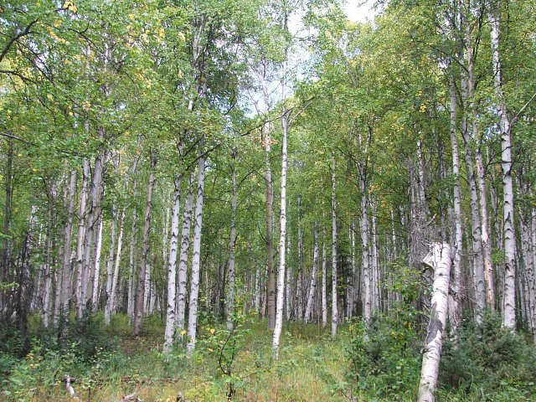
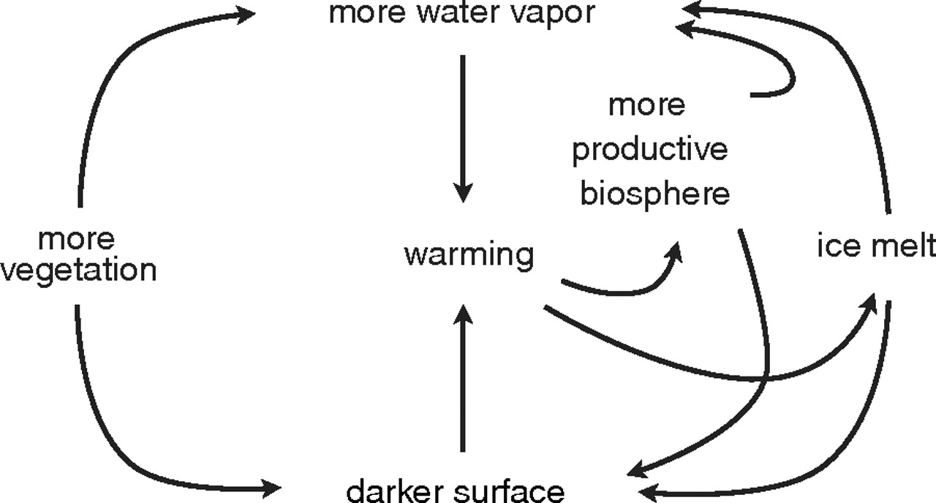
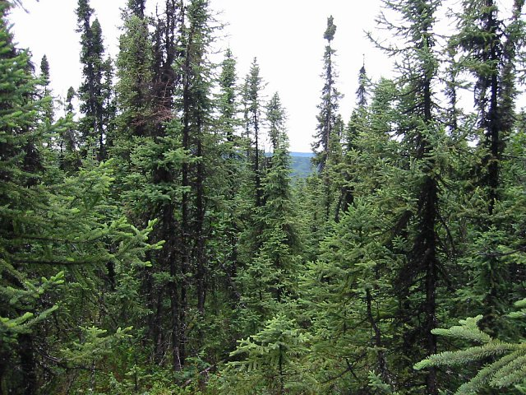
Towards improving global application of FATES
Local Case Studies: Successfully simulating boreal forests.
Motivation:
Popular and Birch
more water vapor
more productive biosphere
1) more vegetation
warming
ice melt
darker surface
Swann et al. 2010
White and Black Spruce
How are water and carbon cycling impacted with shifts to more evergreen (under warming) or deciduous (under drying, fires, changes in nutrient availability)?

Slide 10
First Look -- Simulations of Boreal Mixed Forests in Alaska
(Evergreen tree, deciduous tree, deciduous shrub)
Default ELM-FATES vs. ELM-FATES Hydro
Field Data Basal Area (BA):
~13 m² ha⁻¹
Spruce stands tend to have larger BA
Birch/Popular stands tend to have Smaller BA
ELM-FATES Hydro and water stress
Broadleaf, deciduous tree dominates
ELM-FATES Basal Area (BA):
9.4 m² ha⁻¹
Forest of many small sized stems and shrubs

Slide 11
“Simplistic” but Informative Hydrology Experiments:
1) Default FATES (no plant hydraulics); 2) FATES-Hydro runs; 3) decreased & increased soil moisture (warming/drying & permafrost thawing) via changing surface runoff.
NPP
Lower NPP, closer to observations and stronger seasonal shifts.
Total Water Storage (mm)
Ability to quantify shifts in boreal PFTs with soil hydrology changes.
With drying soils a decrease in deciduous trees and increase in evergreen trees.
Sanity check after altering runoff +/- 40%
PFT Shifts
Notes:
Field Data: Above-ground NPP (ANPP) was consistently larger for deciduous forests than for evergreen boreal forests in each of the major boreal regions, especially for boreal forests in Alaska.

Slide 12
Change in Mortality Rates for a Mixed Boreal Forest when Accounting for Plant Hydraulics
Mortality by PFT
Mortality by PFT

Slide 13
Future Plans…
Defining LULCC driver datasets for FATES that adhere to CMIP6
Ex. Primary to secondary forest transitions by area and mass, using LUH2 data and converting into an LUH1 format for E3SM
Expand Alaska case test to North American boreal forest simulations in ELM-FATES-Hydro (with Plant Hydraulics).
  Continental scale testing of FATES-Hydro
  Testing VFSM soil hydrology with FATES-Hydro
Nutrient Competition coupled between ELM soil-BGC and FATES plant-BGC
Next: Nutrient Uptake and Acquisition
Margolis et. al. 2015
Notes:
Continental scale boreal forest simulations. Why? There is wide spatial variations in locations that will become wetter (permafrost thaw, wetland expansion) or will become drier (fire, climate warming) in the future. What are the impacts to carbon and water cycling, and if areas will be carbon sources or sinks.

Slide 14

FATES Coordination and Liaison-ing with NGEE-Tropics
Just completed their Phase 2 proposal defense
Overview of FATES modeling plans as it relates to E3SM
Koven et al. in review

Slide 15
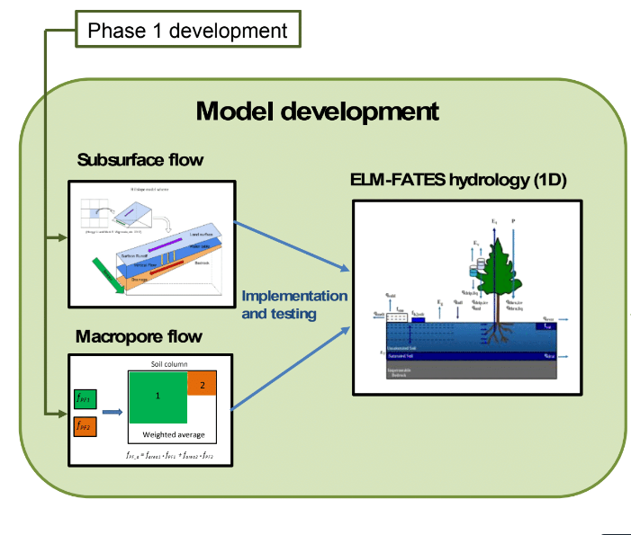
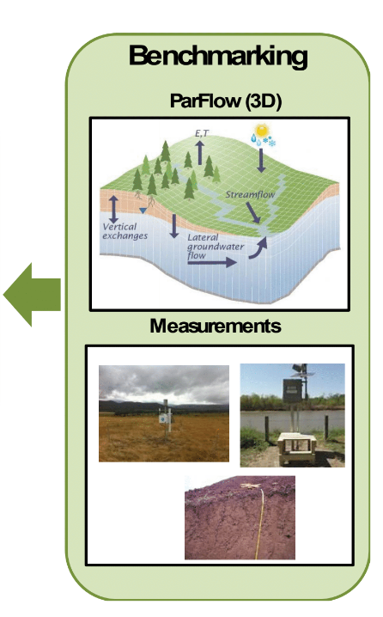
NGEE-Tropics: Use of ELM-FATES for Hydrology
“How does precipitation recycling and the seasonal timing of precipitation respond to changes in CO2, warming, and deforestation?”
2
1
3
Implement and test subsurface flow and macro-pore flow parameterizations in ELM-FATES
Benchmark ELM-FATES using measurements and ParFlow (3D)
Then coupled ELM-FATES-ParFlow for basin-scale simulations
Notes:
Our objective will be achieved through a MODEX approach. Through phase 1, the team has been testing parameterizations of subsurface flow and macropore flow. These parameterizations will be tested in ELM-FATES at hillslope scale using a more realistic hydrology model (ParFlow) and measurements as benchmarks. ELM-FATES, coupled and uncoupled to ParFlow, will be used in basin-scale simulations and experiments over the Amazon to understand the influence of hillslope hydrology and landscape heterogeneity on the spatio-temporal variability of ET.

Slide 16
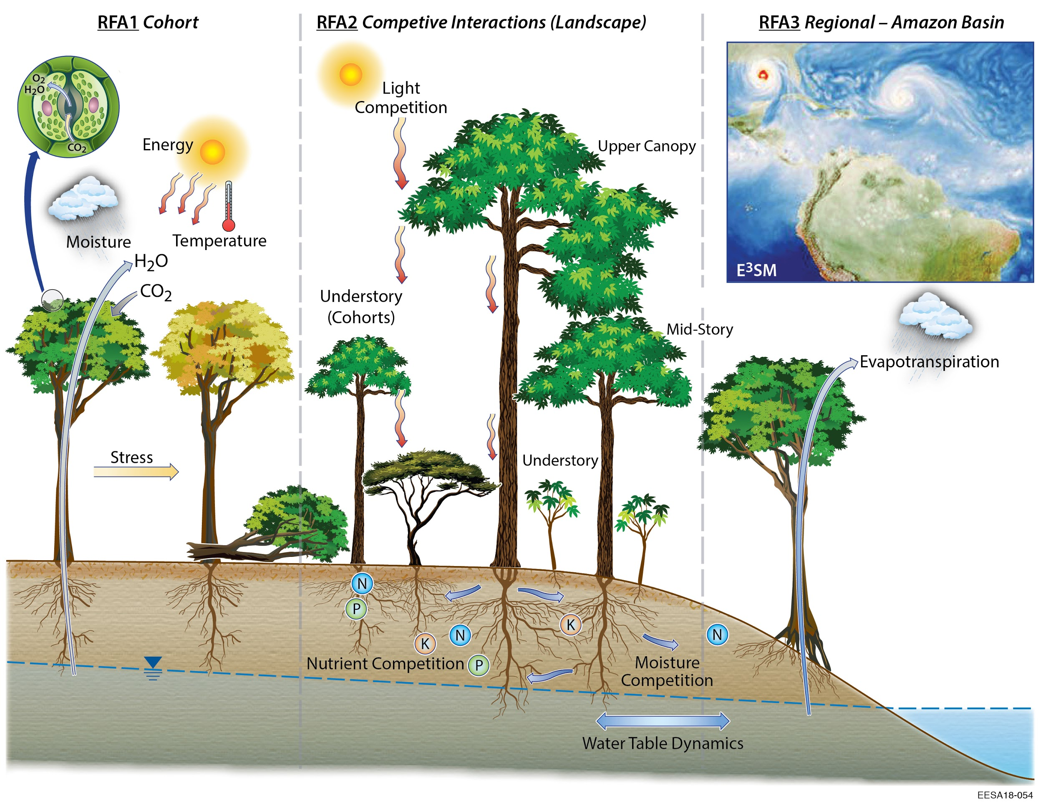
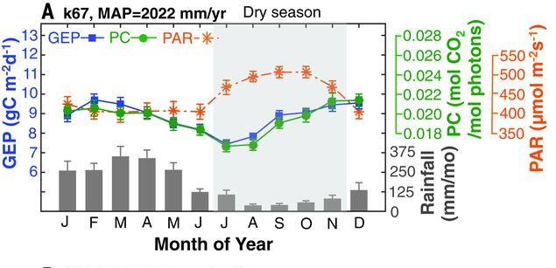
NGEE-Tropics:
FATES coupled to E3SM experiments (longer term goal)
Why: Forest functioning in governing land-atmosphere hydrologic cycling
  How does representing geographic variation in plant hydraulic traits and forest structure affect hydroclimate?
  How does representing seasonal cycles of leaf age phenology affect hydroclimate and dry-> wet season transition?
E3SM coupling
Wu et al. 2016
Notes:
H6: Variation in plant photosynthetic and hydraulic traits, both in space across environmental gradients, and in time from phenological and longer-term vegetation responses to global change, modify diurnal and seasonal cycles of ET, which in turn affect atmospheric convection and the dry-to-wet-season transition in the Amazon.

Slide 17
NGEE-Tropics:
FATES coupled to E3SM experiments (longer term goal)
Scenario Testing in Phases
E3SM-FATES “Standard”
Assess role of plant hydraulics and hydraulic trait variation on simulations
E3SM-FATES-Hydro
Assess role of seasonal ramp-up of photosynthetic capacity during dry season to modify dry-to-wet season transition
E3SM-FATES-Hydro + dynamic leaf age phenology
Key Deliverables from NGEE-Tropics with FATES
Improve modeling of landscape heterogeneity by including hillslope to continental scale soil hydrology and water table dynamics to improve ET.
Well tested and constrained parameterizations of subsurface lateral flow and macropore flow in ELM for modeling drought response.
Global scale coupled simulations using E3SM-FATES with and without plant hydraulic processes and dynamic leaf age phenology to assess the role of ecosystem processes on land-atmosphere exchange of water.
Notes:
Control: E3SM-FATES “standard”
Exp1: E3SM-FATES-Hydro to assess role of plant hydraulics and hydraulic trait variation on simulations
Exp2: E3SM-FATES-Hydro with dynamic leaf age phenology to assess role of seasonal ramp-up of photosynthetic capacity during dry season to modify dry-to-wet season transition

Slide 18





Thanks!
jaholm@lbl.gov
Lawrence Berkeley National Laboratory

