Slide 1
E3SM Next Generation Development (NGD) of Atmospheric Physics
Shaocheng Xie
Lawrence Livermore National Laboratory
DOE LAB Staff
LLNL: Shaocheng Xie, Chris Teri, Philip Cameron-Smith, Yuying Zhang, Chris Golaz, Qi Tang
PNNL: Hailong Wang, Jiwen Fan, Manish Shrivastava, Po-Lun Ma, Yun Qian, Kai Zhang, 2 Postdocs
ANL: Yan Feng
BNL: Wuyin Lin
\
Collaborators
Vince Larson (UWM)
Xiaohong Liu (UW)
Michael Prather (UCI)
Jadwiga (Yaga) Richter (NCAR)
Joao Teixeira (JPL/UCLA)
Guang Zhang (SCRIPPS/UCSD)
Work from LLNL is performed under the auspices of the US DOE by LLNL under Contract DE-AC52-07NA27344. LLNL-PRES- 777474

Slide 2
Goals of NGD-Atmospheric Physics
Develop an improved suite of atmospheric physics suitable for various science applications using low-resolution E3SM V3 (12km – 100km)
Emphasize on reducing outstanding biases in E3SMv1
  Improving its scale-awareness for a smooth transition across the scales
  Improving the unification of treating various types of clouds
  Improving stochastic features of convection
  Improving momentum transport by convection and gravity waves
  Improving cloud microphysics for both convective and stratiform clouds
Enhance the model’s capability to address uncertainty in predicting future changes
  Atmospheric Chemistry and Photolysis
  New aerosol and dust physics
  Coupling of atmospheric chemistry, aerosols, and dusts to BGC and land/energy use
The development will address the combined problems of scientific accuracy, scale-awareness, and computational efficiency

Slide 3
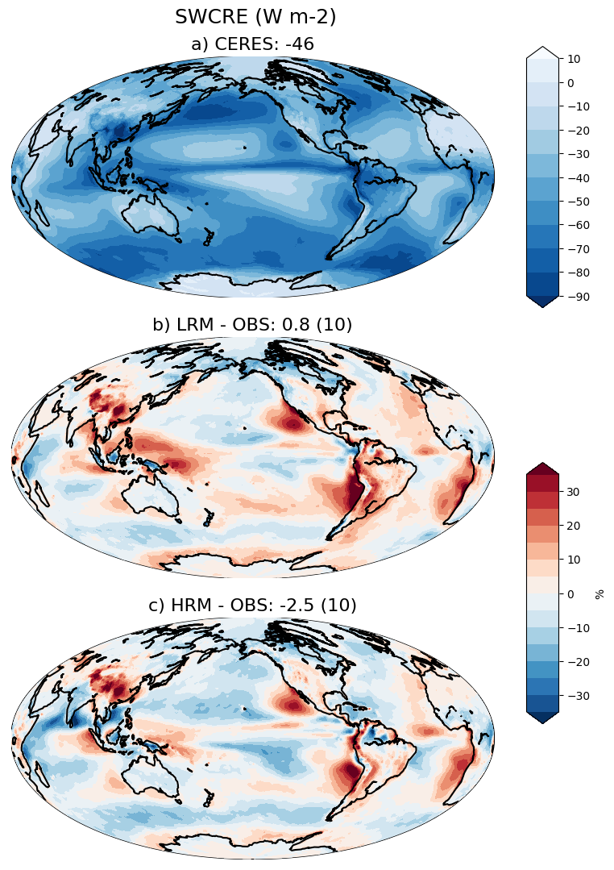
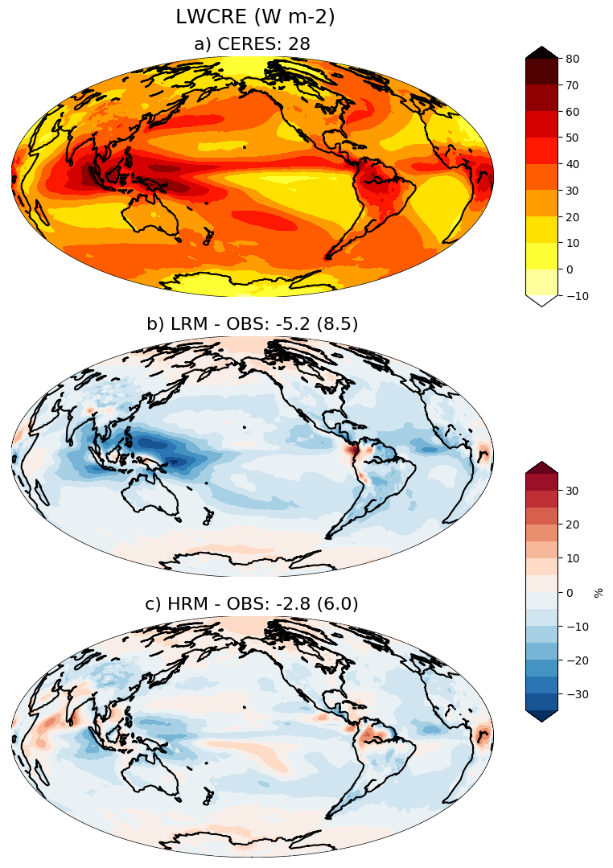
Outstanding Model Bias in E3SMv1
Cloud bias:
  Lack of coastal Sc
  Lack of clouds, particularly high clouds over TWP
  Lack of ice in mixed-phase clouds
Precipitation:
  Excessive precipitation over tropical IO and warm pool and lack of precip over Amazon
  Rain ”too frequent, too weak”
  Double ITCZ
Variability
  Wrong diurnal cycle of precip
  Weak MJO, Kelvin wave, etc
Warm and dry central US
Poor scale-awareness
SWCRE Bias
LWCRE Bias
Lack of clouds over TWP
Lack of coastal Sc
Lack of high clouds over TWP
Zhang, Xie et al. (2019)
Annual Precipitation Bias
Warm and dry central US
Rasch, Xie et al. (2019)
Excessive precip over
Tropical IO & warm pool
Double ITCZ
Dry Amazon

Slide 4
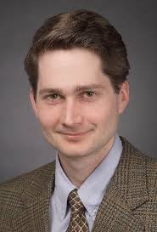
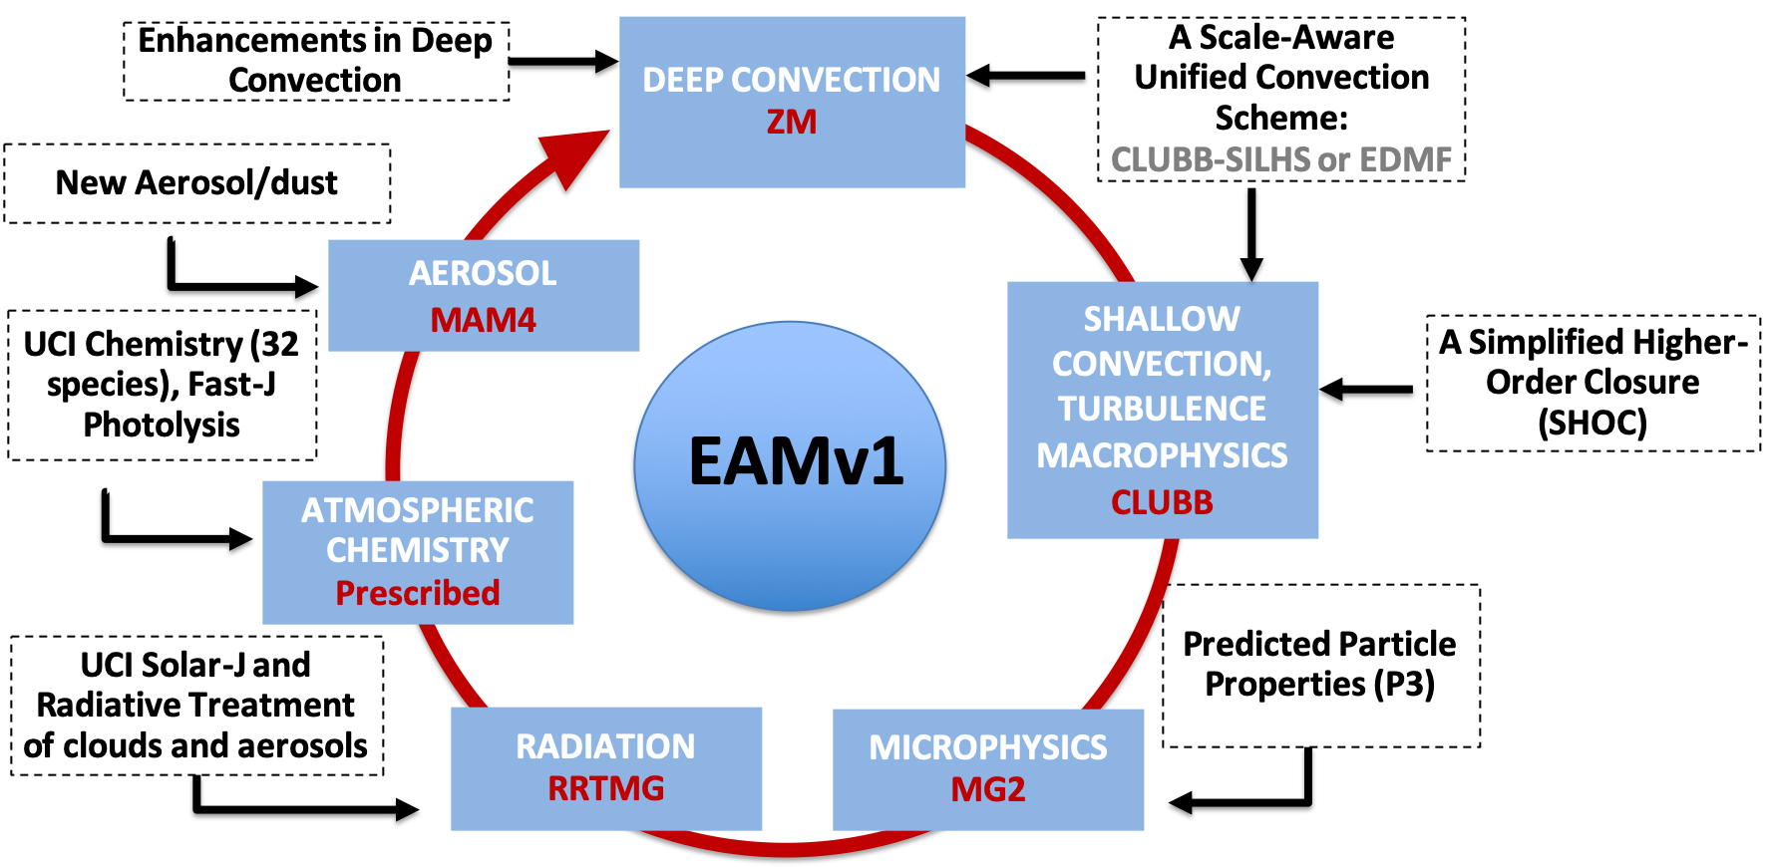
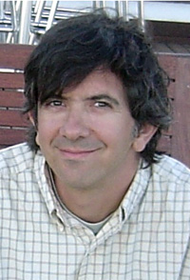


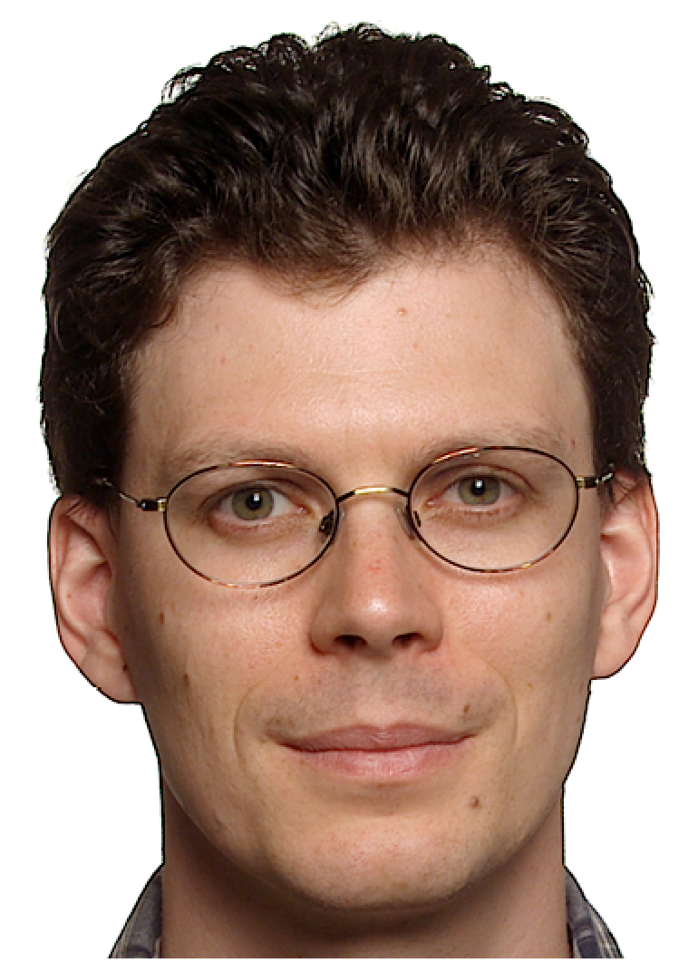


NGD-Atmospheric Physics
Lead: Shaocheng Xie
Vince Larson (UWM)
Yaga Richter
(NCAR)
Guang Zhang
(UCSD)
Joao Teixeira (JPL/UCLA)
Hailong Wang (PNNL)
Chris Terai
(LLNL)
Philip Cameron-smith (LLNL)
Michael Prather (UCI)
Jiwen Fan
(PNNL)

Slide 5
NGD-Atmospheric Physics Breakout
General group business
  E3SM confluence page is a place to manage the project and document project related information
  Monthly telecon
  NGD-Atmosphere mailing list (send me an email if you want to join)
  Computing resource request
  New Staff: Chris Teri (0.5 FTE) for model integration and evaluation (currently evaluating SHOC+ZM)
Progress updates (All task leaders)
General Discussion (will continue the discussion at today’s evening session at 7:30pm)
  Coordination
    Tuesday evening breakout report (Philip Cameron-Smith)
  Roadmaps/Timelines

Slide 6
NGD - Atmospheric Physics
Progress Updates

Slide 7
Interactive Atmospheric Chemistry (AP2)
Philip Cameron-Smith (LLNL)
Michael Prather (UC Irvine)
Juno Hsu (UC Irvine)
Outline of project
  Develop interactive gas-phase chemistry for century+ climate ensembles.
  Couple stratosphere-troposphere O3 chemistry and gas-aerosol chemistry.
  Enable O3-CH4 greenhouse gas simulations in ensembles.
  Enable air quality and climate interaction.
  Provide new chemical tracer diagnostics of E3SM performance.
Summary of Accomplishments (Mar 2019 – Nov 2019)
  chemUCI specifications and data tables updated, ready for pre-processor.
  O3 chemistry V2 (updated Linoz with O3 STE fluxes) implemented and tested, clearly shows stratospheric QBO circulation (w/Qi Tang).
  Super-fast chemistry input file is working again.
    Pre-processor was fixed.
    Currently merging super-fast chemistry with MAM4.
  2 CMIP6 transient compsets completed: ne30 SSP5_8.5 future, and ne120 historical.

Slide 8
Interactive Atmospheric Chemistry (AP2)
Philip Cameron-Smith (LLNL)
Michael Prather (UC Irvine)
Juno Hsu (UC Irvine)
Summary of Issues (difficulties)
  Inability to get preprocessor to work to generate new chemUCI code.
  Delay in implementing LLNL superfast chemistry due to CMIP6 demands

Slide 9
Benchmark Solar Radiation Code fo(AP9)
Michael Prather (UC Irvine)
Juno Hsu (UC Irvine)
Outline of project
  Develop benchmark solar radiation code (Solar-J) that includes many more accurate radiative transfer (RT) methods than RRTMG-SW and is still cost-effective for decadal climate runs.
  Improves basic solar heating as well and aerosol and cloud radiative forcing calculations.
  Provides photolysis calculations for the chemistry.
Summary of Accomplishments (Mar 2019 – Sep 2019)
  Published PNAS paper documenting the errors in flat-atmosphere models (basically all ESMs).
  Updated Solar-J to include many improvements in RT approximations, such as ocean surface albedo.
  First look at Solar-J validation with ARM data (with Qi. Tang).
Summary of Issues (difficulties)
  Need to get chemUCI photolysis code (Cloud-J) implemented so that radiation double-calls (Solar-J and RRTMG-SW) can be made.

Slide 10
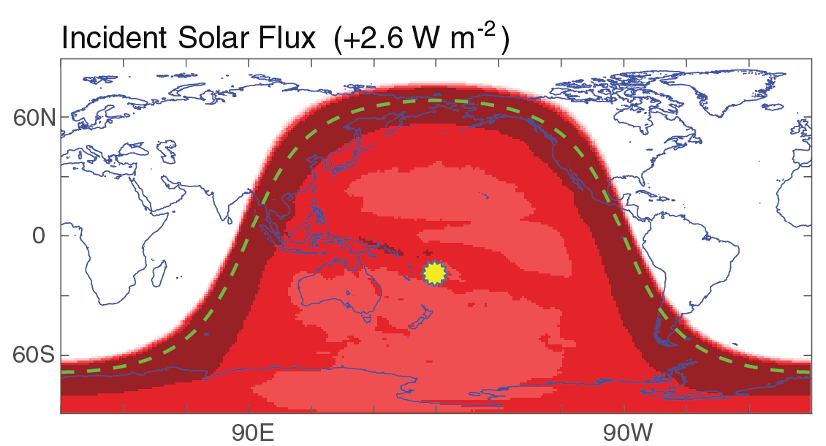
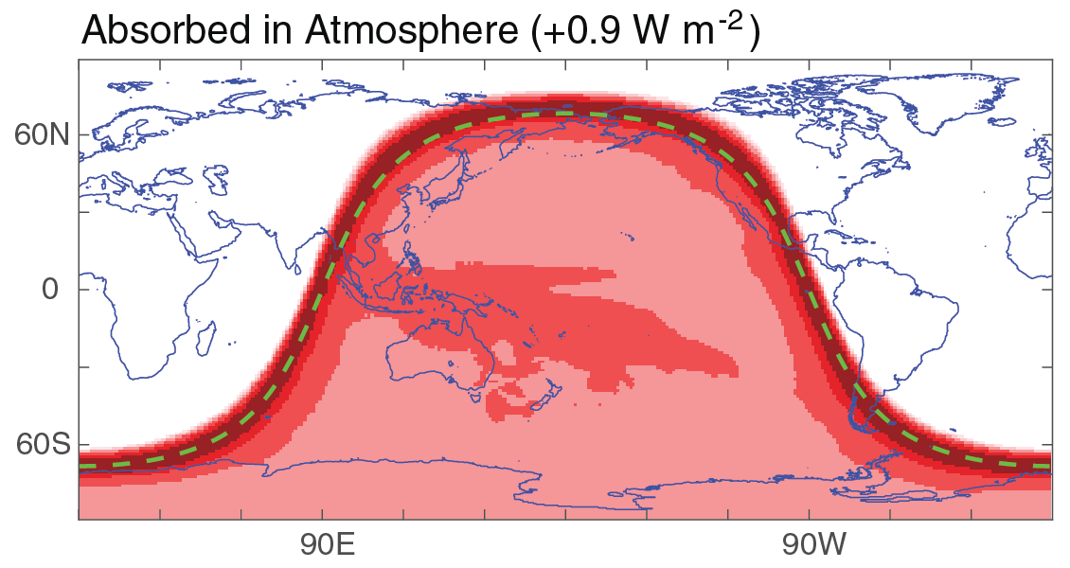
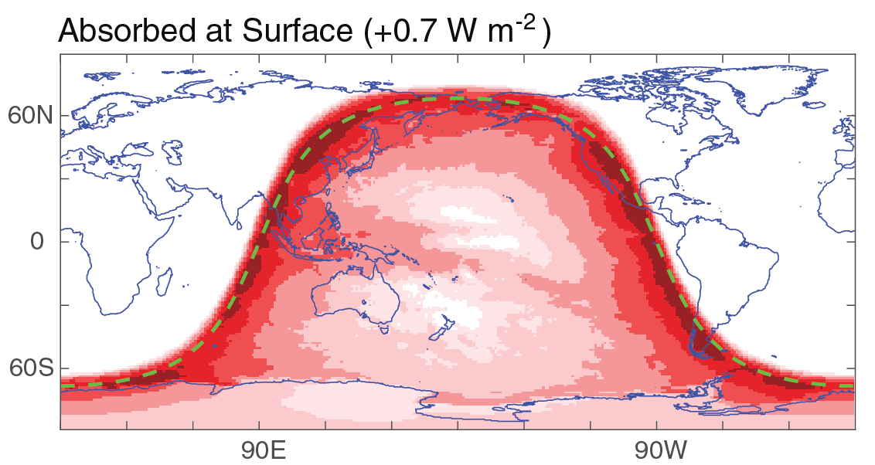
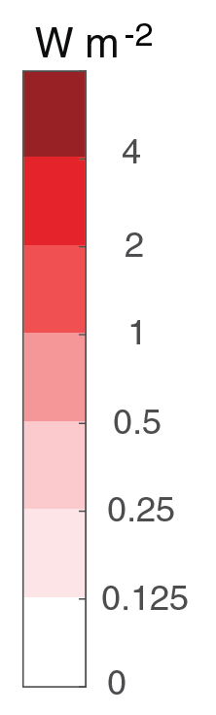
Progress Highlight
Michael Prather (UC Irvine)
Juno Hsu (UC Irvine)
PNAS publication
Error in solar flux for flat-Earth models
Plot of spherical+geometric atmosphere minus flat+geopotential atmosphere, averaged over 31 days in Jan 2015 at 00Z. Panels show incident flux, atmospheric absorption, and surface absorption with average values. Additional reflected flux (1.0 W m⁻²) is not shown. Location of overhead sun is shown in top panel (above). Terminator is shown as green dashed line.

Slide 11
Milestones AP2 & AP9
Philip Cameron-Smith (LLNL)
Michael Prather (UC Irvine)
Juno Hsu (UC Irvine)
Oct – Dec 2019:
  Published PNAS paper documenting errors in flat-atmosphere models (basically all ESMs).
  Several improvements to RT approximations in Solar-J, such as ocean surface albedo.
  First look at Solar-J validation with ARM data (with Qi. Tang).
  ne120 historical CMIP6 transient compset completed. ne120 future compset is in progress.
  Finalize super-fast chemistry with MAM4.
Jan – Mar 2020:
  Complete testing of fully coupled gas-aerosol chemistry using super-fast.
    Implement chemUCI.
  Preliminary interface and testing of Cloud-J with E3SM and superfast chemistry.

Slide 12
Milestones AP2 & AP9
Philip Cameron-Smith (LLNL)
Michael Prather (UC Irvine)
Juno Hsu (UC Irvine)
Apr – Jun 2020:
  Complete Solar-J calibration with ARM data & submit paper, including cloud effects (Qi Tang).
  Connect Fast-J photolysis to E3SM chemistry module.
  Submit chemistry analysis paper on QBO and stratospheric O3 using O3chem v2.
Jul – Sep 2020:
  Update aerosol optical properties in Fast-J and Solar-J for consistency and interactivity with MAM4, and to get aerosol direct RF.
  Test UCI chemistry mechanism in E3SM with decadal run.
Oct – Dec 2020:
  Compare Solar-J and RRTMG heating rates running concurrently in E3SM decadal run.

Slide 13
Backup Slides

Slide 14
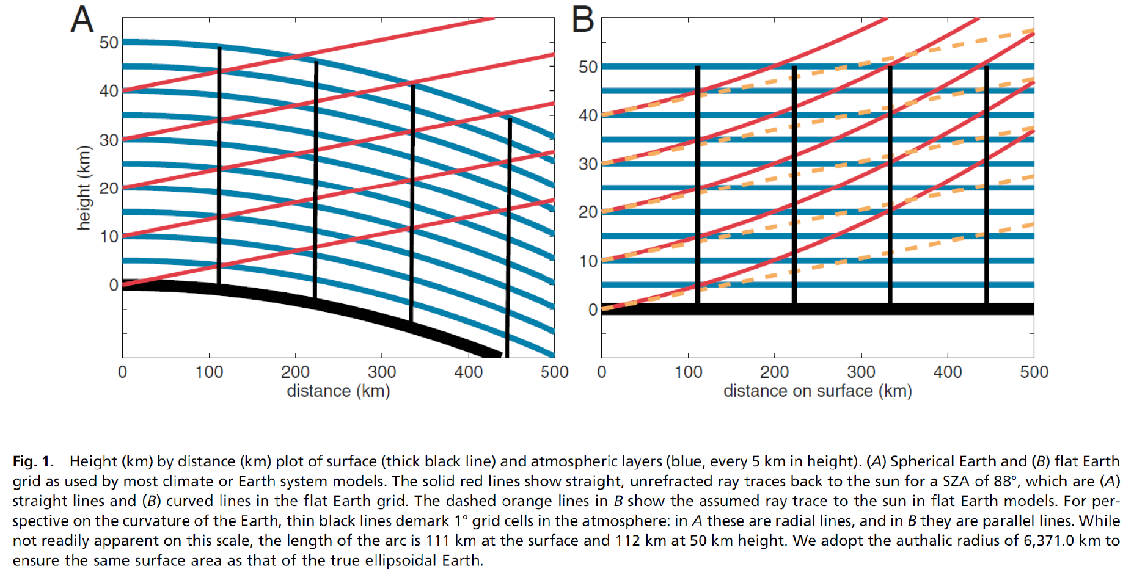
A round Earth for climate models
Michael Prather (UC Irvine)
Juno Hsu (UC Irvine)

Slide 15
Aerosol and Dust Physics
Model developments for the representation of nitrate, SOA, stratospheric sulfate, and dust to better capture their roles in the Earth’s water cycle, biogeochemistry, and/or cryosphere system.
Hailong Wang
(PNNL)
Nitrate Aerosol
Stratosph-eric Aerosol
Hailong Wang (PNNL)
  MOSAIC for Nitrate aerosol and other aerosols
  Simulating volcanic eruption and resulting stratospheric sulfate aerosols
Xiaohong Liu, (TAMU)
Superfast Chemistry
SOA
Dust
Manish Shrivastava,
(PNNL)
Yan Feng
(ANL)
  Explicit treatment of SOA formation and coupling with atmos. Chem. and land/energy use
  Implement new emission and dry deposition schemes; couple to BGC

Slide 16
Aerosol NGD Project overview
Model developments for the representation of nitrate, dust, SOA and stratospheric sulfate to better capture their roles in the Earth’s water cycle, biogeochemistry, and/or cryosphere system.
Hailong Wang, Mingxuan Wu (PNNL)
Nitrate Aerosol
Stratospheric Aerosol
Xiaohong Liu, Ziming Ke (TAMU)
Superfast Chemistry
Manish Shrivastava, Sijia Lou
(PNNL)
SOA
Dust
Yan Feng
(ANL)

Slide 17
New Treatment for Nitrate Aerosol in E3SM
Mingxuan Wu, Hailong Wang (PI)
Pacific Northwest National Laboratory
Outline of project
  Test the MOSAIC scheme and coupling with MAM aerosol and full chemistry in CESM (E3SMv0)
  Implement the MOSAIC scheme to treat nitrate aerosol in E3SMv1
  Integrate the new scheme with chemistry and physics for E3SMv3
  Evaluate the simulation of nitrate aerosol and its radiative impact
Summary of Accomplishments (Oct. 1, 2018 - Nov. 15, 2019)
  Conducted simulations with MOSAIC scheme coupled to MAM aerosol and full chemistry in CESM to provide benchmark for it’s implementation in E3SM
  The simulated nitrate aerosol is compared with other models and evaluated against observations
  Created a baseline chemistry package to prepare for the implementation of MOSAIC and nitrate aerosol treatment in E3SMv1
Summary of Issues (difficulties)
  Uncertainty in the options of chemistry and aerosol configurations

Slide 18
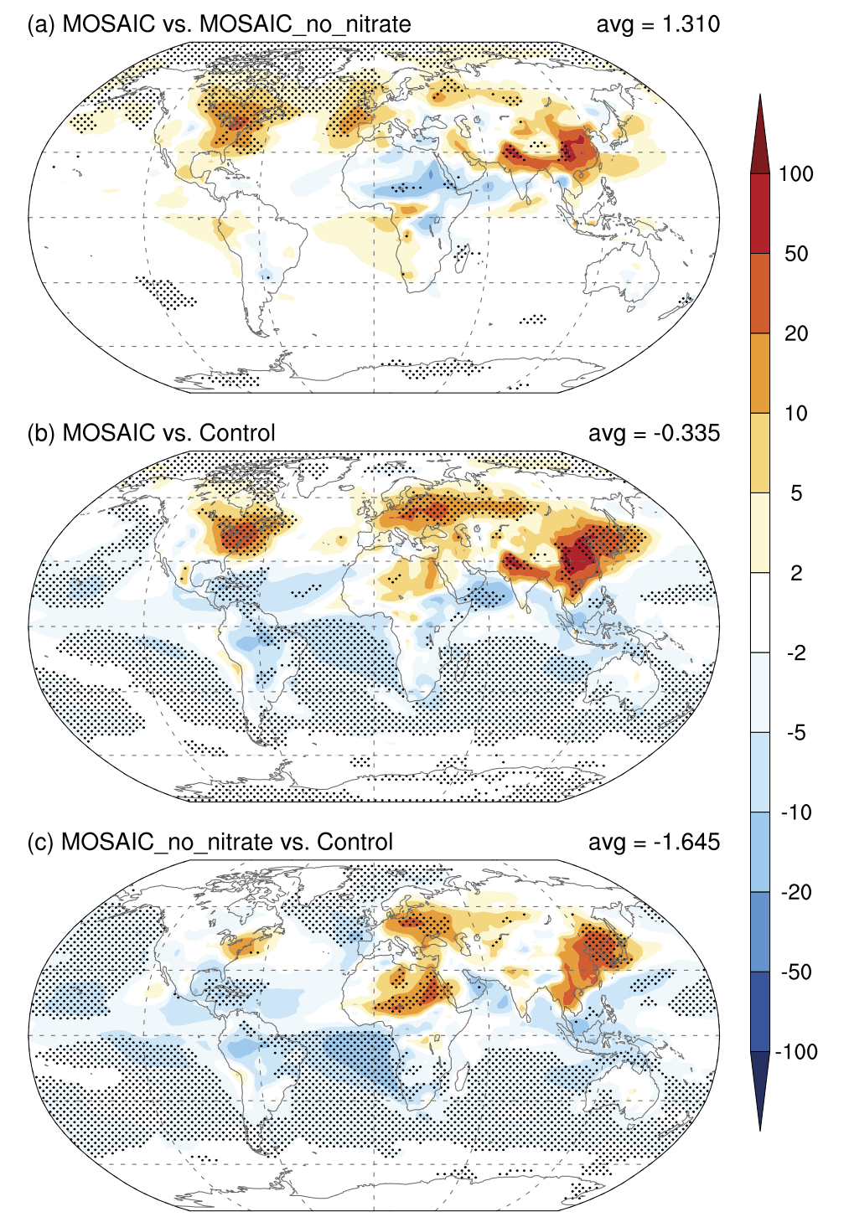
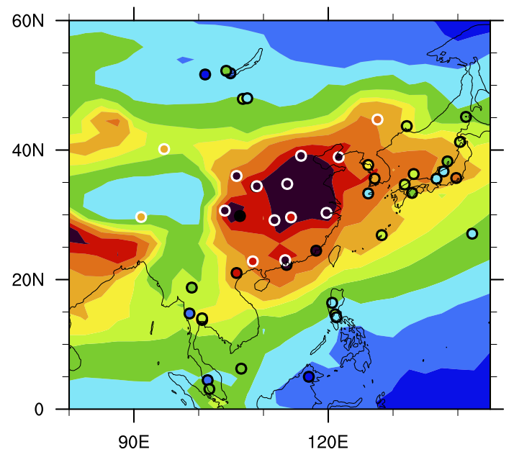
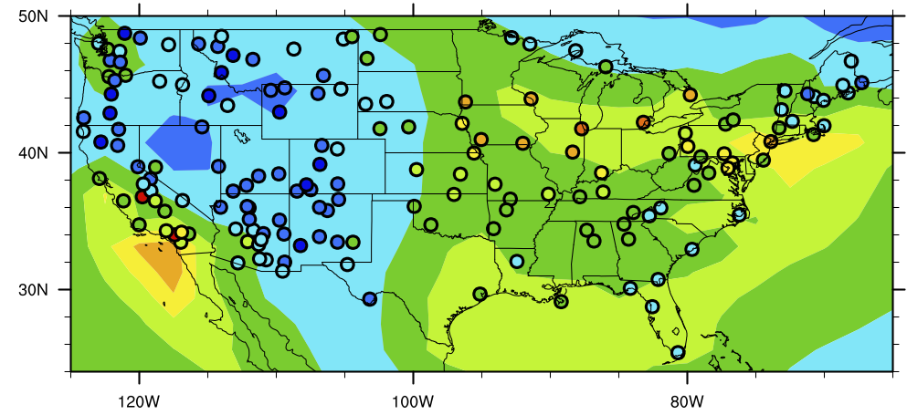
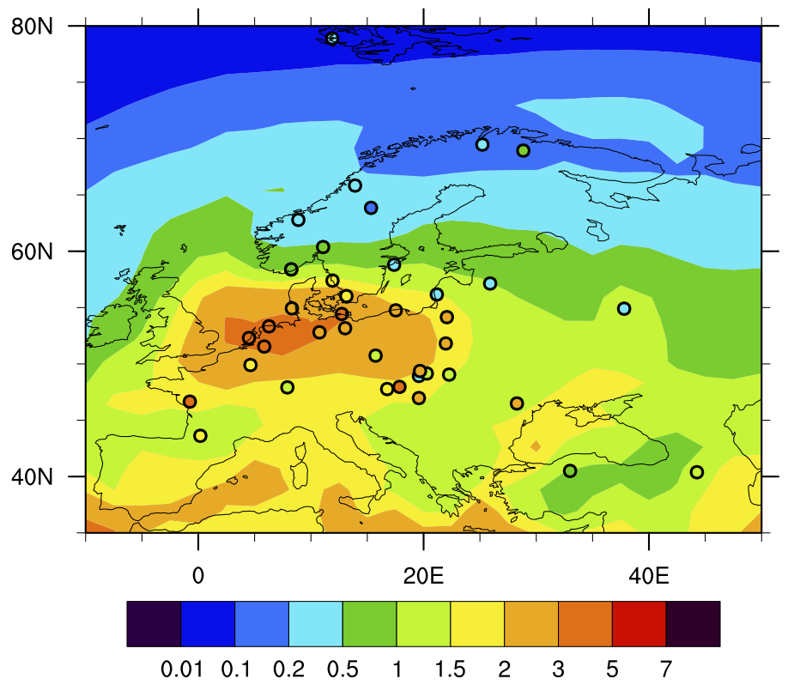
Highlight of the Progress
PNNL: H. Wang, R. Easter, B. Singh, R. Zaveri, R. Zhang
TAMU: Z. Lu, X. Liu
Fig. 1. Nitrate aerosol concentration (um/m³) simulated in CESM compared to surface network in E. Asia (top left), N. America (top right) and Europe (bottom). Model-obs differences vary with regions, in part due to emissions and data quality.
Fig. 2. Impact of MOSAIC treatment and nitrate aerosol on global distribution of CCN concentration (cm⁻³, below 850 mb at 0.1% supersaturation)
Zaveri, R., et al.: Global distribution and radiative effects of nitrate aerosol in CAM5-MOSAIC. To be submitted.

Slide 19
Milestones (past achievements and future plan)
Mingxuan Wu, Hailong Wang (PI)
Pacific Northwest National Laboratory
Apr. – Sep. 2019
  Submitted the E3SMv1 aerosol overview paper; refined MOSAIC-CAM5 results
Oct.- Dec. 2019
  Prepared a chemistry package in E3SMv1 for the implementation of MOSAIC
Jan.- Mar. 2020:
  Implement the nitrate aerosol treatment and conduct initial testing
Apr. – Jun. 2020:
  Integrate with available E3SMv3 chemistry and other new aerosol treatments
Jul. - Sept. 2020:
  Conduct sensitivity experiments of nitrate, dust and gas emissions
Oct. – Dec. 2020:
  Write a paper on performance of nitrate simulation and sensitivity results

Slide 20
New Treatment for Stratospheric Sulfate Aerosols
Ziming Ke, Xiaohong Liu (PI)
Texas A&M University
Outline of project
  Improve the representation of the stratospheric sulfate aerosols in E3SMv1
  Add stratospheric sulfate aerosol modes with specific standard deviations and size ranges
  Add necessary chemistry in the stratosphere to better representing SO₂ oxidation process
  Optimize configuration to maximum computing esfficiency
Summary of Accomplishments (Oct. 1, 2018 - Oct. 15, 2019)
  Implemented three stratospheric sulfate aerosol modes compatible with simple chemistry in E3SMv1.
  It significantly improved the lifetime and burden of sulfate aerosols in the upper troposphere and stratosphere.
  Prepared the emissions for explosive volcano eruptions.
Summary of Issues (difficulties)
  Need computing time for sensitivity tests

Slide 21
Schematic of Stratosphere Sulfate Modes
Ziming Ke, Xiaohong Liu (PI)
Texas A&M University
Stratosphere
coagulation
condensation
The importance of stratospheric sulfate modes and microphysical processes is under testing. Unnecessary modes and processes will be merged.
The OCS chemistry will be added into TS1 chemistry package to better represent background SO₂ evolution in the stratosphere.
The goal is to simulate stratosphere sulfate evolution under short-term volcano eruptions and long-term OCS oxidation scenarios.
condensation
Aitken_S
number
Sulfate
modified std
Accumulation_S
number
Sulfate
modified std & size range
Coarse_S
number
Sulfate
modified std & size range
H₂SO₂ nucleation
Tropopause
Aitken
number
sulfate
secondary OM
sea salt
Accumulation
number
Sulfate
primary OM
secondary OM
BC
sea salt
soil dust
Coarse
number
Sulfate
primary OM
secondary OM
BC
sea salt
soil dust
coagulation
condensation
Primary Carbon
number
Primary OM
BC
Troposphere
Notes:
All panels are showing annual mean so4 concentration with unit g/kg.

Slide 22
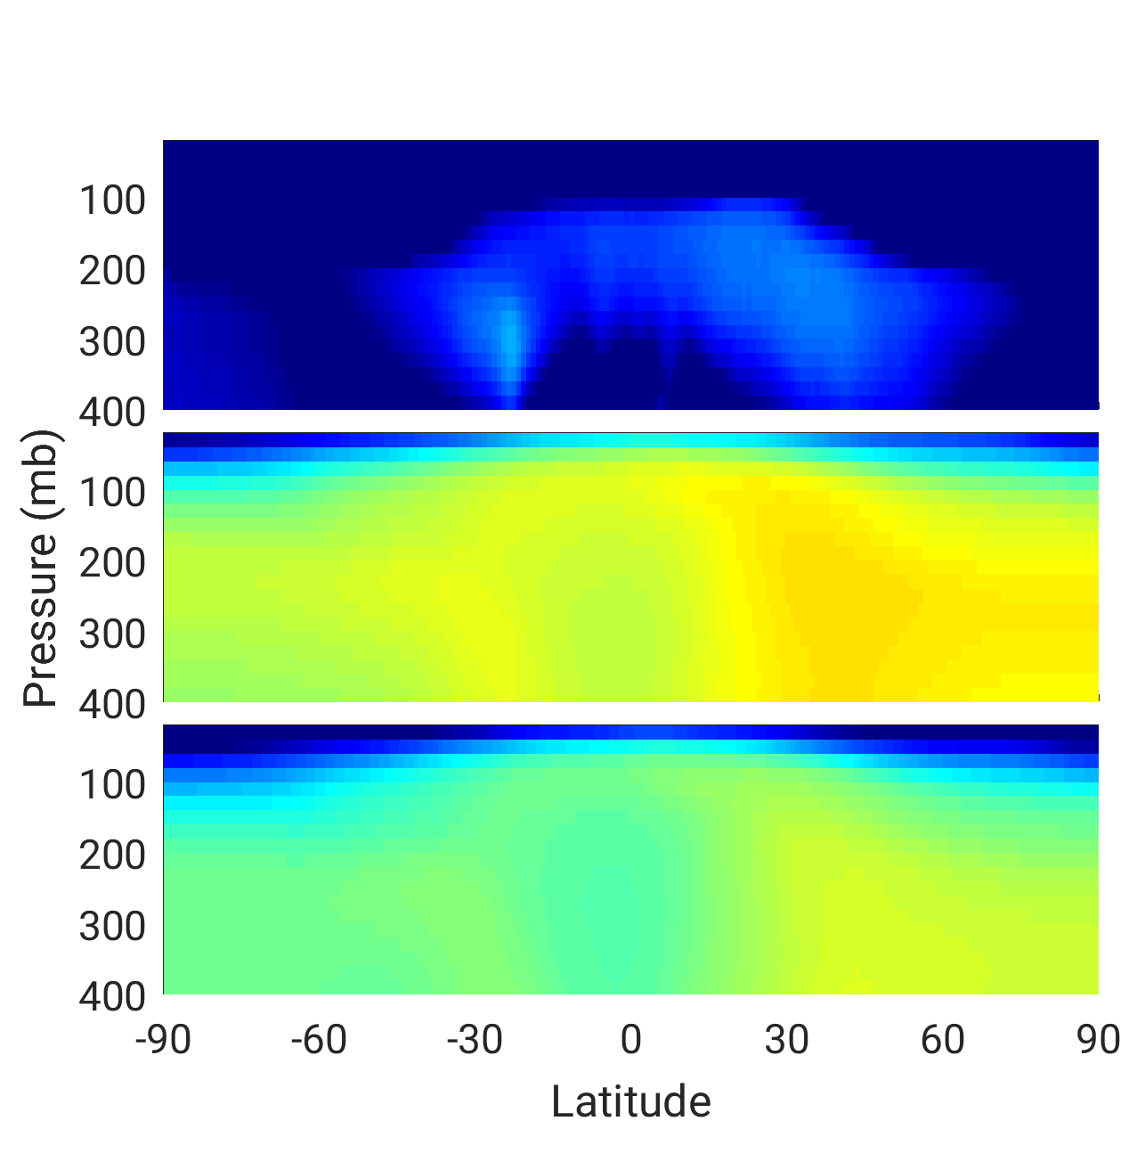
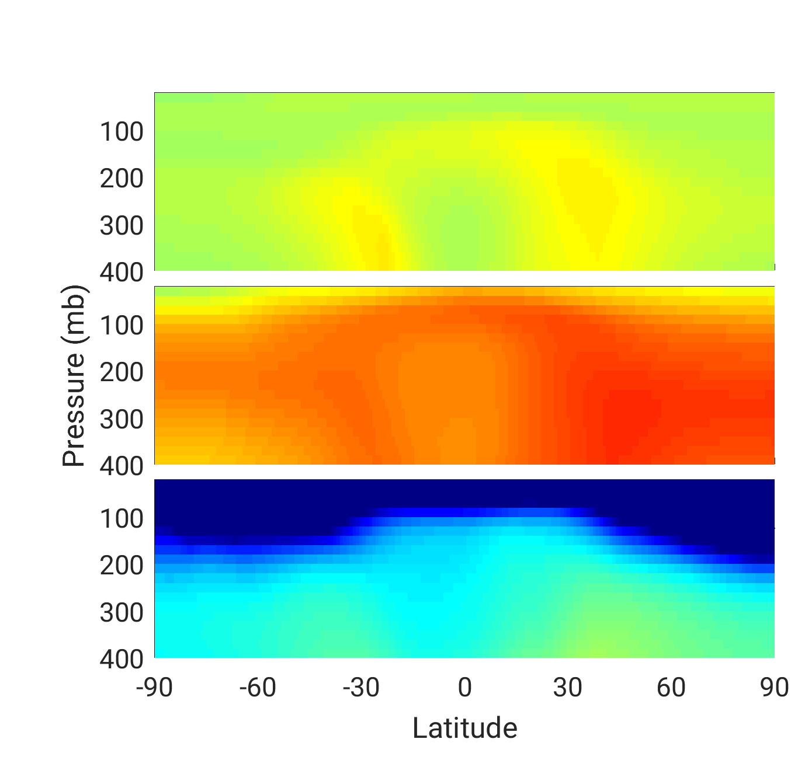
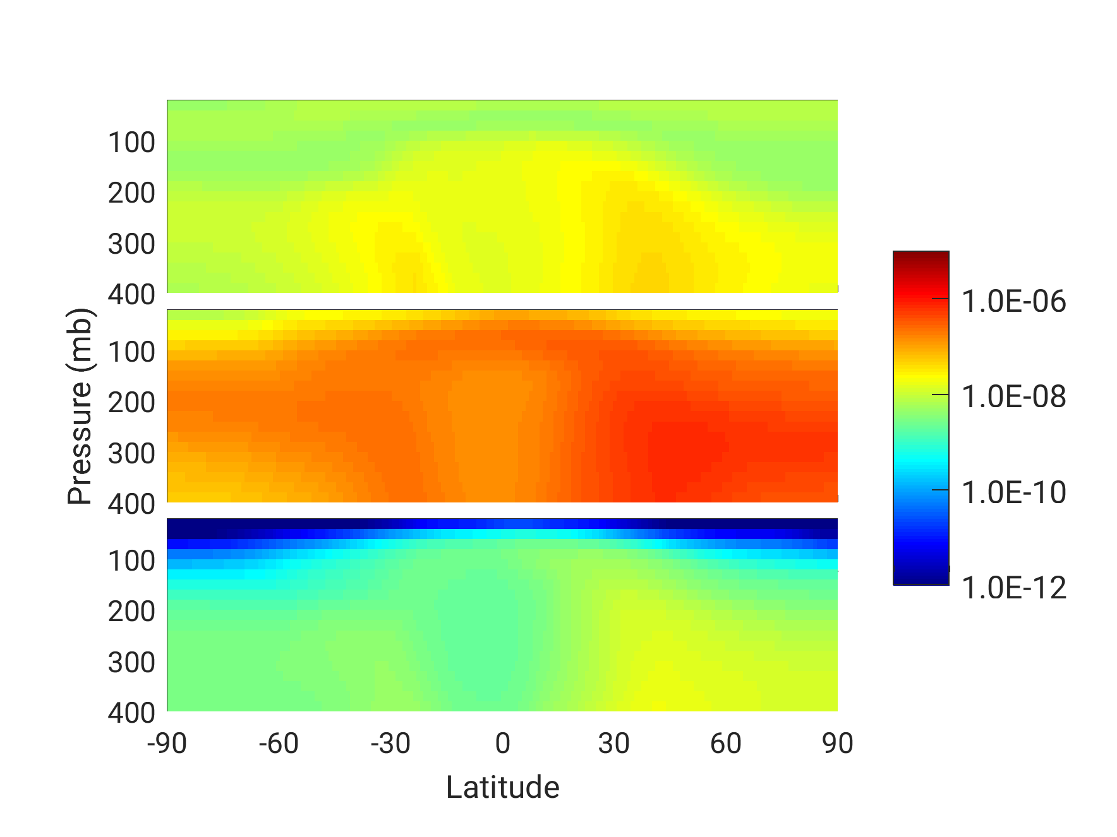
Highlight of the Progress
Ziming Ke, Xiaohong Liu (PI)
Texas A&M University
Increased sulfate aerosol concentration by implementing the stratosphere sulfate modes
Default
Modified
Aitken
Accum
g/kg
Coarse
g/kg
Fig. 2. Sulfate mass concentration in three stratosphere sulfate modes.
Fig. 1. Comparison of sulfate mass concentration in Aitken, accumulation and coarse modes between standard and modified EAMv1 with added sulfate modes.
Notes:
All panels are showing annual mean so4 concentration with unit g/kg.

Slide 23
Milestones (past achievements and future plan)
Ziming Ke, Xiaohong Liu (PI)
Texas A&M University
Oct. – Dec. 2019:
  Couple current stratosphere aerosol modes with TS1 chemistry.
Jan.- Mar. 2020:
  Evaluate the performance of implementation under major volcano eruptions and compare with CESM2 simulation.
Apr. – Jun. 2020:
  Add OCS chemistry in TS1 and evaluate its long-term impact.
Jul. - Sept. 2020:
  Optimize stratospheric aerosol modes and microphysics configuration.
Oct. – Dec. 2020:
  Write up paper on performance of stratospheric sulfate aerosols in E3SM1.

Slide 24
Strong sources and sinks govern secondary organic aerosols (SOA) in the E3SM model
Manish Shrivastava
Pacific Northwest National Laboratory
Outline of project
  Add explicit and computationally efficient SOA treatments in E3SM
  Parameterize complex multigenerational SOA chemistry with minimum number of tracers
  Conduct sensitivity simulations varying sources and sinks of SOA
  Evaluate SOA predictions with a suite of surface, aircraft and satellite measurements
  Determine what SOA processes are essential to reproduce measured SOA horizontal and vertical distributions
Summary of Accomplishments (Oct. 1, 2018 – Nov 13, 2019)
  Global model-measurement comparisons denote that both strong sources and sinks of SOA are essential
  SOA formation rates varied with chemistry treatments: functionalization-fragmentation branching ratios
  Particle-phase photolysis is a key sink needed to reproduce high altitude SOA loadings measured by aircrafts
  PD-PI direct radiative forcing of SOA varies between -0.3 to -0.8 W m⁻² depending on SOA chemistry treatments
Summary of Issues (difficulties)
  Computing and postdoc time needed for future progress

Slide 25
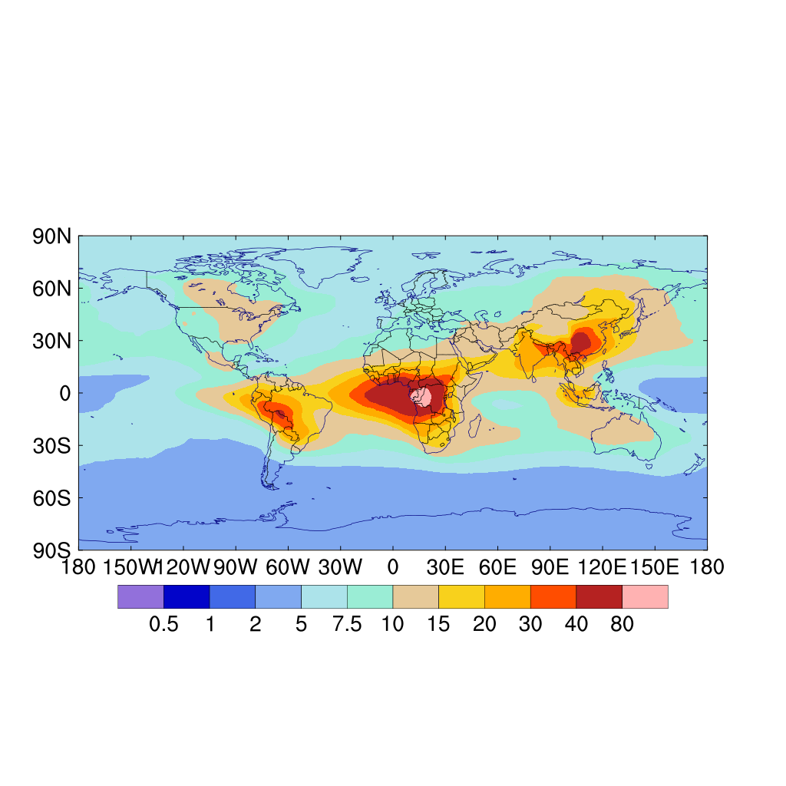
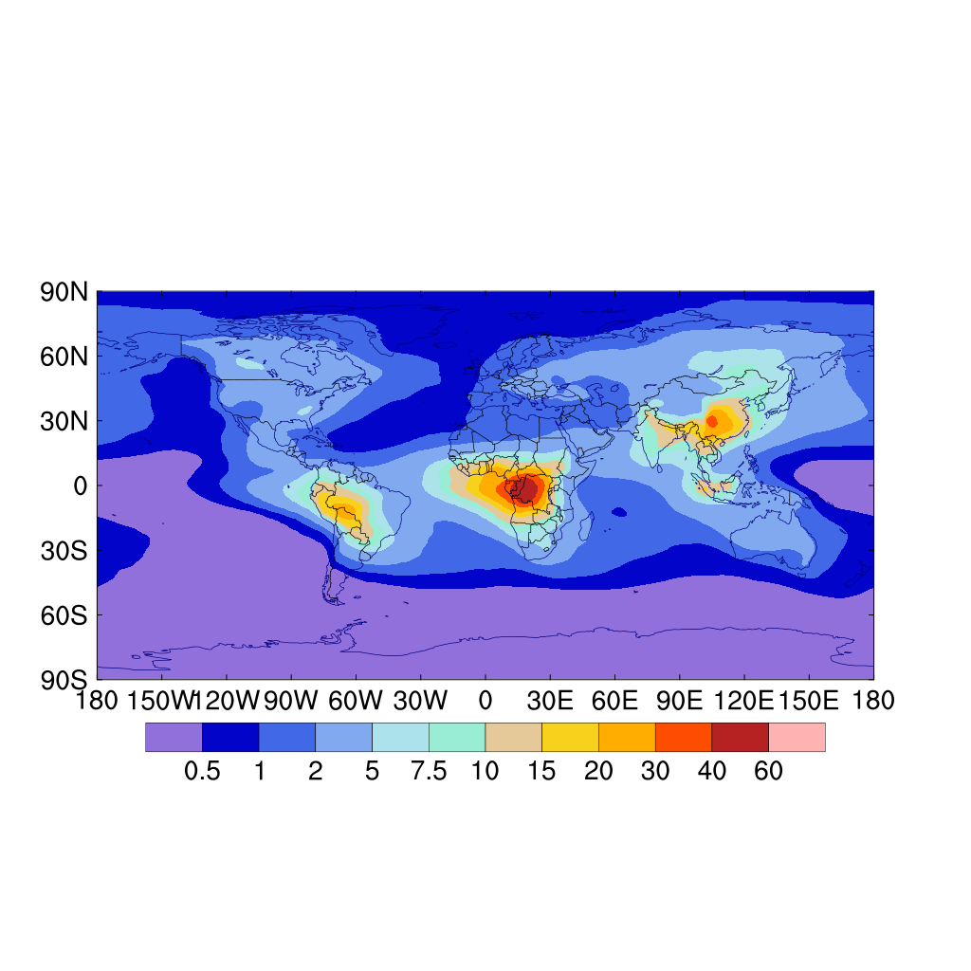
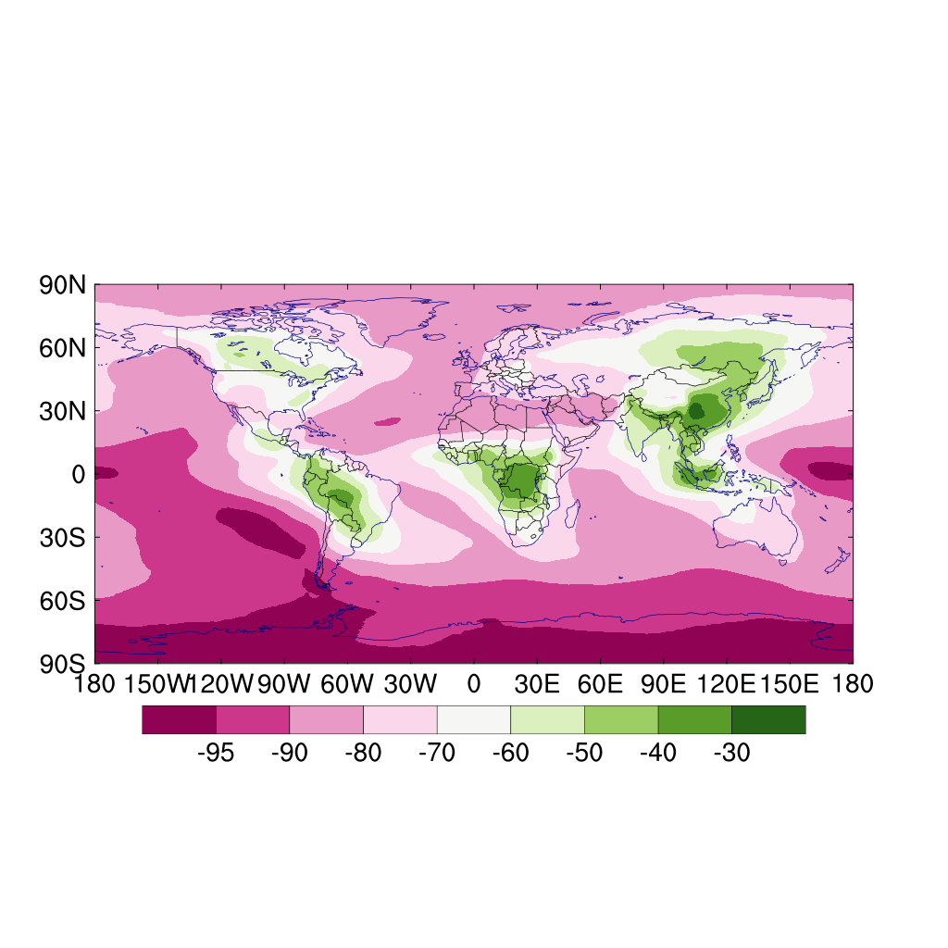
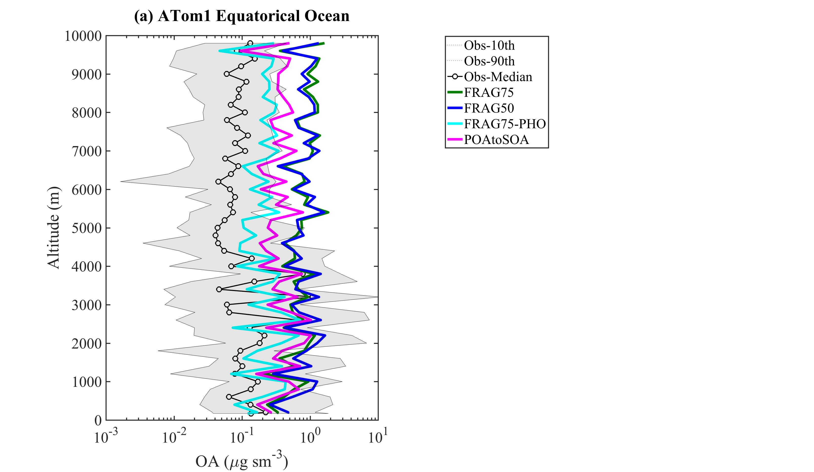
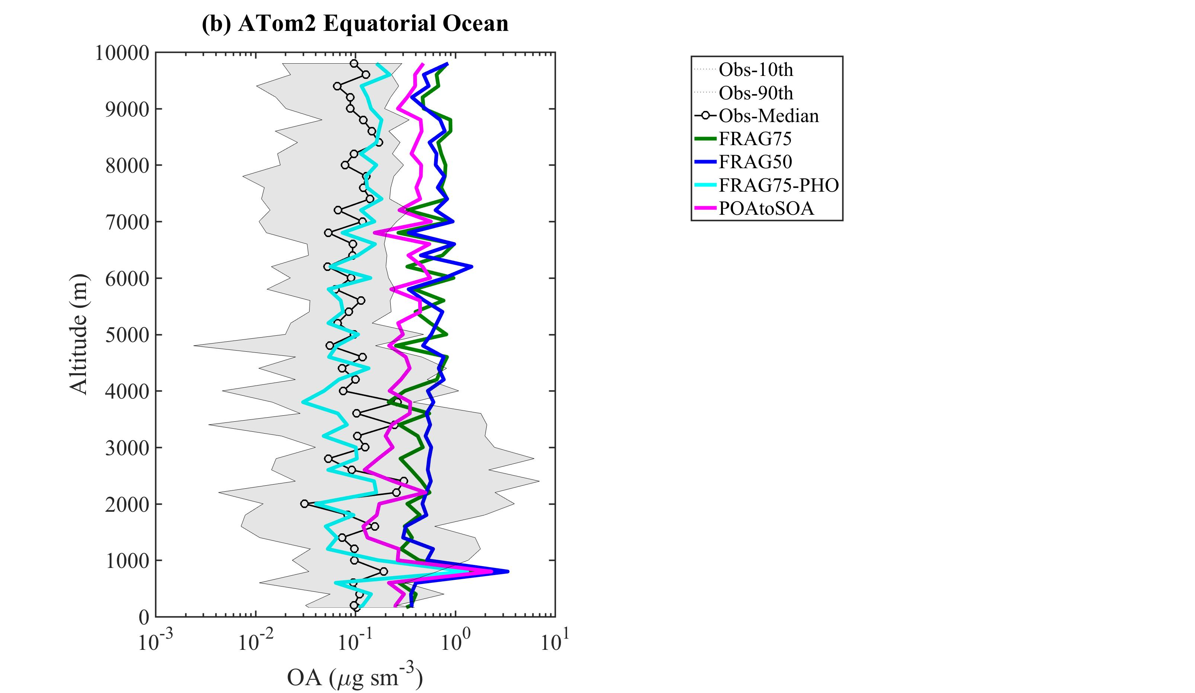
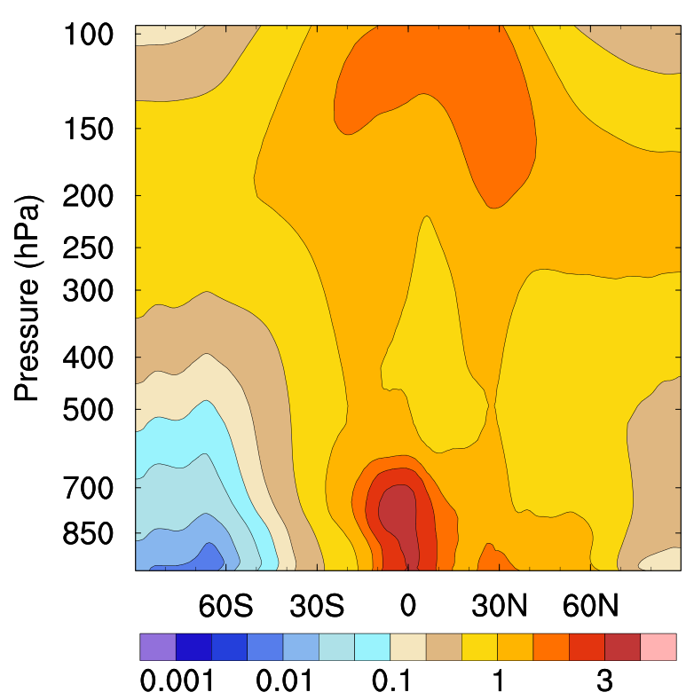
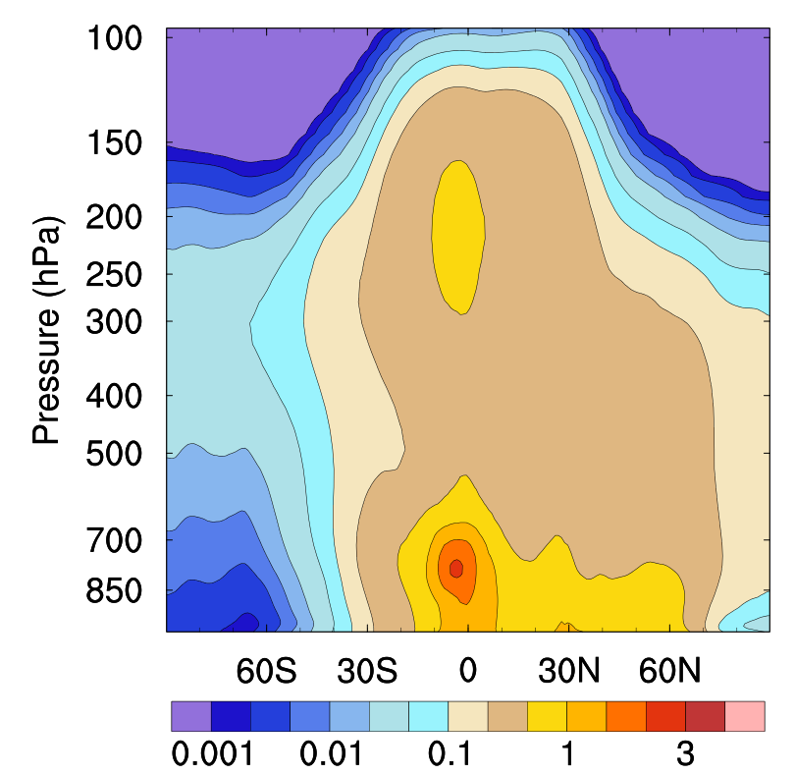
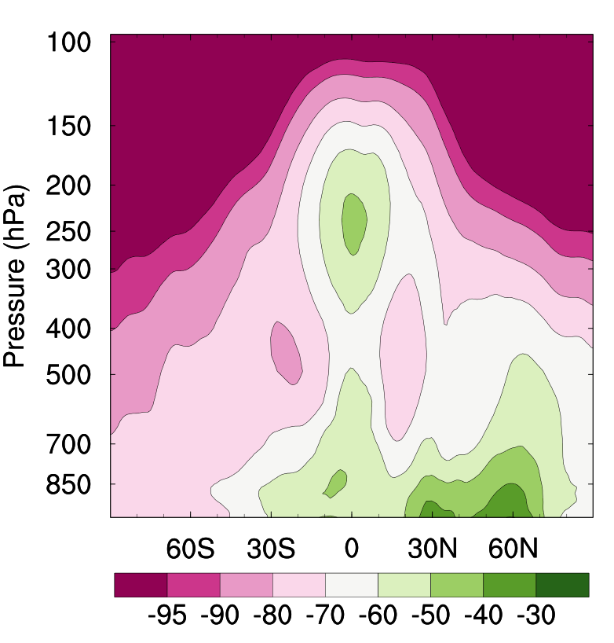
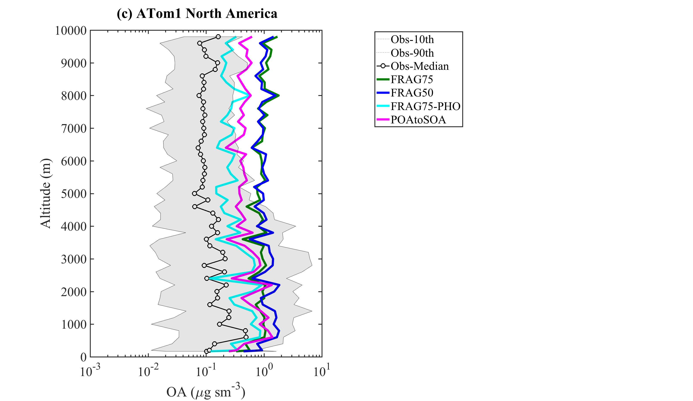
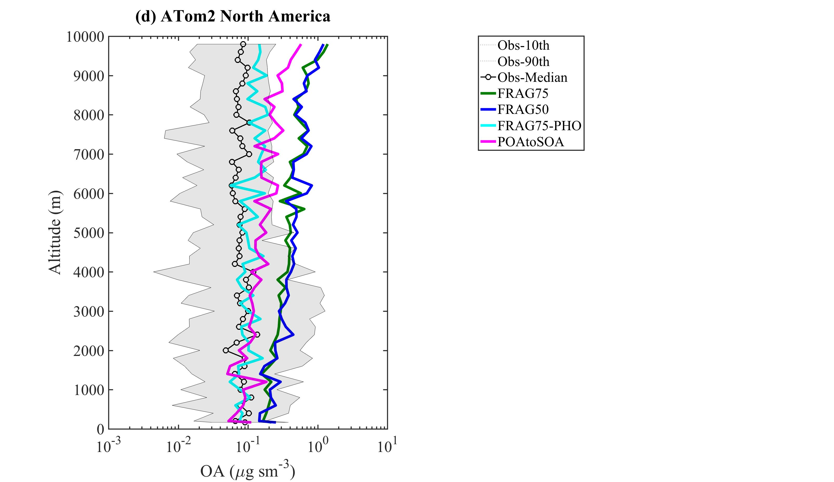
Highlight of the Progress
Manish Shrivastava, Sijia Lou (PNNL)
(a) Photolysis OFF
(b) Photolysis ON
(c) (b – a)/ a $×$ 100%
Photolysis ON
Photolysis OFF
mg m⁻²
mg m⁻²
%
Fig. 1. Effects of particle-phase photolysis on simulated SOA column burdens
(a) Photolysis OFF
(b) Photolysis ON
(c) (b – a)/ a $×$ 100%
Fig. 3. Including photolysis improves simulated SOA vertical profiles significantly compared to Atom2016 aircraft measurements
Fig. 2. Effects of particle-phase photolysis on zonal mean vertical SOA distributions

Slide 26
Milestones (past achievements and future plan)
Manish Shrivastava
Pacific Northwest National Laboratory
Apr. – Sept. 2019
  Added particle-phase photolysis of SOA as a key sink at high altitudes
Oct. – Dec. 2019:
  Write up paper on the performance of new SOA treatments in E3SM
Jan.- Mar. 2020:
  Link new SOA treatments to UCI or Superfast Chemistry mechanisms
Apr. – Jun. 2020:
  Separate SOA sources into biomass, fossil fuel and biogenic categories
Jul. - Sept. 2020:
  Implement new optical properties of SOA (e.g. brown carbon)
Oct. – Dec. 2020:
  Evaluate SOA absorption predictions with measurements

Slide 27
Improving Dust Representation for Water Cycle and BGC in E3SM V3/V4
Yan Feng
Argonne National Laboratory
Outline of project
  Enable a close coupling of atmosphere with land and ocean by improving dust aerosol process as a nutrient supply in E3SM
    Develop dust iron/phosphorous dissolution model
    Implement a new dust emission scheme (Kok et al., 2014) that depends on time-varying soil states
    Develop dust mineral speciation and couple it with iron/phos dissolution model
Summary of Accomplishments (Mar 15, 2019 - Nov. 15, 2019)
  Collaborated with the Cornell/Mahowald group (E3SM University project) and published the paper on development of dust/combustion iron dissolution model (Hamilton et al., 2019)
  Improved the dust size distribution at emission and shortwave absorption; these updates have been integrated into the V2.
  Implemented the new dust emission scheme, and began implementation of the dust speciation code
Summary of Issues (difficulties)
  Need fix the dust over-deposition issue

Slide 28
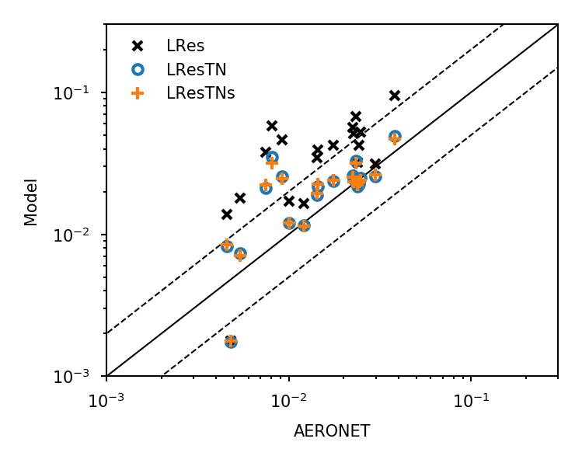
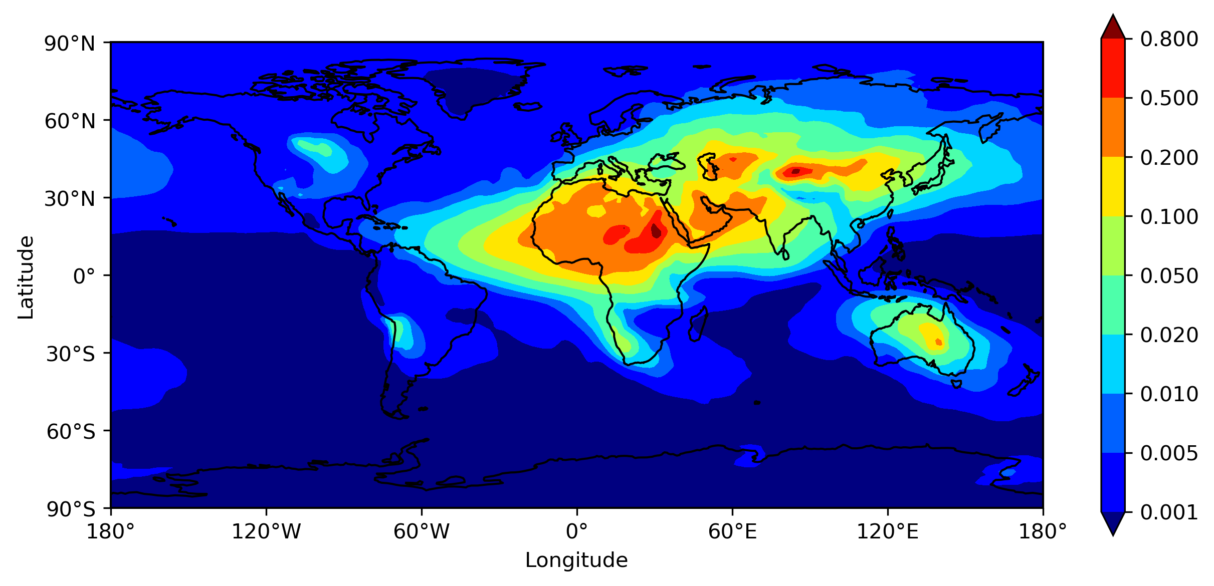
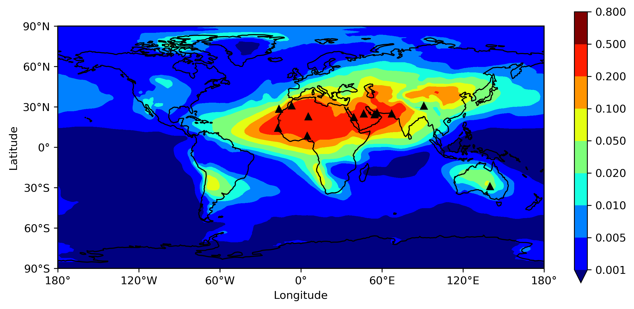
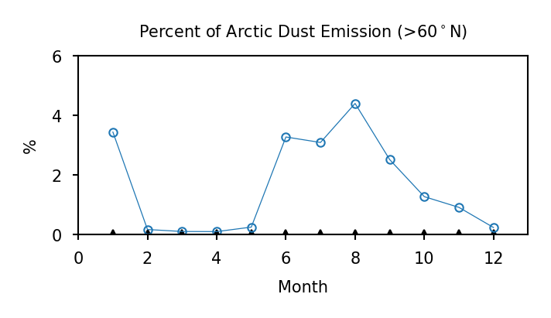
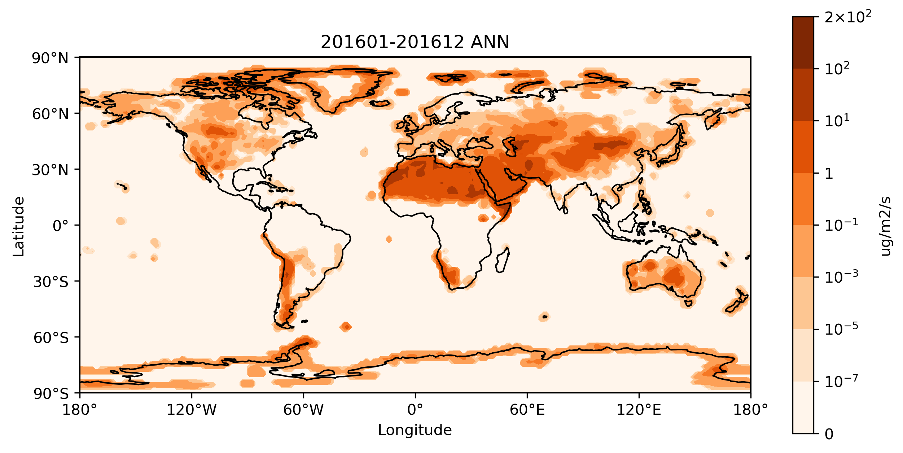
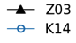
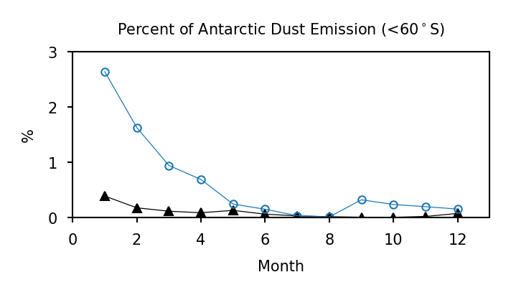
Highlight of the Progress
Yan Feng
Argonne National Laboratory
Z03 (Zender et al., 2003) in E3SM V1
0.028
K14 (Kok et al., 2014)
0.028
V1
V2
Fig. 2. Dust AOD simulated with two emission schemes
Fig. 1. Comparison of absorbing aerosol optical depth from V1 and V2 models with the AERONET observations over dust source regions
K14
5152 Tg
Publications
Hamilton, D. S., Scanza, R. A., Feng, Y., Guinness, J., Kok, J. F., Li, L., Liu, X., Rathod, S. D., Wan, J. S., Wu, M., and Mahowald, N. M.: Improved methodologies for Earth system modelling of atmospheric soluble iron and observation comparisons using the Mechanism of Intermediate complexity for Modelling Iron (MIMI v.1.0), Geosci. Model Dev., 12, 3835-3862. doi:10.5194/gmd-12-3835-2019, 2019.
Fig. 3. High-latitude dust emissions (left) and seasonal cycle (right) with the K14 method
Notes:
Progress on the dust work:
Published the paper on the iron dissolution model (MIMI v1.0) from dust and combustion sources through collaboration with the Cornell/Mahowald university funded E3SM project
Figure 1: shows the improved dust shortwave absorption in V2 from V1, compared with the recent AERONET obs (this data set will be added to the e3sm atmos diagnostics)
Figure 2 & Figure 3 are on the new dust emission scheme being added to the model. It calculates soil erodibility for dust generation online based on predicted soil states from land model, rather than using a fixed map as in V1 model, enabling a close coupling between land and atmospheric processes. Figure 3 shows this new scheme predicts dust emissions in high latitudes (>60N and <60S) related to the glaciation processes, which may have important implications on the high-latitude cloud formation.

Slide 29
Milestones (past achievements and future plan)
Yan Feng
Argonne National Laboratory
Mar. – Jun. 2019: Prepared and submitted the V2 dust updates. Published the Fe dissolution paper
Jul.- Sep. 2019: Implemented the dust new emission and speciation code
Oct. – Dec. 2019:
  Began analysis of the new emission scheme; Fix the over-deposition issue
Jan. - Mar. 2020:
  Perform sensitivity tests of dust emission scheme and dry deposition
Apr - Jun 2020
  Prepare a publication on the new emission scheme
Jul – Sep 2020
  Begin analysis of the dust speciation and iron dissolution
Oct – Dec 2020
  Perform sensitivity tests of dust iron dissolution

Slide 30
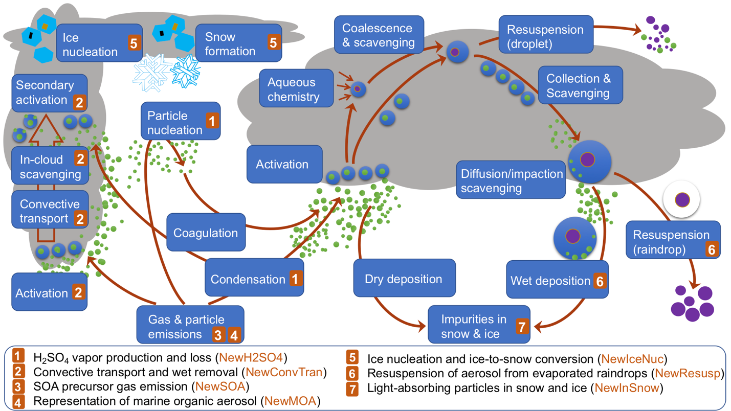
E3SMv1 Aerosol Overview paper revised (Wang et al., 2019)
Notes:
Schematic diagram of aerosol-related processes, denoted by blue boxes in clear air, stratiform cloud (shaded area on the right), convective cloud (shaded area on the left), or ice cloud (shaded area on the upper left) in E3SMv1. Compared to E3SMv0, there are newly added processes (i.e., cloud-base activation and secondary activation in convective cloud; resuspension of aerosols to the coarse mode; aerosol linked to ice nucleation) or old ones that are affected by individual new treatments in E3SMv1. The new treatments are listed in the legend at the bottom and are marked on the processes that are directly modified or added, as detailed in Section 2. The aging process (i.e., primary-carbon mode particles transferred to accumulation mode through condensation and coagulation) is not explicitly depicted here. The diffusion/impaction scavenging process (i.e., capture of interstitial aerosol particles by precipitation particles through Brownian diffusion and inertial impaction, which occurs both in clear air and clouds) is referred to as below-cloud scavenging in previous MAM aerosol studies (e.g., Liu et al., 2012; Wang et al., 2013).

Slide 31

Cloud microphysics development
Jiwen Fan, Kai Zhang, Jingyu Wang
Brief description of the work
Test and evaluate 2-moment Predicted Particle Properties (P3) scheme in E3SM
Further develop the 2-moment P3 into a 3-moment scheme
Summary of Accomplishments (Mar. – Nov. 2019)
Obtained the major results for the E3SM-P3 model development paper
Set up, run, and obtained the major results for the E3SM-P3 evaluation at CONUS RRM 1/4º grid spacing
Summary of Issues (difficulties)
E3SM-P3 is not tuned extensively yet and we need help with it

Slide 32
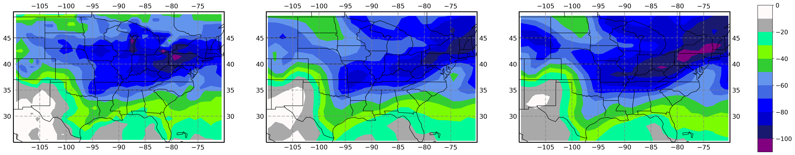
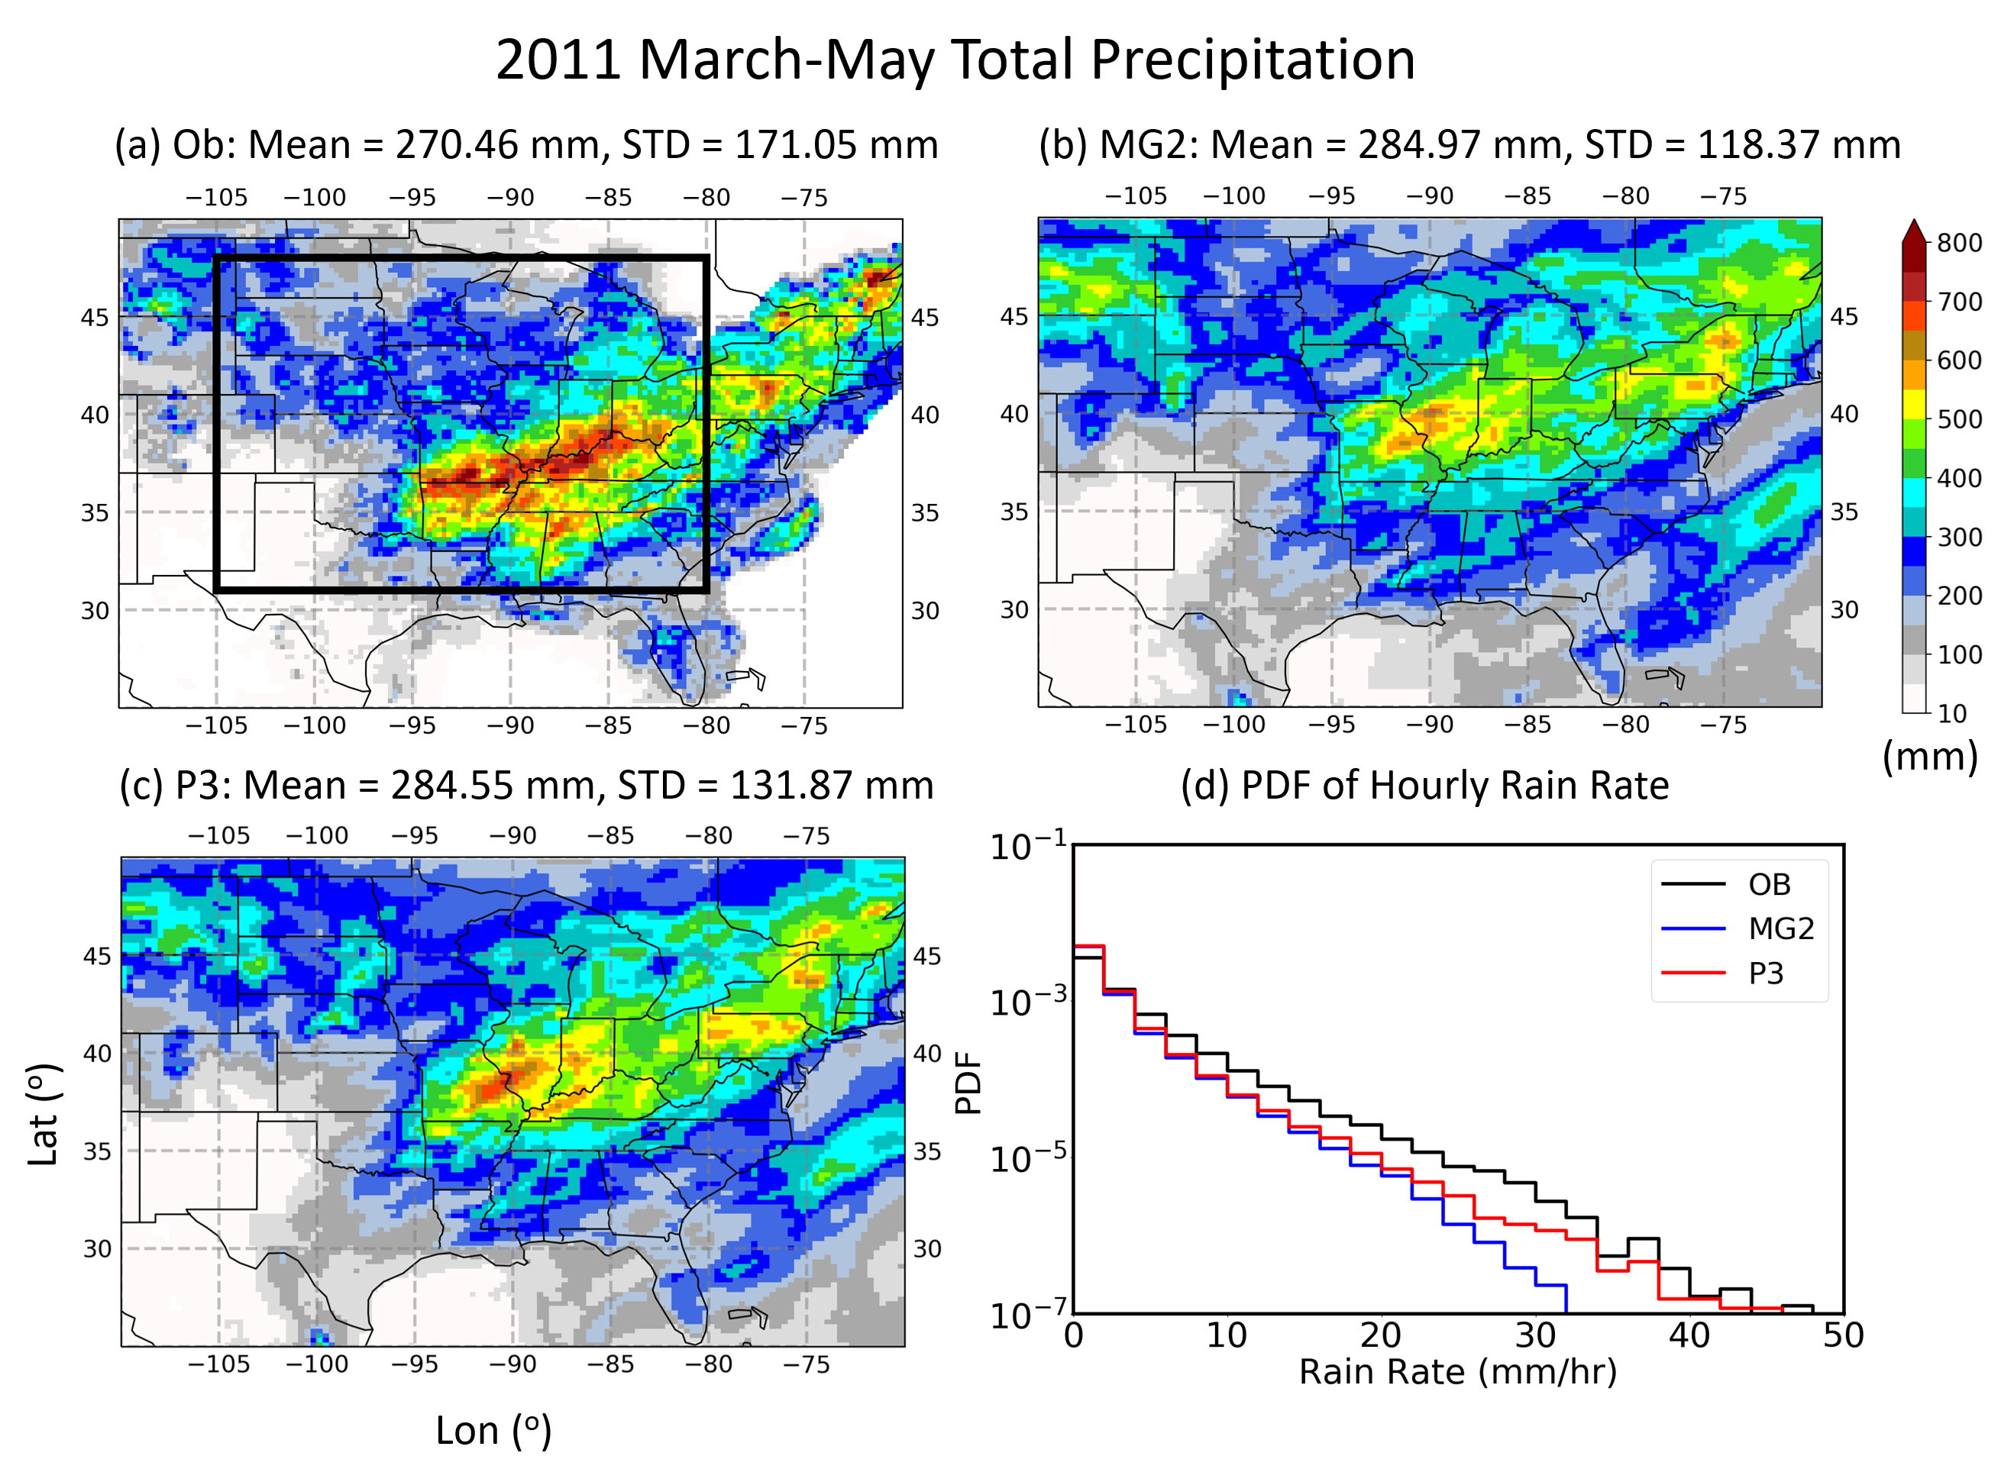
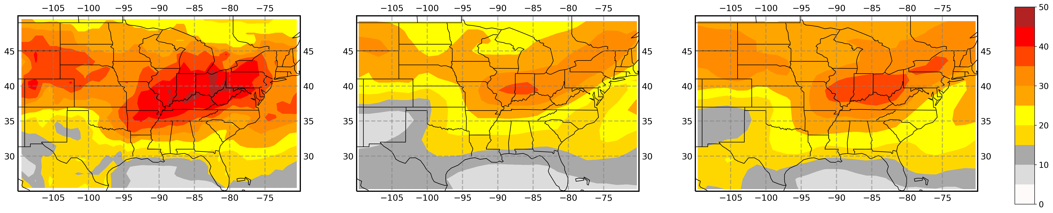
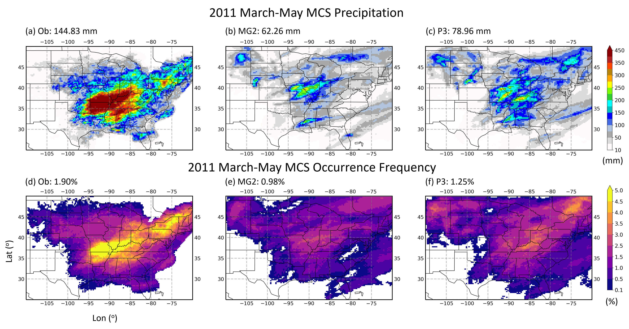
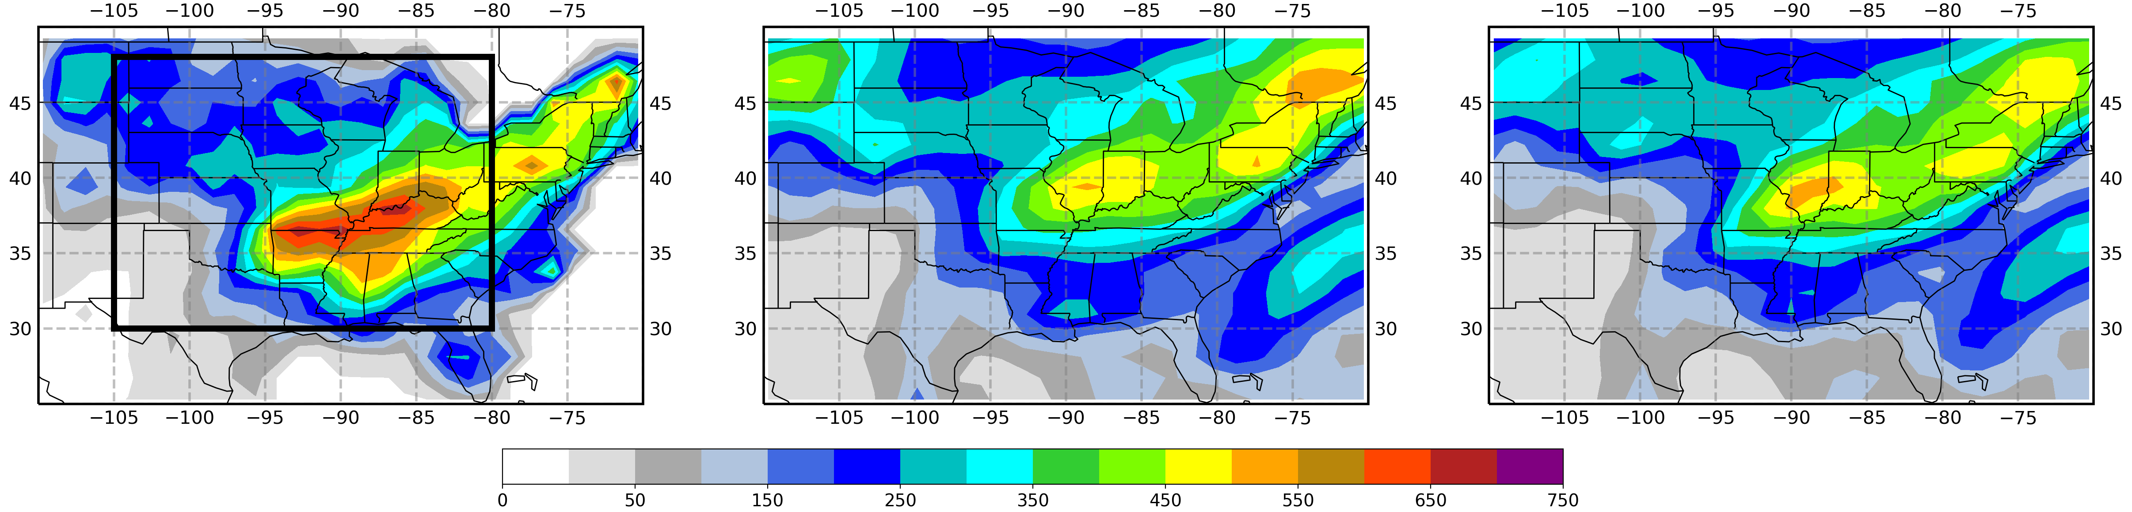
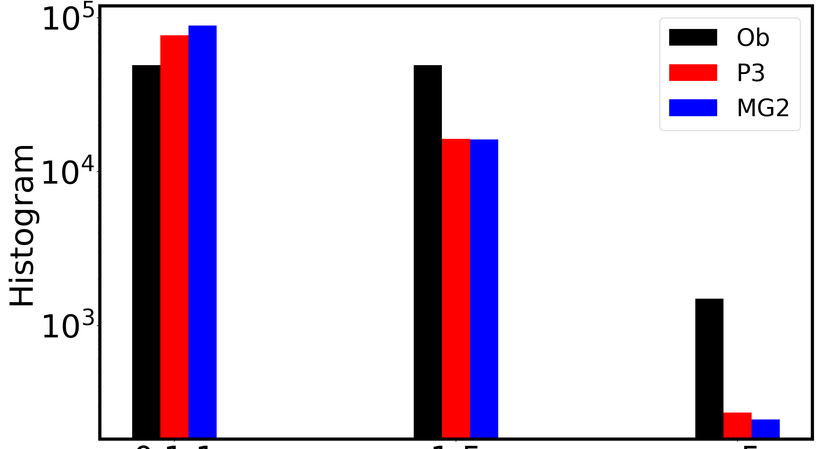
Highlight of the Progress
Coarse resolution (1º)
RRM ¼ º
OBS
MG2
P3
Precipitation
OBS
MG2
P3
SW
171 mm
118 mm
132 mm
LW
Frequency of MCS
1.0%
1.3%
1.9%
Precipitation
At RRM ¼ º, a large gap still exists between model and observed precipitation
Improvements in precipitation and PDF of rain rate by P3 are more significant
P3 improves MCS frequency and the spatial pattern
At 1 deg, P3 shows improvements in SW and LW CRE.
P3 reduces the frequency of light rain and increase that of heavy rain
Light (0.1-1) Moderate (1-5). Heavy (>5)
Hourly rain rate (mm/hr)

Slide 33
Milestones (past achievements and future plan)
Apr. – Jun. 2019:
- Fixed a bug in the ice nucleation scheme that we added and ran sensitivity tests with different parameters
- Set up CONUS RRM 1/4º grid and began some test simulations with MG2 and P3
Jul.- Sep. 2019:
- Finalized the RRM simulations for MG2 and P3 and analyzed the model results.
Oct. – Dec. 2019:
- Further analyzed the results at 1º grid spacing; Finish the draft for E3SM-P3 model development paper.
- Obtained the major results for the CONUS RRM 1/4º simulations; write the draft of the paper.

Slide 34
Milestones (past achievements and future plan)
Jan. - Mar. 2020:
- Submit the E3SM-P3 paper.
- Test P3 with 3-moment rain microphysics in E3SM and full 3-moment P3 in WRF
Apr. – Jun. 2020:
Evaluation of RRM E3SM-P3 with 3-moment rain microphysics, as well as the evaluation of full 3-moment P3 in WRF.
Submit a paper about evaluation of RRM E3SM-P3
July – Sep. 2020:
Obtain the major results for the evaluation of P3 with 3-moment rain microphysics.
Analyze the results about the full 3-moment scheme in WRF.
Oct. – Dec. 2020:
- Submit a paper about the the full 3-moment scheme in WRF.
- Test the full 3-moment scheme in E3SM

Slide 35
CLUBB-SILHS as a deep convective parameterization
PI(s) Vince Larson, UWM
Wuyin Lin, BNL
Project description:
  Implement CLUBB-SILHS in E3SM and let CLUBB serve as the deep convection scheme
Summary of Accomplishments (Mar. 16, 2019 - Oct. 1, 2019)
  Brian Griffin developed and implemented a hole filler for SILHS that conserves water to within machine precision
  Brian enabled BFB restarts of SILHS code by fixing a bug
  Gunther Huebler has begun porting SILHS to GPUs
Summary of Issues (difficulties)
  We are attempting to merge our branch to the latest version of E3SM, but our latest attempt produces a very different climate. Debugging is ongoing.

Slide 36
Subcolumn physics can be computed in parallel, thereby making good use of the GPUs on Summit
PI(s) V. Larson,
W. Lin
DOE’s climate modeling program would benefit from a version of E3SM that can run long-duration climate simulations on Summit.
To run a simulation of long duration (e.g. a 20th-century hindcast), we plan to use coarse resolution (1 degree), which allows the use of a long computational time step.
To provide sufficient work for GPUs, we plan to compute microphysics on many subcolumns.
E3SM’s aerosol physics (MAM) is available to compute indirect effects.

Slide 37
Milestones (past achievements and future plan)
PI(s) V. Larson,
W. Lin
Mar. – Sep. 2019: Developed hole filler that prevents crashes. Done. Began to port SILHS to GPUs.
Oct. - Dec. 2019: Continue to merge SILHS up to head of trunk. Perform initial evaluation of diurnal cycle of precipitation. Continue to port SILHS to GPUs.
Jan. – Mar. 2020: Write microphysics sedimentation in flux form so that can accept level-by-level sample points. Continue to port SILHS to GPUs.
Jan. – Sep. 2020: Port SILHS to GPUs.
Oct. – Dec. 2020: Evaluate revised model with level-by-level sampling and prognostic momentum fluxes.

Slide 38
Eddy-Diffusivity/Mass-Flux (EDMF)
Outline of project
  Improve the simulation of tropical and subtropical boundary layer turbulence, convection and clouds and reduce persistent cloud and convection biases in climate models
  Implement, and validate, the multi-plume stochastic Eddy-Diffusivity/Mass-Flux (EDMF) parameterization in the E3SM framework
  Explore scale-adaptive strategies for EDMF
Summary of Accomplishments (FY 2019)
  Developed a methodology to extract the impact of cold pools on deep convection
  Developed a version of EDMF that unifies dry, shallow, and deep convection
  Tested the sensitivity of this latest EDMF version to different parameters
  Compared EDMF and SHOC implemented in an independent SCM
  Started analysis of the SCREAM code structure and possible implementation strategies for EDMF
  Started running SCM simulations with SCREAM to understand the workflow of the model
Summary of Issues (difficulties)
  More time needed to understand the nuances of the E3SM code structure, modularity, and workflow and its relation to the EDMF code structure

Slide 39
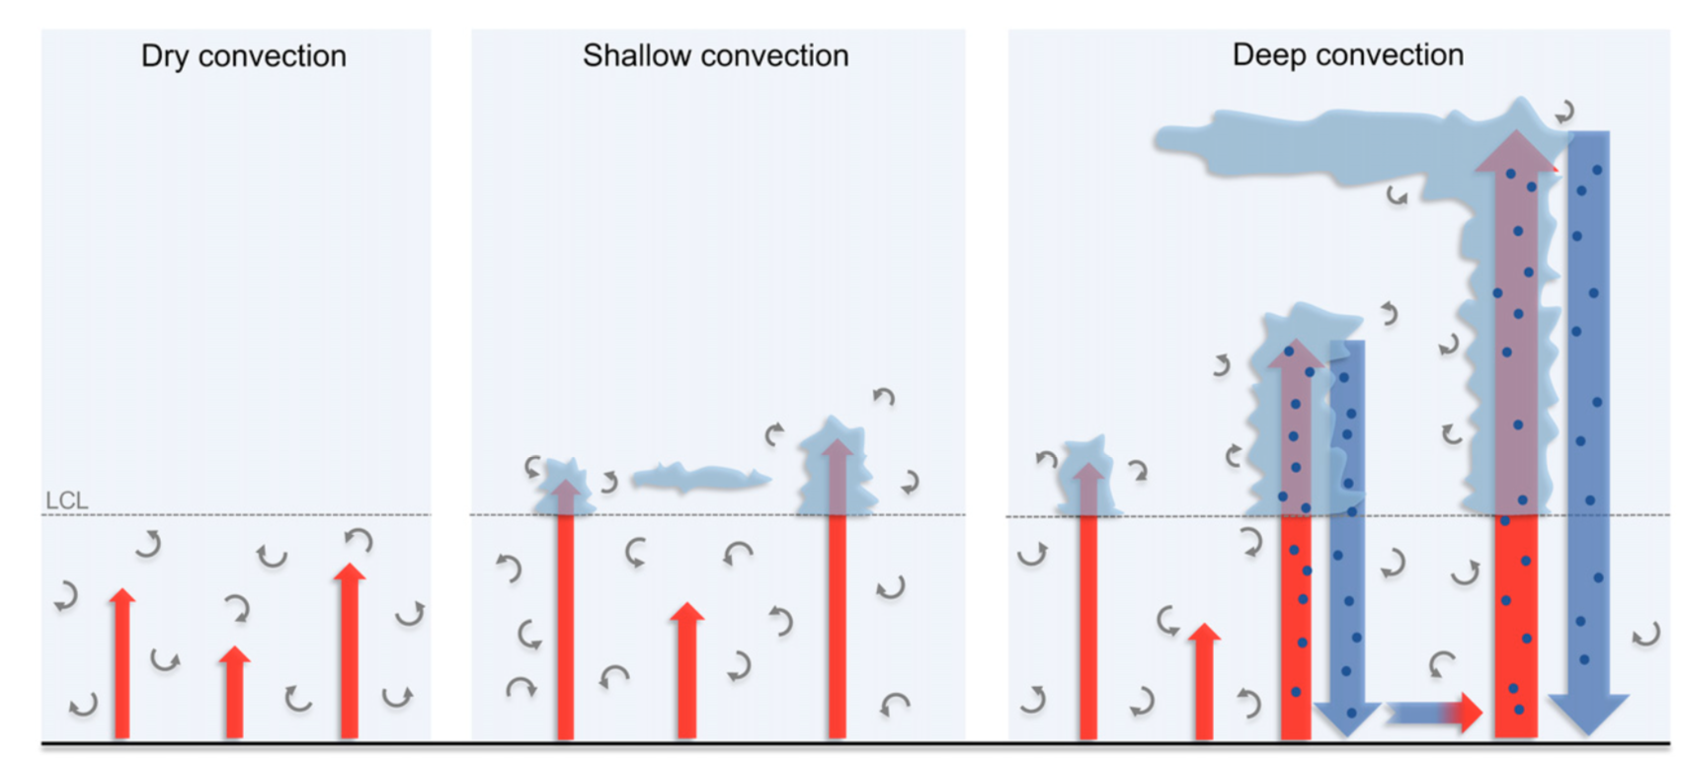
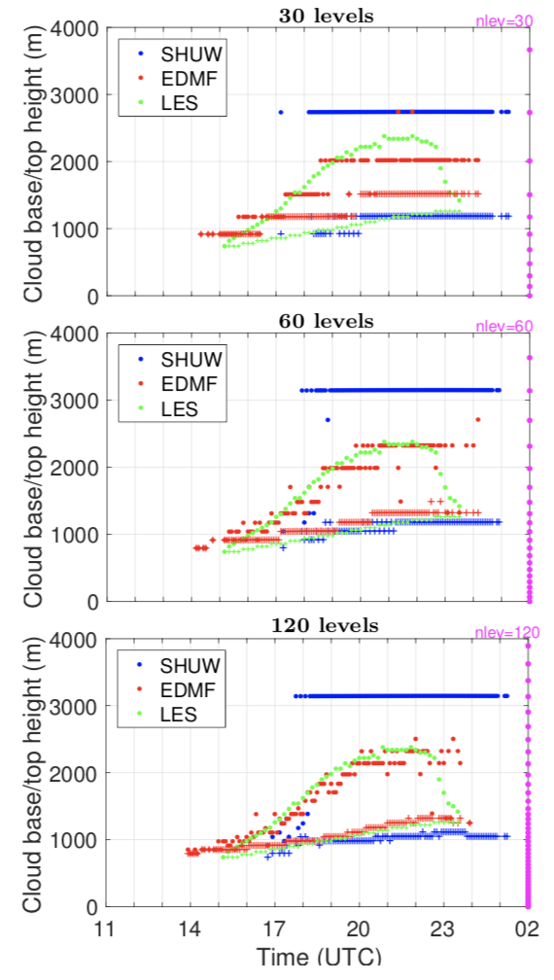
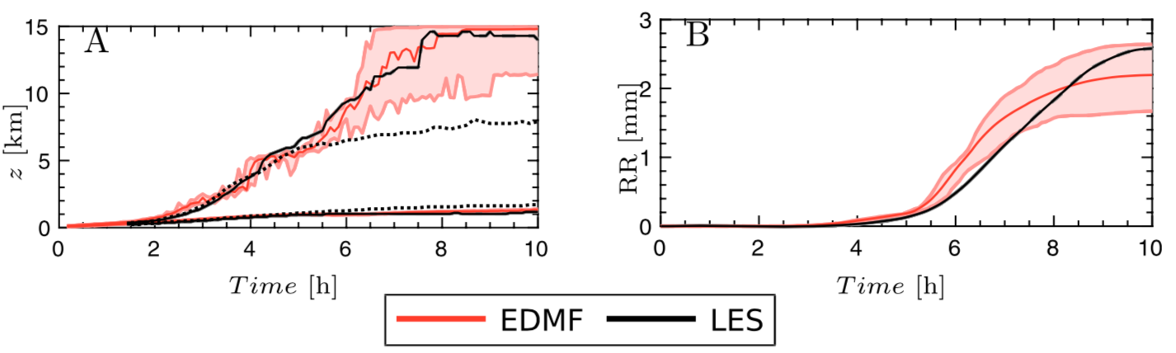
Progress Highlights
Fig. 1. Schematic of three archetypes of convection as represented by the EDMF parameterization (Suselj et al. 2019).
Fig. 3.Diurnal shallow convection as simulated by LES and two CAM5 convection parameterizations: SHUW and EDMF, for different vertical resolutions
(Kurowski et al. 2019).
Fig. 2. Time series of (a) the cloud base and top heights and (b) surface precipitation for the shallow-to-deep convection transition over land (Suselj et al. 2019).

Slide 40
Milestones
Oct. – Dec. 2019:
  Perform simulations with SCREAM Single-Column Model (SCM) for a variety of key LES cases studies.
Jan.- Mar. 2020:
  Implement EDMF parameterization in SCREAM SCM (merge with SHOC).
  Explore Scale-adaptive strategies for EDMF.
Apr. – Jun. 2020:
  Detailed validation of EDMF in SCREAM SCM for a variety of key LES case-studies and DOE MAGIC observations.
Jul. - Sep. 2020:
  Perform preliminary full 3D simulations with the EDMF version of SCREAM.
Oct.-Dec. 2020:
  Perform preliminary validation analysis of full 3D simulations with the EDMF version of SCREAM.

Slide 41
Coupling SHOC with ZM for low-res E3SM V3-Water Cycle
Chris Terai
LLLNL
Outline of project
  Determine whether simulations with Simplified Higher-Order Closure (SHOC) and Zhang-MacFarlane (ZM) produce a climate appropriate for V3 Water Cycle science questions
    Run simulations that use SHOC & ZM (+P3+RRTMGP)
    Evaluate model performance
    Compare alongside E3SMv1
  Explore improvements of the model configuration
    Explore modifications to model physics
    Explore improvements with resolution changes
Summary of Accomplishments (Oct. 1, 2019 – Nov. 14, 2019)
  Successfully ran ~1deg (ne30) simulations with SHOC and ZM using compset produced by Peter Bogenschutz
Summary of Issues
  Need an evaluation criteria for Water Cycle experiments (e.g., what are non-starter biases?)

Slide 42
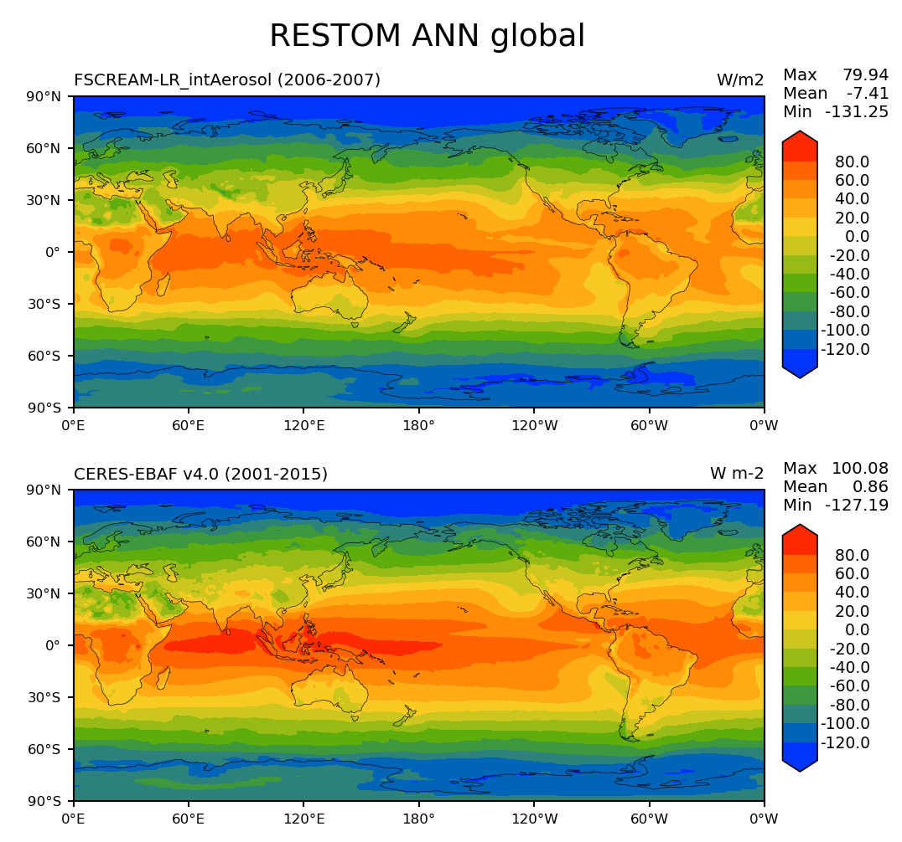
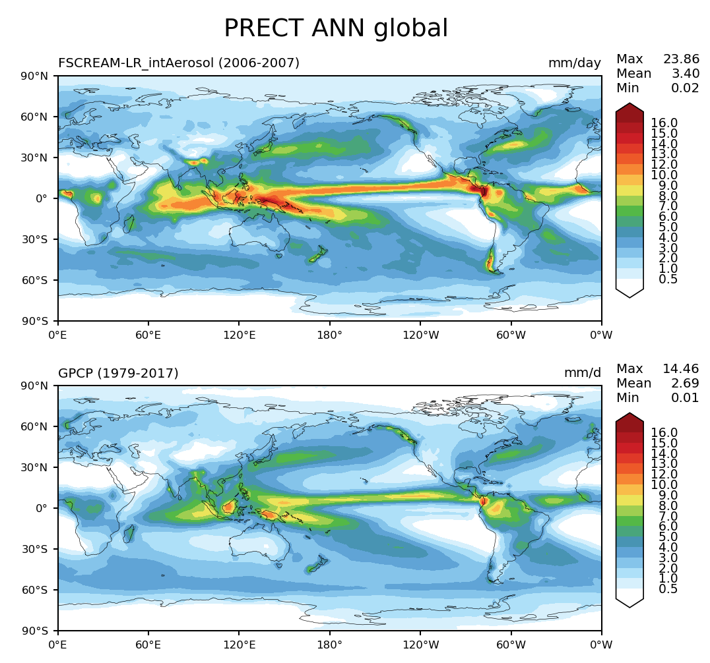
Highlight of the Progress
Chris Terai
LLLNL
UNTUNED
UNTUNED
Fig. 1. Top of atmosphere radiation with respect to CERES
– although clouds reflect more sunlight, model captures general pattern
Fig. 2. Precipitation rate with respect to GPCP
– like many other climate models, precipitation is stronger

Slide 43
Milestones (current progress and future plan)
Chris Terai
LLLNL
Oct. – Dec. 2019:
  Run initial simulations with SHOC and ZM, report the fidelity of simulated climate with respect to observations
Jan. – Mar. 2020:
  Determine minimum level of complexity of the model to obtain a workable climate
Apr. – Jun. 2020:
  Experiment with parameter settings that improve climate
Jul. – Sept. 2020:
  Introduce any necessary structural improvements to model physics
Oct. – Dec. 2020:
  Perform parameter sensitivity tests with model, potentially leading to paper

Slide 44
Enhancing Convection Parameterization for Next Generation E3SM
Guang Zhang
Scripps Institution of
Oceanography
Outline of project
  Improve the simulation of precipitation distribution and statistics by enhancing the representation of convective processes in E3SM
  Add a stochastic convective parameterization component to the Zhang-McFarlane (ZM) scheme
  Make current convection scheme scale-aware
  Add convective microphysics parameterization and couple it with convective dynamics
Summary of Accomplishments (March 16, 2019 – Nov. 18, 2019)
  Carried out sensitivity test of stochastic convection scheme in E3SMv1.
  Performed analysis of scale-awareness of ZM scheme using cloud-resolving model data.
  Implemented a convective microphysics scheme into E3SMv1
Summary of Issues (difficulties)
  Incorporation of P3 into convective microphysics scheme

Slide 45
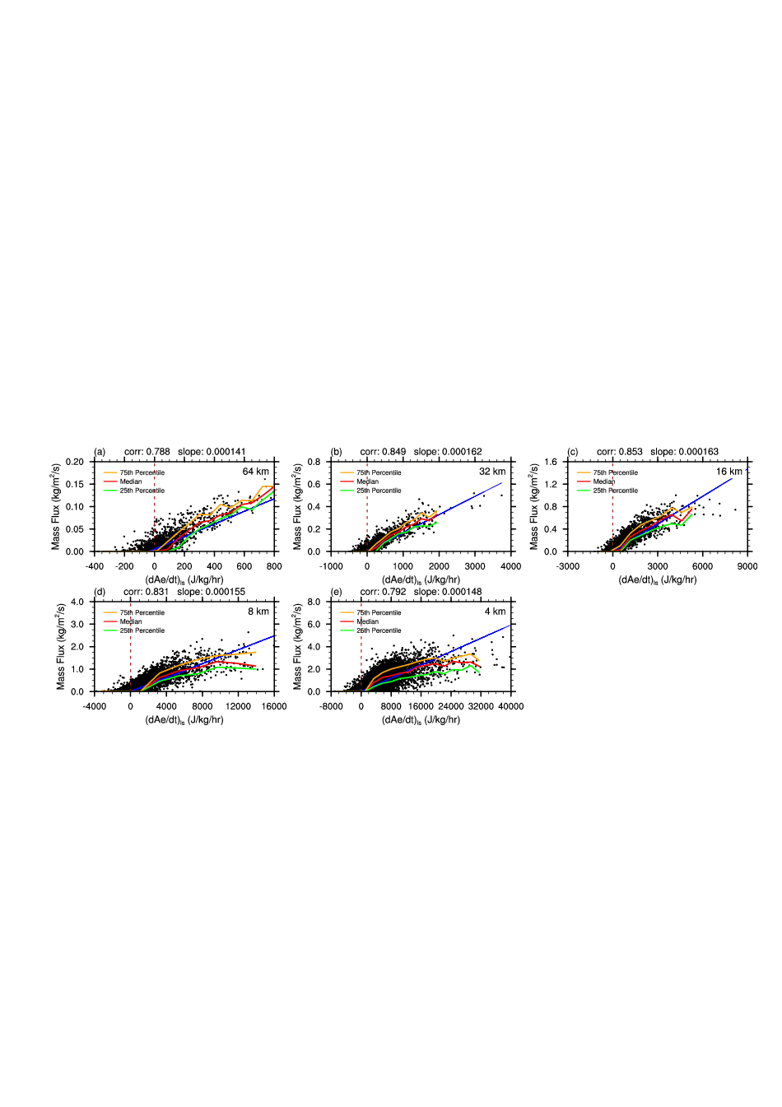
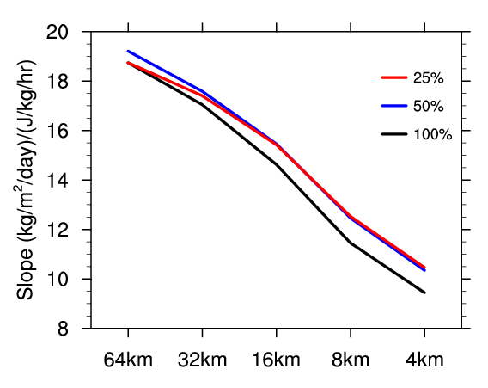
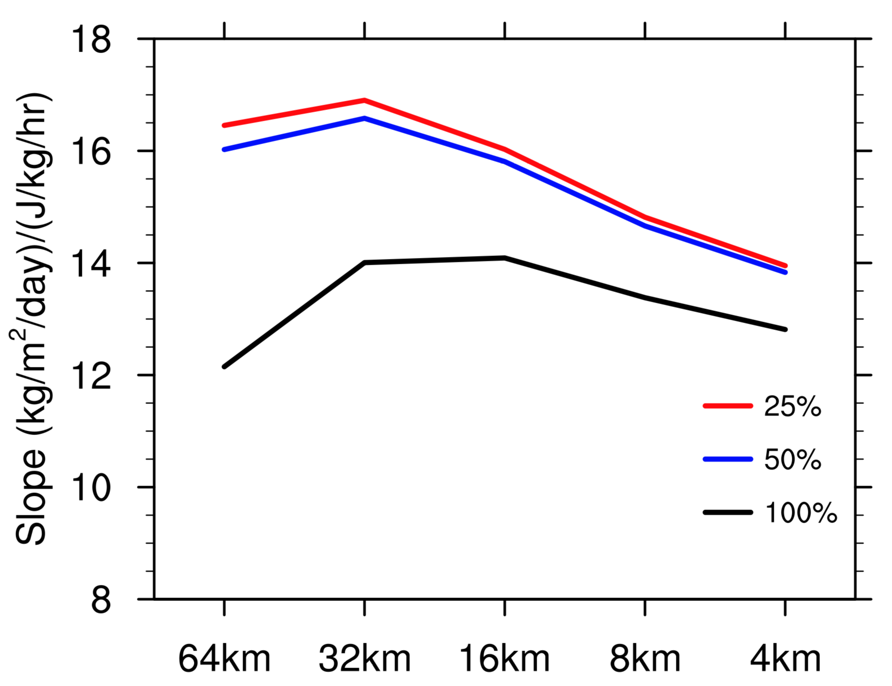

Highlight of the Progress
Guang Zhang
Scripps Institution of Oceanography
Fig. 1. Scatter plots of convective mass flux at 600 mb and dCAPE for different subdomain sizes from TWP-ICE simulation. The blue line is linear regression, with correlation coefficient and slope shown at the top of each plot.
MC3E
TWP-ICE
Fig. 3. Regression slope of convective mass flux at 600 hPa as functions of dCAPE at different GCM-equivalent resolutions from CRM simulation of MC3E and TWP-ICE convection for the strongest 25%, 50% and all (100%) convection.
Fig. 2. Joint pdf of 500 hPa convective mass flux as functions of dCAPE and 500 hPa grid-scale vertical velocity (MC3E case).

Slide 46
Milestones (past achievements and future plan)
Guang Zhang
Scripps Institution of
Oceanography
Apr. – Jun. 2019:
  Began analysis of scale-awareness of ZM scheme using CRM data
Jul. - Sept. 2019:
  Performed sensitivity tests of stochastic scheme.
Oct. – Dec. 2019:
  Write up paper on scale-awareness of dCAPE closure.
Jan. –Mar. 2020:
  Write up paper on performance of stochastic scheme in E3SM1.
Apr. –Jun. 2020:
  Develop a scale-aware version of ZM scheme.
Jul. –Sept. 2020:
  Implement scale-aware ZM scheme into E3SMv1 and test it.
Oct. –Dec. 2020:
  Test convective microphysics scheme in E3SMv1 and evaluate its performance.

Slide 47

Momentum Transport by GWs
Richter, Chen, Moncrieff
NCAR
Improved QBO
Goal:
To improve the representation of the QBO in E3SM
Progress:
Modified convective GW parameterization and improved the QBO period; Results published in Richter et al. (2019)
Richter et al. (2019): “Improved Simulation of the QBO in E3SMv1”, JAMES,

Slide 48




Momentum Transport
by Convection
Richter, Chen, Moncrieff
NCAR
Goal: To represent mesoscale organization in E3SM
Progress: Added mesoscale heating profile and testing free parameters; Demonstrated significant improvement of the MJO
Multiscale Coherent Structure Parameterization (MCSP)
EAM Control:
EAM with MCSP Q:
Added Mesoscale Heating Profile:
$$Q_{m}=Q_{ZMDT} \frac{π}{2}\left(\frac{P_{Qtop}−400}{300}\right)$$

Slide 49
Roadmaps for Jan-Dec 2020
EPIC 4: Momentum Transport by Convection and GWs (Yaga Richter)
  Jan – Mar 2020:
    Implement wind shear dependent trigger into the MCSP;
    Test various combinations of tunable parameters and examine effects on simulation of precipitation, MJO, and Kelvin waves
  Apr – Jun 2020:
    Run single column and nudged simulations with E3SM and compare Convective/Mesoscale Momentum Transport against WRF simulations
  Jul – Sep 2020:
    Write up findings for publications
  Oct – June. 2020:
    Work with MCSP parameterization and other changes to convection in E3SM

Slide 50
E3SM Atmosphere Model tuning and evaluation
Yun Qian
Yuying Zhang
Shaocheng Xie
Outline of project
Using various methodologies (e.g. simulator, PPE) and metrics to better understand model behaviors and physics and to help model evaluation and tuning at both global and process level.
Design and conduct new short PPE simulations.
Maintain and update the satellite simulator package (COSP) in E3SM.
Develop new metrics and perform analysis for assessment of deep convection and other schemes.
Summary of Accomplishments (April 1, 2019 - Nov. 15, 2019)
Upgraded COSP in E3SM to version 2 (COSPv2)
Contributed E3SM papers (Published lead author on cloud evaluation with COSP, contributed the high-res coupled paper, etc.)
Analyzed parametric sensitivity of clouds over different regions and cloud regimes to better understand the EAM model physics and behavior at process level.
Summary of Issues (difficulties)
  MODIS simulator not working appropriately in inline COSPv2

Slide 51




Progress
Cloud evaluation of coupled simulations at high resolution
Dependence of Model Parametric Sensitivity on Cloud Regime
Calipso -- Annual mean total cloud fraction
LR run using the same tuning parameters as HR
Hi-Res produce less clouds than Low-Res
Hi-Res shows more regional features of cloud distribution
COSPv2 new diagnostics:
Lidar opaque cloud diagnostics
CloudSat near-surface precipitation diagnostics
Warm-rain diagnostics

Slide 52
Roadmaps for Jan-Dec 2020
EPIC 9: Model tuning and evaluation (Yun Qian and Yuying Zhang)
  Jul. - Sept. 2019
    Help the analysis of cloud simulations with COSP for high-res coupled paper
    Analyze PPE-EAMv1 results focusing on cloud and process level and write the 2nd PPE-EAMv1 paper.
  Oct. – Dec. 2019
    Merge COSP v2 in E3SM master and fix the MODIS simulator
    Select uncertain parameters and start new (e.g. PPE-SILHS) simulations.
  Jan. - Mar. 2020
    Submit the paper of parametric sensitivity focusing on different cloud regimes based on PPE simulations
    Work with the major NGD tasks to Collect and build metrics for evaluating the impacts of their changes
  Apr. – Jun. 2020
    Analyze the new PPE (e.g. SILHS or other schemes) simulations
    Diagnose the performance of the features from individual tasks and start the assessment of the improvements from different parameterizations and new treatments
  Jul. – Dec. 2020
  . Help analyze EAMv2 results.
  . Submit a paper based on new PPE (e.g. SILHS or other schemes) simulations

Slide 53
General Discussion

Slide 54
Timeline
Complete most Implementations in V1
Merge to and test new features in V2
Integrate all new features for various V3 options
Tuning and optimization for V3
3-moment P3
Complete test of 3-moment P3
Use non-hydrostatic dycore
Integration, tuning, and optimization
Initial test of CLUBB-SILHS, EDMF
Make SHOC+ZM, SILHS and EDMF suitable for deep convection
Address scale-awareness issue for deep Convection
Documentations and Scientific analysis
Test Stochastic scheme/improve scale-awareness and momentum transport
Improved deep convection based on ZM
Continue to evaluate and enhance the new features
Work with core groups to address issues raised from science campaigns
Improved Aerosols and dust emissions
Address SILHS computational issues
Decision on Convection for various configurations
UCI-Chemistry
Dec 31, 2019
Dec 31, 2020
Dec 31, 2021
June 30, 2022

Slide 55
V3 model configurations (ongoing discussion)
Water Cycle
Biogeochemistry
Cryosphere
Atmosphere
CAM-SE NH dycore
Range: 3 km – 100 km global
Atmosphere
CAM-SE NH dycore
RRM: 100/25 km (N. America)
Atmosphere
CAM-SE NH dycore
RRM: 100/25 km (Antarctica)
SCREAM physics; CP and GWD from NGD; simple/prescribed aerosols
NGD atmospheric physics
NGD atmospheric physics
Ocean/ice
RRM: ~ 6 km near North America; 30 – 60 km elsewhere
Ocean/ice
RRM: ~ 6 km near Antarctica; 30– 60 km elsewhere
Include ice sheet and wave
Ocean/ice
Options: MPAS-O/ice; mixed layer; prescribed SST
Land/river
12 km global
Physics from land NGD including dynamic vegetation and C/N/P cycle and GCAM
Land/river
Range: 3 km – 50 km global
Subset of physics from land NGD more relevant for water cycle
Land/river
12 km global
Physics from land NGD including dynamic vegetation
From Ruby’s Talk

Slide 56


E3SM Capabilities Roadmap
CPU and KNL systems
GPU Systems
E3SM v2 (Today’s Machines)
  Watercycle, Cyrosphere, BGC
  O(5000) simulated years per year low-res
  O(100) simulated years per year high-res
E3SM v3 (2-5 years)
  Cyrosphere and BGC simulations with prognostic aerosols.
E3SM v2 (Today’s Machines)
  E3SM-MMF Superparametization. (atmosphere only development simulations)
  Ocean/Ice simulations (CORE forced)
E3SM v3 (Exascale 2-5 years)
  Watercycle simulation campaign (prescribed aerosol, Cloud Resolving atmosphere simulations)
  E3SM-MMF: First use of super-parameterization for a candidate full Earth system model.
E3SM v4 ( 6-10 years)
  Full Earth System Model running on both CPU & GPU systems.
From Mark’s Talk

Slide 57
END

