Slide 1
v2 Scenario Plans

Slide 2
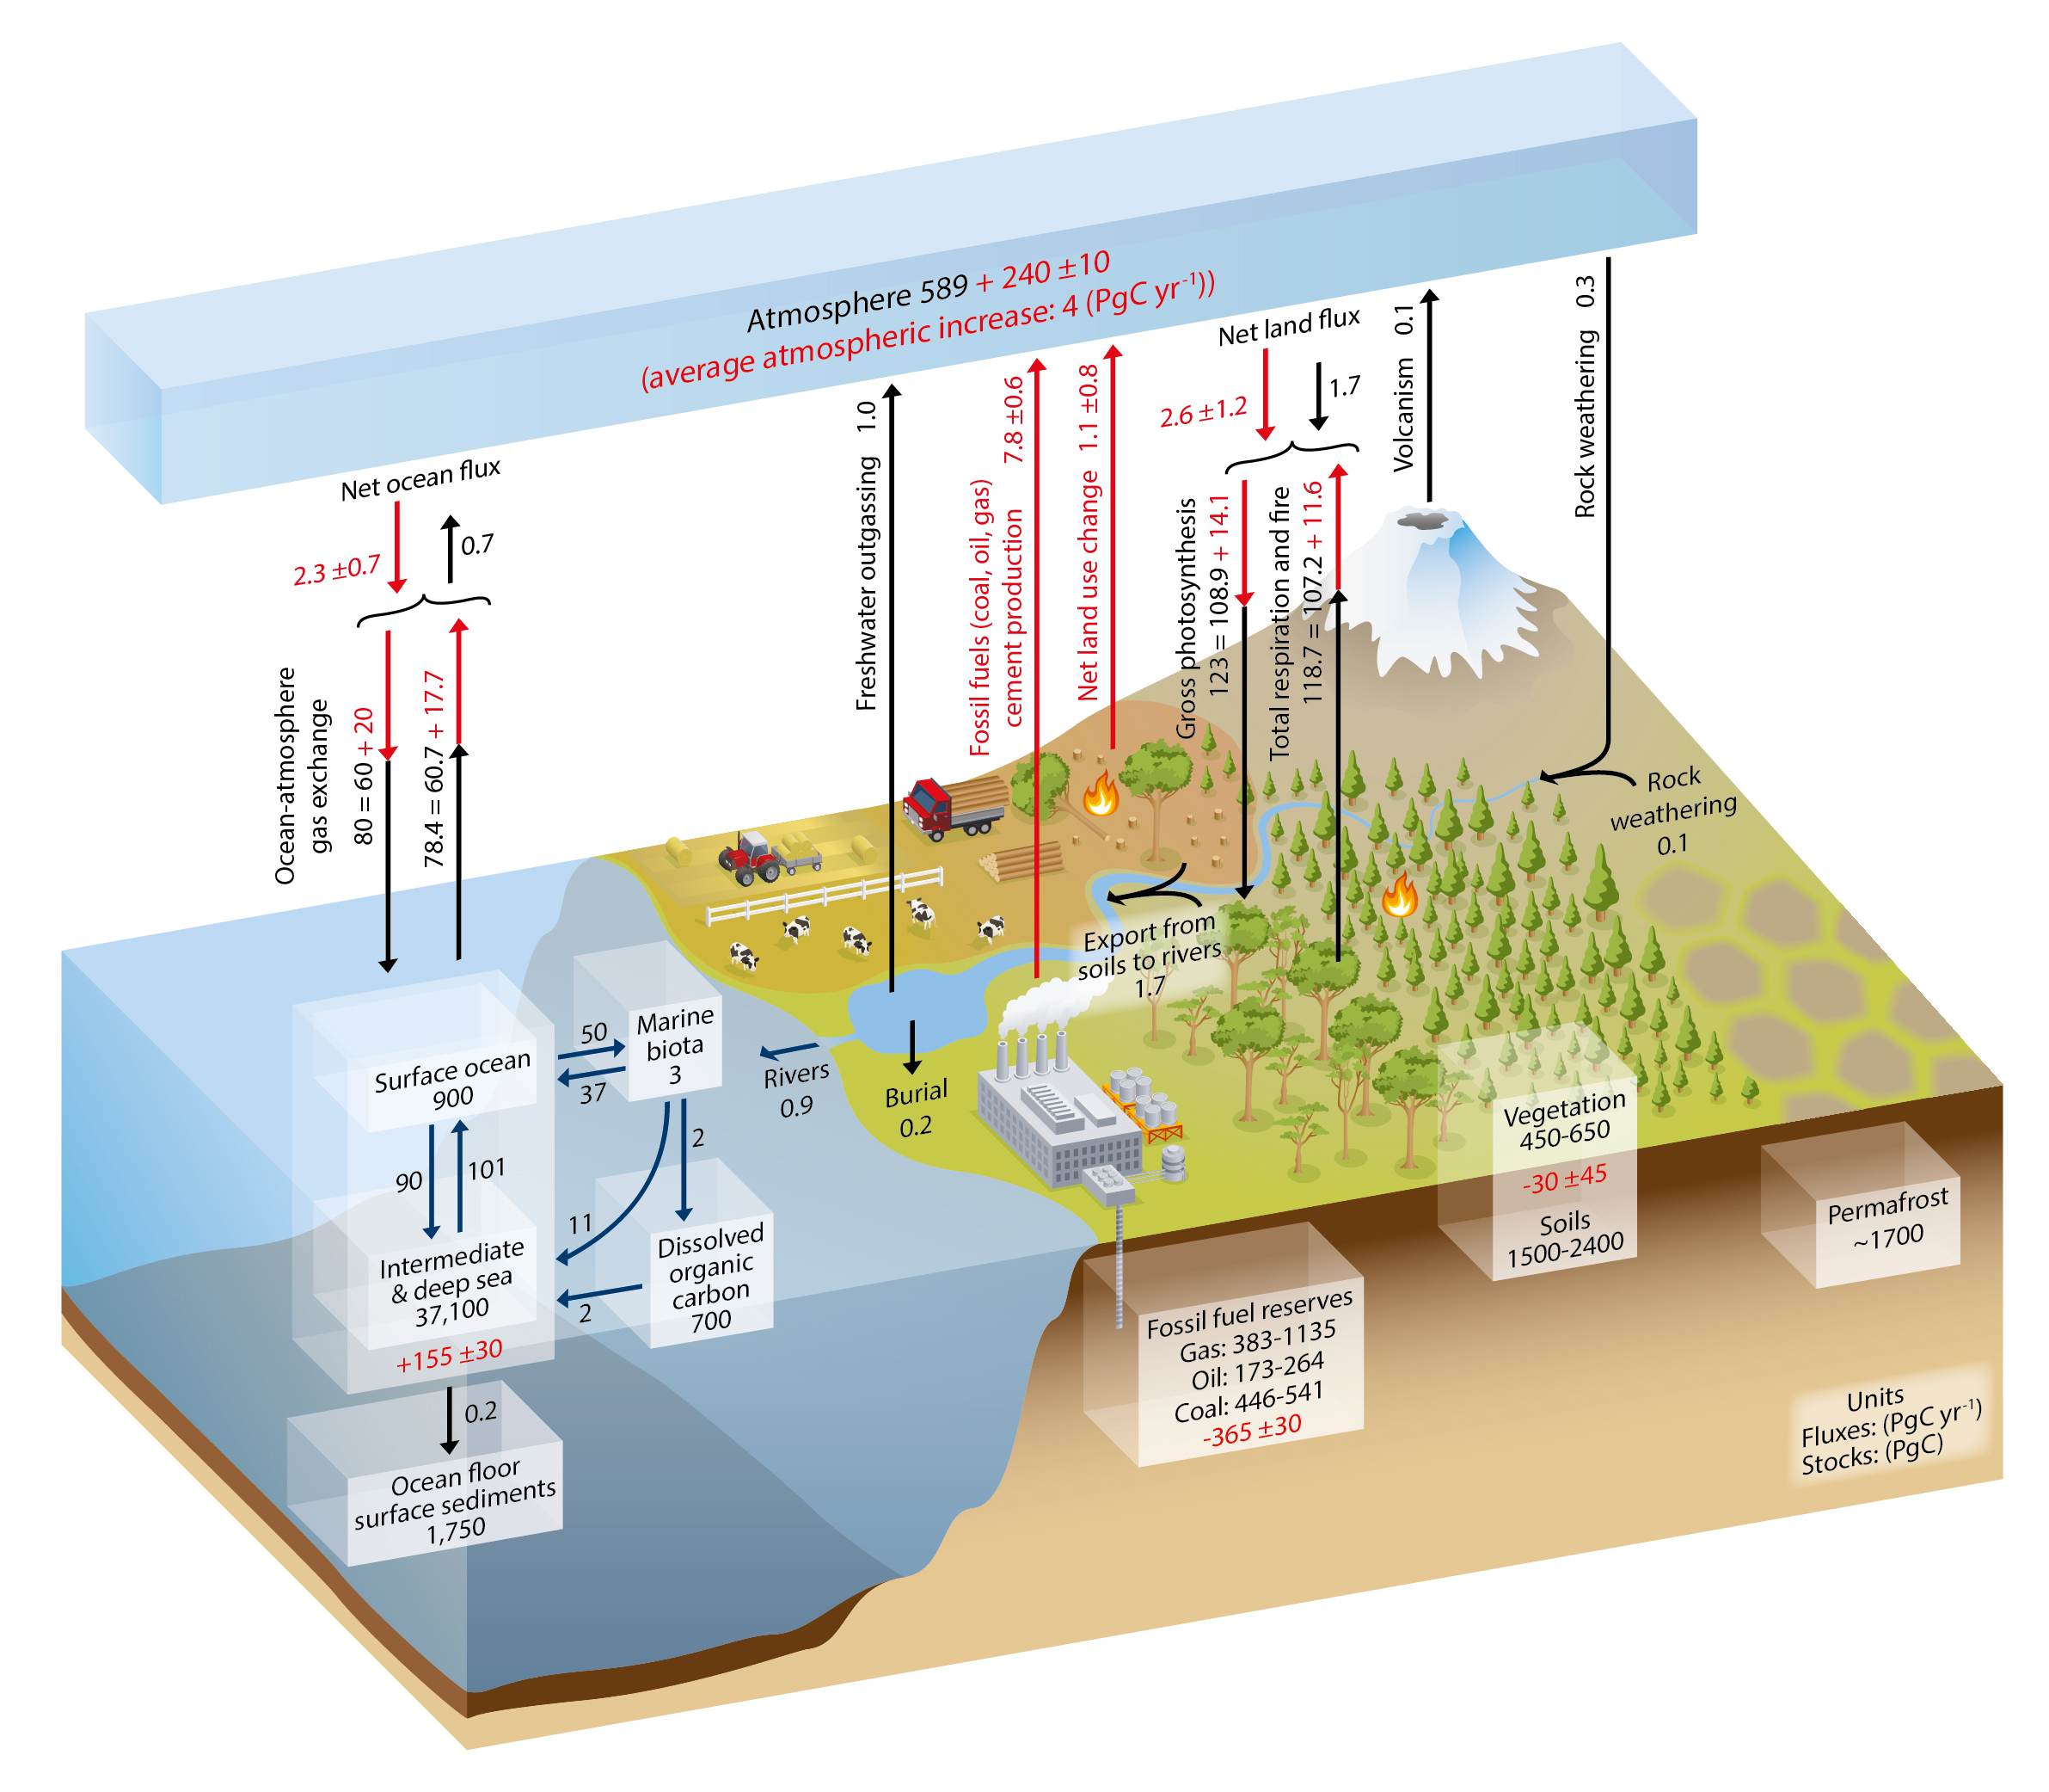
Motivation: Future changes in the Earth system have consequences for biogeochemistry, both globally and in the US.
The RCP8.5 results in:
Increased air temperature,
Soil drying in North America,
Increased forest fires in the US, and
Permafrost thaw.
These changes could reduce terrestrial carbon storage and ocean carbon uptake.
The Global Carbon Cycle
Source: IPCC AR5 WG1 Ch6

Slide 3
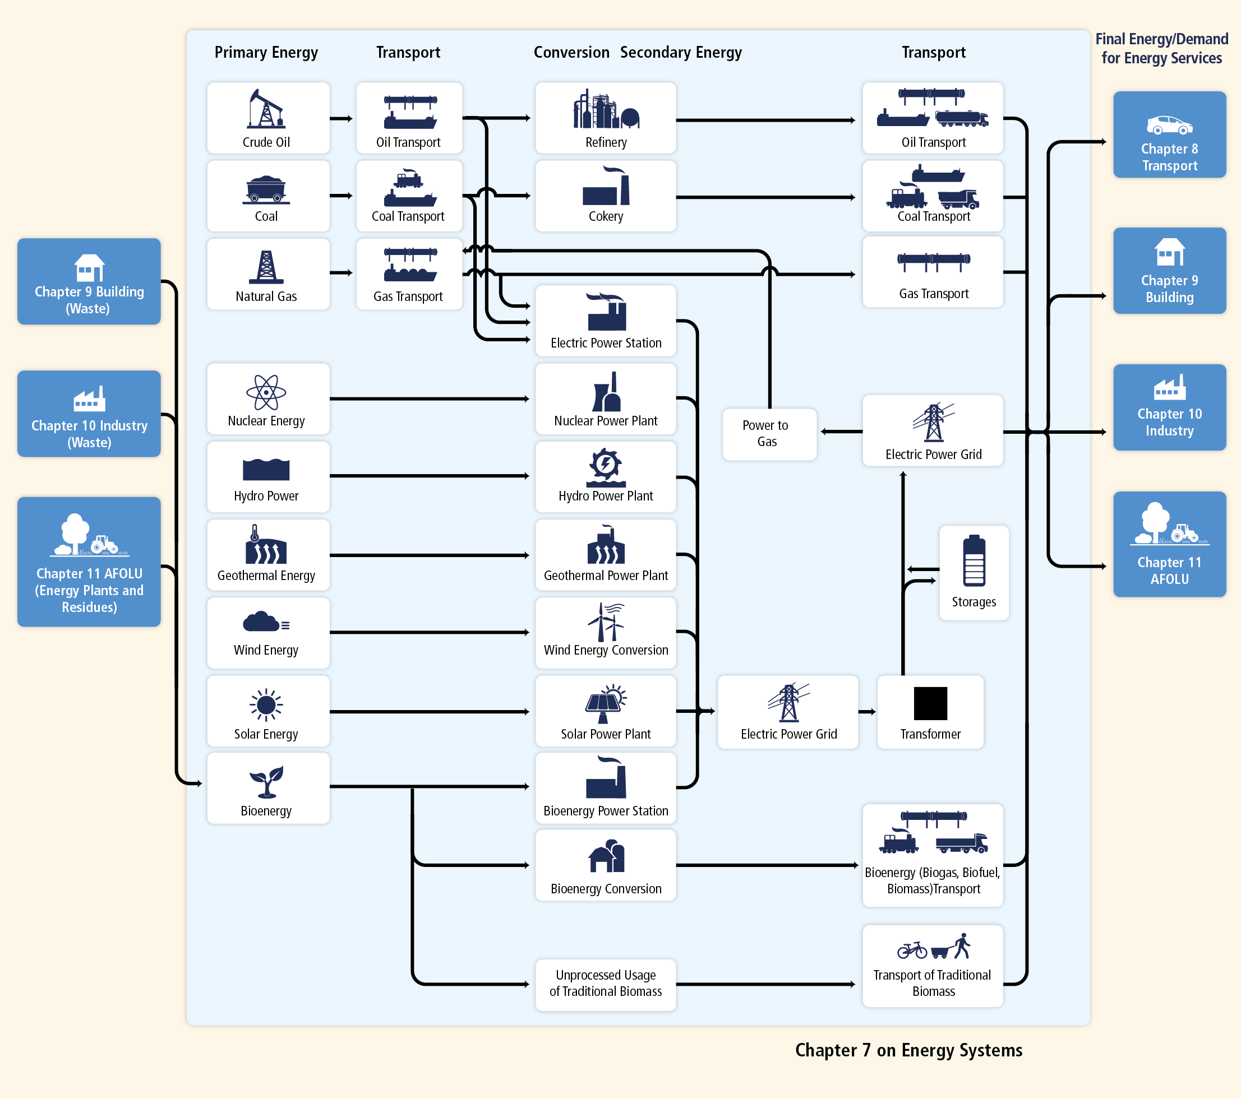
Motivation: Future changes in the Earth system also have consequences for the energy system.
The Energy System
Earth system changes have implications for energy and land, including:
Increases in energy use for air conditioning,
Changes in electricity generation (thermoelectric, hydropower, wind, and solar),
Changes in crop yields and bioenergy potential,
Energy system disruptions (e.g., power outages).
Source: IPCC AR5 WG3 Ch7

Slide 4
Science Question
Overarching Question:
How do the biogeochemical cycles interact with other Earth system components to influence energy-sector decisions?
V2 Question
What are the implications of different energy futures for the biogeochemical cycle through changes in land use land cover, water availability, and extreme events?

Slide 5
Science Question
Overarching Question:
How do the biogeochemical cycles interact with other Earth system components to influence energy-sector decisions?
V2 Question
What are the implications of different energy futures for the biogeochemical cycle through changes in land use land cover, water availability, and extreme events?
Multiple simulations
Model features

Slide 6
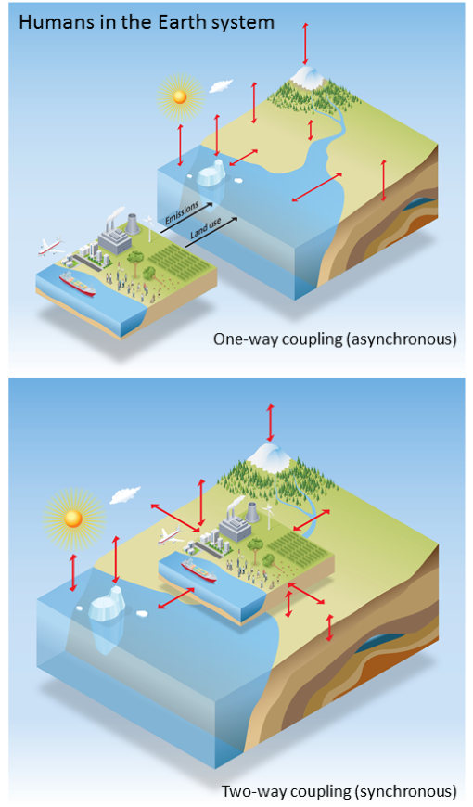
Simulation Plan
BGC Simulation Modes
Model configuration:
Regionally-refined model, branching from water cycle
Active biogeochemistry in the atmosphere, land, ocean, and sea ice
Simulation modes:
One-way coupling (CMIP-like)
Two-way coupling, with human-Earth system interactions

Slide 7
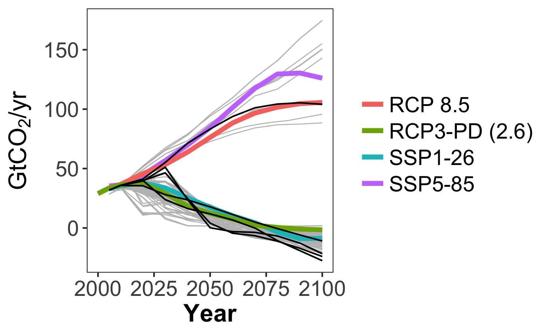
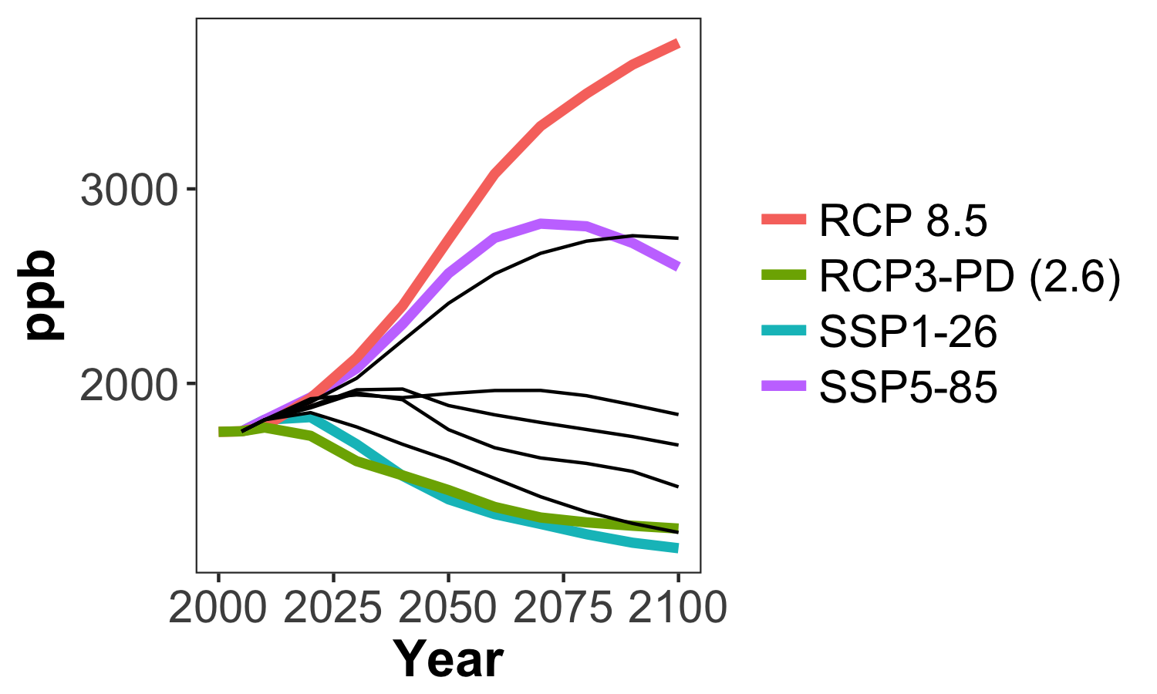
Simulation Plan
Global CO₂ Emissions
Two different energy futures, including a high emissions and a low emissions scenario:
Generated by GCAM
Chosen to span a range of values across key variables (e.g., CO₂, CH₄, LULCC).
CH₄ Concentration
Gray = AR5 Database
Colors = CMIP5 and CMIP6
Black = GCAM-generated from Calvin et al. (2017)

Slide 8
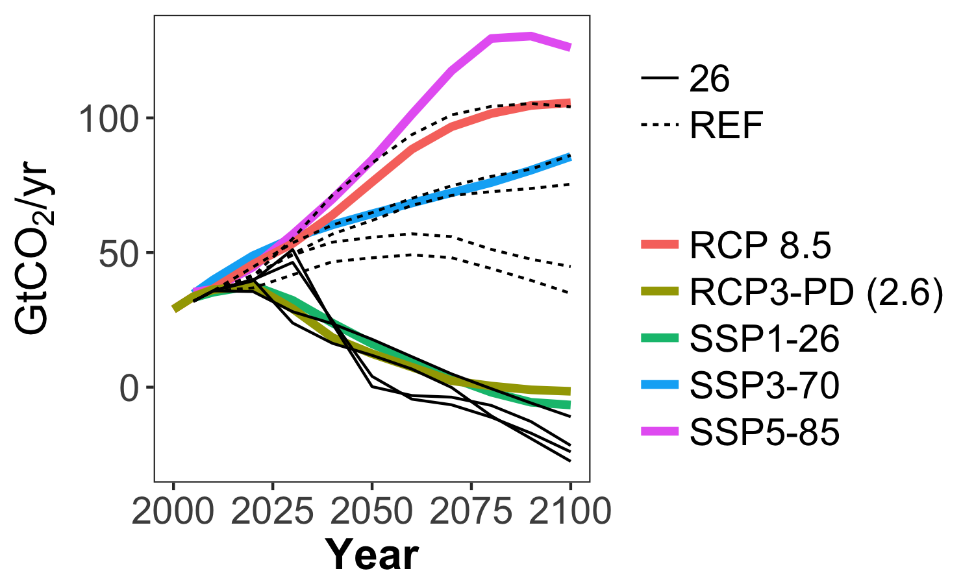
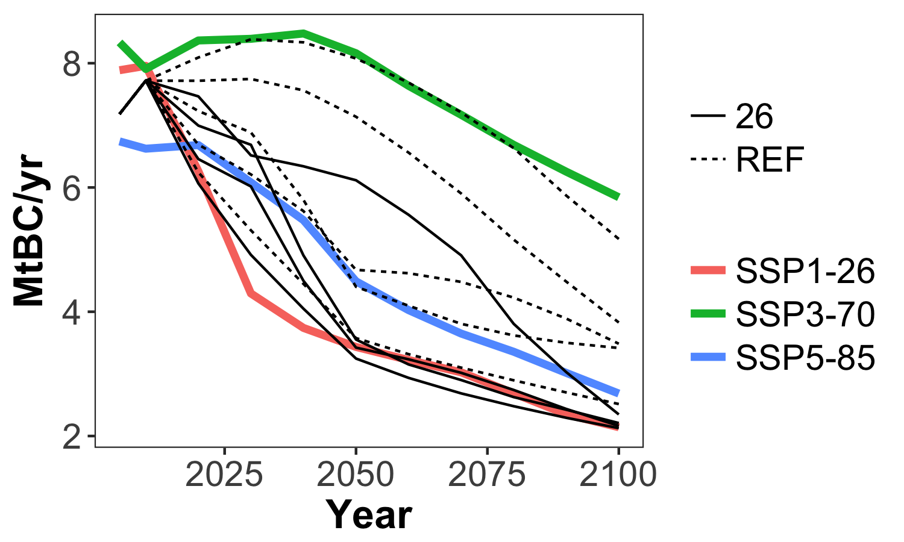
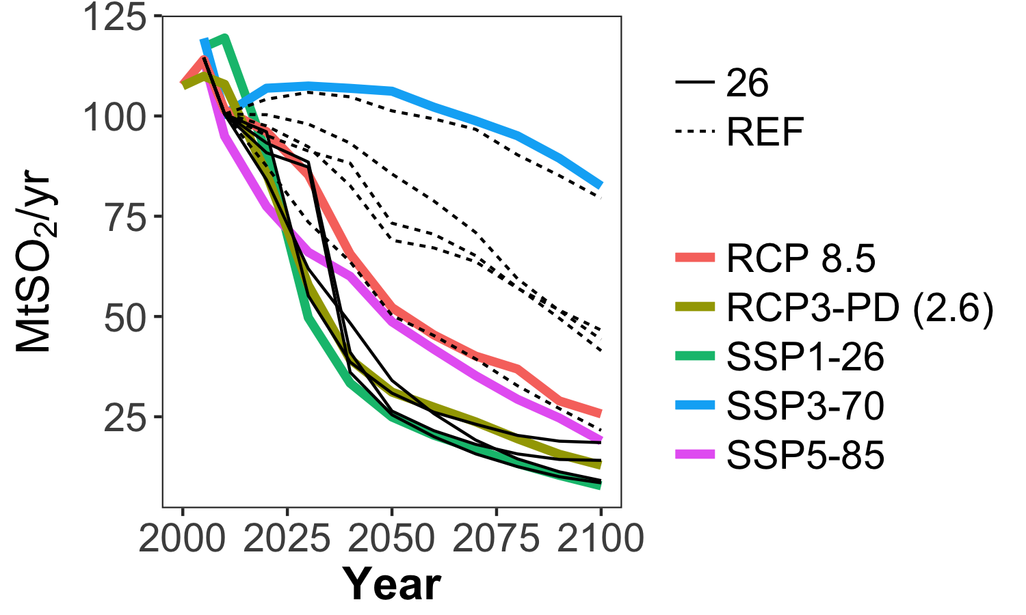
Emissions in different scenarios
CO₂ Emissions
BC Emissions
Sulfur Emissions
Black lines are GCAM scenarios from a 2017 paper.
Dashed lines vary in radiative forcing in 2100.

Slide 9
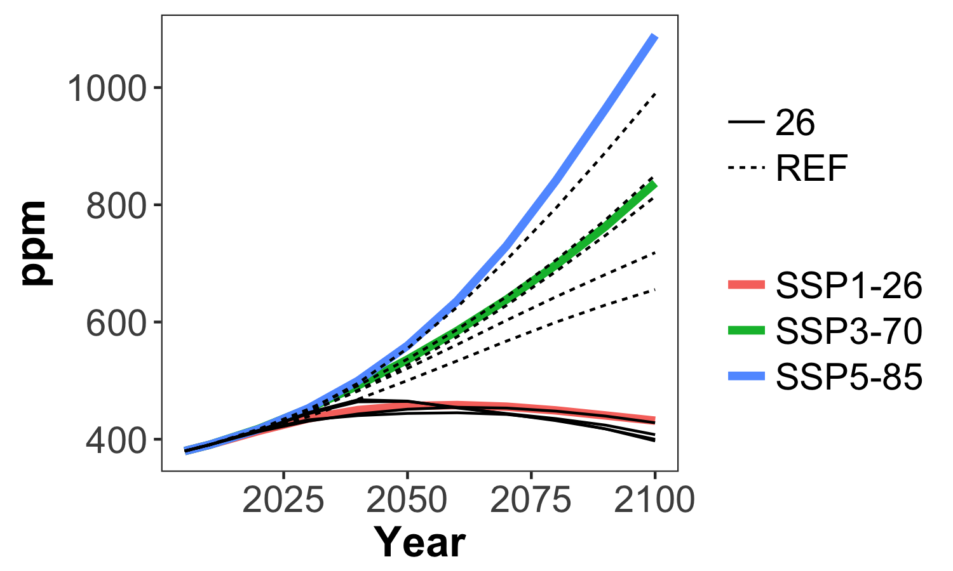
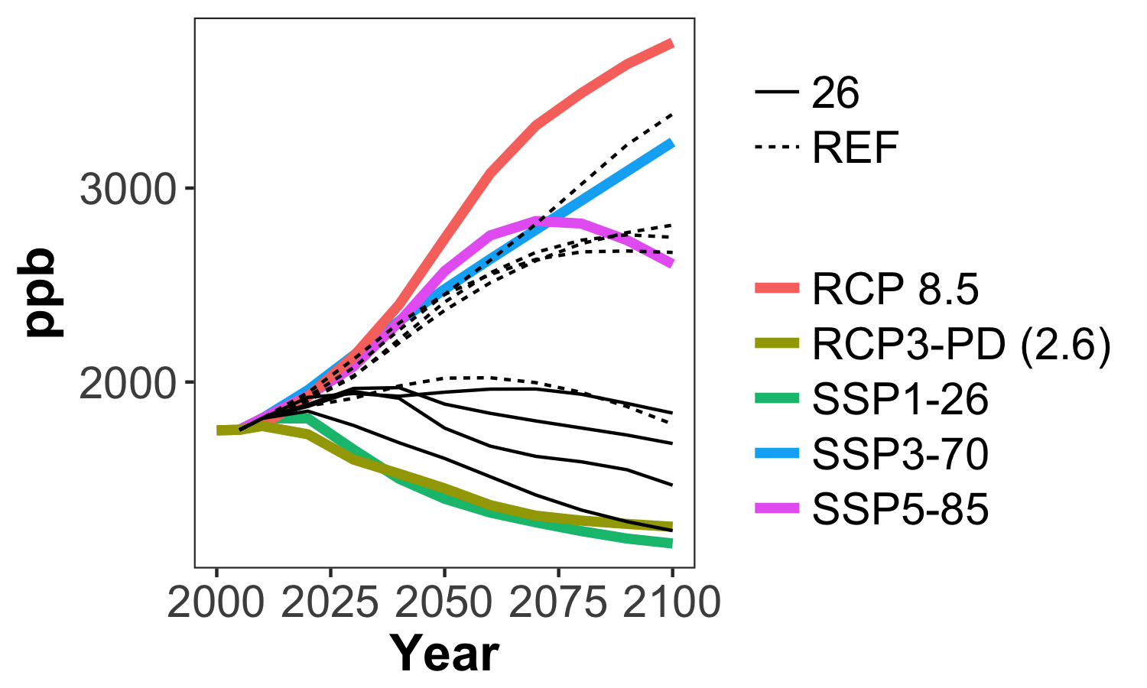
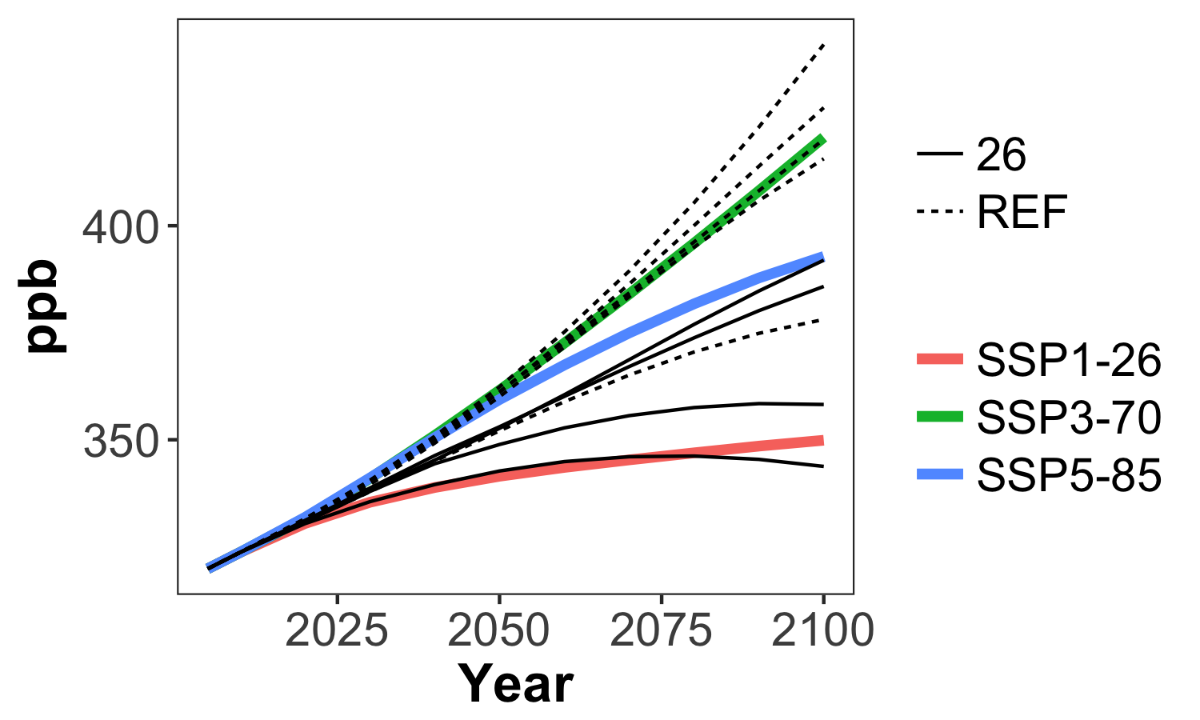
Concentrations in different scenarios
CO₂
CH₄
N₂O
Black lines are GCAM scenarios from a 2017 paper.
Dashed lines vary in radiative forcing in 2100.

Slide 10
What are some key characteristics we want in our v2 simulations?

Slide 11
Simulation Plan
To understand the effect of model features and forcing factors, we will perform a series of land-only, ocean-only, and coupled model sensitivity experiments, including simulations:
With different initial conditions,
With and without FATES,
With and without explicit crops,
With and without LULCC, and
With and without RRM.

Slide 12
Are there additional sensitivities we think are important to do?

Slide 13
Thank you!

