Slide 1
Improve the modeling of soil erosion and lake methane
Zeli Tan
Pacific Northwest National Laboratory

Slide 2
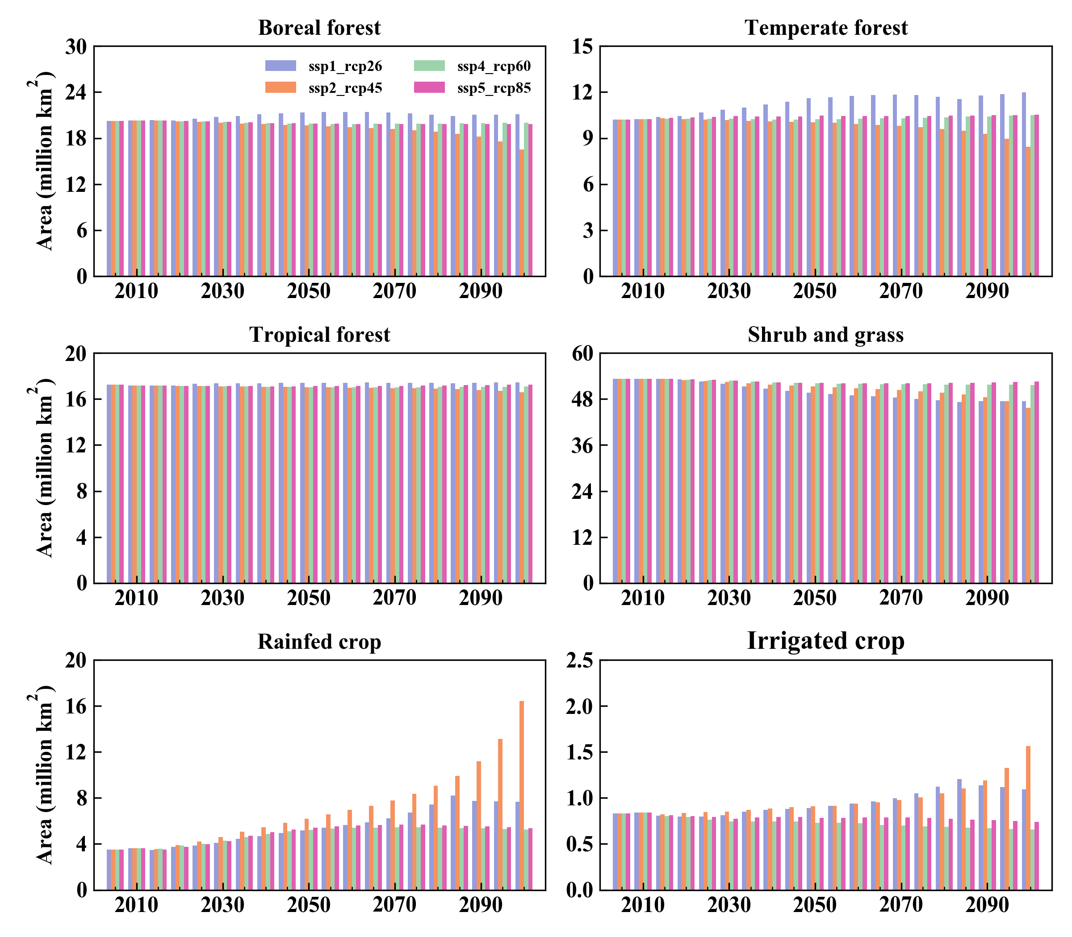
Represent the effects of land use change and cropland management on soil erosion
Turn on the crop and irrigation model for soil erosion modeling.
Incorporate the RUSLE’s P factor, the Lippe’s plant residual factor, and the BQART’s glacier and lithology factor.
Enable the coupling of the dynamic land use and crop model.
Harmonized global map of conservation agriculture
GCAM + Demeter delineated global land use change during 2005–2100
Prestele et al. (2018)

Slide 3
Couple Dynamic land use model and Crop model
Schematic of land cover change impacts on CLM carbon pools and fluxes
Nature vegetation
Crop
Nature vegetation
Crop

Slide 4
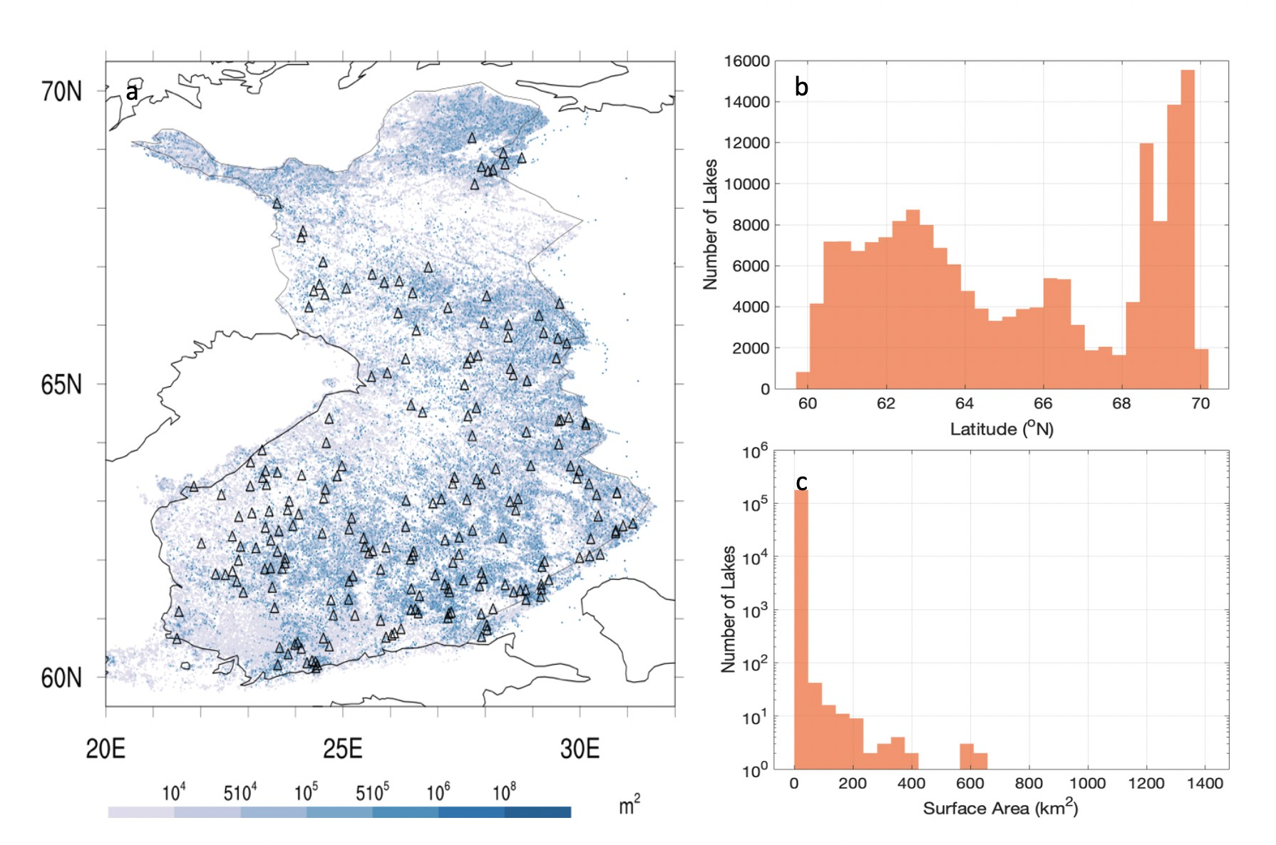
Model methane emissions from boreal lakes
Model methane emissions from Finnish boreal lakes using Arctic Lake Biogeochemistry Model (Tan et al, 2015).
The total number of simulated lakes is 210,773, with the area criteria of 100 m². Lake bathymetry is from SYKE.
Guo et al., in draft

Slide 5
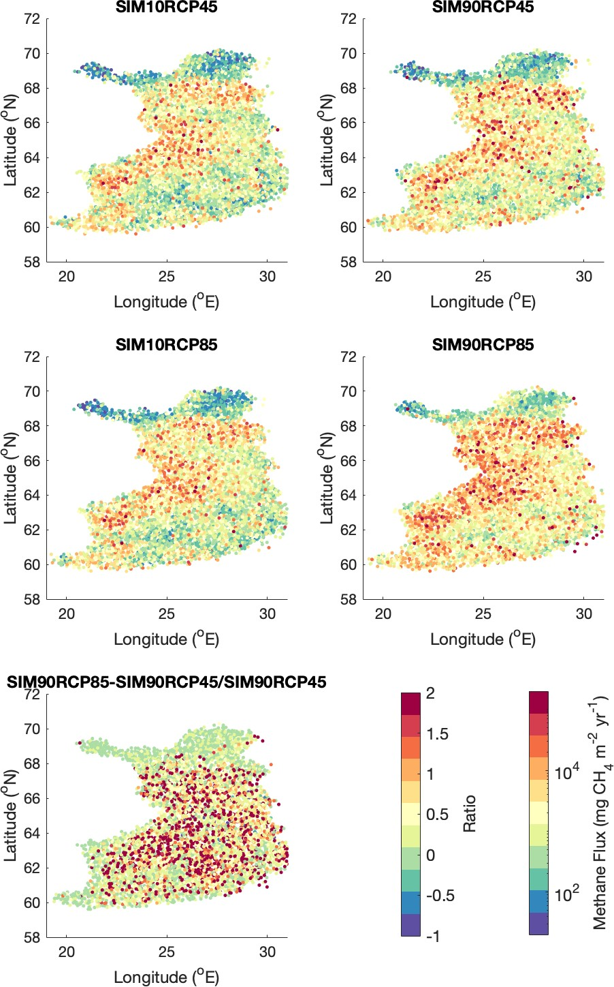
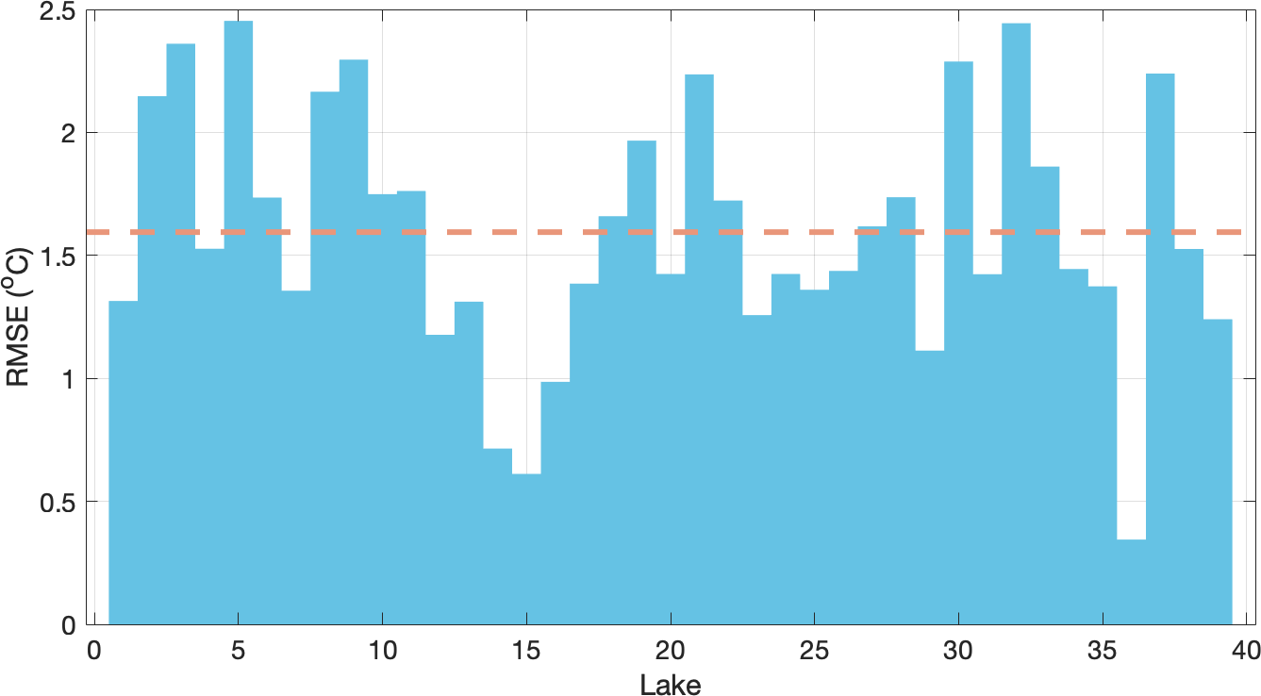
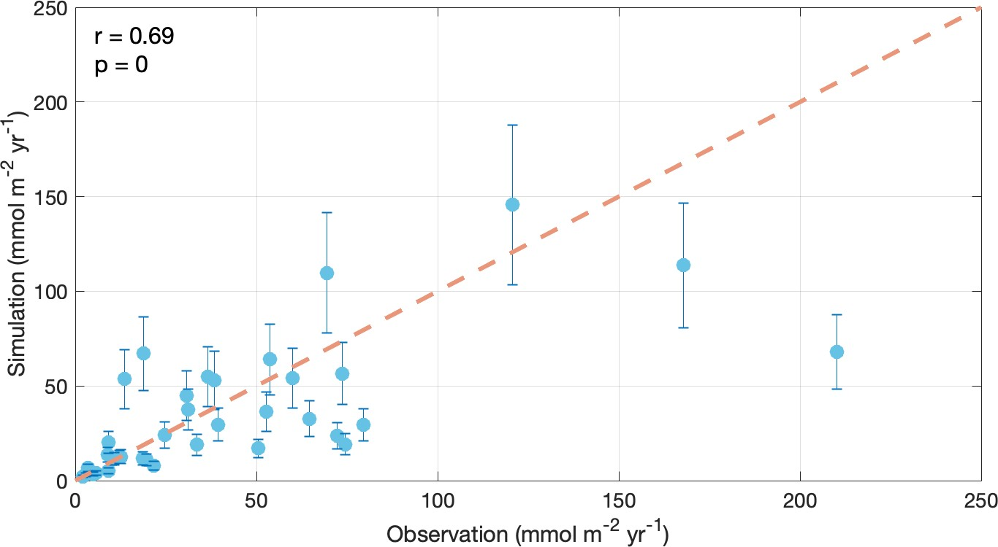
Guo et al., in draft

Slide 6
Q & A

Slide 7
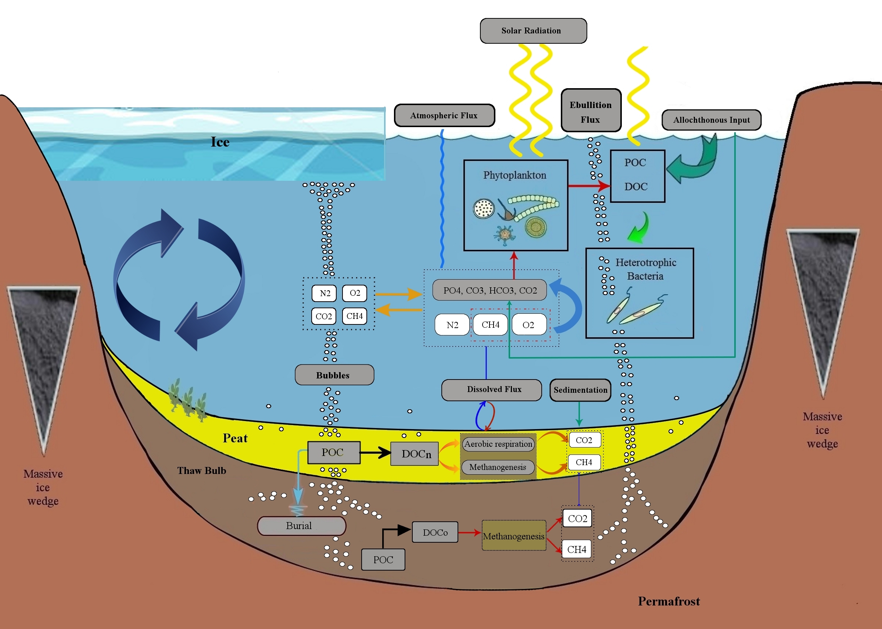
Tan et al. (2015, 2017)

