Slide 1
Modeling ocean biogeochemistry-key physical and ecological challenges
Anand Gnanadesikan
Johns Hopkins University
E3SM All Hands Meeting
November 18, 2019

Slide 2
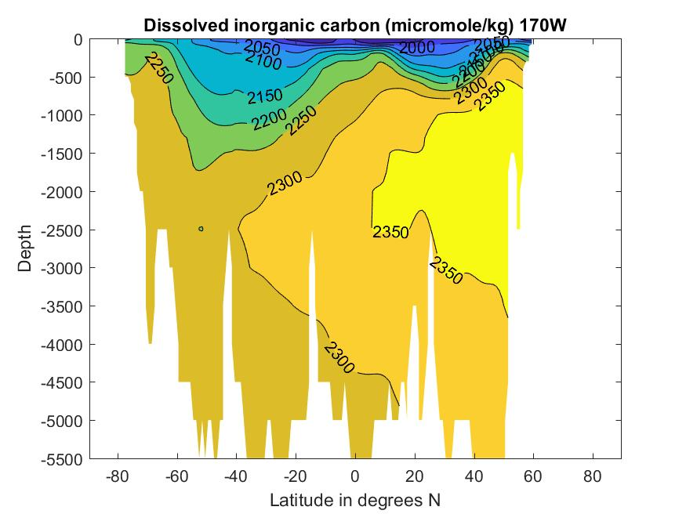
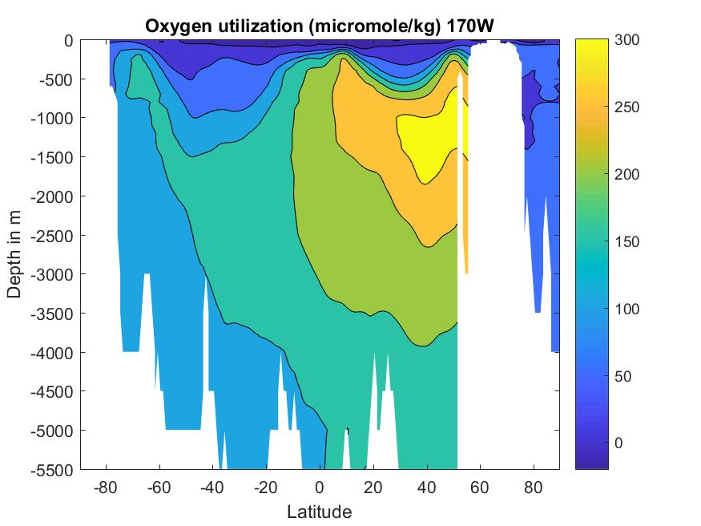
Motivation
“Biological carbon pump” stores 2000GtC of carbon in deep ocean

Slide 3
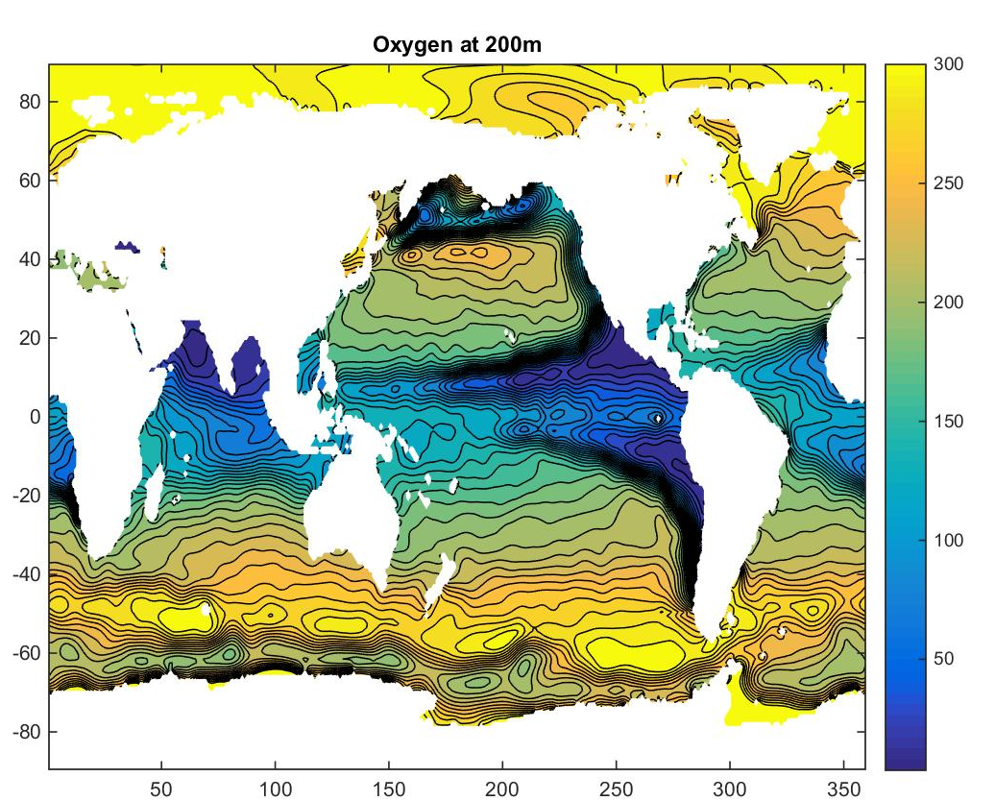
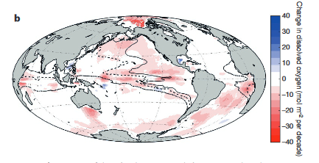
Observed oxygen in ocean
Schmidtko et al. (Nature
2017) show decline in oxygen of 4.7 Pmol- if all of this were biological storage, would imply 44 Gt C extra storage.
Fish excluded
Nitrate metabolized
Low oxygen zones occur at edges of ocean gyres

Slide 4
Oxygen in CMIP5 models
Top line oxygen and latitudinal distribution of hypoxia.
Bottom shows change under doubled CO2
Why is this so variable?
Oxygen Consumption?
Or oxygen supply?
Bahl, Gnanadesikan and Pradal, GBC, 2019

Slide 5
What do we know about relationship between surface production and consumption?
Highly productive waters export a greater fraction of productivity.
Linked to dominance of large phytoplankton (diatoms/large green algae) over small phytoplankton (watch NASA EXPORTS for more info)
Eppley and Peterson, 1979

Slide 6
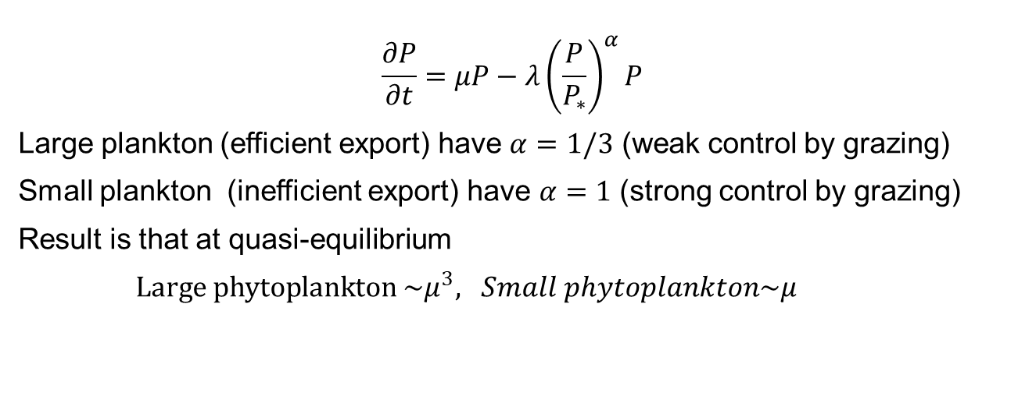
How might we model such a relationship? (GFDL miniBLING, BLING, TOPAZ)
$$\frac{∂P}{∂t}=μP−λ{\left(\frac{P}{P_{∗}}\right)}^{α}P$$
Large plankton (efficient export) have $α=1/3$ (weak control by grazing)
Small plankton (inefficient export) have $α=1$ (strong control by grazing)
Result is that at quasi-equilibrium
$Large phytoplankton \sim μ^{3}, Small phytoplankton\sim μ$

Slide 7
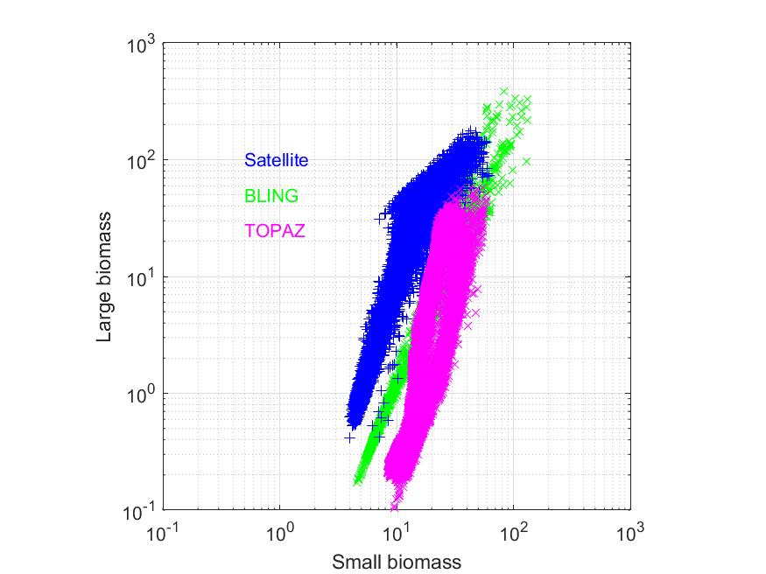
Result
Some correspondence with satellite estimates of particle structure.

Slide 8

But what about oxygen supply?
Ocean is highly stratified, weakly stirred
Mixing coefficient along density surface is 8-9 orders of magnitude larger than mixing across density surfaces.
  Parameterized by a “Redi” coefficient
  Value of this coefficient varies from <400 m²/s to 2000 m²/s in CMIP5
Diffusion-stirs along isopycnal surfaces.
$$\left\langle uhC\right\rangle =−{\left\langle h\right\rangle A}_{Redi}\frac{∂\left\langle C\right\rangle }{∂x}$$

Slide 9
Change in oxygen and hypoxic volume
CMIP5
AREDI suite

Slide 10
Reason for this: 3-d structure
Oxygen increases slightly in low latitude, decreases in deep (also true in CMIP5 models).
Shallow increase not seen in obs.
Deep change dominates total oxygen.

Slide 11
Sidelight: Biogeochemical feedback to extremes
Biology acts to trap heat near surface
Changes to ocean optical components have impacts on seasonal cycle, temperature extremes
(Gnanadesikan, Kim and Pradal, GRL, 2019)

Slide 12
Conclusions
So why should DOE care about ocean biogeochemical cycles?
Carbon storage
May already be changing O(20 GtC through direct storage- potentially more significant changes in future)
We can’t simulate current changes well.
Unclear whether this is a failure to capture transition between high and low export ecosystems
Or whether it is a failure to get mixing and associated plumes right.
Optics and temperature extremes

