Slide 1
Work from LLNL is performed under the auspices of the US DOE by LLNL under Contract DE-AC52-07NA27344.
UCRL:LLNL-PRES-796979
Accepted @ JAMES 10/23/19
https://portal.nersc.gov/project/acme/petercal/ papers/Caldwell_et19_HiRes_Accepted.pdf

Slide 2
Experimental Design
High Resolution: 25 km atm & land, 1/8^{O} river runoff, ocn & ice △x=16 km at equator and 8 km at poles
This study focuses on 50 yrs of coupled 1950 ctrl following HighResMIP protocol
This is a 1950 ctrl because simulating 1850-1950 is boring + too expensive
Exception: we use prognostic aerosol
Follow-on experiments:
Continuing 1950-control another 100 yrs
Planning 1950-2050 transient

Slide 3
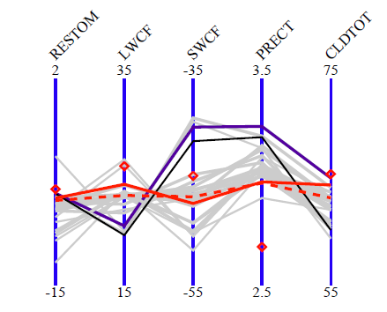
Tuning
High-res (HR) and low-res (LR) E3SMv1 were tuned separately
  Requires a separate “LRtunedHR” run to identify resolution effect
  HR was tuned mostly from 24-48 hr forecast runs (see Fig)
  Fig: Key global-average metrics for June-Aug simulations. Diamonds indicate observed values, gray lines are forecast runs, and black lines are free-running simulations. Red lines indicate forecasts (dashed) and free-running (solid) simulations for one particular tuning. Courtesy Wuyin Lin.
Research question: How do we tune a model we can’t afford to run?

Slide 4
Initialization
Initial ocean temperature (T) and salinity (S) from Polar Hydrographic Climatology (Steele et al, 2001)
Ran ocean standalone for 3 months with T and salinity restored to initial climatology and imposing annually-averaged wind stress
Used this to run ocean and ice for 3 yrs forced by COREv2 atmospheric reanalysis, with ice initially 1 m thick poleward of 70^{O}
Used this to run fully coupled for 5 yrs, fixed runaway sea ice loss by reverting CNT aerosol activation, then used this 5 yr run as the initial condition for the 50 yr run
Research question: what is impact of short spin up on model bias in high-res simulations?

Slide 5
Expected Improvement: Orographic Precipitation
More realistic topography leads to better orographic precip, better snowpack, and better mountain streamflow (duh)
Fig: Climatological pattern of precipitation (in mm/day) over the W coast of North America from obs (left), LRtunedHR run (middle), and HR run (right).

Slide 6
… But What About Upscale Effects?
If finer resolution is all we want, downscaling is sufficient…
  but terrain improvements should have upscale effects, right?
Strikingly, HR has almost no impact when upscaled to 2.5 degrees
HR – GPCP obs (mm/day)
LRtunedHR – GPCP obs (mm/day)
Fig: Annual-mean surface precipitation bias (relative to GPCP observations) regridded to 2.5^{O}.

Slide 7
More General Investigation of Upscale Effects
HR bias is generally better than LR and CMIP5
  Due to some combo of higher resolution, tuning, and short spin up…
Research question: what is impact of short spin up on model bias in high-res simulations
Fig: Uncentered spatial RMSE for HR and LRtunedHR 1950 ctrl, LRv1 CMIP6 historical, and 45 CMIP5 historical runs as box (=25-75%) and whiskers (=envelope of data).

Slide 8
Drift
HR is ~0.5 W/m2 out of balance (losing heat) after 50 yrs
  shows little sign of equilibrating, though surface T is decreasing slightly
Sea ice is ~steady
Research Question: How do we equilibrate a coupled model we can’t afford to run?
Left Fig: Global-ave ocean T change versus depth (relative to yr 1 values)
Right Fig: Global ave energy and ice timeseries

Slide 9
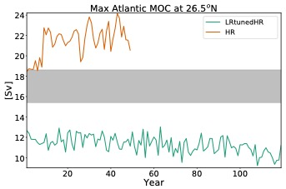
Atlantic Meridional Overturning Circulation (AMOC)
Mean strength and variability of AMOC is much stronger in HR. Could be due to:
  improved stratification (due to e.g. reduction in Labrador Sea ice and stratification biases)
  increased oceanic poleward heat transport
  Improved representation of dense water flowing over N Atlantic bathymetry
Fig: Max AMOC strength at 26.5^{O} N. The gray shaded region represents the bounds of observed variability from the RAPID station.
Research Question: What is physical reason for resolution sensitivity of AMOC?

Slide 10
El Nino/Southern Oscillation (ENSO)
E3SMv1 does ok but not great in reproducing the SST pattern associated with ENSO
Unlike previous high-res studies, increased resolution doesn’t change ENSO structure
  though HR has substantial non-ENSO noise, resulting in lower variance explained
Fig: First EOF of SST for HadISST obs (1870-2010), LR with HR tuning, and HR (from left to right).

Slide 11

Expected Improvement: Stratocumulus
adf
Lack of stratus and warm SST are a canonical GCM problem
Higher atm res helps in all papers I know of
Gent et al (2010) explains why
Gent et al (2010) Explanation:
1. Finer topography channels and strengthens winds in along-shore direction
2. This increases Ekman transport of cold sub-surface water
3. Colder SST increases stratus, which blocks sun-light and fur-ther cools SST
Fig: SST bias in CCSM3.5 at a) 2^{O} atm res and b). 0.5^{O} atm res relative to Levitus. From Gent et al (2010)

Slide 12
Improved Stratocumulus in E3SMv1 HR?
LRtunedHR
SST and stratus don’t improve in E3SMv1
Upwelling does occur, but changes are too coastally confined to help much
LRtunedHR
HR
HR
Research question: why does/doesn’t HR help stratus?
Fig: Wind-stress induced vertical velocity in LR and HR runs from E3SMv1
Fig: Annual-mean SST bias (relative to Hadley/OI obs) in LRtunedHR (top) and HR (bottom)

Slide 13
Why High Res? Ocean Eddies/Bathymetry
HR improves sea ice distribution, deep water formation, and overturning circulation by:
  Resolving narrow passages (e.g. northwest of Greenland)
  Better resolving runoff
  Capturing eddying ocean circulations
  Capturing atmospheric flow around topography (e.g. S tip of Greenland and katabatic flows off Antarctica)
Russia
Russia
North
America
North
America
Greenland
Greenland
Fig: Mean March sea ice thickness for years 31-50. Colors indicate thickness and opacity indicates ice fraction. Observed 1979-1999 NOAA sea ice extent from Meier et al (2014; equivalent to 15% fraction contour) is traced in orange with thick lines=mean and thin lines =±1𝜎 temporal variations.

Slide 14
Expected Improvement: Tropical Cyclones (TCs)
Eyewalls of tropical cyclones are O(25 km) in diameter, so resolution at least this fine is needed to capture them
E3SMv1 HR does a decent job of capturing TC climatology; LR is insufficient
Obs
LRv1
Karthik Balaguru has a paper draft going into more detail on this
Fig: Tropical cyclone tracks (colored by intensity) from all 50 yrs of HR and LRtunedHR simulation. Obs come from years 1966-2015 of the International Best Track Archive for Climate Stewardship
HR

Slide 15
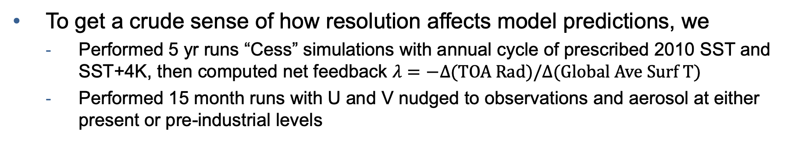
Impact on Model Predictions
To get a crude sense of how resolution affects model predictions, we
  Performed 5 yr runs “Cess” simulations with annual cycle of prescribed 2010 SST and SST+4K, then computed net feedback $λ=−Δ\text{(}\text{TOA} \text{Rad}\text{)/}Δ(\text{Global} \text{Ave} \text{Surf} \text{T}\text{)}$
  Performed 15 month runs with U and V nudged to observations and aerosol at either present or pre-industrial levels
Surprisingly, the impact of tuning (LRtunedHR vs LRv1) is much bigger than resolution change!
Table: Net feedback, total effective aerosol radiative forcing (ERF), ERF from aerosol-cloud interaction (ERF_{aci}), ERF from aerosol-radiation interaction (ERF_{ari}), and ERF due to surface albedo change from prescribed-SST runs as described above.

Slide 16
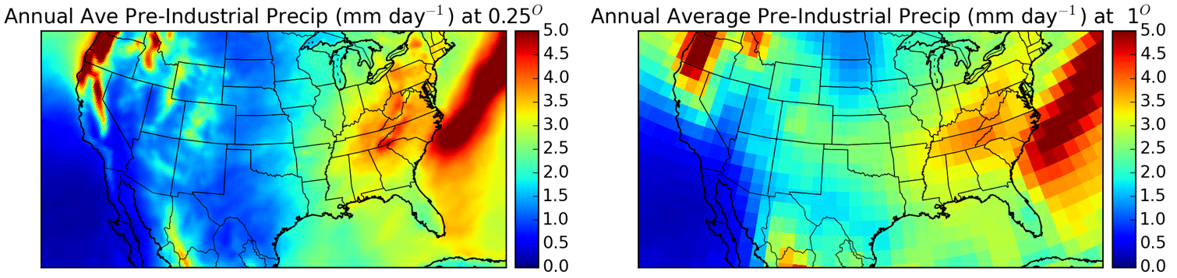
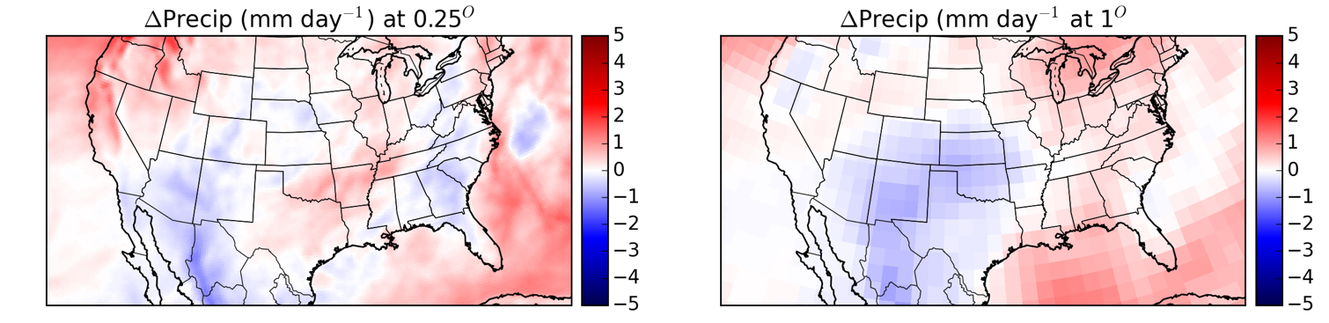
Impact on Model Predictions (2)
∆x=1/4⁰
∆x=1⁰
High resolution is needed to capture topographic effects on rainfall (top row)
and topography has an important effect on rainfall changes (bottom row)!
Annual-Ave Precip (mm day⁻¹) at ¼^{O}
Annual-Ave Precip (mm day⁻¹) at 1^{O}
Fig: Precipitation over US from ACME v1 beta0 F1850 simulations at ∆x=1/4⁰ and 1⁰ (top row). The bottom row shows the impact of increasing SST uniformly by +4K. Simulations are 5 yrs long and SST is prescribed from pre-industrial conditions.
To do: Redo this analysis with published simulation

Slide 17
Conclusions
Increased resolution had surprisingly little effect on many large-scale measures (particularly in the atmosphere)
  though regional impacts of resolution are definitely apparent
Positive impact of resolution is more clear in ocean and sea ice components
High-res had much better RMSE than standard tunings or other CMIP5 models… due to short spinup?

