Slide 1
Infrastructure Group Status, Plans, Issues
Rob Jacob
Chengzhu Zhang
E3SM 2019 Fall Meeting
November 19, 2019

Slide 2
Infrastructure Group responsibilities
Develop, maintain and support software that is needed for E3SM but is not part of the main prognostic models. Configure, build, test, diagnostics, analysis, workflow, driver/coupler
Manage data sets
Define, document, manage the process and procedures used in software development within the E3SM Project.
Everything we do should help make the model development, simulation and analysis happen.

Slide 3
Progress since Spring meeting (highlights)

Slide 4
Compy is in production!
Compy:
460 node Skylake CPU system housed in PNNL's Computational Science Facility
Allocated using a fare-share strategy with the allocation based on how the purchase funds were provided by projects at BER:
E3SM: 50%
RGMA: 35%
ESMD: other projects, including SciDAC: 15%
Porting mostly done by late June
All nodes in regular use since early September
Fastest per-node machine for E3SM.

Slide 5
Compy config
Job limits: 2 running jobs per user.
Short queue: 40 nodes set aside for jobs less then 2 hours.
If your case fits, it will by default go in short queue.
20 jobs per user (for postprocessing jobs)
780 TB disk. 65% full
Queue limits coming soon:
1-100 nodes 36h que limit
101-180 24h
181→440 6h
This is all adjustable
liao313 e3sm 20 slurm 48898 R 4:38:56
liao313 e3sm 20 slurm 48908 R 4:38:37
tanz151 e3sm 10 slurm 49375 R 44:40
zhan391 esmd 1 slurm 49344 R 5:15
ricc364 e3sm 10 short 49376 R 9:16
zhan391 esmd 1 slurm 49343 R 8:22:58
zhuq283 e3sm 32 slurm 49095 R 1-21:45:23
xumi699 rgma 88 slurm 49212 R 17:48:51
chen871 e3sm 40 slurm 49369 R 1:50:36
vanr302 rgma 92 slurm 49284 R 11:33:03
zhuq283 e3sm 32 slurm 49258 R 13:51:54

Slide 6
Other Machine changes
NERSC Edison went away May 13. OLCF Titan decommissioned on Aug 1st.
NERSC “Cori-knl” is the externally supported machine we point people to at e3sm.org
Currently supported machines are:
Cori-knl
Cori-haswell
Compy (limited access for RGMA, ESMD projects)
Theta
Summit (GPU-based work only)
Anvil (E3SM project only)
“supported” means latest master and maintenance branch versions should compile and run. You have to procure an allocation.

Slide 7
v1 Data Publication Progress (as of Nov. 14th)
CMIP6
Standard
17 simulations
105 variables per simulation
1156 datasets
18649 files
3.7TB of data
Each model component has its own automated CMIP6 workflow which handles horizonal/vertical regridding, time series variable extraction, CMOR variable conversion, output directory structure generation, and adds the custom E3SM specific metadata.
processflow and e3sm_to_cmip are main scripts used.
30 simulations
311 datasets
183,596 files
172TB of data

Slide 8
Status: Testing
System testing continues (with baselines) on core set of machines.
Compy added and testing pgi with baselines. Some problems.
Integration and testing process running (mostly) smoothly.
Continue to strike balance among expense of testing/need for overnight results/availability of machine time.

Slide 9
CIME, testing and repository changes
New “nbfb” test suite.
Runs one each of 3 new test types (developed under CMDV)
MVK: Komogorov-Smirnov
PGN: Perturbation Growth
TSC: Time step convergence
Test meaning:
PASS: no change in climate (even if there was a non-bfb change)
FAIL: climate is different.
Additional external submodules added
Kokkos: Kokkos built as a sharedlib
RRTMGP: pulling directly from RTE-RRTMGP “develop” branch.
SCORPIO: faster, more capable version of PIO developed under ECP.
New terminology: “PIO1” = “SCORPIO-classic”, “PIO2” = “SCORPIO”
Significant improvements to CIME's use of XML as a database
Big performance and robustness improvements

Slide 10
CIME Config/Build system changes: CMake
Overhauled E3SM’s CIME build system to be based on Cmake
Big improvements in build speed (almost 2x in some cases)
No changes visible for most users. Now just one build log: e3sm.bldlog.runid
Makes it much easier for developers to build E3SM directly without using CIME commands.
> source $case/.env_mach_specific.sh
> cd $EXEROOT/cmake-build
> make
“./case.build --use-old” if CMake causes problems.
Tutorial! Wed 7:30-8pm: “Working with E3SM's new cmake-based build system”

Slide 11
V2 development timeline
Most of planned v2 PRs have been integrated to master (except RRM)
Coupled tuning/testing in progress (Golaz and WC group). First v2alpha tag soon.
Jan 15, 2020 Coupled tuning finished? Start v2 simulations runs
May have additional beta tags after this.
development during this time can't change answers for in-progress v2 simulations.
But can change answers in other cases.
Can accept limited v3, v4 changes subject to above constraint
24 Mar 2021 v2 data and model release. All simulation campaigns.

Slide 12
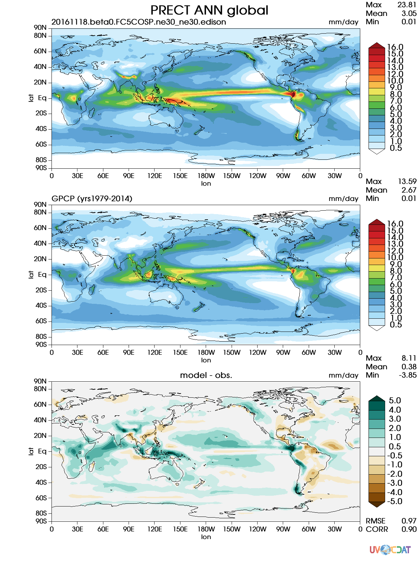
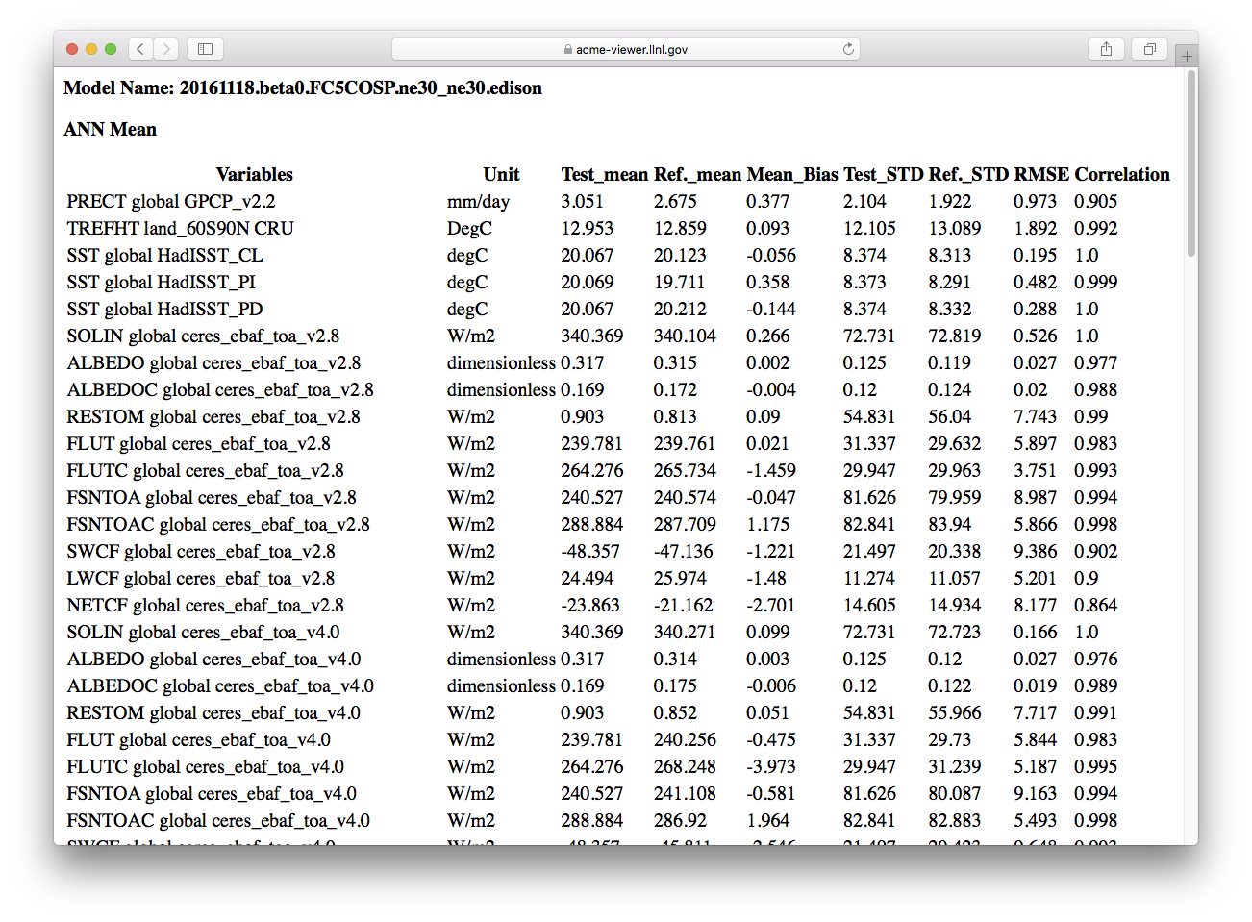
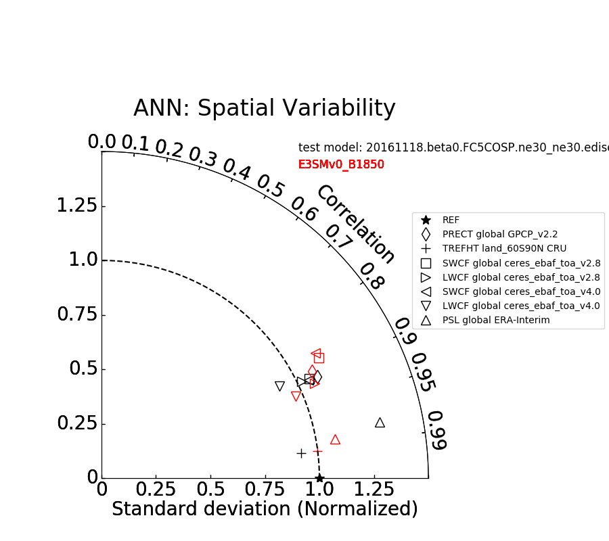
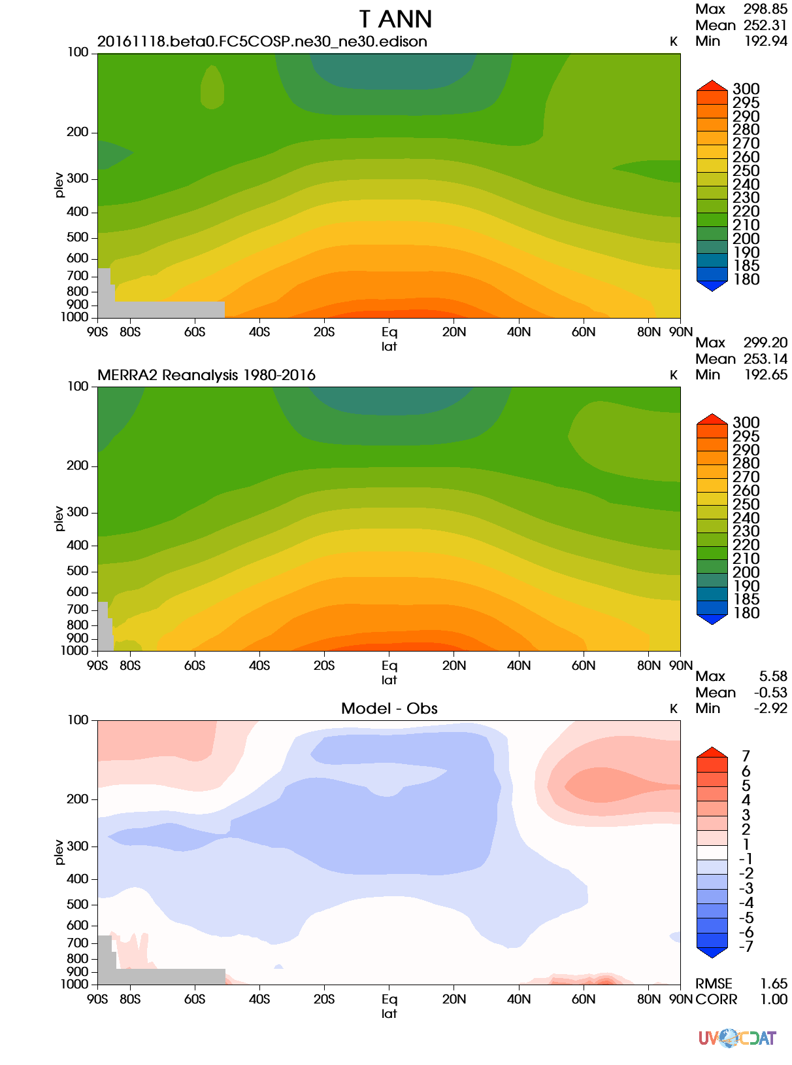
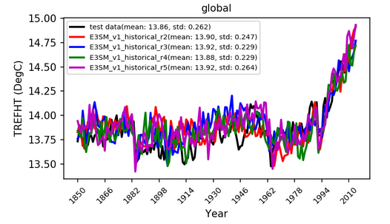
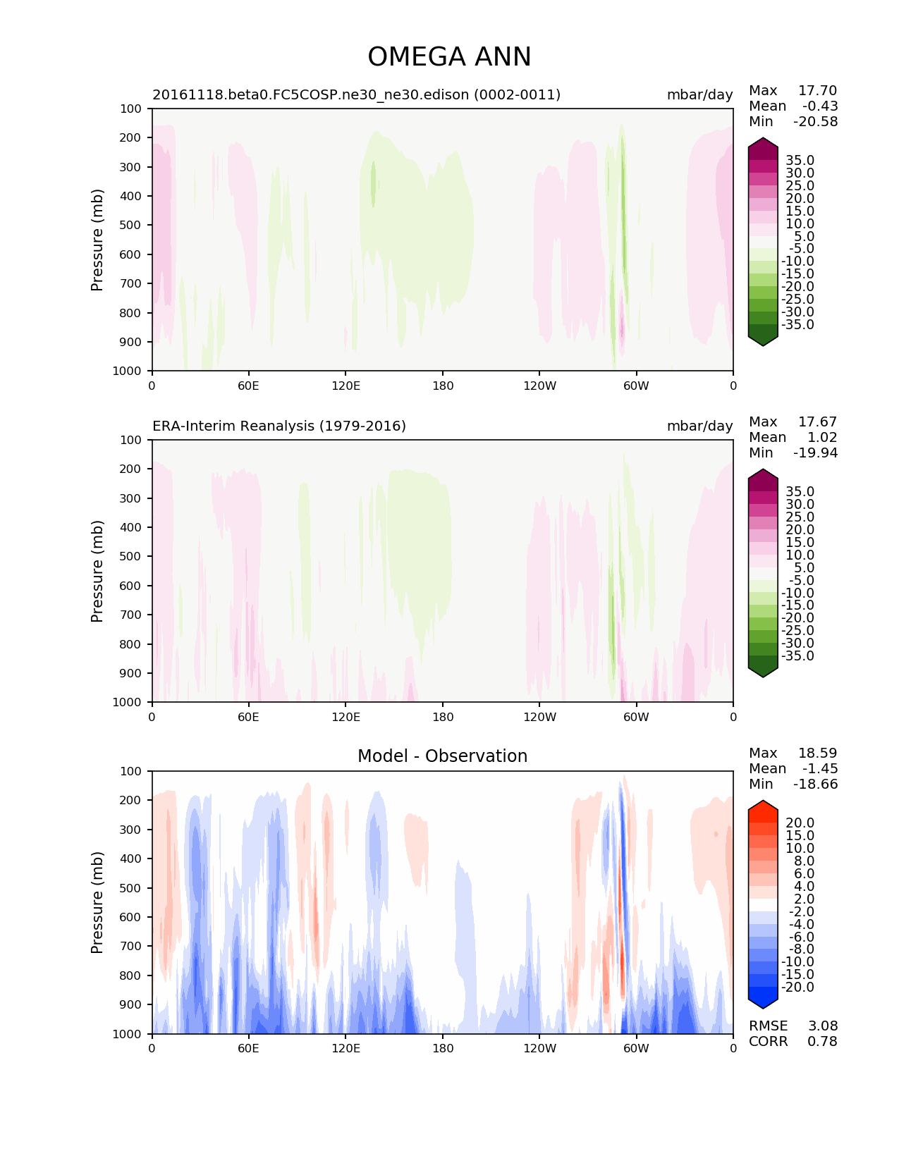
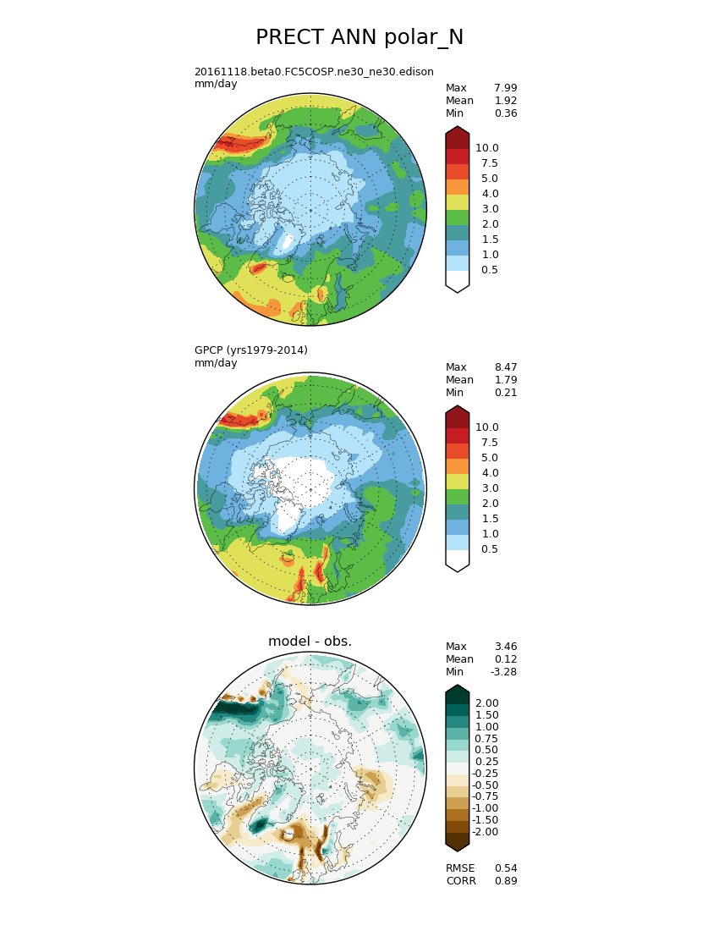
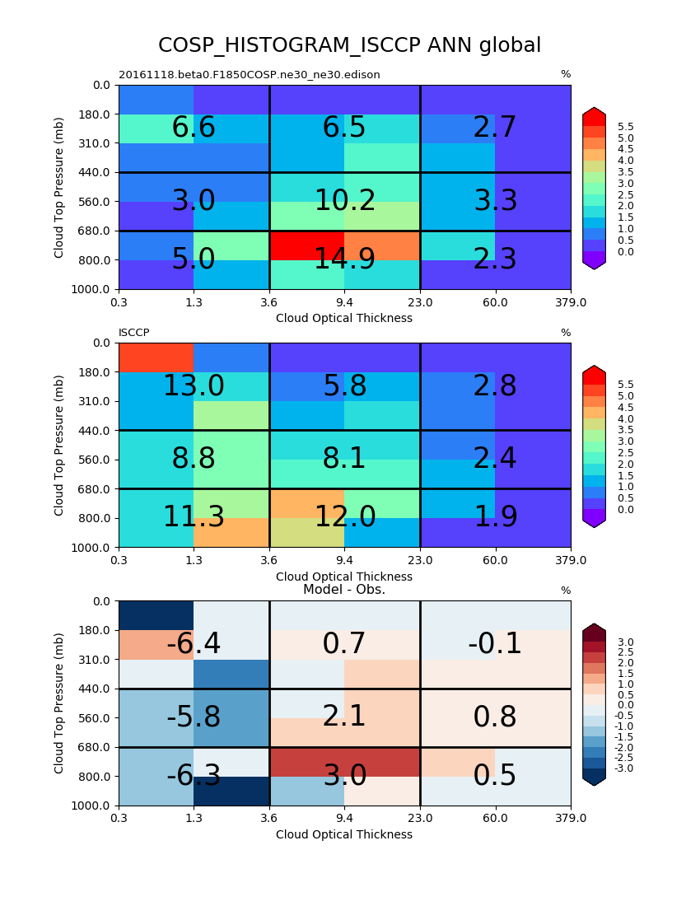
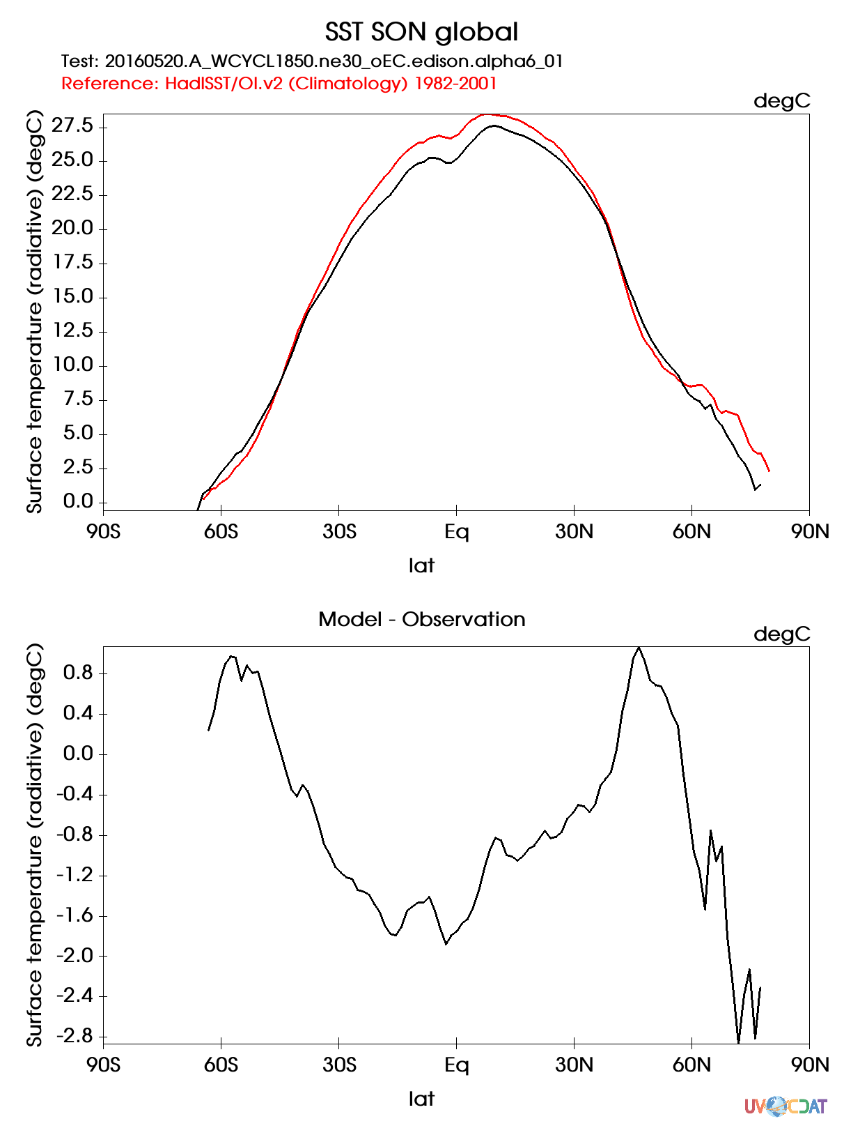
e3sm_diags: E3SM Diagnostics Package Comprehensive E3SM atmosphere diagnostics, analysis data and toolkit
A modern, Python-based diagnostics package for evaluating earth system models
Flexibly add new obs/variables/diagnostics, modify figures.
Easy installation, configuration and execution, with provenance saved
Uses multi-processing.
Updated analysis data (compared to AMWG)
Just released v2.0.0
Code refactored: cleaned, more flexibility to add diags
Python 3 supported
Pressure-Longitude meridional mean contour plots added.
Added time-series diagnostics for annual mean trend for
selected variables
More obs to support water cycle and BGC diags.

Slide 13
MPAS-Analysis (ocean, sea ice)
9 releases
Most recently v1.2.6 earlier this month
Addition of 21 new analysis tasks and other major enhancements, including:
Eddy Kinetic Energy
Ocean BGC
Ocean transects
Temperature/Salinity diagrams
Regional-mean time series and depth profiles
7 new observational data sets for validation
Python3

Slide 14
NCO progress
Vertical interpolation (ncremap)
Four modes: Hybrid, pressure <-> hybrid, pressure
Two interpolation methods (log, linear)
Four extrapolation methods (U, T, Z, missing value)
Simultaneous horizontal + vertical regridding (ncremap)
Generate initial conditions for new resolutions
ECMWF IFS F640L137 -> SCREAM ne1024L72
Algorithmic improvements (ncremap + ncclimo)
Accelerated for sub-gridscale fractions (land, sea ice)
Finer-grained multi-node MPI parallelization
CMIP6 contributions
Helped write/implement WGCM CMIP6 output+regridding specs
ncclimo/ncremap workflow for all E3SM CMIP6 timeseries

Slide 15
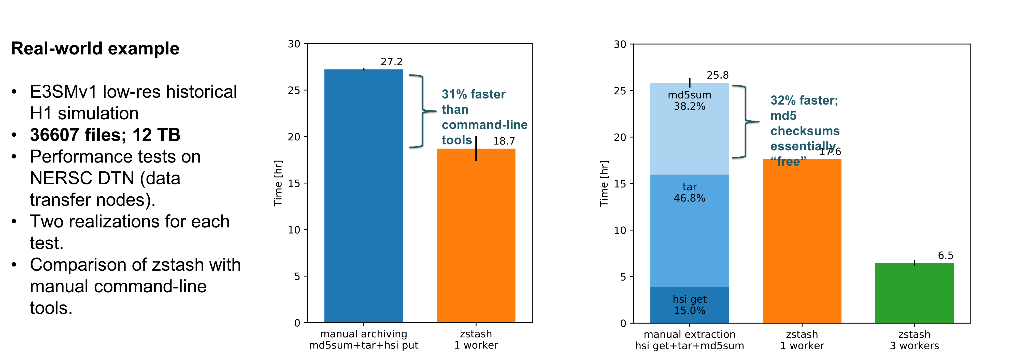
zstash: HPSS long-term archiving tool Developed from a prototype to a production software over the past year
A Python tool for long-term HPSS archiving of E3SM simulations with features:
Standard tar files generated locally before transfer to HPSS
Checksums (md5) are computed on-the-fly during archiving and verified on extraction
Metadata stored in a sqlite3 index database, enabling faster retrieval for target files
Parallel extraction and verification for increased performance
DECK v1 original model
output has been archived
on NERSC HPSS
using zstash
Performance (see fig)

Slide 16
E3SM-Unified: conda package for all analysis tools. progress
Six releases and deployments since project start
v1.3.0 earlier this month
Put all tools in your path with one command. >source /compyfs/software/e3sm-unified /load_latest_e3sm_unified.sh
Coordinates 16 “main” packages
python, nco, jupyter ipython, globus-cli, mpas-analysis, ilamb, livvkit, geometric_features, mpas_tools, tempest-remap, ncl, cdat, e3sm_diags, processflow, zstash
336 dependencies; all mutually compatible
Available on all officially supported platforms
Notes:
In bold are packages the E3SM team is involved in developing

Slide 17
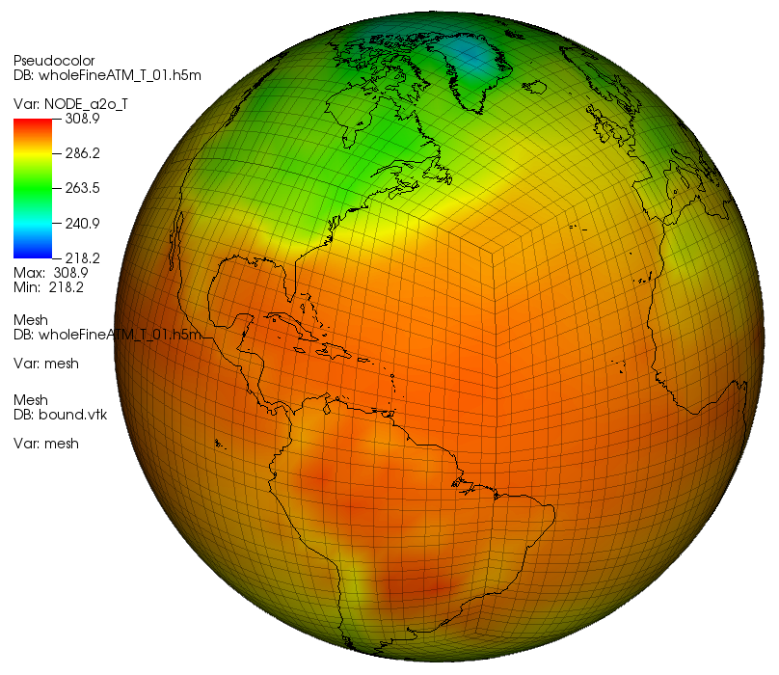
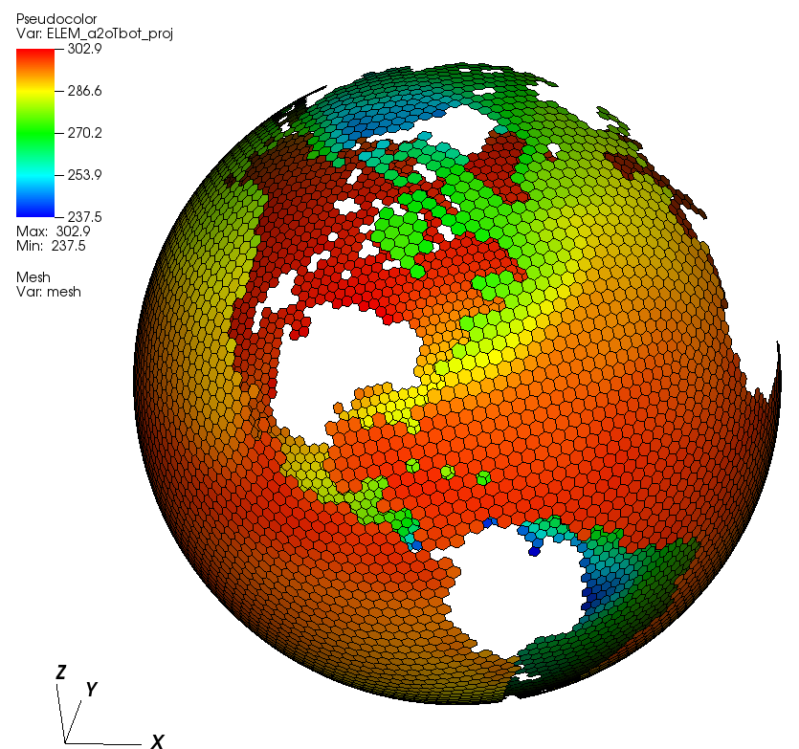
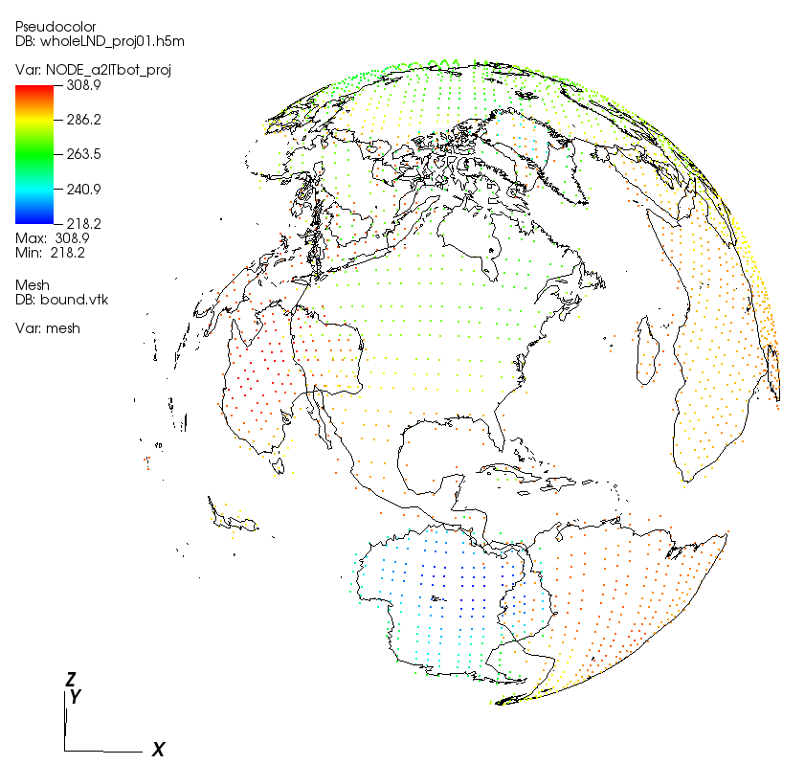
MOAB-based coupler
Online computation of mapping weights/communication working for atm - ocn and for atm - lnd coupling, (weight calculation using TempestRemap)
Offline “mbtempest” tool now available (on Cori) for making mapping files with same algorithms. Supports MPI data-parallelism.
atm
ocean
land

Slide 18
Infrastructure Group works for YOU
IG should be working on tools you want/need to use
If there are any problems with IG software, always FILE AN ISSUE.
Only way to let others experiencing the problem to know its been reported.
Group leads can prioritize the work and track progress.
See the “IG Software” summary page which lists Infrastructure software and, after one more click, the link to the github issues page.

Slide 19
Some of the topics to be discussed this week
Processing/analysis for high resolution
How much has to be done at full resolution? Where is parallelism needed?
Test coverage:
Need more system tests with debugging. Not enough for the many land-model compsets.
Need more testing of CIME itself
Need more integrators. Current cohort is overextended.
Standardizing sub-monthly output and processing

Slide 20
Some of the topics to be discussed this week
Renaming CAM->EAM and CLM->ELM in all source code/output before v2 sim start.
Standardizing output file metadata across all components.
Automating data staging and movement
Improving integration and code-review process
Your topic here!

Slide 21
IG schedule this week
Today: breakout (1:45-3:30, room #2)
Status and plans for: CIME CCS (20min), Testing coverage (20min), Workflow tools (20min), diagnostic/analysis tools (30min).
Wednesday: evening sessions (Room #2)
7-7:30pm: BGC data archiving and publication discussion
7:30-8pm: Working with E3SM's new cmake-based build system tutorial.
Thursday: speed dating
11-11:30am: IG and Watercycle on diagnostics (Room #1)
11:35-12:05pm: IG and BGC: diagnostics and processflow (Plenary)
12:10-12:40pm: IG and NGD SCREAM: IO, diagnostics, coupling (Plenary)
Thursday: Tutorial
4-4:30pm: Processflow workflow tutorial (Room #1)

