Slide 1
Next-Generation Developments in Software and Algorithms including some funded by the CMDV Software Modernization Project
Andy Salinger (Sub-Project Lead)
Hyun Kang, Salil Mahajan, Andrew Bradley, Andrew Steyer, Hui Wan, Kai Zhang, Jian Sun, Andreas Wilke, Irina Tezaur, Josh Fu, Rong-You Chien, and others

Slide 2
How the NGD Software and Algorithms Sub-Project
Fits in the Larger E3SM Ecosystem
Infrastructure Core
Software Eng.
Diagnostics
NGD Software and Algorithms
SciDAC BER Applications
SciDAC Institutes
Other DOE Computational Science Investments
Performance Core
Core Science Teams
SCREAM NGD
ECP Cloud-Resolving MMF
Incorporation into E3SM:
0-2 Years (v2)
1-3 Years (v3)
3-10 Years (v4)

Slide 3
Software and Algorithms NGD
Major Themes: Make targeted investments to,
Improve model throughput on exascale machines
  Algorithms, Performance
Improve developer productivity
Create a culture of verification
Leverage DOE Computational Science investment’s and entrain talented computational scientists into E3SM
Implemented as a portfolio of independent R&D Epics:
Selection of Epics: some push, some pull.

Slide 4
Outline
7 Highlights on 7 Slides
2 Slides of Lists of Future Plans

Slide 5
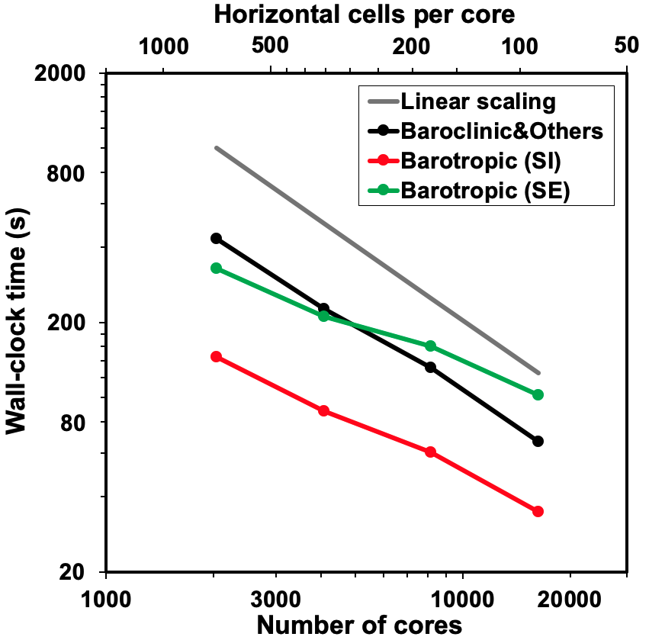
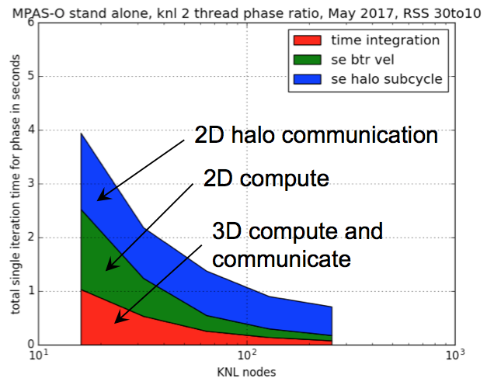
MPAS Barotropic Mode Solver
Ocean barotropic mode
  Very fast mode (30x), not important for climate
  Vertically integrated (2D) mode
  Limits scalability in all ocean models
Preconditioners investigated to reduce number of global communications (BiCGStab iterations)
  2.9x speedup for barotropic mode solve
  1.65x speedup of MPAS-O at scale
Motivation: Split-Explicit (SE) Scheme
2040
4080
3x
8160
MPAS grid:
30km-to-10km
16320

Slide 6
Semi-Lagrangian Tracer Transport Communication Pattern
Semi-Lagrangian tracer transport gives substantial Atmosphere Dycore speedup:
COMPOSE SciDAC project: 3x speedup
Upwind MPI task: communicate only interpolated points from upwind partitions, not full halo:
NGD Software & Algorithms: Another 2x speedup
Total speedup of Semi-Lagrangian transport in the atmosphere: 6x.
SciDAC project working on ocean next!

Slide 7
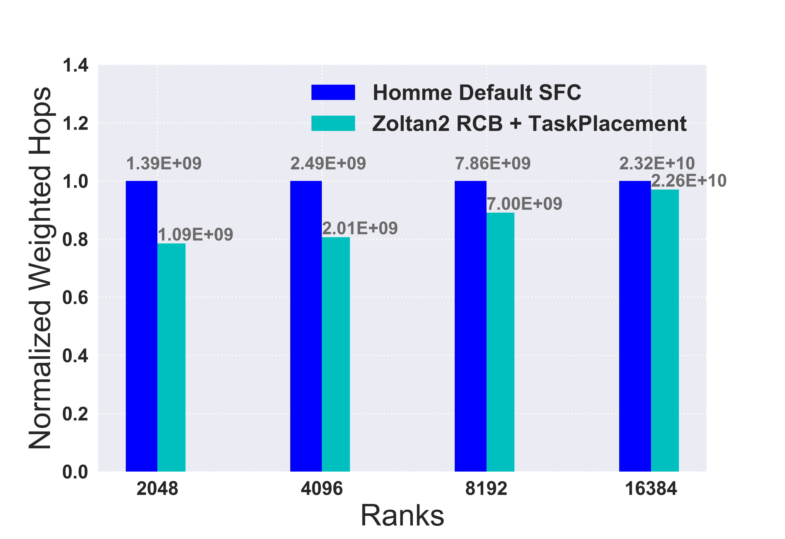


Improved Task Placement
Fast GPUs mean that MPI Communication is (still) the scalability bottleneck.
Task Placement can impact communication time, ~10-20%
The permutation of MPI ranks to reduce communication distance: uses Zoltan2 library
Must be run-time
Machine dependent
Preliminary Results for HOMME:
Decrease in communication “Hops”
on Theta at ALCF with Dragonfly network.
In Progress:
Zoltan2 Back end for FatTree for Summit
Using MPI profiling to automate
assembly of Communication Graph

Slide 8
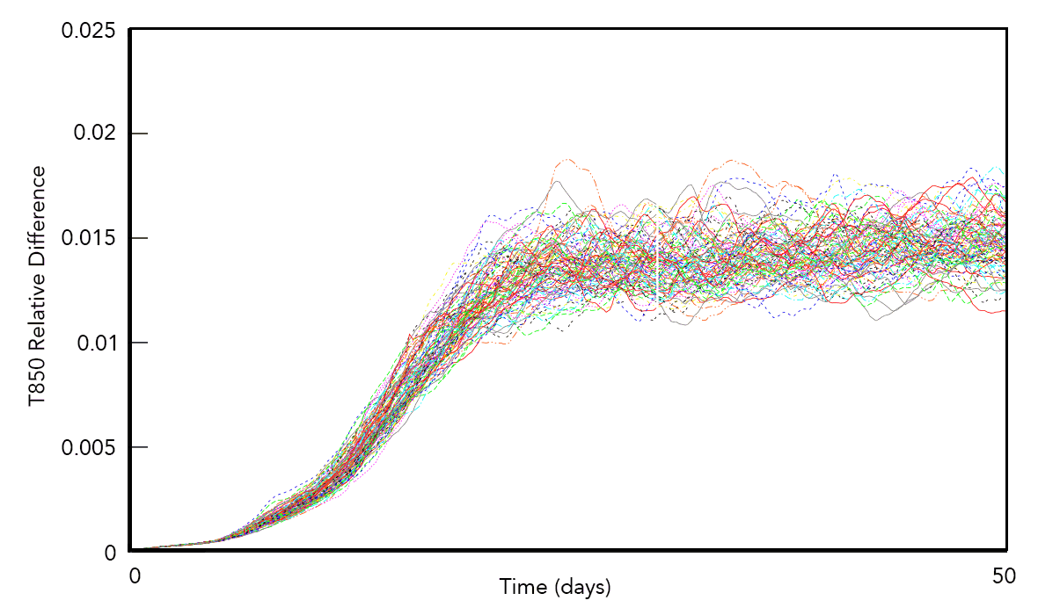
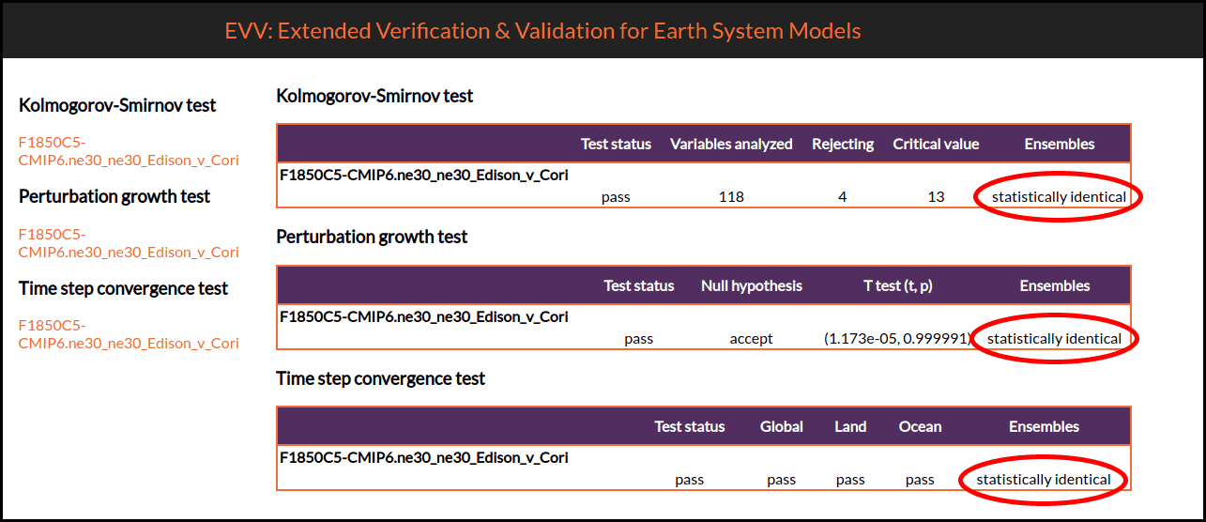
Multivariate Tests for
Climate Reproducibility
Use advanced machine learning multivariate techniques to determine if non-b4b changes significantly impact model climate statistics using short ensembles:
Implemented for Atmosphere
Progress in MPAS Ocean as well!
Growth of differences in 850 mb temperature (in Kelvin, using the L1 norm) between each pair of simulations in a 100-member ensemble. Adapted from Mahajan et al., 2017 ICCS.
Highlight:
Question: Can we switch computers in the middle of a science campaign?
The Verdict: Cori and Edison are Statistically Indistinguishable

Slide 9
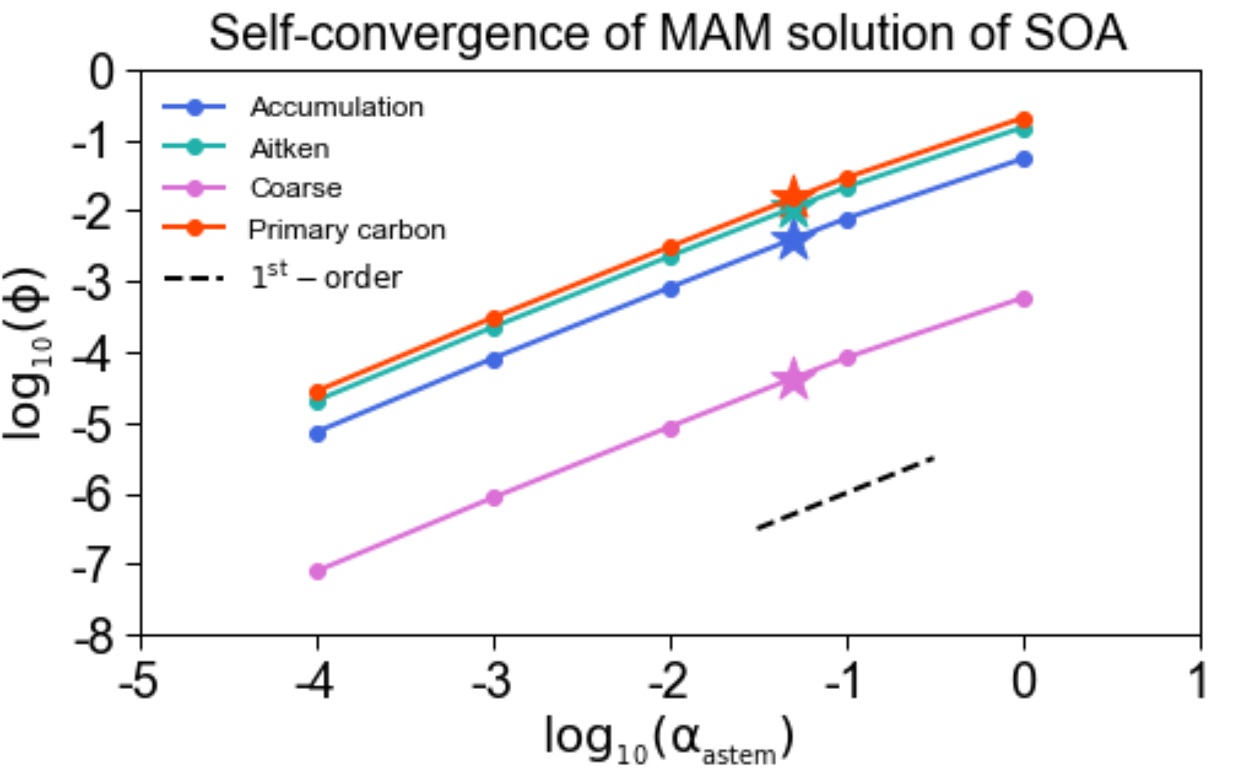

Verification:
Demonstrations and Infrastructure
Goal: Instill a culture of Verification into E3SM
“Climate Models need to demonstrate their trustworthiness at a level commensurate with the decisions that will be made based on their predictions.” [Salinger, 2019]
Mature and deploy verification
infrastructure:
  Jupyter notebooks combine equations
  with executable scripts for on-demand
  documentation
  Best progress on MAM
  Fixes: MG2, P3, MAM, CLUBB, SHOC

Slide 10
Implicit-Explicit (IMEX) and Exponential (ETI) integrators for Nonhydrostatic Atmosphere Dycore
wind
problem
geop initial
geop after update
topography
HEVI splitting isolates terms (boxed) responsible for fast vertical acoustic wave propagation. (Steyer et al, Efficient IMEX Runge-Kutta methods for nonhydrostatic dynamics, arxiv:1906.07219).
IMEX Schemes that worked great on test problems were going unstable with steep topography. This issue was recently solved by including additional topography gradient term in implicit treatment.

Slide 11
Improved Atmosphere Chemistry Solver: ROS2
The ROS2 solver was previously implemented in CESM
The improved computational efficiency of the ROS-2 solver is due to the reuse of the Jacobian matrix and lower upper (LU) factorization during its multistage calculation
Now implementing in E3SM
  Student recently hired and making quick progress
Solver | Total CPU time for chemistry alone
1 year simulation
ORI solver | 686 hours
ROS-2 solver | 360 hours
Speedup: 1.9×
Saved time: 47%
(Sun et al., 2017, doi:10.1002/2016MS000863
Sun et al., 2018, doi:10.1029/2018MS001276)

Slide 12
Outline
7 Highlights on 7 Slides
2 Slides of Lists of Future Plans

Slide 13
Software and Algorithms NGD Plans
1. Short Term
Finish of ongoing work in:
  Barotropic Solve
  IMEX Time Integration
  Atmosphere Chemistry Solver
  Task Placement
  Climate Reproducibility Testing
”Declare Success” on Verification and Unit Testing
  Part of project Code Review process
  Actively part of SCREAM, EAGLES, etc.
  Will start monthly discussion group
Continue to fund two star researcher-developers
In scope, but funded elsewhere:
  Coupling algorithms
  Ice sheet algorithms
  Asynchronous Multi-Task
  Semi-Lagrangian Transport in Ocean
  Kokkos work in SCREAM

Slide 14
Software and Algorithms NGD Plans
Potential New Epics -- Large
Software infrastructure and diagnostics for large ensembles
  E.g., 50-1000 concurrent simulations
  Need scientist to drive and UQ expertise
Define mathematically the scalar metric used in tuning the E3SM model
  Enable automated tuning with optimization algorithms
  Reproducible science – explicitly write out the weightings of different metrics
  Bayesian UQ – ensembles sampled from distributions of potential tunings
  Ability to make quantitative choice of quality vs performance

Slide 15
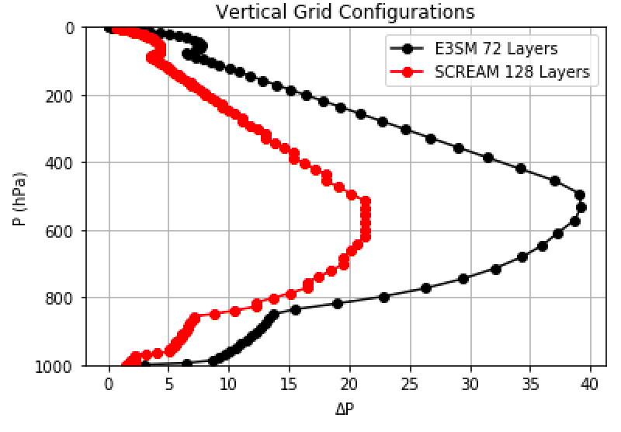
Software and Algorithms NGD Plans
Potential New Epics -- Small
Automated recovery from instabilities (Atmosphere’s “Negative Layer Thickness”)
  Back up and use smaller time steps / more frequent remap
  Use throw/catch error handling
Mixed Precision to get speed of single precision
  Rigorous analysis with adjoint-based sensitivities of a metric
Optimal selection of vertical level grid spacing
  Staffed!
Pilot project to explore Julia programming
language
Notably Missing: Machine Learning

Slide 16
HOMMEXX: Performance Portable Atm in C++/Kokkos
Single Node/GPU Performance
3km “Cloud Resolving” Atmosphere Grid
10x per Summit Node
Nvidia has chosen to work with us to prepare a Gordon Bell Prize submission using Summit.

