Slide 1
OpenACC Tutorial E3SM 2019 Fall All-Hands
Phil Jones, Sarat Sreepathi

Slide 2
Goals
Quick basic tutorial on most common bits
Brief hardware digression
Refactoring existing code
OpenMP 4.5 and later
Matt Norman mini-weather app
Information presented is from
Nvidia tutorials
Confluence pages by M. Norman and others

Slide 3
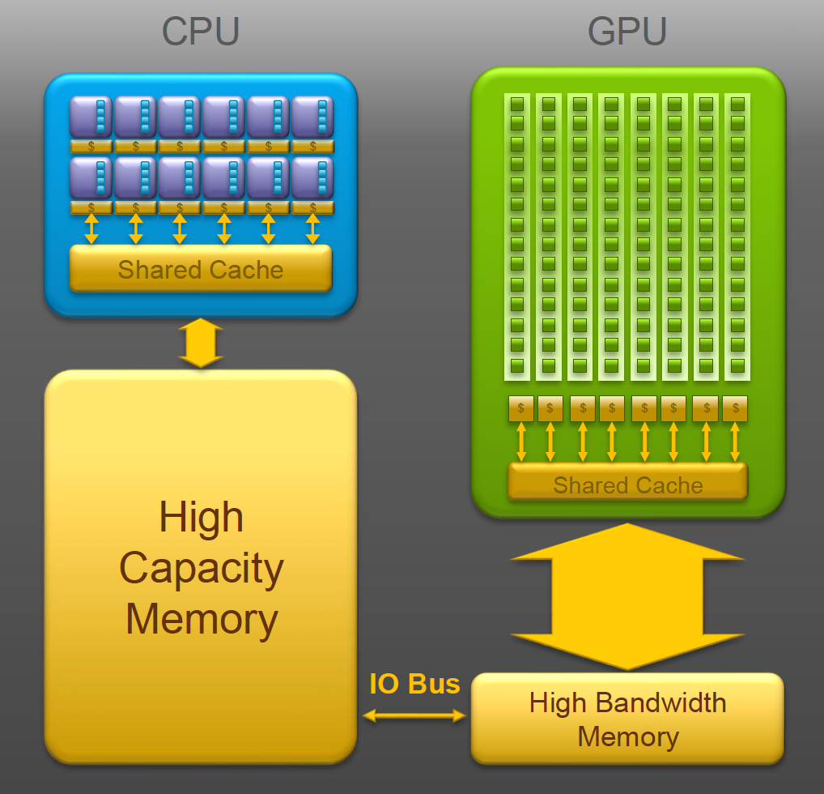
A tiny bit of hardware and why OpenACC
Hybrid architecture, CPU+accel
Accelerators (GPUs)
High internal parallelism
84 SMs w/ 64 FP32, 32 FP64, 8 TC
Tens of thousands of threads
Local high-bandwidth memory
Also managed/unified memory
OpenACC
Directive-based approach
Express parallelism
Manage data motion
Host-device model

Slide 4
Example code (from OpenACC tutorials, J. Vetter)
while ( error > tol && iter < iter_max )
{
error = 0.0;
for( int j = 1; j < n-1; j++)
{
for( int i = 1; i < m-1; i++ )
{
Anew[j][i] = 0.25 * ( A[j][i+1] + A[j][i-1]
+ A[j-1][i] + A[j+1][i]);
error = fmax( error, fabs(Anew[j][i] - A[j][i]));
}
}
for( int j = 1; j < n-1; j++)
{
for( int i = 1; i < m-1; i++ )
{
A[j][i] = Anew[j][i];
}
}
if(iter % 100 == 0) printf("%5d, %0.6f\n", iter, error);
iter++;
}
do while ( error > tol .and. iter < iter_max )
error=0.0_fp_kind
do j=1,m-2
do i=1,n-2
Anew(i,j) = 0.25_fp_kind * ( A(i+1,j ) + A(i-1,j ) + &
A(i ,j-1) + A(i ,j+1) )
error = max( error, abs(Anew(i,j)-A(i,j)) )
end do
end do
do j=1,m-2
do i=1,n-2
A(i,j) = Anew(i,j)
end do
end do
if (mod(iter,100) == 0 ) write(*,'(i5,f10.6)'), iter, error
iter = iter + 1
end do

Slide 5
Basic loop directives
do while ( error > tol .and. iter < iter_max )
error=0.0_fp_kind
!$acc parallel loop, reduction(max:error)
do j=1,m-2
do i=1,n-2
Anew(i,j) = 0.25_fp_kind * ( A(i+1,j ) + A(i-1,j ) + &
A(i ,j-1) + A(i ,j+1) )
error = max( error, abs(Anew(i,j)-A(i,j)) )
end do
end do
!$acc parallel loop
do j=1,m-2
do i=1,n-2
A(i,j) = Anew(i,j)
end do
end do
if (mod(iter,100) == 0 ) write(*,'(i5,f10.6)'), iter, error
iter = iter + 1
end do
while ( error > tol && iter < iter_max )
{
error = 0.0;
#pragma acc parallel loop, reduction(max:error)
for( int j = 1; j < n-1; j++)
{
for( int i = 1; i < m-1; i++ )
{
Anew[j][i] = 0.25 * ( A[j][i+1] + A[j][i-1]
+ A[j-1][i] + A[j+1][i]);
error = fmax( error, fabs(Anew[j][i] - A[j][i]));
}
}
#pragma acc parallel loop
for( int j = 1; j < n-1; j++)
{
for( int i = 1; i < m-1; i++ )
{
A[j][i] = Anew[j][i];
}
}
if(iter % 100 == 0) printf("%5d, %0.6f\n", iter, error);
iter++;
}

Slide 6
Loop clauses
collapse (n)
private (list)
reduction (operator:list)
Operators are +,*, min, max, bitwise or logical and/or
tile (expression)
device_type or dtype (list)
Fine tune work distribution
gang (num_gangs)
worker (num_workers)
vector (vector_length)
Loop dependency
seq
independent
auto

Slide 7
Basic loop directives again
do while ( error > tol .and. iter < iter_max )
error=0.0_fp_kind
!$acc parallel loop, collapse(2), reduction(max:error)
do j=1,m-2
do i=1,n-2
Anew(i,j) = 0.25_fp_kind * ( A(i+1,j ) + A(i-1,j ) + &
A(i ,j-1) + A(i ,j+1) )
error = max( error, abs(Anew(i,j)-A(i,j)) )
end do
end do
!$acc parallel loop, collapse(2)
do j=1,m-2
do i=1,n-2
A(i,j) = Anew(i,j)
end do
end do
if (mod(iter,100) == 0 ) write(*,'(i5,f10.6)'), iter, error
iter = iter + 1
end do
while ( error > tol && iter < iter_max )
{
error = 0.0;
#pragma acc parallel loop, collapse(2), reduction(max:error)
for( int j = 1; j < n-1; j++)
{
for( int i = 1; i < m-1; i++ )
{
Anew[j][i] = 0.25 * ( A[j][i+1] + A[j][i-1]
+ A[j-1][i] + A[j+1][i]);
error = fmax( error, fabs(Anew[j][i] - A[j][i]));
}
}
#pragma acc parallel loop, collapse(2)
for( int j = 1; j < n-1; j++)
{
for( int i = 1; i < m-1; i++ )
{
A[j][i] = Anew[j][i];
}
}
if(iter % 100 == 0) printf("%5d, %0.6f\n", iter, error);
iter++;
}

Slide 8
Managing data: data clauses
copy (list)
Allocates array on device, copies data to device at beginning and copies out at end
copyin (list)
Allocates array on device and copies data from host to device at beginning
copyout (list)
Allocates array on device and copies data from device to host at end
create (list)
Allocates array on device but does not copy
present (list)
Don’t allocate/transfer because we know it’s already there
List
Variable name
Can also specify bounds, shape (e.g. A(beg:end) or A[beg,length]) if needed for sections, different bounds (more for C where array info not available)

Slide 9
Loop directives with data (inefficient)
do while ( error > tol .and. iter < iter_max )
error=0.0_fp_kind
!$acc parallel loop, collapse(2), reduction(max:err), &
!$acc copyin(A), copyout(Anew)
do j=1,m-2
do i=1,n-2
Anew(i,j) = 0.25_fp_kind * ( A(i+1,j ) + A(i-1,j ) + &
A(i ,j-1) + A(i ,j+1) )
error = max( error, abs(Anew(i,j)-A(i,j)) )
end do
end do
!$acc parallel loop, collapse(2), copyin(Anew), &
!$acc copyout(A)
do j=1,m-2
do i=1,n-2
A(i,j) = Anew(i,j)
end do
end do
if (mod(iter,100) == 0 ) write(*,'(i5,f10.6)'), iter, error
iter = iter + 1
end do
while ( error > tol && iter < iter_max )
{
error = 0.0;
#pragma acc parallel loop, collapse(2), reduction(max:error), \
copyin(A[0:n*m]), copyout(Anew[0,n*m])
for( int j = 1; j < n-1; j++)
{
for( int i = 1; i < m-1; i++ )
{
Anew[j][i] = 0.25 * ( A[j][i+1] + A[j][i-1]
+ A[j-1][i] + A[j+1][i]);
error = fmax( error, fabs(Anew[j][i] - A[j][i]));
}
}
#pragma acc parallel loop, collapse(2), copyin(Anew[0:n*m]),\
copyout(A[0:n*m])
for( int j = 1; j < n-1; j++)
{
for( int i = 1; i < m-1; i++ )
{
A[j][i] = Anew[j][i];
}
}
if(iter % 100 == 0) printf("%5d, %0.6f\n", iter, error);
iter++;
}

Slide 10
Data regions
Specific region in routine
!$acc data clauses (the same copy, copyin, copyout, create)
!$acc end data
Larger data regions spanning routines
!$acc enter data clauses
!$acc exit data clauses
Enter data clauses
copyin, create as before
async, wait to overlap transfers
Exit data clauses
copyout as before
delete
async, wait
finalize

Slide 11
Data regions
!$acc data copy(A), copyin(Anew)
do while ( error > tol .and. iter < iter_max )
error=0.0_fp_kind
!$acc parallel loop, collapse(2), reduction(max:err)
do j=1,m-2
do i=1,n-2
Anew(i,j) = 0.25_fp_kind * ( A(i+1,j ) + A(i-1,j ) + &
A(i ,j-1) + A(i ,j+1) )
error = max( error, abs(Anew(i,j)-A(i,j)) )
end do
end do
!$acc parallel loop, collapse(2)
do j=1,m-2
do i=1,n-2
A(i,j) = Anew(i,j)
end do
end do
if (mod(iter,100) == 0 ) write(*,'(i5,f10.6)'), iter, error
iter = iter + 1
end do
!$acc end data
#pragma acc data copyin(A[0:n*m]), copyout(Anew[0,n*m])
while ( error > tol && iter < iter_max )
{
error = 0.0;
#pragma acc parallel loop, collapse(2), reduction(max:error)
for( int j = 1; j < n-1; j++)
{
for( int i = 1; i < m-1; i++ )
{
Anew[j][i] = 0.25 * ( A[j][i+1] + A[j][i-1]
+ A[j-1][i] + A[j+1][i]);
error = fmax( error, fabs(Anew[j][i] - A[j][i]));
}
}
#pragma acc parallel loop, collapse(2)
for( int j = 1; j < n-1; j++)
{
for( int i = 1; i < m-1; i++ )
{
A[j][i] = Anew[j][i];
}
}
if(iter % 100 == 0) printf("%5d, %0.6f\n", iter, error);
iter++;
}
#pragma acc end data

Slide 12
Other topics
Data synchronization
Update self (or host), device
!$acc update self (list)
!$acc update device (list)
Use of gang, worker, vector
Usually best to collapse and let compiler choose all
Worker rarely used
Best to let compiler choose gangs
Vector_length sometimes helpful, so combine collapse/vector_length
Use of !$acc routine
Deep copies
!$acc parallel num_gangs(2) &
!$acc num_workers(2) vector_length(32)
!$acc loop gang worker
do j = 1,4
!$acc loop vector
do i=1,32
array(i,j) = ….
end do
end do

Slide 13
Asynchronous execution
Overlap tasks
Hide data transfers
Hide kernel launch latency
Use both CPU, accelerator
Though better to use GPU?
async, wait
!$acc parallel loop async(1)
do i=1,N
a(i) = i
end do
!$acc parallel loop async(2)
do i=1,N
b(i) = 2.0 * i
end do
!$acc wait(1) async(2)
!$acc parallel loop async(2)
do i=1,N
c(i) = a(i) + b(i)
end do
!$acc update self(c) async(2)
!$acc wait
!$acc parallel loop async
do i=1,N
c(i) = a(i) + b(i)
end do
!$acc update self(c) async
!$acc wait

Slide 14
Needed refactoring
Mostly copied from Matt Norman’s page:
https://acme-climate.atlassian.net/wiki/spaces/ED/pages/1041499662/Fortran+GPU+Refactoring+Guide+Using+Directives
Also Fortran and C++ best practices
https://acme-climate.atlassian.net/wiki/spaces/ED/pages/128585462/Fortran+Performance+Best+Practices
https://acme-climate.atlassian.net/wiki/spaces/ED/pages/885522459/C+Programming+Best+Practices+in+Scientific+Computing
General rules
Minimize data transfers
Maximize work
Test as you go

Slide 15
Tightly Nested Loops
!This is NOT tightly nested
do k = 1 , nlev
if (levelActive(k)) then
do j = 1 , ny
do i = 1 , nx
enddo
enddo
endif
enddo
!This IS tightly nested
!$acc parallel loop collapse(3)
do k = 1 , nlev
do j = 1 , ny
do i = 1 , nx
if (levelActive(k)) then
...
endif
enddo
enddo
enddo
Generally want tightly nested loops
Maximize number of threads
Conditionals
Can be handled, but best on innermost
But…disrupts vectorization
Mult mask might still be preferred?
Do not loop over column or point-wise function calls
Push loops into routines instead

Slide 16
Declare private vars
Loop scalars private by default
!$acc parallel loop collapse(3) private(tmp)
do k = 1 , nlev
do j = 1 , ny
do i = 1 , nx
tmp(1) = a(i,j,k,1)*b(i,j,k,1)*c(1)
tmp(2) = a(i,j,k,2)*b(i,j,k,2)*c(2)
d(i,j,k) = tmp(1) + tmp(2)
enddo
enddo
enddo

Slide 17
Race conditions - reductions
! A reduction is most easily handled
! when it is done across all dimensions
! of the loops
max_wave = 0
do k = 1 , nlev
do j = 1 , ny
do i = 1 , nx
cs=sqrt(gamma*p(i,j,k)/rho(i,j,k))
max_wave_loc = max(abs(u(i,j,k)), &
abs(v(i,j,k)), &
abs(w(i,j,k)) ) + cs
max_wave = max( max_wave ,&
max_wave_loc )
enddo
enddo
enddo
! You handle this in OpenACC and OpenMP with
! the reduction clause
max_wave = 0
!$acc parallel loop collapse(3) &
!$acc reduction(max:max_wave) &
!$acc private(cs,max_wave_loc)
max_wave = 0
do k = 1 , nlev
do j = 1 , ny
do i = 1 , nx
cs = sqrt(gamma*p(i,j,k)/rho(i,j,k))
max_wave_loc = max(abs(u(i,j,k)), &
abs(v(i,j,k)), &
abs(w(i,j,k))) + cs
max_wave = max( max_wave ,&
max_wave_loc )
enddo
enddo
enddo

Slide 18
Race conditions - atomics
!$acc parallel loop
do k = 1 , nlev
u_column(k) = 0
enddo
!$acc parallel loop collapse(3) private(tmp)
do k = 1 , nlev
do j = 1 , ny
do i = 1 , nx
!You can only apply an atomic statement that
! looks like: a=a+b
!Therefore, you need to precompute the RHS of the
! update before doing the atomic statement
tmp = (u(i,j,k) - u0(k))*factor_xy
!Now, you can apply the atomic directive
!$acc atomic update
u_column(k) = u_column(k) + tmp
enddo
enddo
enddo
do k = 1 , nlev
u_column(k) = 0
enddo
do k = 1 , nlev
do j = 1 , ny
do i = 1 , nx
u_column(k) = &
u_column(k) + u(i,j,k)
enddo
enddo
enddo

Slide 19
Prefix sums or scans
!First, we compute the arithmetic completely in parallel
!$acc parallel loop collapse(3)
do k = 1 , nlev
do j = 1 , ny
do i = 1 , nx
hy_temp(i,j,k) = [lots of arithmetic]
if (k == nlev) hy_press(i,j,nlev) = 0
enddo
enddo
enddo
!Next, we do the prefix sum serially in the dimension summed
!minimizing the amount of serial work
!$acc parallel loop collapse(2)
do j = 1 , ny
do i = 1 , nx
!$acc loop seq
do k = nlev-1 , 1 , -1
hy_press(i,j,k) = hy_press(i,j,k+1) + hy_temp(i,j,k)
enddo
enddo
enddo
!Finally, we return to full parallelism for the rest of the work
!$acc parallel loop collapse(3)
do k = 1 , nlev
do j = 1 , ny
do i = 1 , nx
otherstuff(i,j,k) = hy_press(i,j,k) + [stuff]
...
enddo
enddo
enddo
do j = 1 , ny
do i = 1 , nx
hy_press(i,j,nlev) = 0
do k = nlev-1 , 1 , -1
hy_press(i,j,k) = &
hy_press(i,j,k+1) + [arithmetic]
enddo
do k = 1 , nlev
otherstuff(i,j,k) = &
hy_press(i,j,k) + [stuff]
enddo
enddo
enddo

Slide 20
OpenMP
v4.5 and later support accelerators
Not all vendors support OpenACC
OpenMP meant to be standards-based solution
For simple constructs, translation relatively straightforward

Slide 21
OMP version
!$omp target map(tofrom: A), map(to:Anew)
do while ( error > tol .and. iter < iter_max )
error=0.0_fp_kind
!$omp parallel do, collapse(2), reduction(max:err)
do j=1,m-2
do i=1,n-2
Anew(i,j) = 0.25_fp_kind * ( A(i+1,j ) + A(i-1,j ) + &
A(i ,j-1) + A(i ,j+1) )
error = max( error, abs(Anew(i,j)-A(i,j)) )
end do
end do
!$omp parallel do, collapse(2)
do j=1,m-2
do i=1,n-2
A(i,j) = Anew(i,j)
end do
end do
if (mod(iter,100) == 0 ) write(*,'(i5,f10.6)'), iter, error
iter = iter + 1
end do
!$omp end target
#pragma omp target map(tofrom: A), map(to:Anew)
while ( error > tol && iter < iter_max )
{
error = 0.0;
#pragma omp parallel for, collapse(2), reduction(max:error)
for( int j = 1; j < n-1; j++)
{
for( int i = 1; i < m-1; i++ )
{
Anew[j][i] = 0.25 * ( A[j][i+1] + A[j][i-1]
+ A[j-1][i] + A[j+1][i]);
error = fmax( error, fabs(Anew[j][i] - A[j][i]));
}
}
#pragma omp parallel for, collapse(2)
for( int j = 1; j < n-1; j++)
{
for( int i = 1; i < m-1; i++ )
{
A[j][i] = Anew[j][i];
}
}
if(iter % 100 == 0) printf("%5d, %0.6f\n", iter, error);
iter++;
}

