Slide 1
Impact of mesoscale convection parameterization and convective gravity wave drag in E3SMv1
Jadwiga (Yaga) Richter, Jack Chen, Mitch Moncrieff, Changhai Liu
Shaocheng Xie, Qi Tang, Phil Rasch
11/21/2019

Slide 2
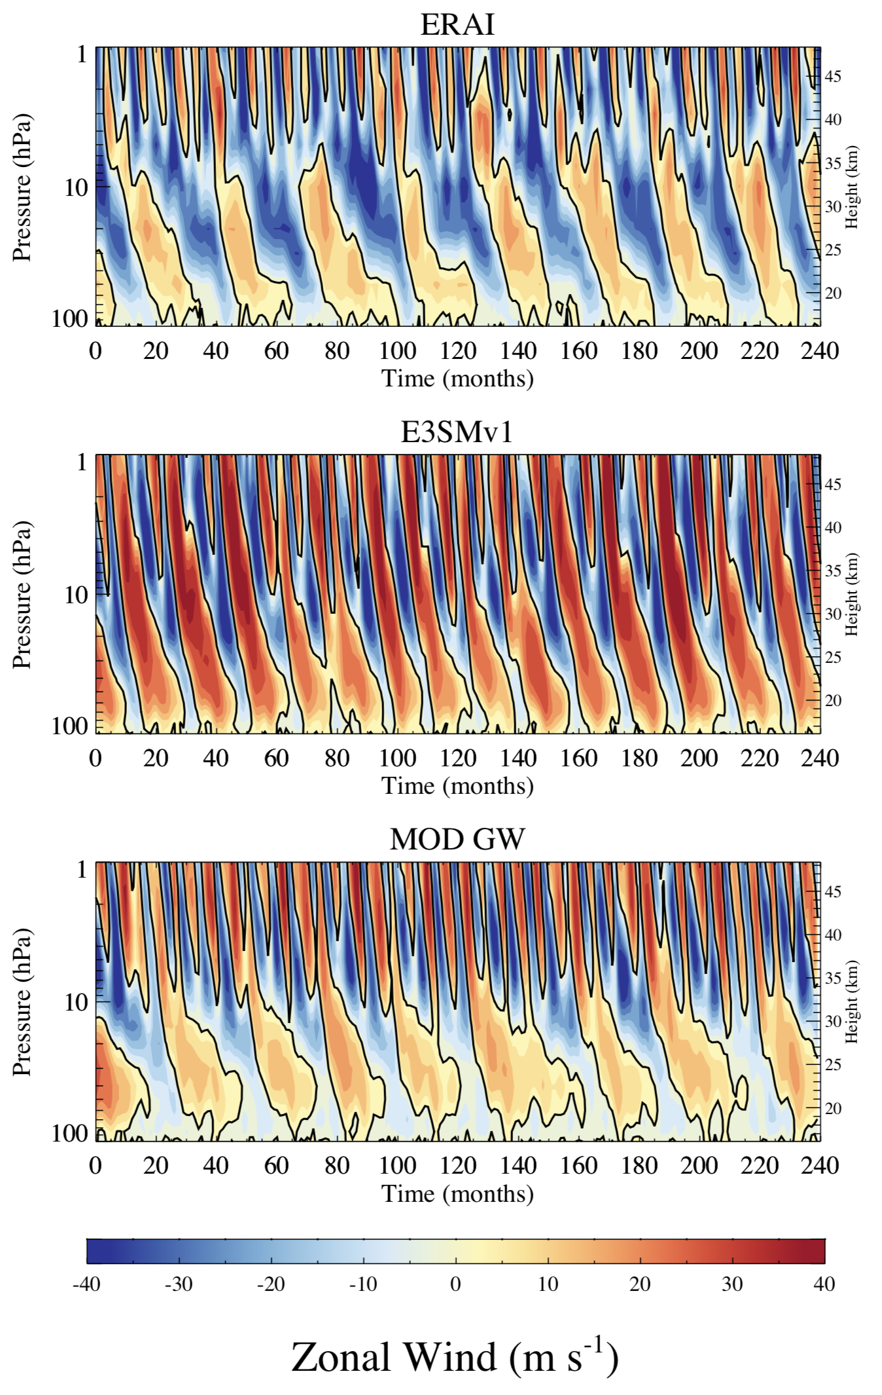
Momentum Transport by GWs
Improved QBO
Goal:
To improve the representation of the QBO in E3SM
Progress:
Modified convective GW parameterization and improved the QBO period; Results published in Richter et al. (2019)
Richter et al. (2019): “Improved Simulation of the QBO in E3SMv1”, JAMES,

Slide 3
Power Spectrum and Amplitude
Control
ERAI
Control
New
Settings
ERAI
New Settings
Changes come from changing efficiency of GWs generated by convection
& changed conversion factor from grid box to convective heating rate
Richter et al. (2019): “Improved Simulation of the QBO in E3SMv1”, JAMES,

Slide 4
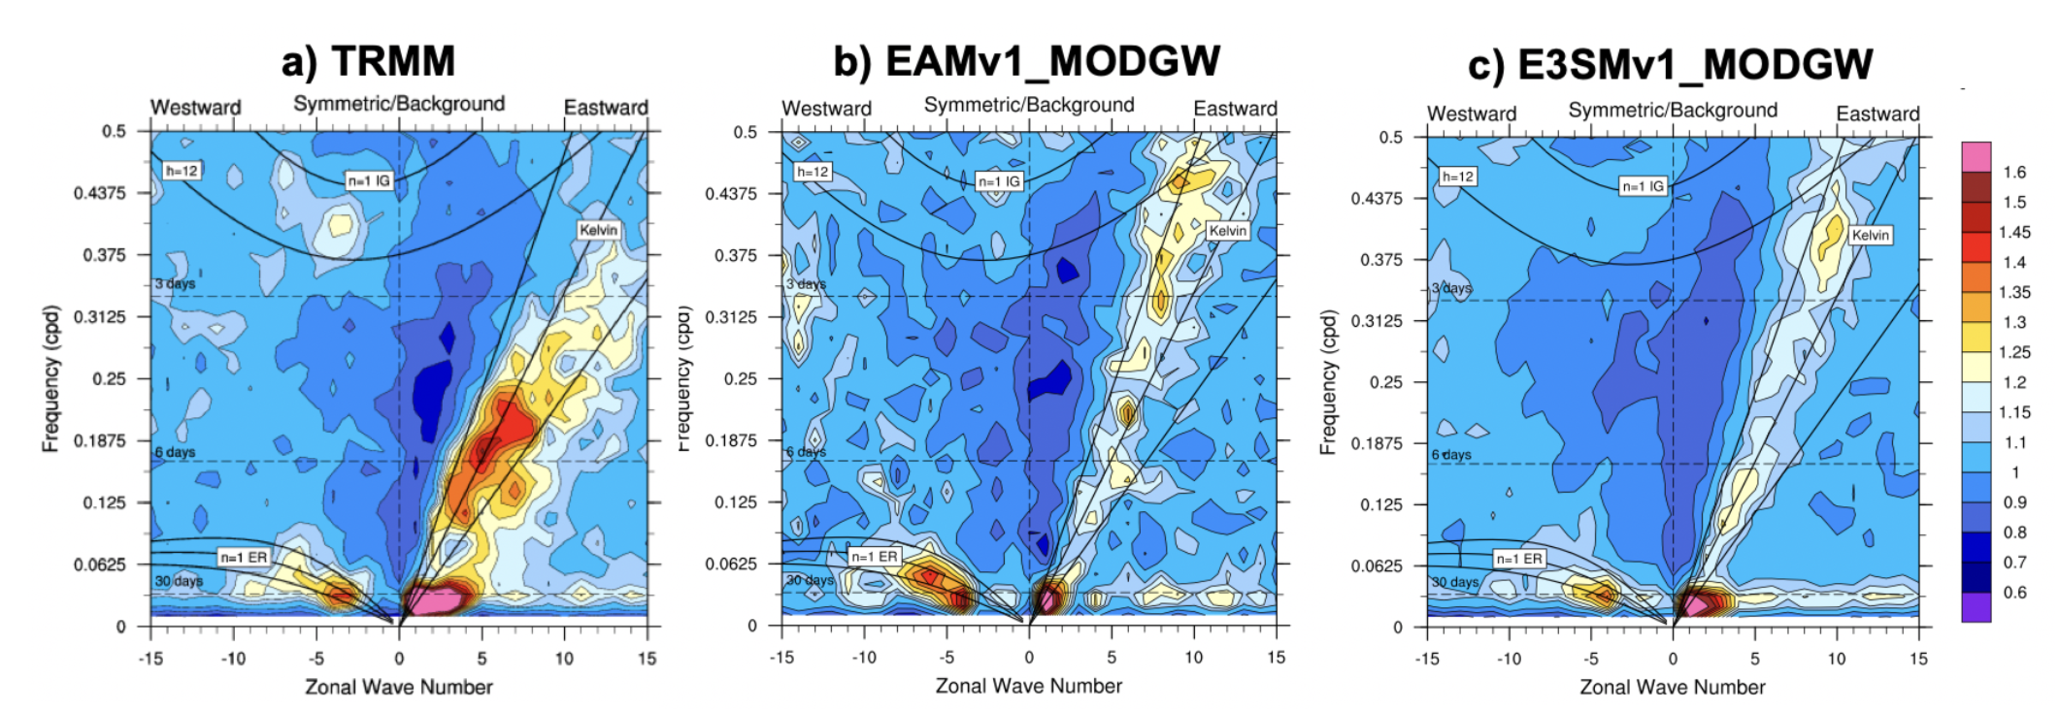
Convectively Coupled Waves
15S to 15N
Richter et al. (2019): “Improved Simulation of the QBO in E3SMv1”, JAMES,
Kelvin wave and MJO activity too weak in E3SMv1

Slide 5
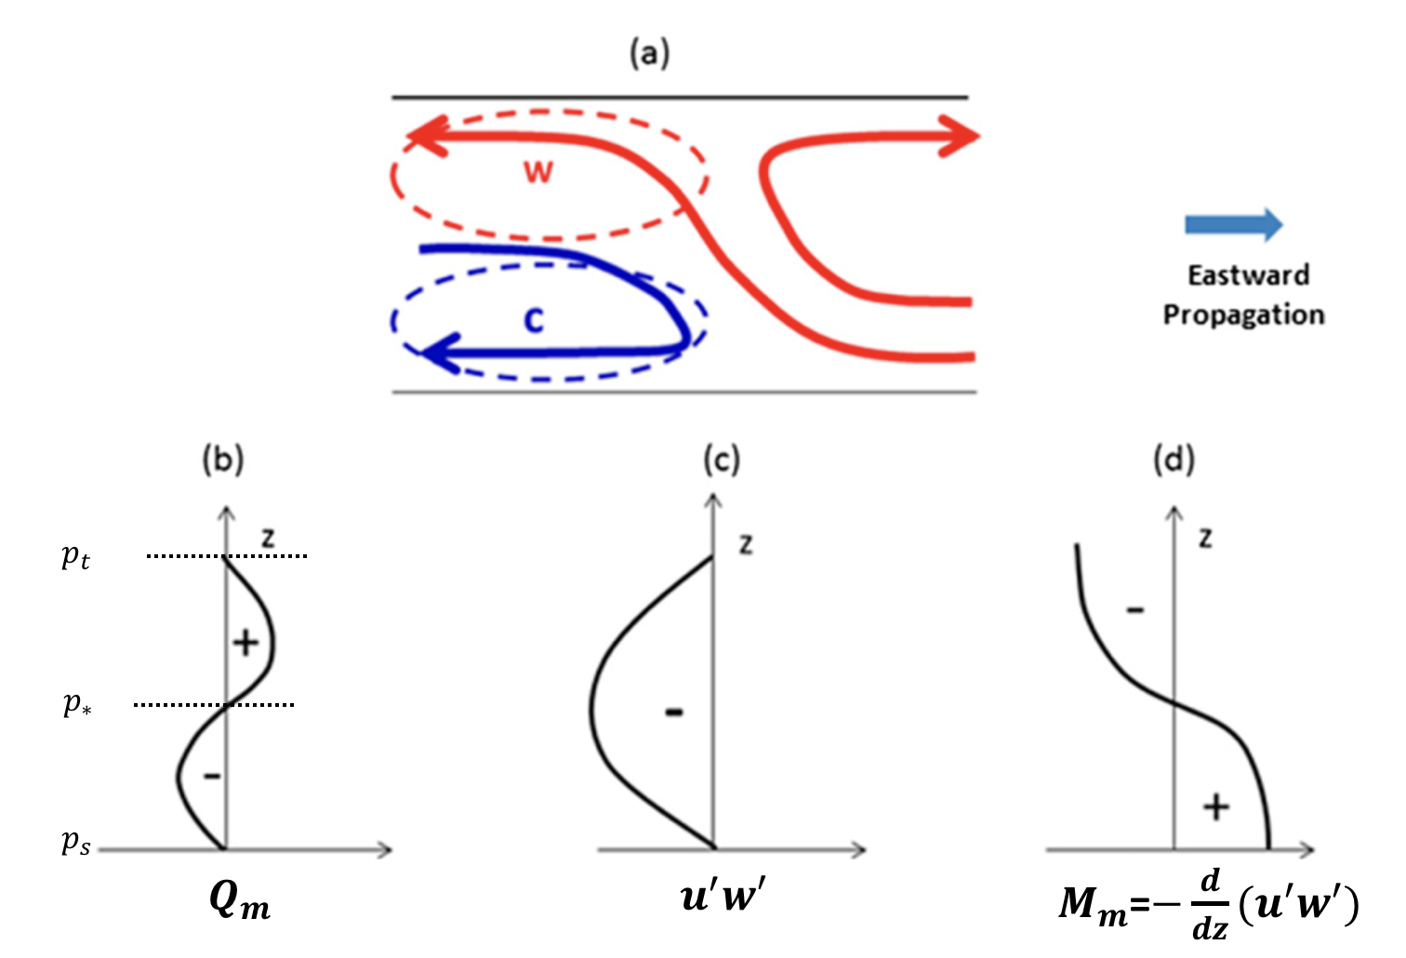
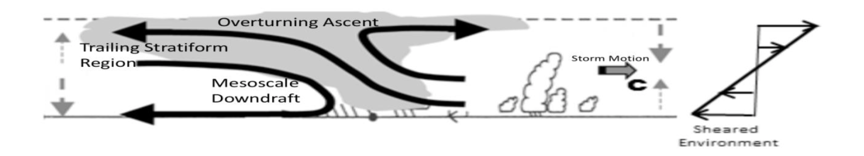
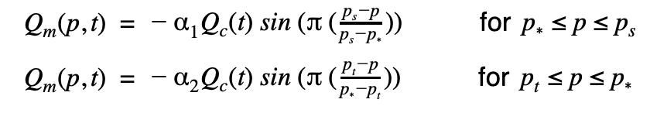


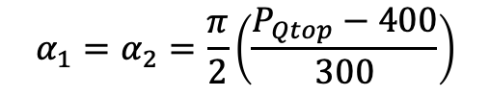
Parameterization of mesoscale convection
Goal: To represent mesoscale organization in E3SM
Multiscale Coherent Structure Parameterization (MCSP)
+
-
Multiscale coherent structure (MCSP) with a slantwise overturning layer including a trailing stratiform region, an overturning ascent and a mesoscale downdraft.
Added Mesoscale Heating Profile:
Tried 4 AMIP runs with different settings
$α_{1}=α_{2}$= 1.0, 0.75, 0.5
$$α_{1}=α_{2}=\frac{π}{2}\left(\frac{P_{Qtop}−400}{300}\right)$$
$Q_{c}=Q_{ZM}$ (Zhang McFarlane Heating)

Slide 6
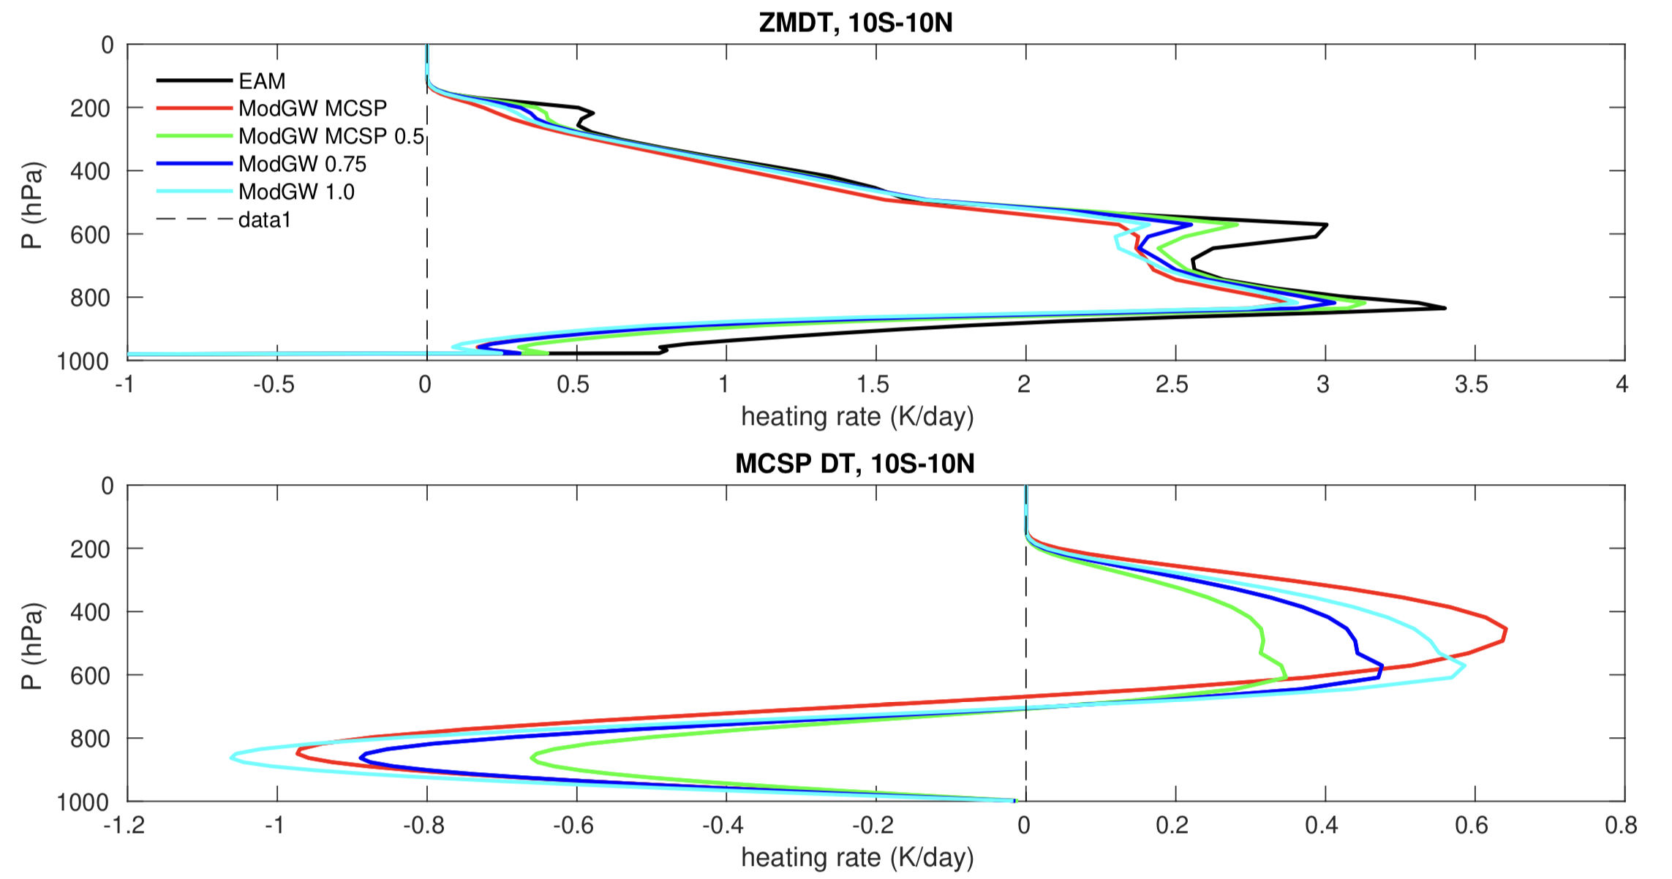





Convective heating:
ZMDT: 10S-10N
$$α_{2}=\frac{π}{2}\left(\frac{P_{Qtop}−400}{300}\right)$$
Mesoscale Heating: 10S-10N
$$α_{2}=\frac{π}{2}\left(\frac{P_{Qtop}−400}{300}\right)$$
$α_{2}$= 0.75
$α_{2}$= 1.0
$α_{2}$= 0.75
Adding mesoscale convective heating reduces parameterized convective heating

Slide 7
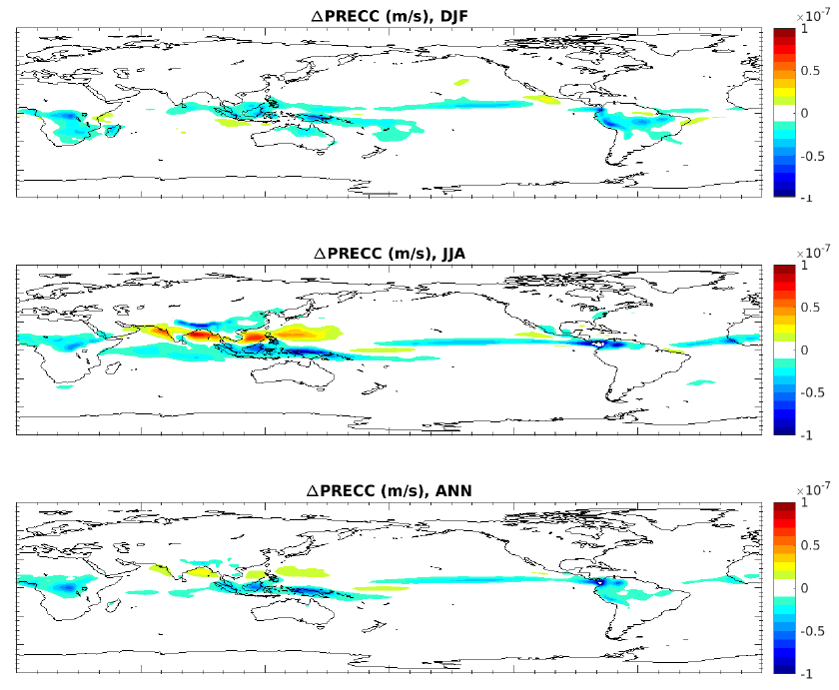


Precipitation changes:
$α_{2}$= 1.0
$$α_{2}=\frac{π}{2}\left(\frac{P_{Qtop}−400}{300}\right)$$
Adding mesoscale convective heating reduces precipitation

Slide 8
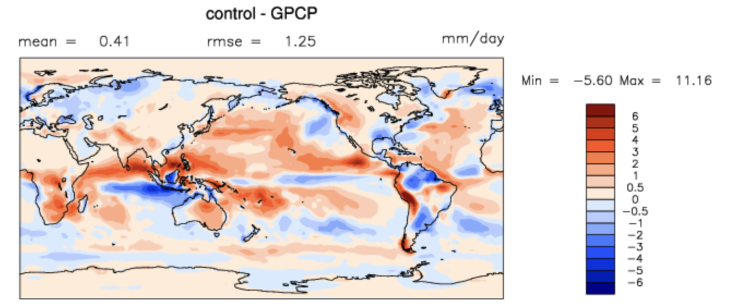
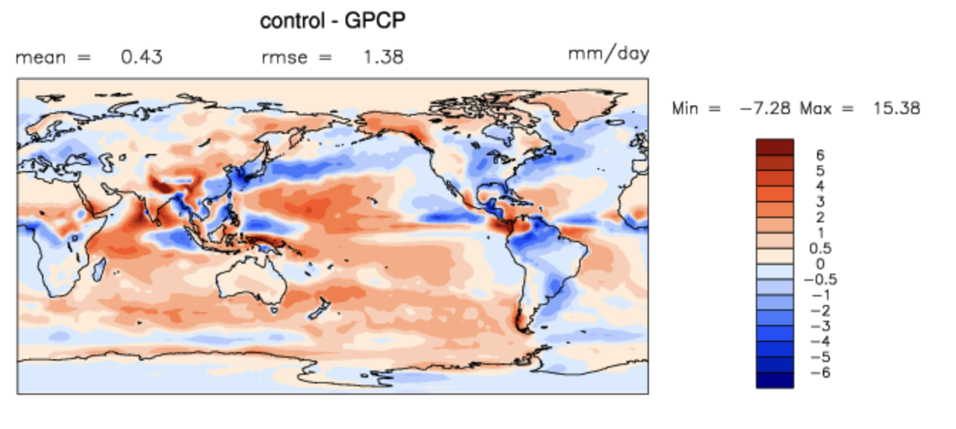
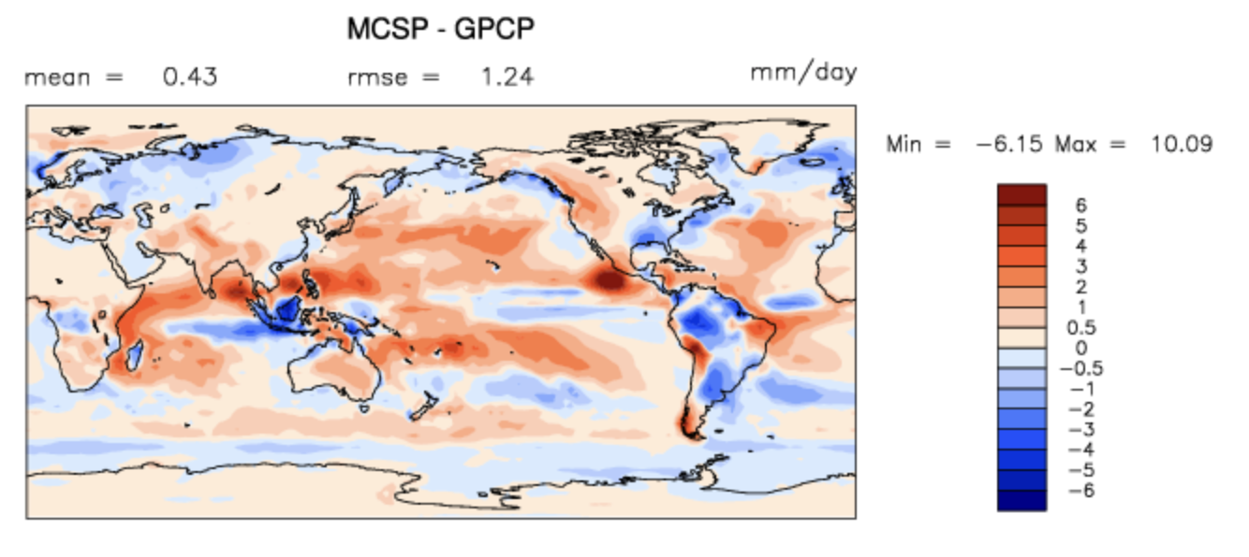
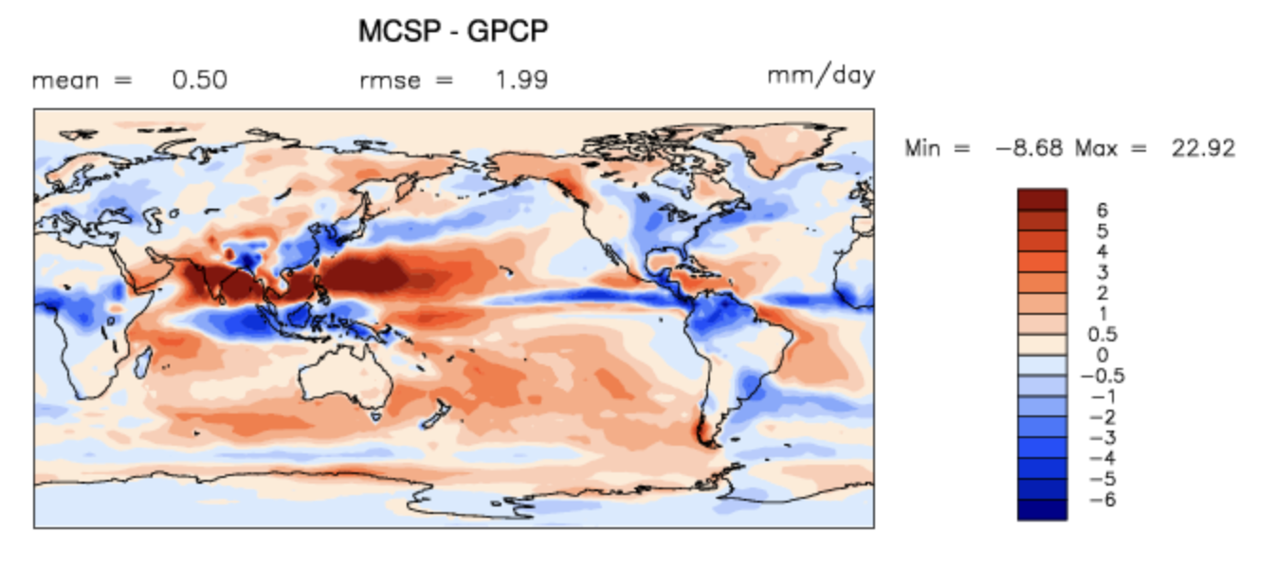
Precipitation biases:
DJF
JJA
Precipitation changes are in the right direction in DJF but not in JJA

Slide 9
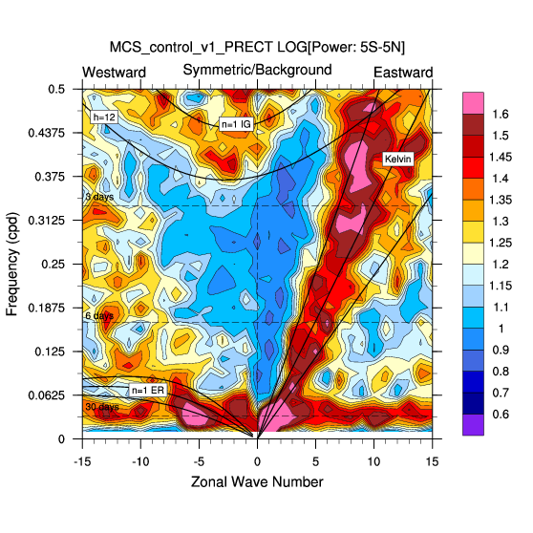
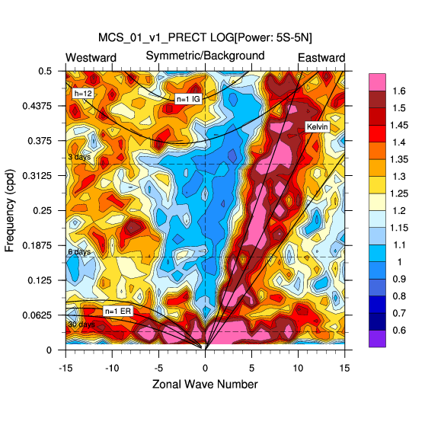
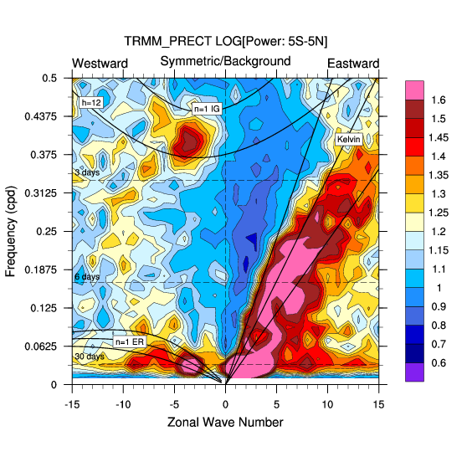


Variability:
EAM
EAM with MCSP
TRMM
$α_{2}$= 1.0
$$α_{2}=\frac{π}{2}\left(\frac{P_{Qtop}−400}{300}\right)$$
Mesoscale heating improves Kelvin wave generation

Slide 10
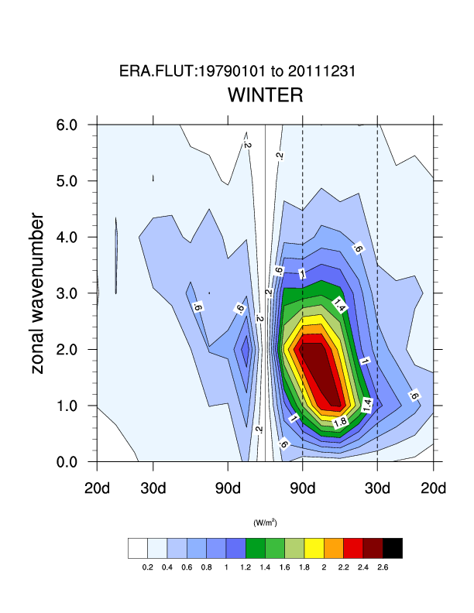
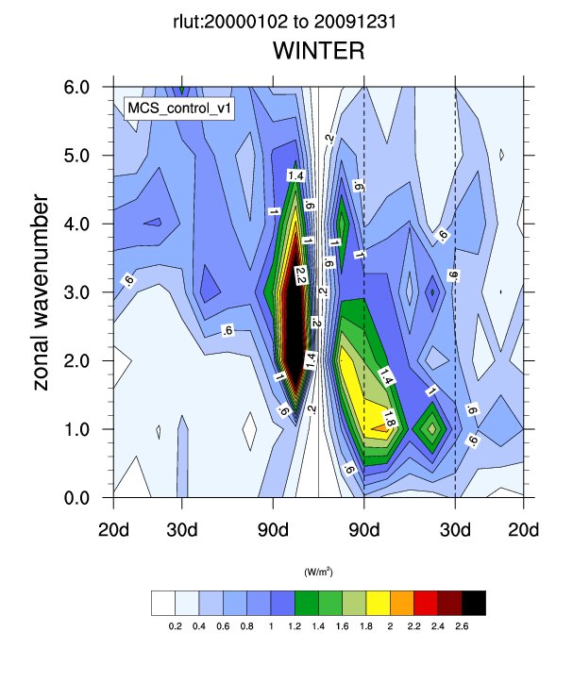
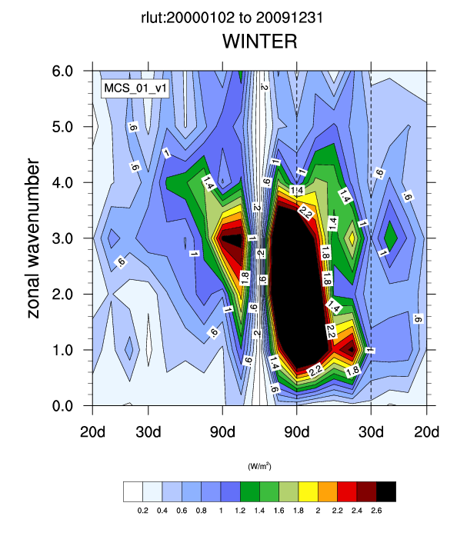


Momentum transport by convection
EAM
EAM with MCSP
ERA
$α_{2}$= 1.0
$$α_{2}=\frac{π}{2}\left(\frac{P_{Qtop}−400}{300}\right)$$
MCSP increases MJO amplitude: much more when heating is elevated

Slide 11
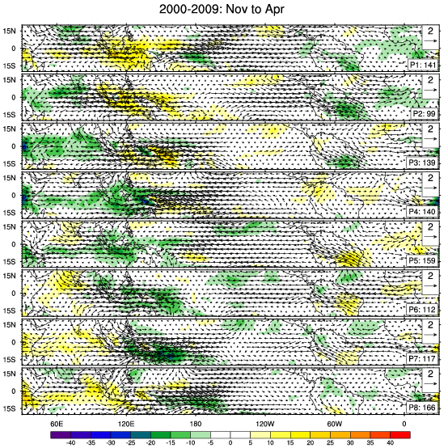
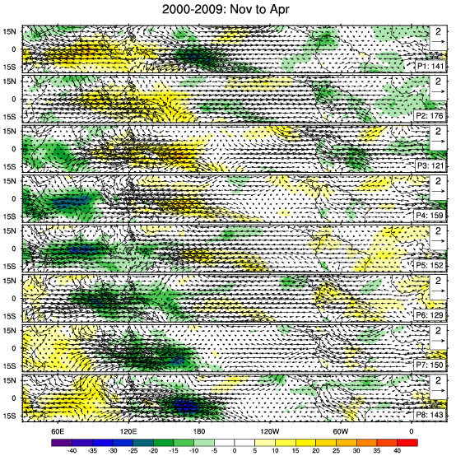
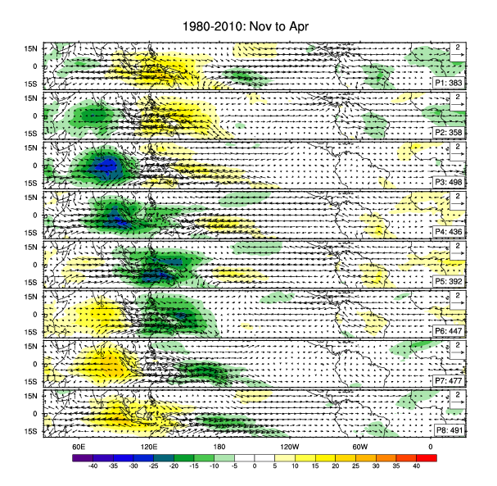


Momentum transport by convection
EAM
EAM with MCSP
ERA
$α_{2}$= 1.0
$$α_{2}=\frac{π}{2}\left(\frac{P_{Qtop}−400}{300}\right)$$
MJO propagation looks more realistic (although now too strong)

Slide 12
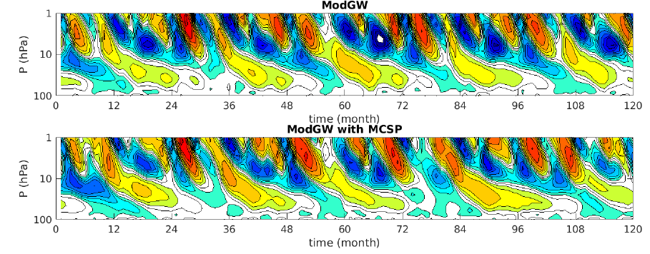
Feedback back onto the QBO
Increased Kelvin wave activity maybe changing the QBO

Slide 13
Summary and Next Steps
Summary:
We have improved the representation of the QBO in E3SMv1
We have implemented a parameterization of mesoscale convective organization (just the heating component)
Implementation of the mesoscale heating improves Kelvin wave generation and strengthens the MJO
Next Steps:
Explore parameter space more (depth of heating/cooling)
Implement wind shear dependent trigger
Implement mesoscale momentum transport

Slide 14
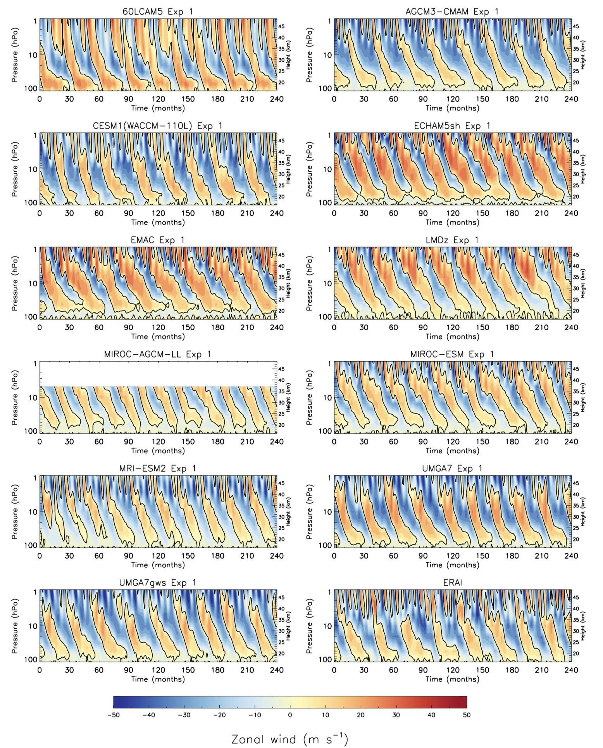
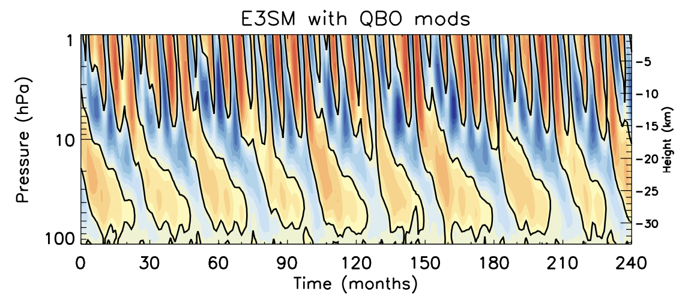
QBO: E3SM vs Other Models (mostly high top)
Left: QBOs in QBOi models and ERAi – figure not published yet

