Slide 1
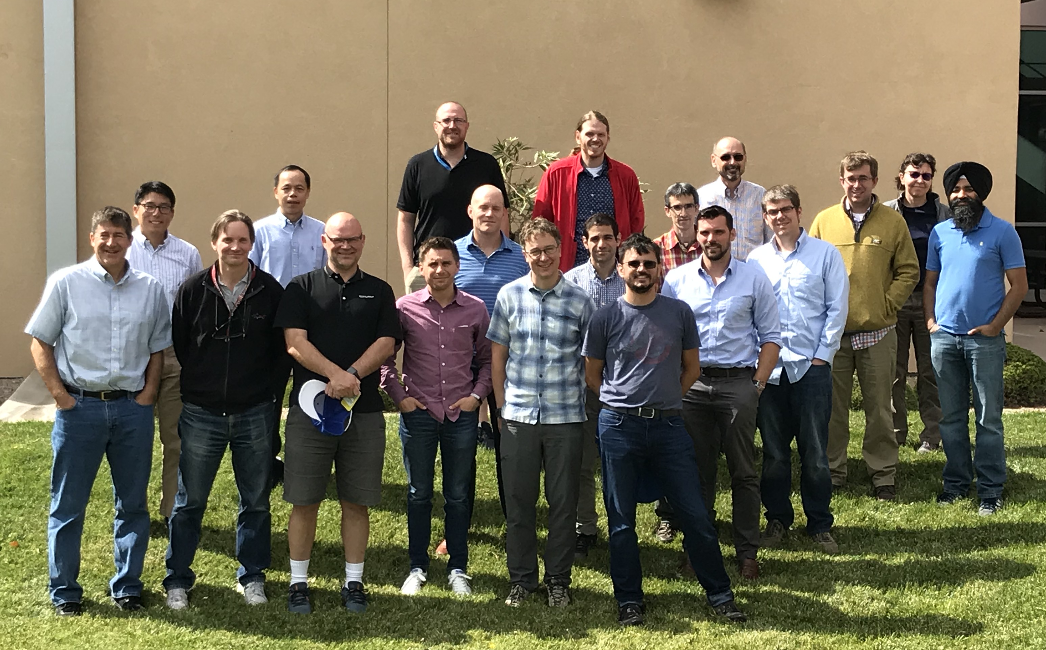
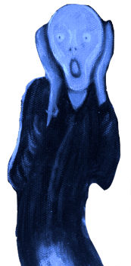
Next-Generation Development: the Non-Hydrostatic Atmosphere
Peter Caldwell, Andy Salinger, Luca Bertagna, Hassan Beydoun, Peter Bogenschutz, Andrew Bradley, Aaron Donahue, Jim Foucar, Chris Golaz, Oksana Guba, Ben Hillman, Noel Keen, Wuyin Lin, Kyle Pressel, Balwinder Singh, Andrew Steyer, Mark Taylor, Chris Terai, and Paul Ullrich
Work from LLNL is performed under the auspices of the US DOE by LLNL under Contract DE-AC52-07NA27344.
UCRL:LLNL-PRES-796423

Slide 2
SCREAM - Simple Cloud-Resolving E3SM Atmosphere Model
Code Name:
Goal is to keep code as simple as possible
You shouldn’t trust results you don’t understand physically…
Resolving more makes complex parameterizations less important
Simplicity makes clean rewrite (needed for performance) possible
Not quite cloud-resolving (yet!), but makes for a cool acronym
target dx = 3 km globally, 128 vertical layers with a top at 40 km
MPAS ocean and sea-ice already work at these scales
Goal here is a coupled km-scale system, not just an atm model
Notes:
virtuous cycle

Slide 3
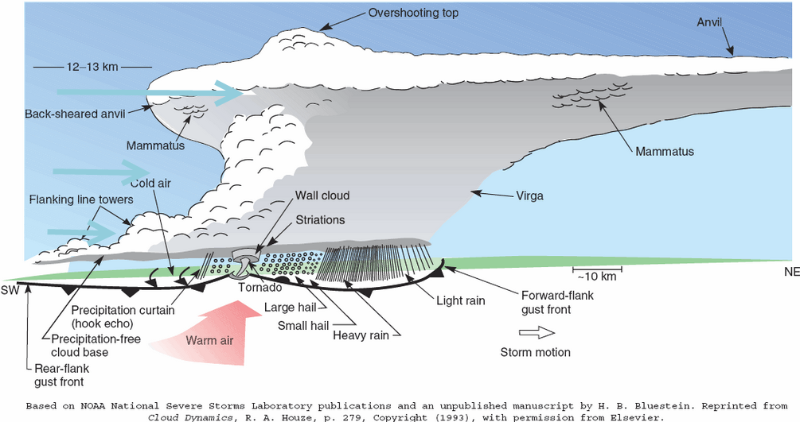
Motivation: Why do we Need km-scale Resolution?
Lots of important processes are smaller than GCM grid scales and are hard to parameterize
Particularly deep convection
Schematic of a supercell thunderstorm from Houze’s Cloud Dynamics (1993), extracted in color from inthecloudhead.blogspot.com.

Slide 4
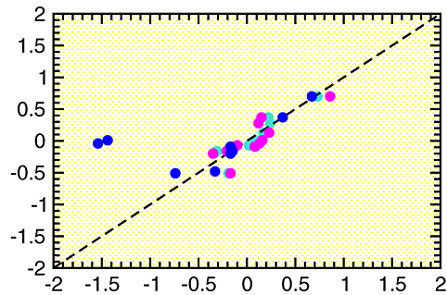
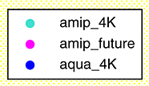
Thesis: Climate Change Can be Understood from Short Runs
Clouds are the main source of climate uncertainty
Clouds respond rapidly to forcing change
⇒ cleverly-designed short runs should tell us a lot
Several clever short tests already exist
5 yr Cess (prescribed SST increase) runs
15 mo aerosol sensitivity tests nudged to observations
This thesis is critical to SCREAM because high-res requires short timesteps (for CFL stability), limiting simulation length
4xCO2 λ_{cloud} (W m⁻² K⁻¹)
Fixed-SST λ_{cloud} (W m⁻² K⁻¹)
Fig: Cloud feedback from full-complexity (y-axis) versus fixed SST simulations in CMIP5. Adapted from Ringer et al, (2014 GRL).

Slide 5
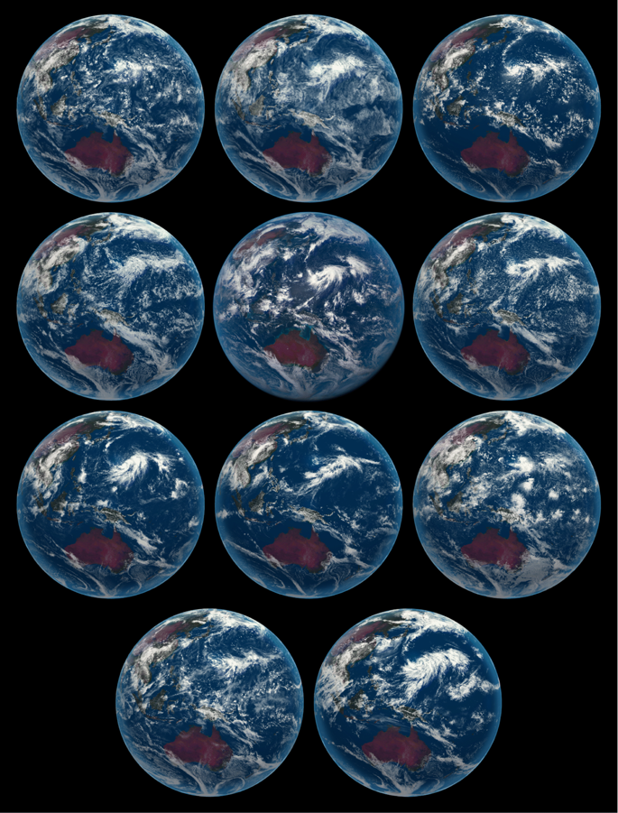
Other Efforts: DYAMOND
IFS-4 km
IFS-9 km
NICAM
Many other groups are working on global storm-resolving models (GSRMs)
9 models (on right) participated last year in an intercomparison of 40 day simulations with dx<5 km globally
SCREAM is playing catch up, but will bring some unique elements…
Himawari (obs)
ARPEGE
ICON
FV3
GEOS5
UKMO
SAM
MPAS
Fig: Snapshot of cloud fields from Aug 4, 2016 from GSRMs and Himawari satellite

Slide 6
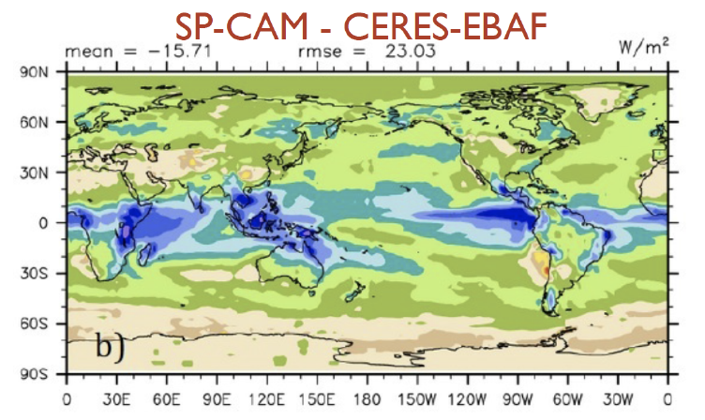
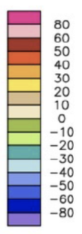
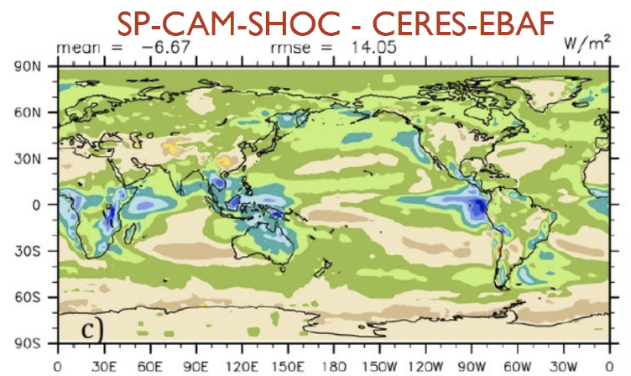
E3SM Advantages:
Most GSRMs use all-or-nothing cloud schemes. SCREAM will parameterize sub-grid cloudiness (see fig)
SE dycore, simple physics, GPU support, and access to DOE exascale machines enables bigger simulations
Obsession with testing will yield a more trustworthy model
Access to eddying ocean/ice enables coupled runs
Fig: Bias in shortwave Cloud Forcing from a SP-CAM simulation using default turbulence closure (top) and one using SHOC (bottom). From Bogenschutz + Krueger (2013 JAMES)

Slide 7
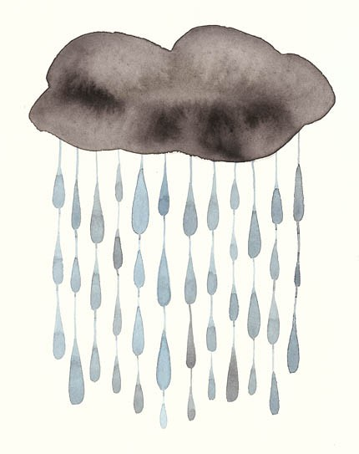
Overview of Processes
parameterized convection
Resolved-scale fluid dynamics treated by a non-hydrostatic Spectral Element (SE) approach
Turbulence and cloud formation handled by Simplified Higher-Order Closure (SHOC)
Radiation handled by externally-developed, GPU-ready RRTMGP package
Microphysical processes handled by Predicted Particle Properties (P3) scheme
Aerosols will be prescribed in initial implementation

Slide 8
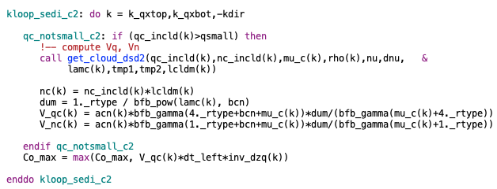
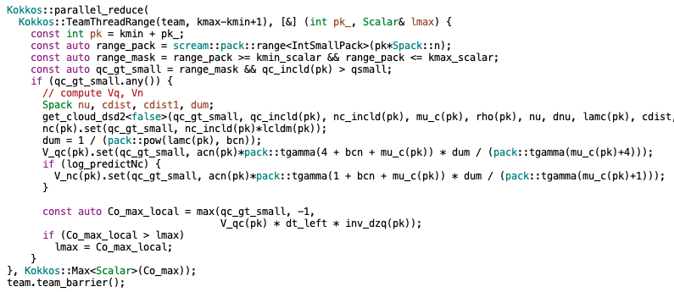
Coding
SCREAM will be rewritten from scratch in C++:
Allows use of Kokkos library, which abstracts on-node parallelism
single code runs efficiently on CPUs, GPUs, etc
Original F90
Unlocks more parallelism…
But results in more complex code
Requires tighter collaboration between computer and atm scientists
Ported to C++/Kokkos

Slide 9
Process Coupling
Atmospheric processes are all instances of the atm_process class. Having all processes behave the same:
makes adding/reordering/parallelizing processes easy
improves code-reusability
Processes are broken into:
SCREAM-specific interface layers
Model-agnostic process implementations which make:
our code easy to share with other models
standalone process simulations straightforward
Processes communicate entirely through a field manager which provides interface layers pointers to requested variables
Atm Driver
Proc 1
Proc 2
field manager
Interface
Interface
Process Representation
Process Representation
Fig: SCREAM coupler structure

Slide 10
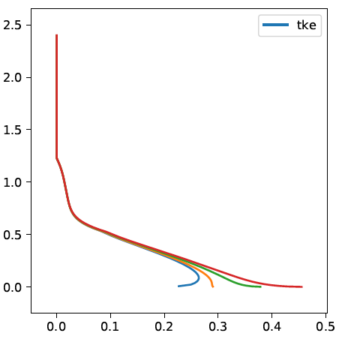
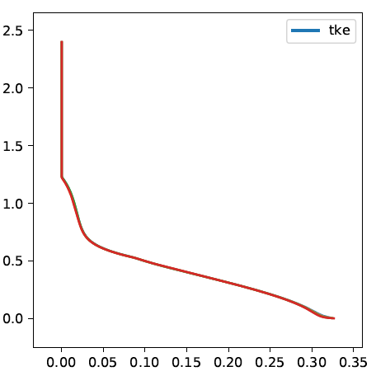
Testing
Emphasis on property tests (checking code is behaving physically) in addition to regression tests (checking answers haven’t changed)
Convergence in △t, △z, and △x is a good property test. Applying to SHOC (see fig) revealed problems with:
the Bretherton+Park (2009) shear production boundary condition
the Blackadar (1984) turbulent length scale near the surface
Encapsulation of parameterizations makes unit tests easy
F90→C++ protected by bit-for-bit tests
Original
Fixed
Coarse dz (~160 Pa)
Mid-Coarse (~80 Pa)
Mid-Fine (~40 Pa)
Fine dz (~25 Pa)
Height (km)
TKE (m2/s2)
TKE (m2/s2)
Fig: SHOC standalone simulations running the BOMEX test case (trade wind Cumulus) for 6 hrs with a variety of vertical resolutions

Slide 11
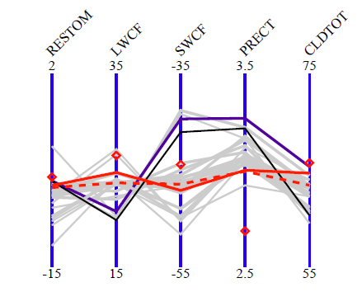
Evaluation/Tuning
Handling global 3 km data (~60M columns) is a challenge:
Files are huge. Handling by:
evaluating data where created, limiting output, using special viz tools
Runs are expensive. We are exploring cheaper proxies:
low resolution
regional refinement (with nudging in coarse region)
small-planet radiative convective equilibrium
limited-area “SCREAM-IOP” runs
short forecasts simulations (see fig)
Fig: Key global-average metrics for June-Aug simulations. Diamonds indicate observed values, gray lines are 24-48 hr forecast runs, and black lines are free-running simulations. Red lines indicate forecast (dashed) and free-running (solid) simulations for one particular tuning. Courtesy Wuyin Lin.

Slide 12
Progress/Plans
July 2018 Project started
now SCREAMv0 (F90 version) runs. Starting to evaluate climate
March 2020 DYAMOND Phase 2 starts– it would be good(?) to participate
Planned Gordon-Bell submission for dycore
July 2021 SCREAMv1 (C++ version): promised
2023? E3SMv3: ‘water cycle’ release uses SCREAM atm
2026? E3SMv4: SCREAM atm is only atm model

Slide 13
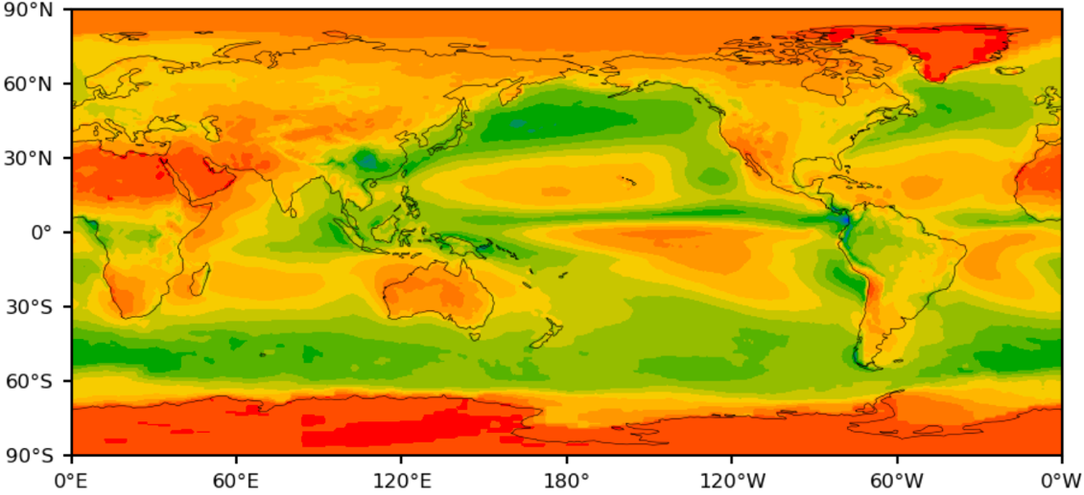
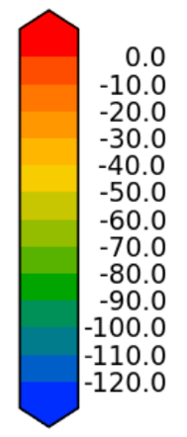
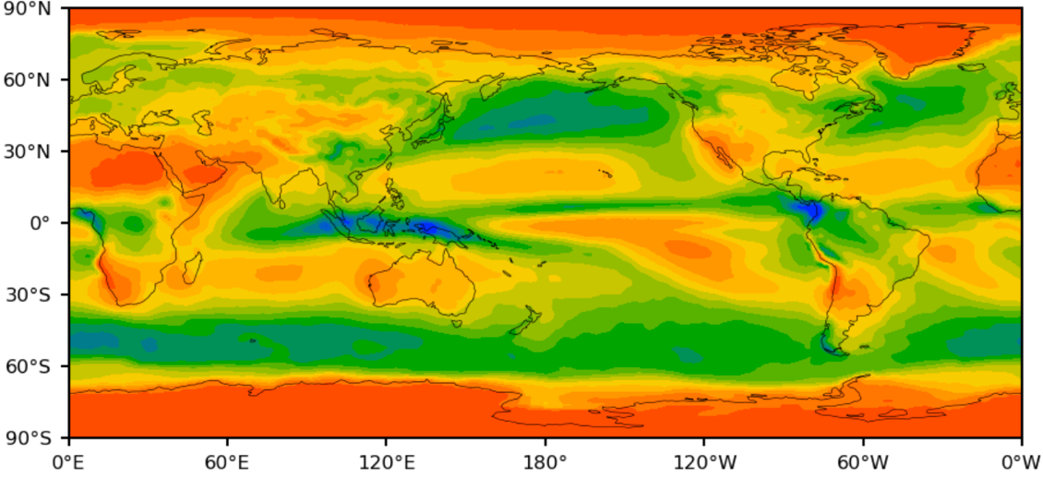
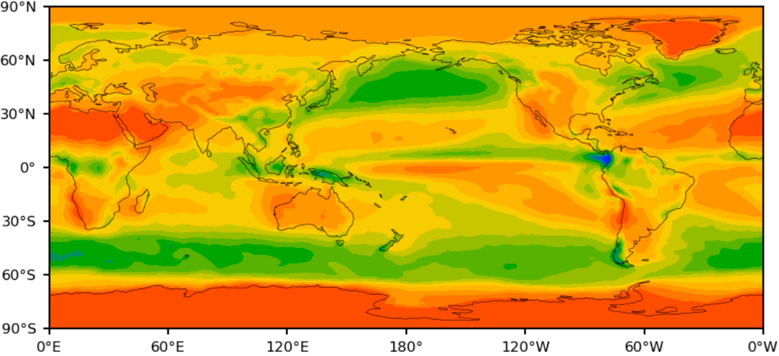
Low-Resolution Implementation
We have a low-res version which:
adds Zhang-McFarlane deep convection (from E3SMv1) and hydrostatic dycore
runs at 1^{O} resolution
produces earth-like behavior even though it hasn’t been tuned
CERES-EBAF
SWCF (W/m2)
SCREAM Physics
E3SM Physics
Fig: Shortwave cloud forcing from untuned 5 yr SCREAM-LR simulations at △x=1^{O}.

Slide 14
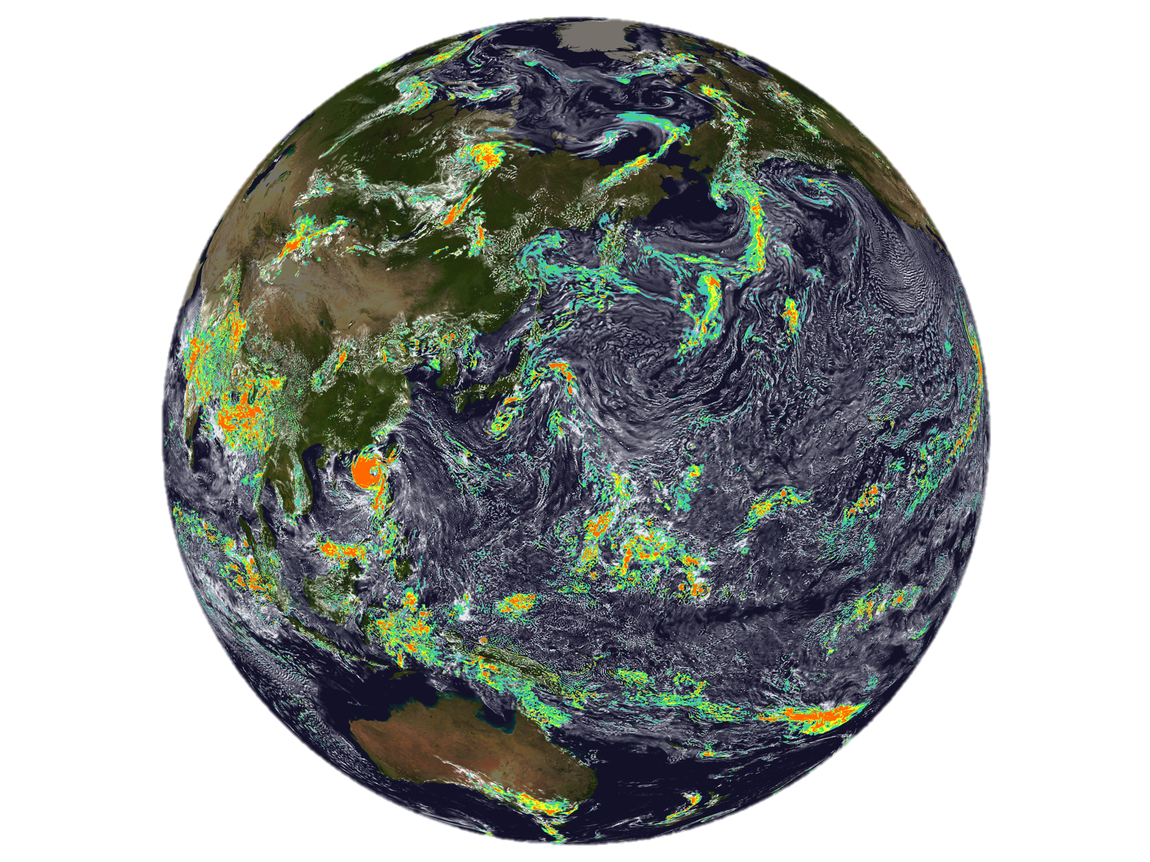
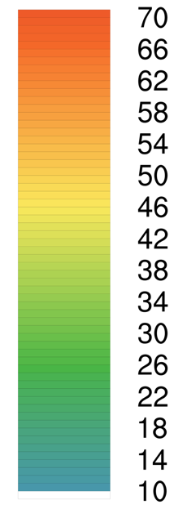
High-Res SCREAMv0
2016-08-01 01:00 UTC
adf
Alaska
China
Initial results look pretty good!
mm/day
Australia
Fig: Snapshot of precipitation (color) and liquid water path (opacity with opaque white = 200 g m⁻²) after 1 hr of simulation
Graphic by Chris Terai

Slide 15
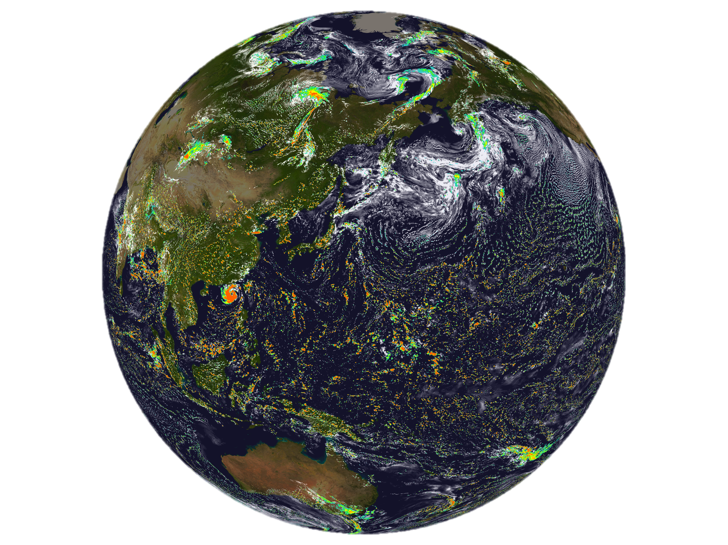
High-Res SCREAMv0
2016-08-01 07:00 UTC
Alaska
But as time goes on, things worsen…
small but intense storms speckle the tropics
Liquid water path decreases
China
mm/day
Australia
Fig: Snapshot of precipitation (color) and liquid water path (opacity with opaque white = 200 g m⁻²) after 7 hrs of simulation
Graphic by Chris Terai

Slide 16
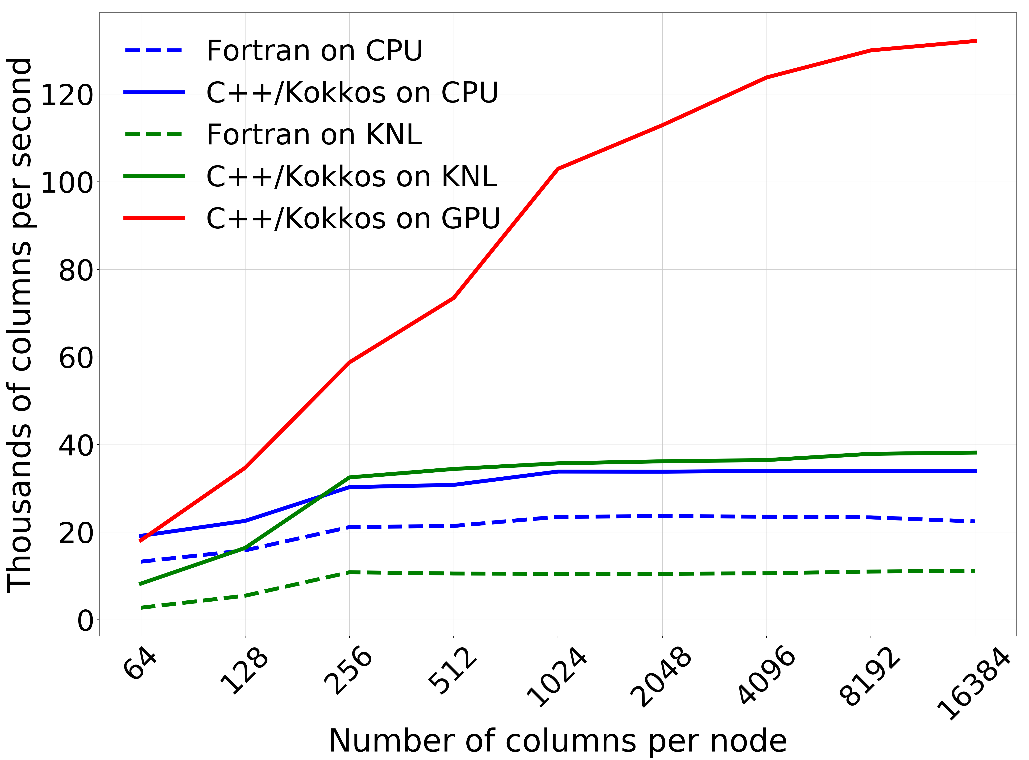
Comments on Performance
GPUs only help when there’s lots of work per node
Rewriting from scratch by computer scientists has resulted in speedup on CPUs in addition to GPUs!
Better/Faster
Using massive number of nodes
Running the whole model on a few nodes
Figure: Scaling curves for rain-sedimentation micro app. Courtesy Jim Foucar + Andrew Bradley, SNL.

Slide 17
Summary
SCREAM is not the only GSRM, but it:
may do better than others for boundary-layer clouds because of SHOC cloud scheme
should be able to do bigger runs than other centers
Super-high res rewards exascale machines, so is a good fit for DOE
Focus on testing/correctness increases trustworthiness
We are doing 3 km F90 runs now, should be doing C++ runs in 1-2 yrs

Slide 18
Thanks!

Slide 19
Progress/Timeline
100%
Implement Tests
Get F90 SHOC working
SHOC design doc
Get SCREAMv0 running at 3 km
Get RRTMGP working with new C++ driver
Evaluate SCREAM
Effort (∝ Height of Box)
Port to C++
Get F90 P3 working
SHOC design doc
Get NH dycore working
Dycore design doc
AD design doc
AD design doc
0
Design/Implement new Atmosphere Driver
time into project
July ‘18
July ‘19
now
July ‘20
July ‘21
Thoughts:
When will port finish? When will NHxx finish? When will AD finish?
What tasks am I missing? Prescribed aerosol is one!
I’d like to see more effort on testing, but we’re so busy with other tasks…
We need to finish design docs

Slide 20
Motivation: Why do we Need km-scale Resolution?
Updraft
The impact of cold pools on DMS transport provides a scary example (see figure)
Altitude (km)
Updraft
Cold Pool
x position
Fig: Snapshot of DMS concentration (green=low, red=high) in a 2d CRM of oceanic deep convection (domain =256 km, ∆x = 1 km). Neglecting the spatial pattern of DMS reduced convective transport by 50%. From Devine et al, 2006 GRL, pointed out by Ken Carslaw

