Slide 1
Alas, poor Bug! I knew him, Horatio.
Some Thoughts and Progress on Verification
Andy Salinger
Hui Wan, Irina Tezaur, many others

Slide 2
E3SM Testing Vocabulary
1a,C,ii,a
Testing Types:
Regression Testing: Did the answer change?
  B4B
  Climate Reproducibility
Verification Testing: are the equations and algorithms coded correctly?
  Properties such as Conservation, convergence
Validation: Does the code output match observations?
Performance Testing: Is the code as fast/slow as it was?
Code being tested:
Unit Tests
Component Tests
System Tests
Testing Frequency:
Manual
Automatic (Jenkins, cron)
  Nightly
  Continuous Integration (Every PR)

Slide 3
E3SM Testing Vocabulary
1a,C,ii,a
Testing Types:
Regression Testing: Did the answer change?
  B4B
  Climate Reproducibility
Verification Testing: are the equations and algorithms coded correctly?
  Properties such as Conservation, convergence
Validation: Does the code output match observations?
Performance Testing: Is the code as fast/slow as it was?
Code being tested:
Unit Tests
Component Tests
System Tests
Testing Frequency:
Manual
Automatic (Jenkins, cron)
  Nightly
  Continuous Integration (Every PR)

Slide 4
Verification first, then Validation
Many anecdotes from E3SM meetings sound to me like:
“I saw something unphysical, so I looked for a code bug”
Why is this not enough?
Bugs that aren’t egregious are not caught
It is very hard to locate bugs from B-Compset runs
  Interactions are too complex to isolate cause
  Too slow to rerun many debugging hypothesis
  Offending code is not fresh in developer’s mind
  “It took 2 months to track down”

Slide 5
A great verification example (Bradley from Caldwell talk): convergence order
Coarse dz (~160 Pa)
Mid-Coarse (~80 Pa)
Mid-Fine (~40 Pa)
Fine dz (~25 Pa)
Coarse dz (~160 Pa)
Mid-Coarse (~80 Pa)
Mid-Fine (~40 Pa)
Fine dz (~25 Pa)

Slide 6
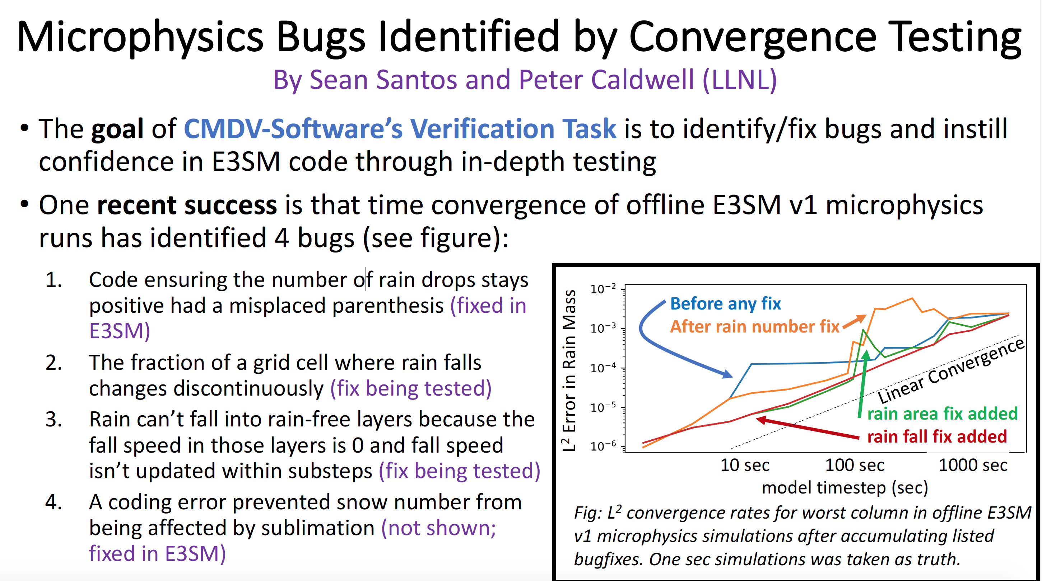

Slide 7
Other verification examples
Shar Mountains for Non-hyrdostatic Dycore (Taylor talk):
No atmosphere forcings over topography → zero flow?
IOP-SCREAM (Bogenschutz Talk):
Set up small planet so that every column is the same as a Single Column Model test case
Convergence:
Time step
Vertical levels
Physical Properties:
Conservation at the process level
Have radiation algorithm calculate Earth’s cross section: πR²

Slide 8

Documentation/post-processing: Jupyter notebooks
Common tool for writing documentation and post-processing/re-generating verification results.
Documentation to new/existing users of various E3SM components and template for writing verification/unit tests.
The following can be embedded within a Jupyter notebook:
  LaTex
  Python
  Matlab
  Julia
  …

Slide 9
Verification example from MAM: Aerosol Coagulation
https://e3sm-project.github.io/CMDV-testing/Coagulation.html
R. Scanza, R. Easter (PNNL)
The physics
Smaller aerosol particles collide to form larger particles, reducing the total number of particles and increasing their mean size
The code
Describes aerosol population by a few log-normal distribution functions (modes)
Solves ordinary differential equations (ODEs) for mass and number concentrations of each mode
The verification
Assess convergence of time stepping method
10 different initial conditions * 19 concentrations = 190 ODEs
Integration length: 30 min
Reference solutions using 4th order Runge-Kutta with ∆t = 1s
Test fails when convergence rates is significantly < expected
Unit isolation: MAM box model (Fortran)
Notes:
In addition:
Two parts
Quantify error in coefficients of the equations
Assess convergence of time stepping method

Slide 10
Verification example from MAM: Aerosol Water Uptake
Wet particle
J. Sun, K. Zhang, H. Wan (PNNL)
Dry particle
The physics
Aerosol particles absorb water and grow in size
The code
Assumes quartic relationship between air humidity and particle wet radius
Calculates wet radius (a root of quartic function) using analytical expression
Expects 1 real-and-physical root
The verification
Verifies the analytical expression and its implementation
Calculates wet radius for 576 different combinations of humidity, particle composition, and dry radius
Reference solutions using root-finding by bisection
Test fails if relative difference between any pair of MAM and reference solutions exceeds 1E-15 (machine precision)
Unit isolation: MAM box model (Fortran)
https://e3sm-project.github.io/CMDV-testing/wateruptake/verification.html

Slide 11
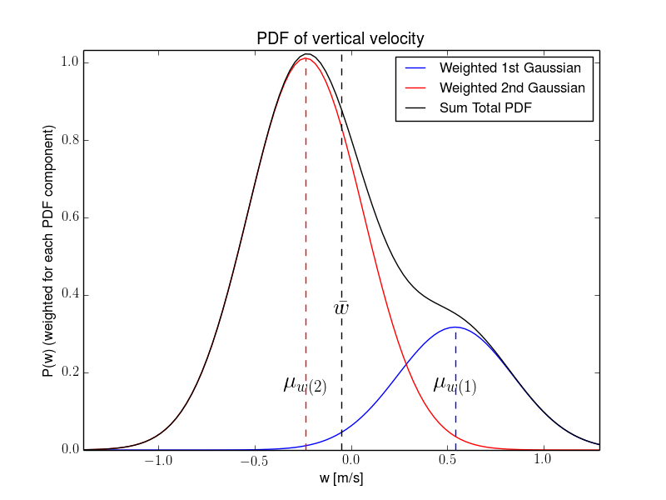
Verification example from CLUBB:
Turbulence Closure
V. Larsen (U Wisconsin)
The physics
CLUBB’s subgrid PDF is used to diagnose cloud fraction within a grid box.
CLUBB’s PDF shape is a double Gaussian (sum of 2 Gaussian components).
The code
Parameterizes the mean and variance of each Gaussian component in terms of the mean and variance over the entire grid box.
The verification
Tests whether the aforementioned algebra is correct.
More specifically, for a variety of selected inputs, the test uses CLUBB code to parameterize the component means and variances, and then checks whether the original grid mean and variance can be recovered.
Unit isolation: CLUBB PDF subroutine (Fortran).

Slide 12
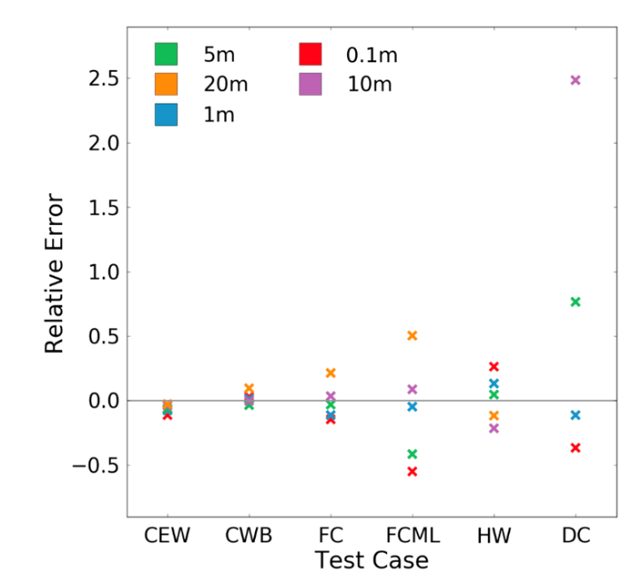
https://e3sm-project.github.io/CMDV-testing/palm_cvmix_compare.html
Verification example from MPAS-O:
K-Profile Parameterization
L. Van Roekel, L. Conlon, J. Gafur (LANL)
The physics
The K-Profile Parameterization (KPP) represents small scale (below the grid scale) vertical turbulent fluxes of heat, salt, and momentum in the ocean.
The code
KPP does not contain any prognostic equations, but utilizes diagnostic equations and scaling relationships to parameterize turbulent fluxes.
KPP is known to not exhibit convergence with vertical resolution, but is robust to time step variation.
No known analytic solutions for comparison in most cases.
The verification
Utilize a large eddy simulation as a baseline to verify the temperature tendency and entrainment depth (figure) returned by KPP, critical quantities for the ocean simulation.
Unit isolation: CVMix module and MPAS-Ocean vertical mixing interface.
Relative error across test cases and resolution

Slide 13

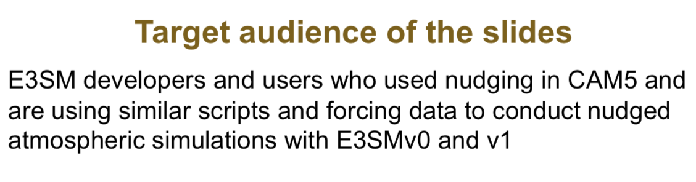
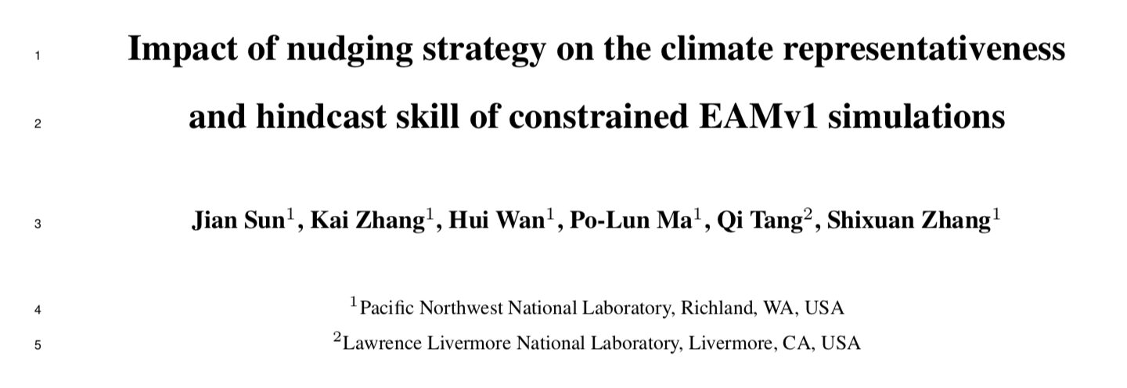
Another Success story
Issues in the implementation and use of nudging in E3SM were uncovered!
A more flexible implementation was developed.
Journal article accepted by JAMES
Notes:
Nudging = data assimilation technique in aerosol-climate simulations
Can quantify model sensitivities in precipitation and cloud forcing
Convection, temperature, wind nudging
From Hui’s email:
1. About a year ago, Kai noticed that the nudged simulations he conducted using EAMv1 was giving unexpected results. After some investigation, he realized that the implementation of nudging in this new version was different from what he was (and many others were) used to in CAM5. The new implementation was not as flexible or comprehensive, and the design was also a bit different. There existed comments in the code that provided some explanation of the new implementation but there was no separate user guide about it. As a result, most of the users and developers were unaware of those changes. This was the background of that slide deck which Kai distributed to the E3SM mailing list, and I took screenshots of the first 2 pages of their slides for our 2nd "success story".
2. The inconveniences in the new code motivated Kai and Jian to revise the implementation in EAMv1. In that process, they also conducted a comprehensive evaluation of the characteristics of the nudged simulations, as well as the sensitivities of the results to how the nudged simulations were configured at run time (for example, which model-simulated fields to nudge, how to deal with the fact that the externally specified constraining data has a lower time resolution than the model's time step, etc.) Based on Kai's experience, they described two types of anticipated applications of the nudging capability: (1) to carry out sensitivity experiments for the evaluation (validation) of the simulated long-term statistics, using nudging to increase the signal-to-noise ratio of the results so that one can use shorter simulations and hence save computer time; (2) to steer the model-simulated atmospheric flow to evolve like the observations at shorter time scales to facilitate model evaluation (validation) from a more deterministic perspective. In that paper, they evaluated the model results in both scenarios and made recommendations on how to configure the nudged simulations in either case.

Slide 14
Starting in CY20:
E3SM Verification Interest Group
Monthly Telecon
Notes:
https://acme-climate.atlassian.net/wiki/spaces/NGDSA/pages/968786603/Roadmap+Year+2+Software+and+Algorithms+NGD

