Slide 1
IMEX and ETD Methods for NonHydrostatic Atmosphere
Andrew J. Steyer (Sandia National Laboratories, Albuquerque, NM
Sandia National Laboratories is a multi-mission laboratory managed and operated by National
Technology and Engineering Solutions of Sandia, LLC., a wholly owned subsidiary of Honeywell
International, In., for the U.S. Department of Energys National Nuclear Security Administration
under contract DE-NA0003525. This paper describes objective technical results and analysis. Any
subjective views or opinions that might be expressed in the paper do not necessarily represent the
views of the U.S. Department of Energy or the United States Government. SAND2019-14081 PE

Slide 2
Time-stepping nonhydrostatic dynamics in operational models
Exascale: targeted 3km horizontal resolution motivates switch from a nonstiff hydrostatic to a stiff nonhydrostatic dynamic core.
E3SM: decadal-length simulations means the atmosphere dynamic core needs to chug through millions of time-steps.
CFL/stability/efficiency is still a major challenge in operational atmosphere models (since fully-implicit is too expensive).
HEVI (Horizontally explicit, vertically implicit) partitioning of nonhydrostatic equations – can use a hydrostatic time-step in a HEVI nh model with an IMEX or exponential time-stepping method.
Fundamental issue: finding the right balance between accuracy, size of time-step, and cost per time step.
IMEX Runge-Kutta and exponential time differencing methods two approaches with pros and cons.

Slide 3
Laprise-like formulation of nh-Euler equations
Laprise-like (R. Laprise, The Euler equations of motion with hydrostatic pressure as an independent variable, Mon. Wea. Rev., 102 (1992), pp. 197-207), (Taylor et al, An energy consistent discretization of the nonhydrostatic equations in primitive variables, arxiv:1908.04430)
formulation of nh-Euler equations posed on spherical domain:
HEVI splitting isolates terms (boxed) responsible for fast vertical acoustic wave propagation. (Steyer et al, Efficient IMEX Runge-Kutta methods for nonhydrostatic dynamics, arxiv:1906.07219).

Slide 4
IMEX and ETD RK methods
ETD Formulation: given rewrite equation as
IMEX:
Explicit RK on the nonstiff terms, implicit RK on the stiff terms.
Implicit stages add dissipation, but require potentially expensive solves requiring many iterations.
With topography the final stage must be implicit.
Parallelizing solves is tricky.
ETD
Form exponential of the linearized stiff terms, explicit RK on the remaining terms.
In HEVI, forming matrix exponentials requires a fixed number of iterations rather than solves.
Can compute exponentials in parallel at each time-step.
Exponentials do not add much dissipation.
Untested: ETD in problems with topography.
wind
problem
geop initial
geop after update
topography

Slide 5
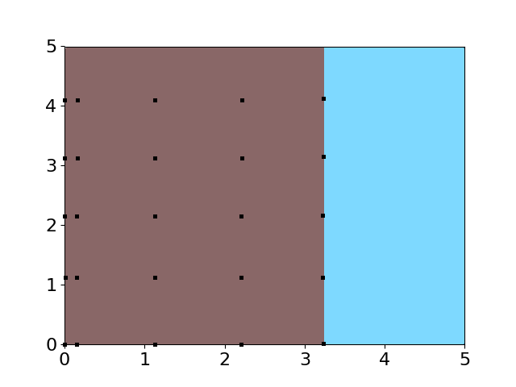
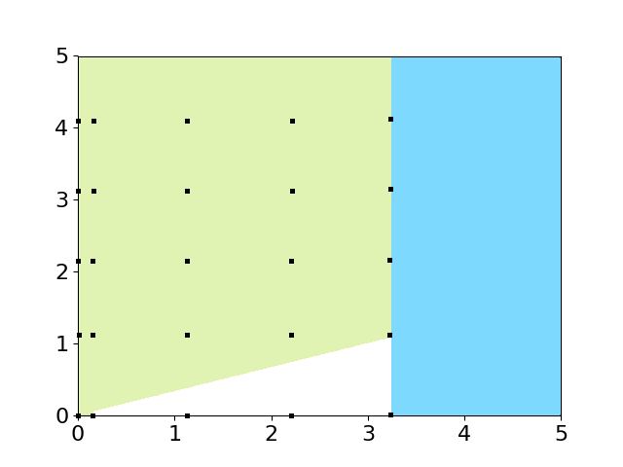
Getting to the hydrostatic time-step
Goal: Run NH-model with a hydrostatic time-step (with IMEX or ETD).
Methods need good joint stability of the implicit and explicit RK method (in IMEX RK) and the explicit RK and exponential (in ETD RK).
Optimal case: HEVI-stability region is a “trunk'' with width equal to explicit Sub-optimal case: HEVI-stability region is a “shrub’’.
Have several IMEX methods that run nonhydrostatic model with hydrostatic time-steps.
Trunk (left) and shrub (right). Dots represent wave numbers supported by the model. Green, brown represent regions of stability, white and blue represent regions of instability. Julia software package to generate HEVI-stability regions for IMEX and ETD methods: https://github.com/asteyer/timestepper_stability_regions

Slide 6
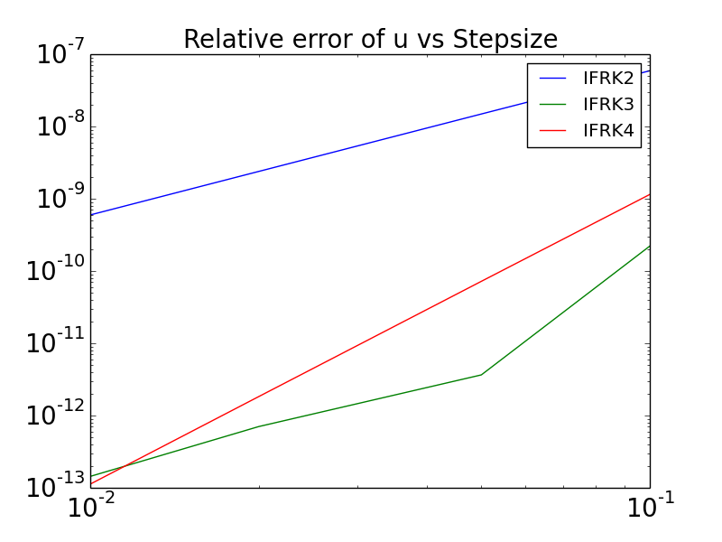
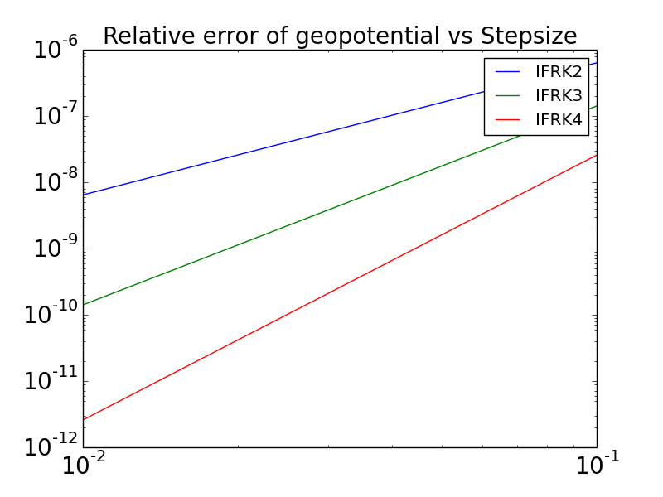
Convergence study for ETD methods
Cassidy Krause (year-round student worker at Sandia National Laboratories, PhD student at University of Kansas) implemented HEVI matrix exponential capability in HOMME-NH and integrating factor methods (a class of ETD methods) of various orders. See her poster: “Exponential Integrators for the HOMME-NH Nonhydrostatic Model”
Error vs step-size for u and geopotential for a second (IFRK2), third (IFRK3), and fourth (IFRK4) order integrating factor Runge-Kutta (IFRK) type ETD methods. A spin-up run of the DCMIP Test Case 4.1 (Baroclinic Instability) is used to generate a non-trivial flow. The error above is then computed using short 0.1 second restart run without dissipation or remap and then taking the L2-norm difference of the solutions found with the ETD methods from a reference ’’exact solution’’ formed by an explicit third order RK method with a time-step of 1e-5.

