Slide 1
Initial Performance of ne1024/ne512 on Cori-KNL Using scream repo, CAM_TARGET=theta-l, 5 min timesteps
Noel Keen LBL

Slide 2
With ne1024, need to run with many more elements
per node than with ne120. Cori has 9668 KNL nodes.
resolution | # elements | # nodes required for 2048 elements/node | # nodes required for 1024 elements/node | # nodes required for 512 elements/node
ne120 (28km) | 86400 | 43 | 85 | 169
ne512 (6.5km) | 1572864 (18x) | 768 | 1536 | 3072
ne1024 (3.25km) | 6291456 (73x) | 3072 | 6144 | 12288
nodes | Elements per node with ne1024
1024 | 6144
1536 | 4096
2048 | 3072
3072 | 2048
4096 | 1536

Slide 3
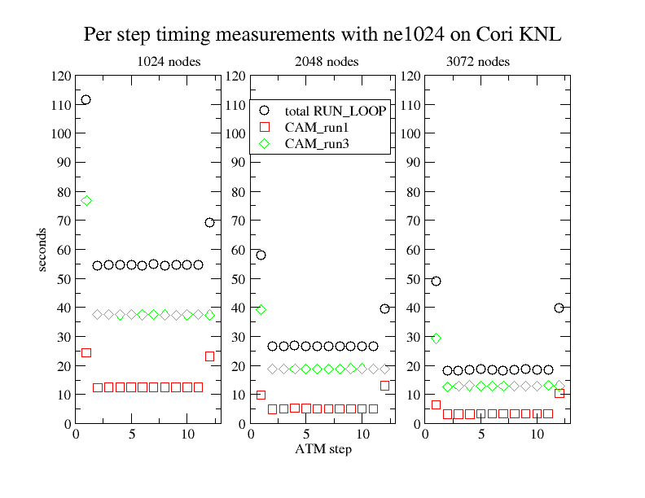
No I/O. Per step timing remarkably consistent (outside of first & last steps) and can be used to make estimates

Slide 4
Estimated SDPD (simulated day per day) on Cori-KNL based on 12 steps runs with 5min timesteps
ne1204 strong scales well
nodes | PPN | PIO_VERSION | With Restart at end of Day | Without Restart
1024 | 8 | 1 | 4.6 | 5.5
2048 | 8 | 1 | 6.2 | 11.5
3072 | 8 | 1 |  | 16.1
ne512 -- PIO2 allows about 2x write improvement and using 16 PPN about 24% faster than 8 PPN
Nodes | PPN | PIO_VERSION | With Restart at end of Day | Without Restart
1024 | 8 | 1 | 24.3 | 34.9
1024 | 8 | 2 | 29.4 | 36.8
1024 | 16 | 2 | 30.2 | 45.5
All runs with shoc. Some runs included rrtmgp and p3 which had small effect on performance

Slide 5
Summary
Demonstrate strong scaling with ne1024
Tested PIO_VERSION=2 with ne512. Experimenting with PIO stride and PIO buffer size. Does not yet work with ne1024
Iterating on optimal ways to run with 1024 Cori KNL nodes to take advantage of MPP discount & Q priority.
Tested running with shoc, rrtmgp, and p3 with ne1024
Using more MPI’s per node should improve performance if we can avoid OOM
Writing timing checkpoints per step provides interesting performance analysis with shorter run times
Need to improve initialization time (30-35 min for ne1024)

