Slide 1
Progress toward a high-resolution offline ELM simulation over North America
Peter Thornton, Dali Wang, Peter Schwartz, Fengming Yuan, Rupesh Shrestha, Michele Thornton, Shih-Chieh Kao, Jiafu Mao, and Marcia Branstetter
ORNL

Slide 2
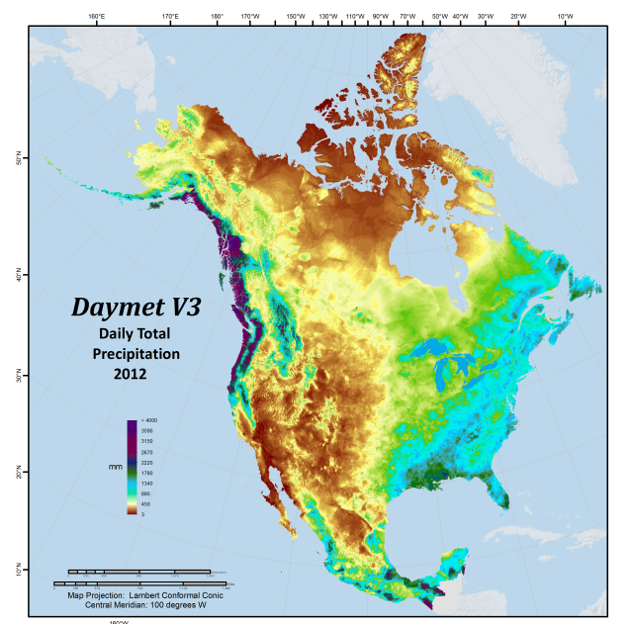
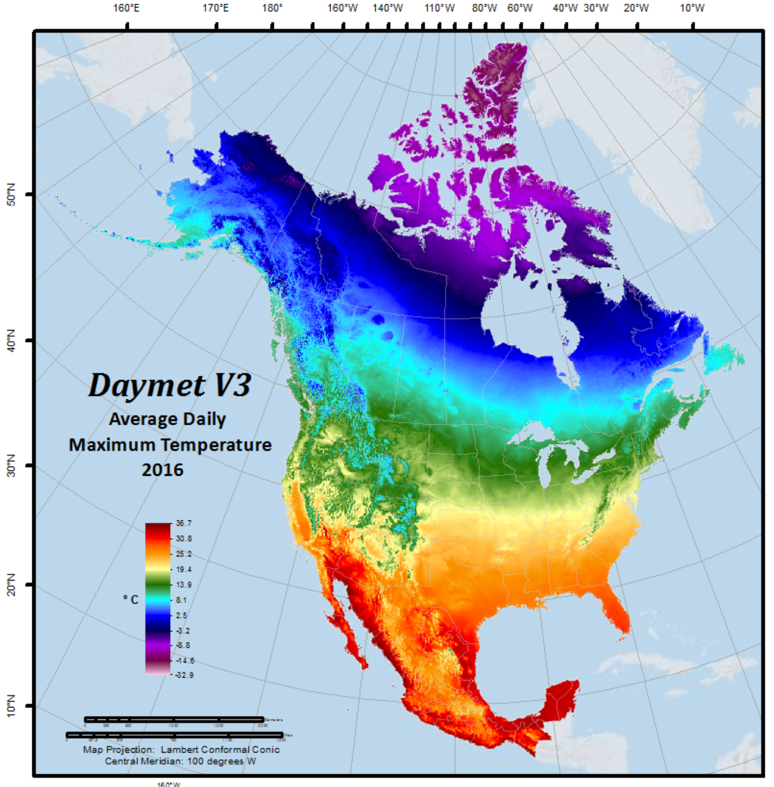
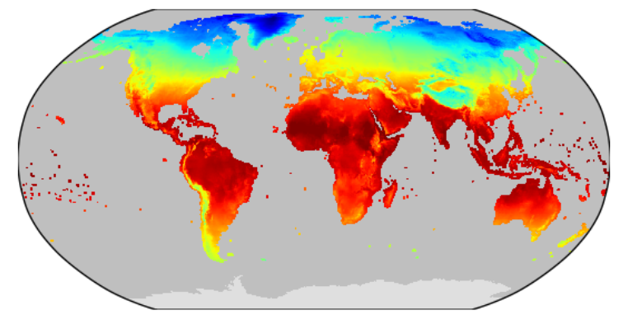
Target: 1km² grid resolution over N. America
Annual Average Tmax (2016)
Annual Total Precipitation (2012)
Notes:
The images for annual total precipitation and annual average Tmax are used to show what a 1km N. Am. grid looks like, for some of the typical offline land forcings. These summary images are from the Daymet dataset, which is being amended with temporal downscaling and used to force the offline simulations. The inset shows an example of the current global offline land grid at 0.5 degrees resolution (CRY air temperature model driver), for comparison. In case anyone asks, we will also be running Puerto Rico and Hawaii.

Slide 3
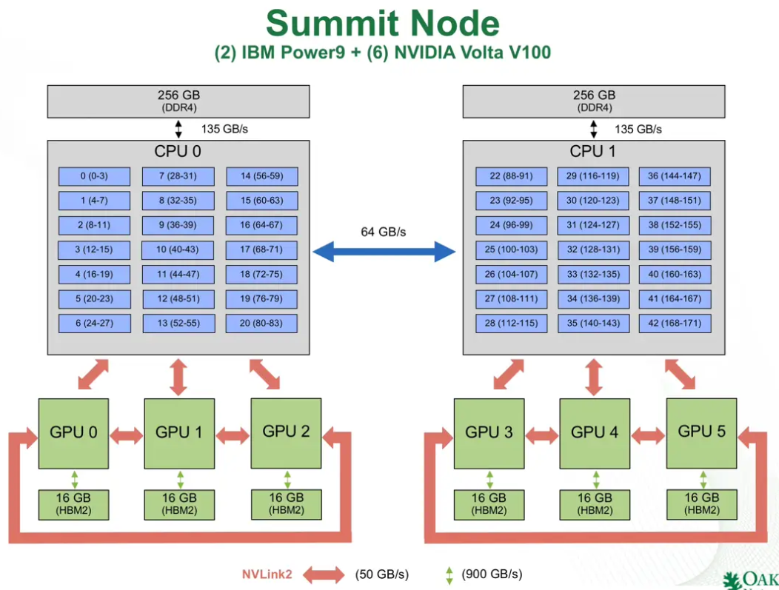
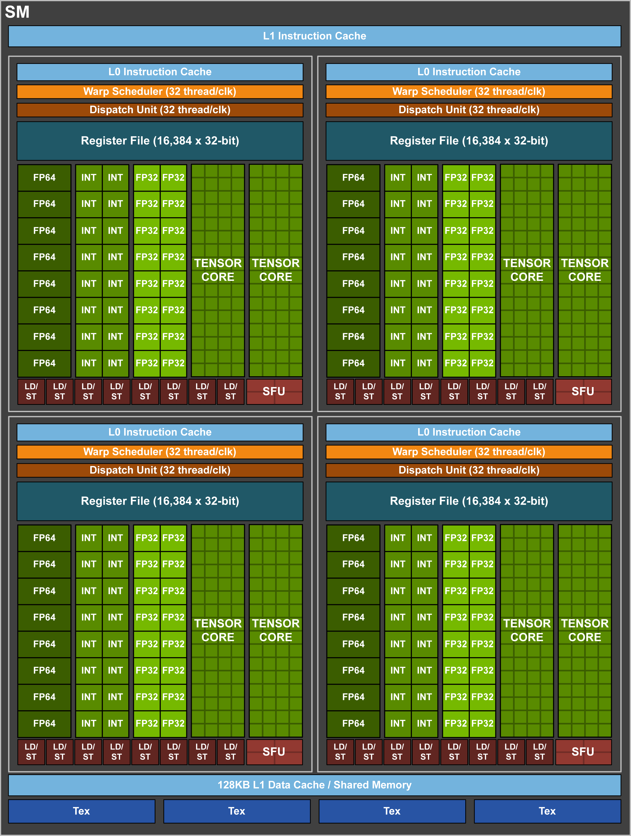
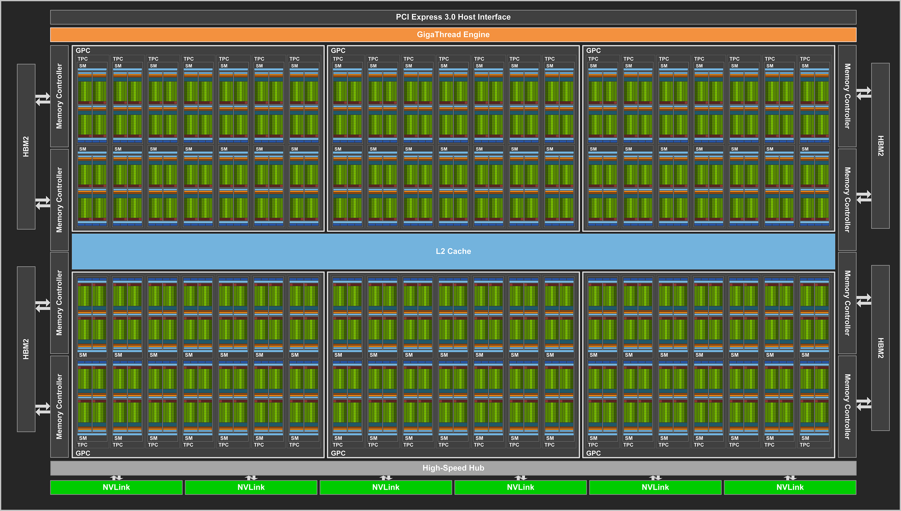
Computational strategy: OpenACC on Summit
Each GPU has 80+ Streaming Multiprocessors (SMs) and 16 GB of shared memory (HBM2)
Each SM has 32 double precision cores, which can be “over-subscribed” with threads to an extent that depends in part on availability of register space and heap space.
Each Summit node has 6 NVIDIA Volta V100 GPUs. We plan to have 1 ELM MPI task per GPU, so 6 MPI tasks per node
Our approach is to use the existing “clumps” parallelism in ELM (traditionally connected to OpenMP), and tie it to the double precision cores on the V100 GPUs via OpenACC, using 1 gridcell per clump.
Notes:
This slide shows what the GPU computational resource looks like on Summit, and how we are making use of an existing parallelism in the model to move computation onto the GPU

Slide 4
OpenACC kernel = complete ELM timestep
CPU
Using OpenACC deep copy directive to move entire ELM data structure (all clumps) onto GPU.
Sequential execution of all subroutines in ELM run step on GPU.
Update CPU on exit from GPU block, to allow I/O
Using the Functional Unit Testing framework developed by Dali Wang during E3SM Phase 1 to rapidly prototype the GPU kernel
Performance tests show near-ideal scaling of compute time out to ~10,00 clumps per GPU.
As expected, data transfer time scales with number of clumps per GPU.
Next steps: continue adding subroutines to the GPU kernel, test timing with multiple MPI tasks on one node (fill multiple GPUs with work).
Initialize
GPU
Run timestep
Update
Notes:
Near-ideal scaling of compute time means that we can go from 1 to 2200 clumps (gridcells) of work on one GPU, and the compute time for one model time step is the same. We are testing other configurations that allow us to put more than 2200 clumps on one GPU.
“Data transfer time scales with number of clumps per GPU” means that, as we put more gridcells on the GPU, it takes more time to initialize the data structures on the device. After that initial overhead, the actual computation goes equally fast if we are running one gridcell (one clump) or 2200 gridcells. In other words, this looks like it is working exceptionally well.
Note that this is a very different computational paradigm than is usually pursued for a GPU port. We’re not trying to find the slowest parts of the code and customizing parallelization for those parts. Instead, we’re taking advantage of the deep copy and other nice features of OpenACC to just push large amounts of rather routine computation out to the GPUs. Our approach requires very little rewriting at the driver and subroutine level.

Slide 5
Preliminary performance data
Time (ms)
# of clumps per MPI process

